Slide 1
Catering to my own desires
I Corinthians 6:9-20
James 4:1-8

Slide 2
1 Corinthians 6:9-10 (ESV) Or do you not know that the unrighteous will not inherit the kingdom of God? Do not be deceived: neither the sexually immoral, nor idolaters, nor adulterers, nor men who practice homosexuality, nor thieves, nor the greedy, nor drunkards, nor revilers, nor swindlers will inherit the kingdom of God.
6:11 (ESV) And such were some of you. But you were washed, you were sanctified, you were justified in the name of the Lord Jesus Christ and by the Spirit of our God.
Notes:
Good News
Nervous about delivery
Going to say things that will likely make some people uncomfortable, and may not say things they want to hear
Don’t worry as we go – if I haven’t said something to make you uncomfortable, just wait it might yet be coming
Don’t want to say things inappropriate for young ears
Don’t want to create too much interest in unrighteous pursuits
Don’t want to misrepresent God’s truth in any way
Do want to encourage you all to do what leads to true love and good works
So on the good news side – In my nerviousness I may something a little off – providing you an opportunity to rib me for years to come
On the bad news side – I need to address a topic that has become contentious in today’s society – so please bear with me and hear me through
Kick off with reading from I Corinthians 6

Slide 3
Who are the unrighteous?
I Corinthians 6
Elsewhere in Scripture
Sexually immoral
Idolators
Adulterers
Homosexuality
Thieves
Greedy
Drunkards
Revilers
Swindlers
Evil thoughts, Murder, Coveting
Sensuality, impurity, sorcery
Slander, strife, jealousy,
Pride, fits of anger
Foolishness, divisions, malice
Arrogance
Disobedient to parents
Conceited, heartlessness
Lover of Pleasure, orgies

Slide 5
How big a deal is Sexual Immorality?
Galatian 5:19
Romans 13:12-4
Colossians 3:5-6
Matthew 15:19-20
Mark 7:21-23
Romans 1:24-27
I Corinthians 5,6
2 Peter 2:7-8
Leviticus 18:20
Deuteronomy 22:22-24
Leviticus 20:13
Leviticus 18:6-18
Hebrews 13:4
I Thessalonians 4:3-7
Numbers 25:1-9
Genesis 9:22-25
Genesis 34:7
Genesis 38:24
2 Samuel 13 21-22
2 Corinthians 12:21
2 Samuel 11:27
Malachi 3:5
Deuteronomy 22:13-21
Exodus 20:14
Leviticus 19:29
Leviticus 18:22
Ezekiel 22:11
Matthew 5:27-28
I Peter 4:1-3
Acts 15:19-20

Slide 6
What is Sexual Immorality?
Created to be Good!
Created to Unite Men and Women in the Context of Marriage
Created to Enable the Command to be Fruitful!
Created to be enhance the marital bond
Created to bring joy and enjoyment
Notes:
NOTES:
We are the result of a creative God
Our natures are created and they come in one of two state categories
Male
Female
God created us male and female
He created us distinctly to be complimentary to each other – and families/propagations comes through leaving and cleaving
Warning from Genesis and temptation in second guessing God’s intent
Did God not say
This is not so???
Are we trying to make ourselves God?

Slide 7
How big a deal is sexual morality?
Song of Solomon
Genesis 2:24-25
Genesis 1:28
Proverbs 5:15-19
Ecclesiastes 9:9
I Corinthians 7
Hebrews 13:4
I Corinthians 7
Matthew 19:5
Mark 10:6-9
Matthew 19:4-6

Slide 8
So then, what is Sexual Immorality
Quick Summary
Biblical Words
Sexual immorality is not sexual morality
Any pursuit or expression of sexuality outside of the marriage covenant
Marital sexual expression outside of love and respect
Adultery
Fornication
Homosexuality
Pornography
Lust
Withholding from your spouse
Any sexual abusiveness
Notes:
But we live in the age of free sex:
Birth control
Perception of consequences
Abortion
Emotional/psychological impacts
Led to the MeToo movement – really the modern framework/law for sexual relationships

Slide 9
How then do we respond to unrighteousness?

Slide 10
TAKE TWO: Who are the unrighteous?
6:11 (ESV) And such were some of you. But you were washed, you were sanctified, you were justified in the name of the Lord Jesus Christ and by the Spirit of our God.
Notes:
Answer 1: We used to be
Answer 2: The world is
Thoughts for consideration
Church is not comprised of sinlessly perfect people but of sinners saved by mercy—accept one another as Christ accepted you

Slide 11
Whether in the church or in the world
“Canceling” someone is wrong
Notes:
Matthew 5:8-12 (ESV) “Blessed are the pure in heart, for they shall see God.
“Blessed are the peacemakers, for they shall be called sons of God.
“Blessed are those who are persecuted for righteousness' sake, for theirs is the kingdom of heaven.
“Blessed are you when others revile you and persecute you and utter all kinds of evil against you falsely on my account. Rejoice and be glad, for your reward is great in heaven, for so they persecuted the prophets who were before you.

Slide 12
Who are the unrighteous?
I Corinthians 6
Sexually immoral
Idolators
Adulterers
Homosexuality
Thieves
Greedy
Drunkards
Revilers
Swindlers

Slide 13
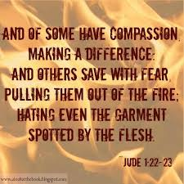
Notes:
Jude 1:17-23 (ESV) But you must remember, beloved, the predictions of the apostles of our Lord Jesus Christ. They said to you, “In the last time there will be scoffers, following their own ungodly passions.” It is these who cause divisions, worldly people, devoid of the Spirit. But you, beloved, building yourselves up in your most holy faith and praying in the Holy Spirit, keep yourselves in the love of God, waiting for the mercy of our Lord Jesus Christ that leads to eternal life. And have mercy on those who doubt; save others by snatching them out of the fire; to others show mercy with fear, hating even the garment stained by the flesh.

Slide 14
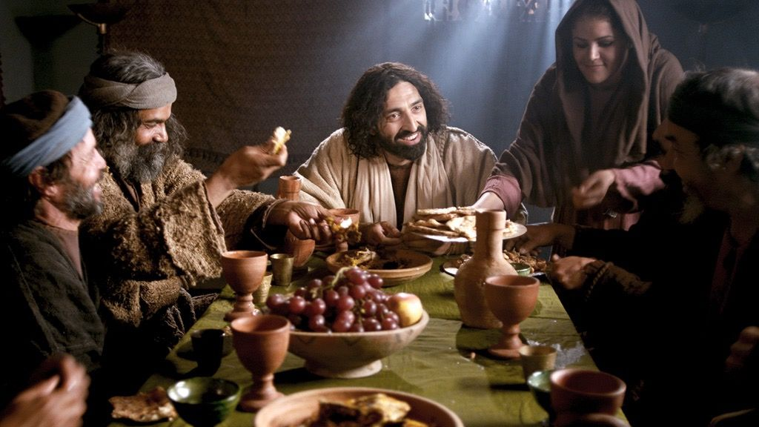
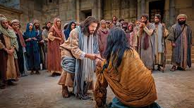
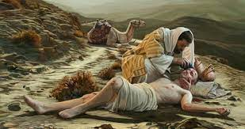
What does Jesus teach us about relating to the unrighteous?
Notes:
John 17:16 tells us we are in the world and not of the world – how does that work?
Parable of the Wheat and Tares – Matthew 13:24-43 – The risk of causing more harm than good in rooting out all that does not belong; call to let God sort it out in judgement
Jesus and the woman caught in adultery - John 8:1-11 – None of us are qualified to cast the first stone; how do we treat others who are struggling in sin
Jesus ate with sinners and tax collectors – Matthew 10:9-17 – “It is not the healthy who need a doctor; I desire mercy not sacrifice; I have not come to call the righteous, but sinners”
The Parable of the Good Samaritan – Luke 10:25-37 – The righteous are not the religious, but the merciful, the neighbor
Exactly who did Jesus dress down in his teachings? The religious, the pious. He came seeking reconciliation to the sinners – the OG minister of reconciliation Paul talks about in 2 Cor
The challenging relationship between the righteous and unrighteous
Seth Bonds’s testimony
Other sins in the list — how do we respond?
Divorce and remarriage — historical challenge — By comparison, how do we treat divorced people?
Matthew 5:9-12 (ESV) “Blessed are the peacemakers, for they shall be called sons of God.
“Blessed are those who are persecuted for righteousness' sake, for theirs is the kingdom of heaven.
“Blessed are you when others revile you and persecute you and utter all kinds of evil against you falsely on my account. Rejoice and be glad, for your reward is great in heaven, for so they persecuted the prophets who were before you.

Slide 15
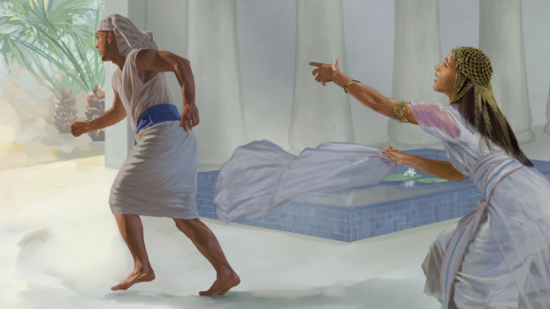
Protect God’s Precious Purchase!
1 Corinthians 6:12-20 (ESV) / Genesis 39
“All things are lawful for me,” but not all things are helpful.
“All things are lawful for me,” but I will not be dominated by anything.
The body is not meant for sexual immorality, but for the Lord
You are not your own, for you were bought with a price. So glorify God in your body.
Notes:
1 Corinthians 6:12-20 (ESV) “All things are lawful for me,” but not all things are helpful. “All things are lawful for me,” but I will not be dominated by anything. “Food is meant for the stomach and the stomach for food”—and God will destroy both one and the other. The body is not meant for sexual immorality, but for the Lord, and the Lord for the body. And God raised the Lord and will also raise us up by his power. Do you not know that your bodies are members of Christ? Shall I then take the members of Christ and make them members of a prostitute? Never! Or do you not know that he who is joined to a prostitute becomes one body with her? For, as it is written, “The two will become one flesh.” But he who is joined to the Lord becomes one spirit with him. Flee from sexual immorality. Every other sin a person commits is outside the body, but the sexually immoral person sins against his own body. Or do you not know that your body is a temple of the Holy Spirit within you, whom you have from God? You are not your own, for you were bought with a price. So glorify God in your body.
Addicting nature o
Flee sexual immorality
What about cultivating non-sexual but romantic interests?

