Slide 1
Marriage:
How To Live ‘Happily Ever After’

Slide 2
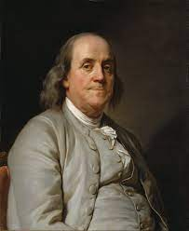
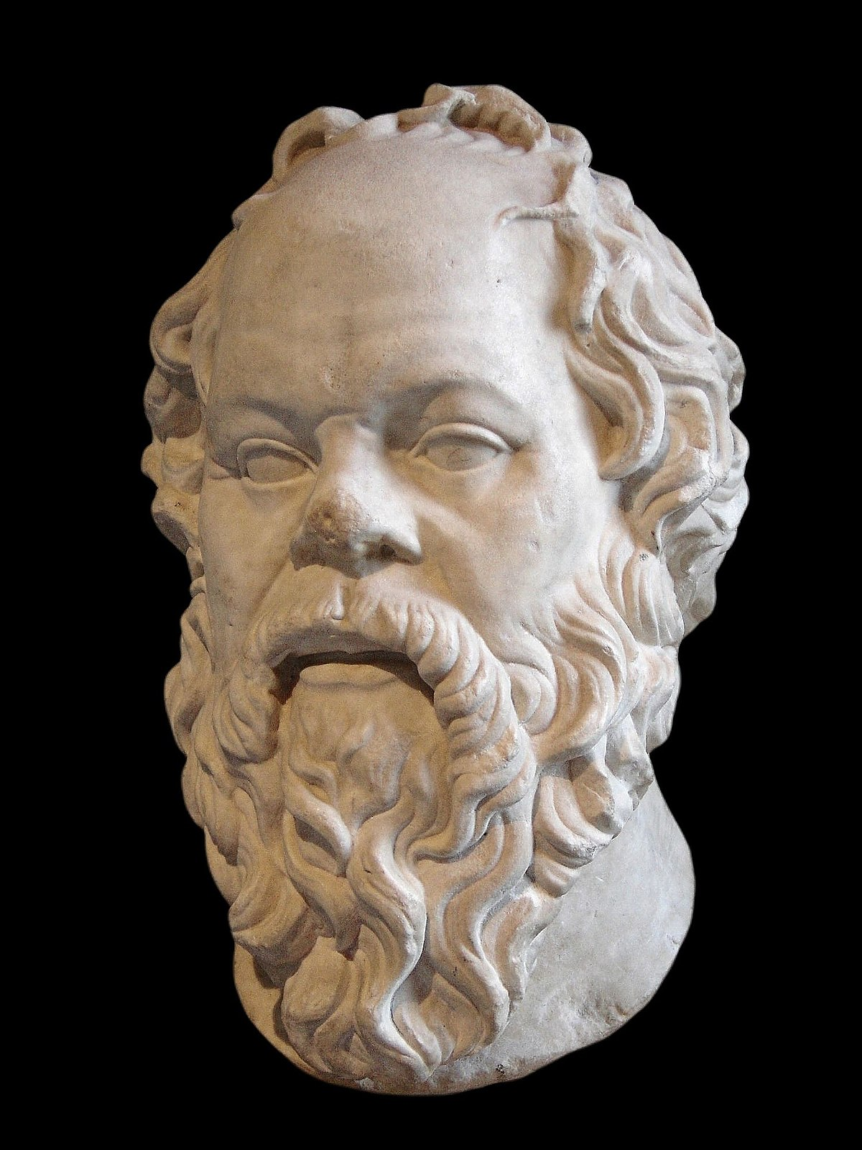
Not a marriage retreat lesson. It is a sermon that will apply to all.
“Keep your eyes wide
open before marriage,
half shut afterwards.”
By all means marry.
If you get a good wife, you’ll be happy. If you get a bad one, you’ll become a philosopher.

Slide 3
“Happy families are all alike; every unhappy family is unhappy in its own way.”

Slide 4
Emotional Stability

Slide 5
What is emotional stability – what is “normal?”
The dictionary, philosophy, statistics, medical doctors, lab tests, psychology, sociologists and anthropology

Slide 6
Emotional stability:
Maturity in Christ
“Counseling”
Place one’s mind in the proper place
Correct information and knowledge
We proclaim him, admonishing and teaching
everyone with all wisdom, so that we may present everyone perfect in Christ ~ Colossians 1:28
A decisive message heading to a definite, binding point.
Not sinless: Mature

Slide 7
Three characteristics of Christ-like behavior
Self-Control/Discipline
It is God’s will that you should be sanctified: that each of you should learn to control his own body in a way that is holy and honorable… ~ 1 Thess. 4:3,4
For God did not give us a spirit of timidity, but a spirit of power, of love and of self-discipline.
~ 1 Thess. 4:3,4

Slide 8
Three characteristics of Christ-like behavior
Love
About brotherly love we do not need to write to you, yourselves have been taught by God to love each other…yet we urge you to do so more and more
~ 1 Thess. 4:10
Love does not always feel good.
It is not always nice – it’s helping people live according to God’s will

Slide 9
Three characteristics of Christ-like behavior
Peace
Blessed are the peacemakers for they will be
called sons of God – Matthew 5:9
If it is possible, as far as it depends on you, live at peace with everyone – Romans 12:18
Peace is not the absence of conflict – it is self-control and purposeful thinking (love) during conflict.

Slide 10
Three types of marriage
Destructive
Disappointing
Difficult
These can be “Delightful”

Slide 11
For God…made his light shine in our hearts to give us the light of the knowledge of God’s glory displayed in the face of Christ.
But we have this treasure in jars of clay
to show that this all-surpassing power is
from God and not from us…so that the life of Jesus may be revealed in (us).
2 Cor 4:6.7.10

