Slide 2
And he went throughout all Galilee, teaching in their synagogues and proclaiming the gospel of the kingdom and healing every disease and every affliction among the people. So his fame spread throughout all Syria, and they brought him all the sick, those afflicted with various diseases and pains, those oppressed by demons, those having seizures, and paralytics, and he healed them. And great crowds followed him from Galilee and the Decapolis, and from Jerusalem and Judea, and from beyond the Jordan.
-- Matthew 4:23-25

Slide 3
And Jesus went throughout all the cities and villages, teaching in their synagogues and proclaiming the gospel of the kingdom and healing every disease and every affliction. When he saw the crowds, he had compassion for them, because they were harassed and helpless, like sheep without a shepherd. Then he said to his disciples, “The harvest is plentiful, but the laborers are few;
-- Matthew 9:35-37

Slide 4
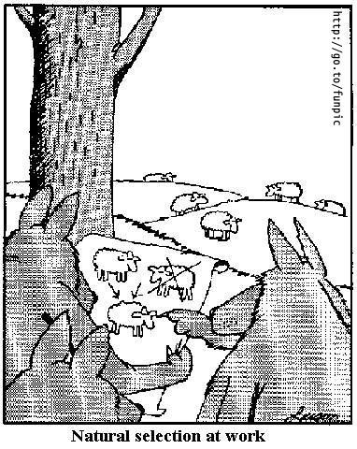

Slide 5
And Jesus went throughout all the cities and villages, teaching in their synagogues and proclaiming the gospel of the kingdom and healing every disease and every affliction. When he saw the crowds, he had compassion for them, because they were harassed and helpless, like sheep without a shepherd. Then he said to his disciples, “The harvest is plentiful, but the laborers are few;
-- Matthew 9:35-37

Slide 6
Miracles are:

Slide 7
Miracles are:
a) Suspension of Natural Law

Slide 8
Miracles are:
a) Suspension of Natural Law
b) Humanly Unexplainable

Slide 9
Miracles are:
a) Suspension of Natural Law
b) Humanly Unexplainable
c) Attributable to God

Slide 10
“Deep inside a woman, a miracle occurs.”

Slide 11
And they went into Capernaum, and immediately on the Sabbath he entered the synagogue and was teaching. And they were astonished at his teaching, for he taught them as one who had authority, and not as the scribes. And immediately there was in their synagogue a man with an unclean spirit. And he cried out, “What have you to do with us, Jesus of Nazareth? Have you come to destroy us? I know who you are—the Holy One of God.” But Jesus rebuked him, saying, “Be silent, and come out of him!” And the unclean spirit, convulsing him and crying out with a loud voice, came out of him. And they were all amazed, so that they questioned among themselves, saying, “What is this? A new teaching with authority! He commands even the unclean spirits, and they obey him.” And at once his fame spread everywhere throughout all the surrounding region of Galilee.
-- Mark 1:21-28

Slide 12
They came to the other side of the sea, to the country of the Gerasenes. And when Jesus had stepped out of the boat, immediately there met him out of the tombs a man with an unclean spirit. He lived among the tombs. And no one could bind him anymore, not even with a chain, for he had often been bound with shackles and chains, but he wrenched the chains apart, and he broke the shackles in pieces. No one had the strength to subdue him. Night and day among the tombs and on the mountains he was always crying out and cutting himself with stones. And when he saw Jesus from afar, he ran and fell down before him. And crying out with a loud voice, he said, “What have you to do with me, Jesus, Son of the Most High God? I adjure you by God, do not torment me.”
-- Mark 5:1-7

Slide 13
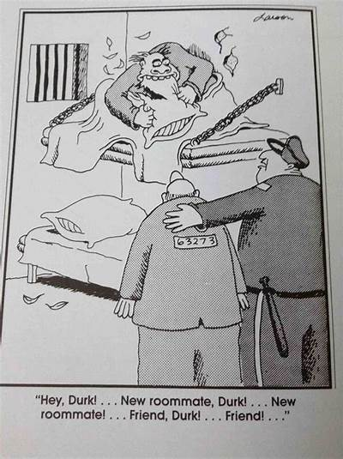

Slide 14
And they came to Jesus and saw the demon-possessed man, the one who had had the legion, sitting there, clothed and in his right mind, and they were afraid
-- Mark 5:15

Slide 15
And he did not permit him but said to him, “Go home to your friends and tell them how much the Lord has done for you, and how he has had mercy on you.” And he went away and began to proclaim in the Decapolis how much Jesus had done for him, and everyone marveled.
-- Mark 5:19,20

Slide 16
Over your demons

