Slide 1
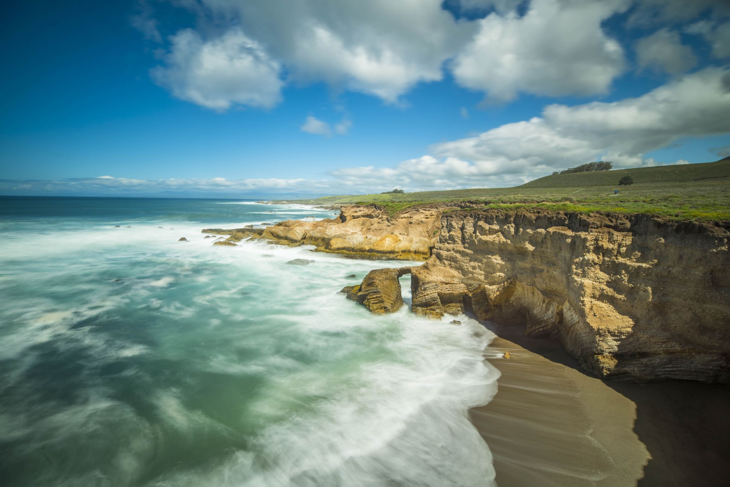
The Value of the Lamb’s blood…
and you.
Revelation 5:7-10

Slide 2
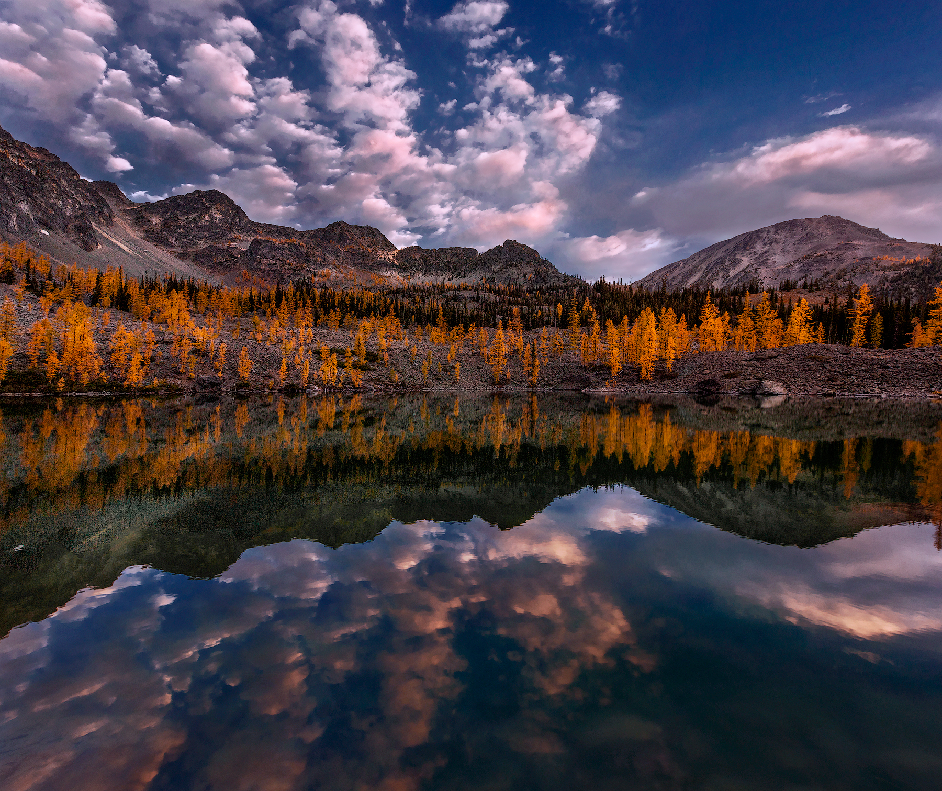
The spiritual: the Reality of realities. (4:1,2)
God is on the throne ~ he rules
the universe (4:3-6)
The centrality of God. (4:6-11)
The Song of the universe (4:8)

Slide 3
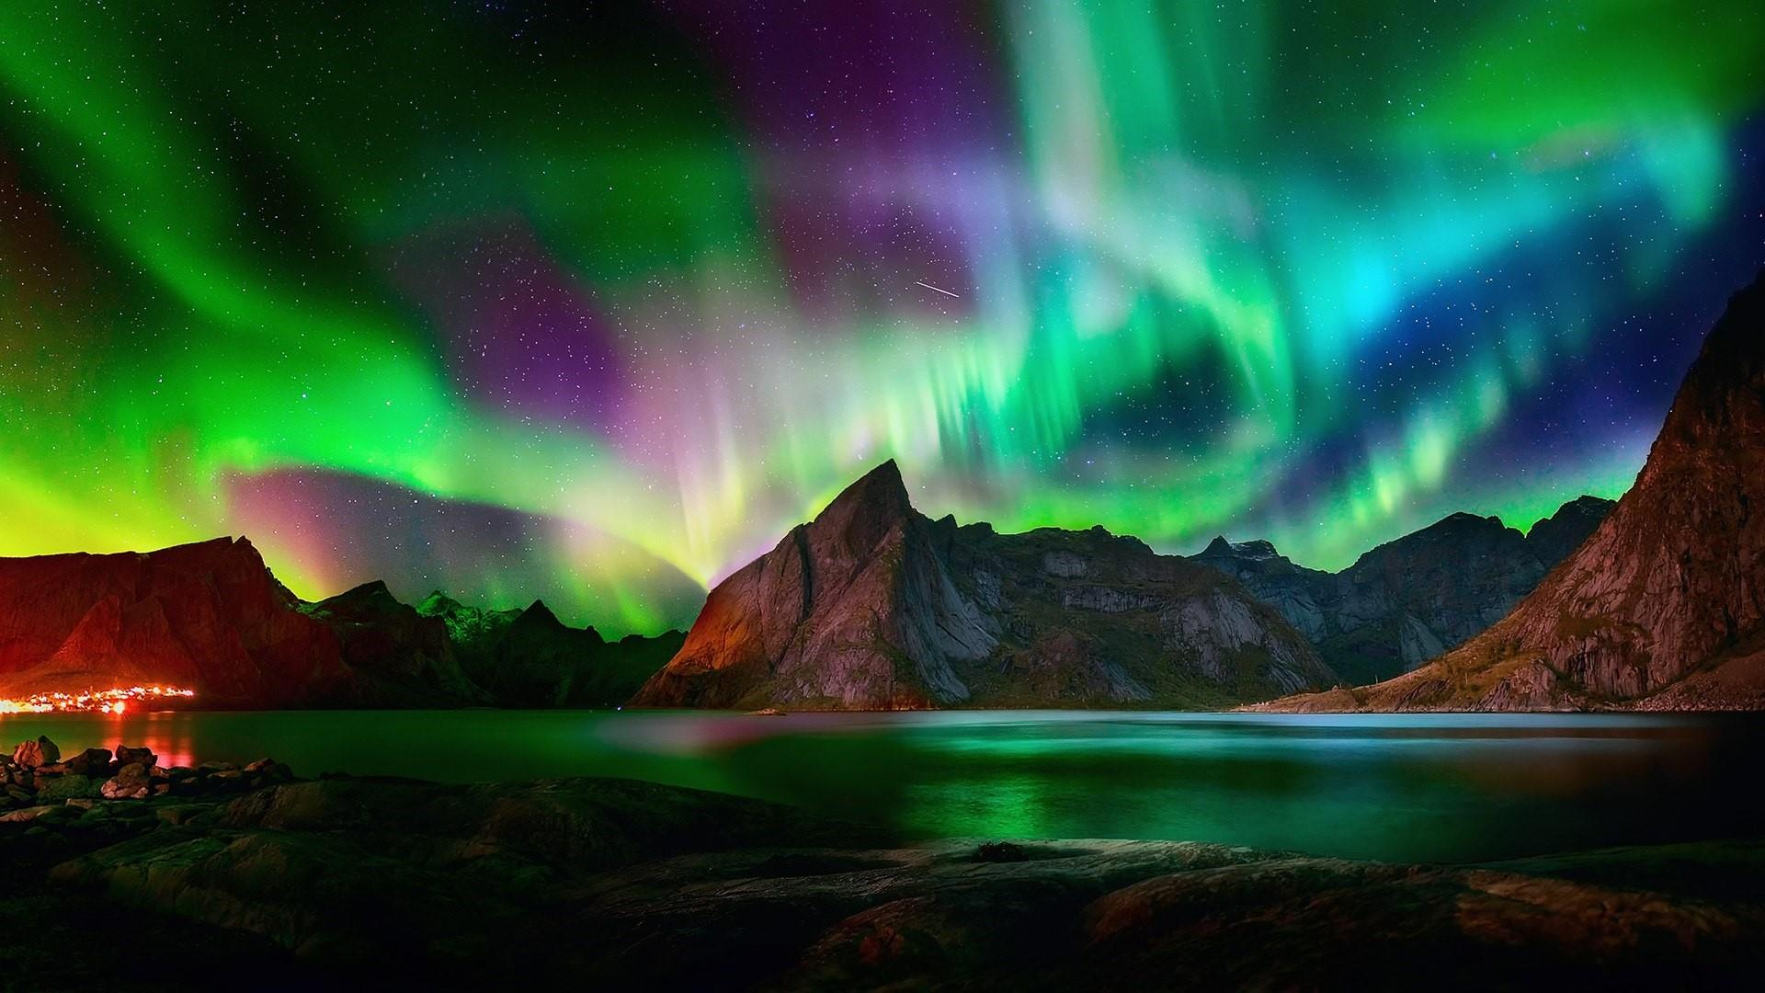
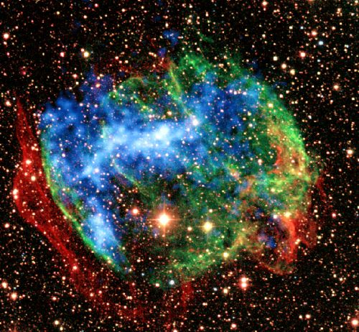
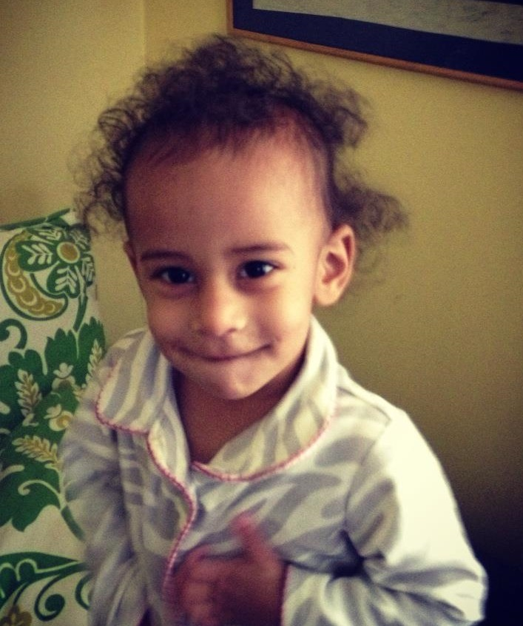
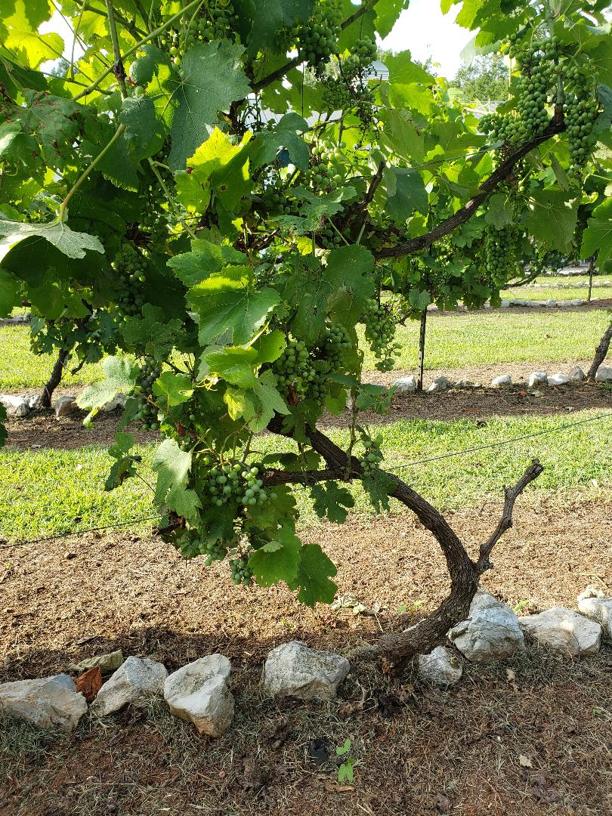
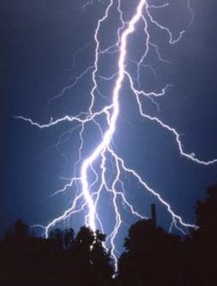
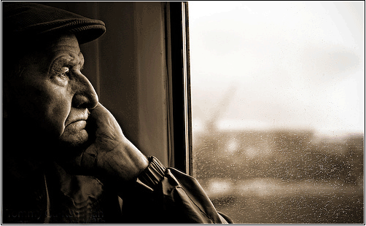
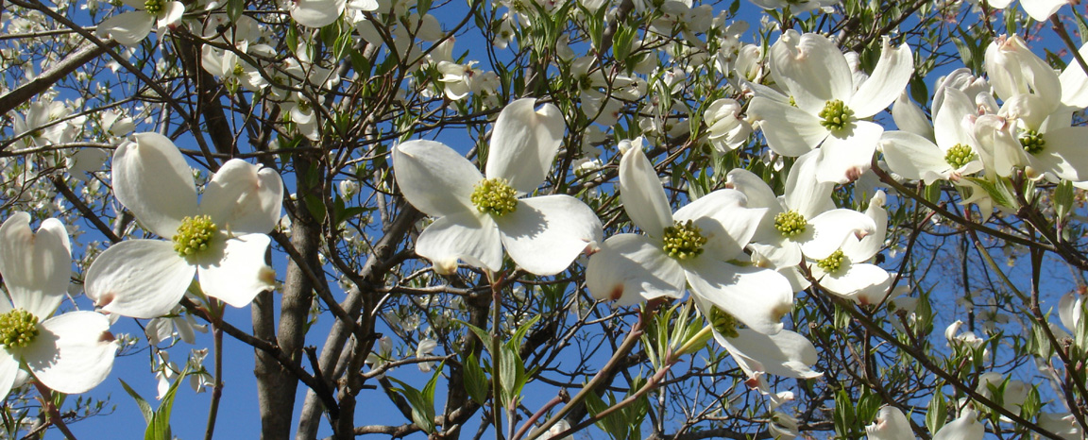
“Holy, holy, holy is the Lord God Almighty, who was and is and is to come.”

Slide 4
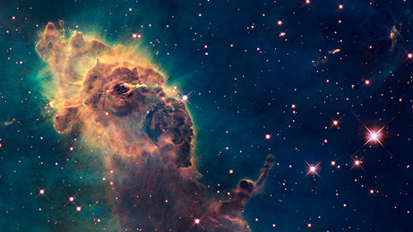
Sadness and weeping around the throne (5:1-5)
Good news proclaimed (5:6)
He came and took the scroll from the right hand
of him who sat on the throne. And when he had
taken it, the four living creatures and the
twenty-four elders fell down before the Lamb.
Each one had a harp and they were holding
golden bowls full of incense, which are the
prayers of the saints.

Slide 5
And they sang a new song :
You are worthy to take the scroll
and to open its seals, because you were slain,
and with your blood you purchased men for God
from every tribe and language and people and nation. You have made them to be
a kingdom and priests to serve our God,
and they will reign on the earth.

Slide 6
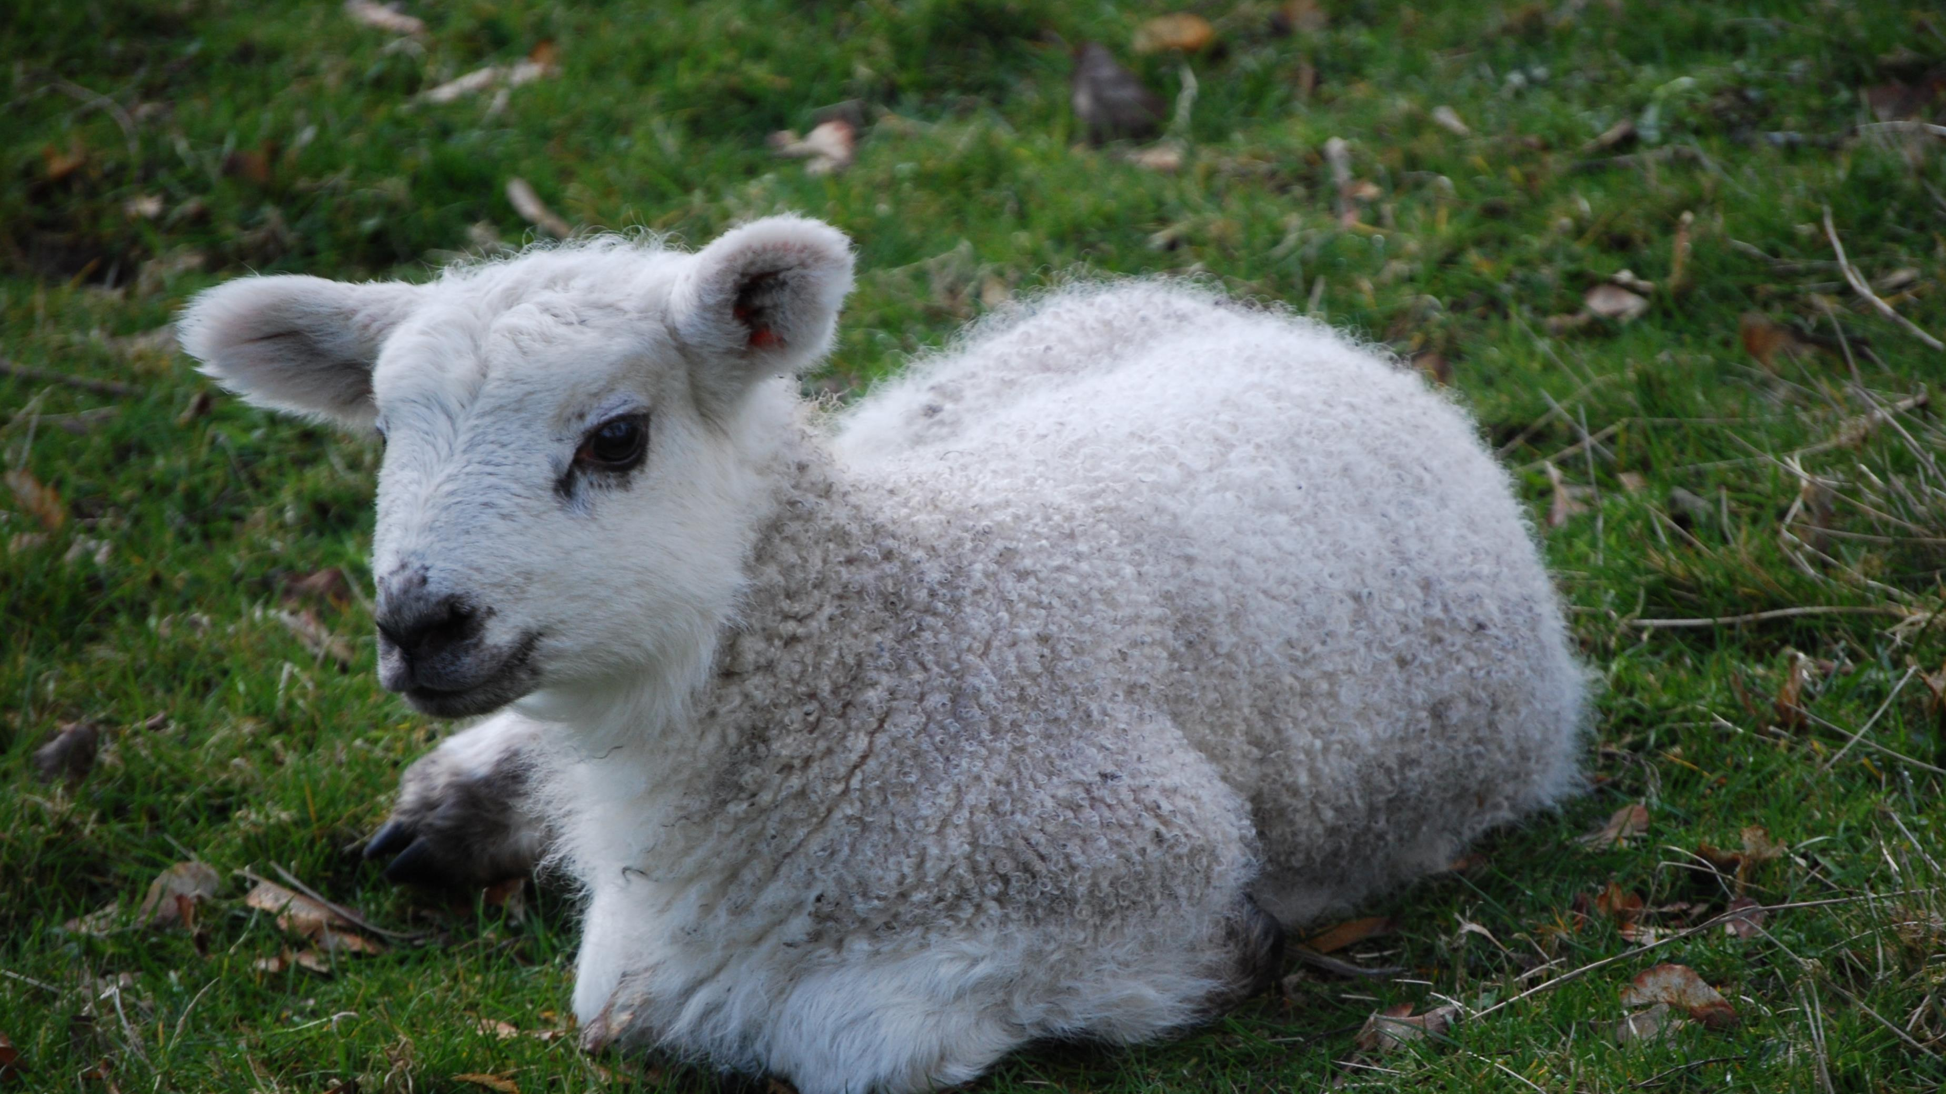
The worth of the Lamb: came and took v7
He is worth God, he is equal with God.
Harps – symbolic of praise
Golden bowls full of incense – prayers
The Value of the Lamb v. 7-8

Slide 7
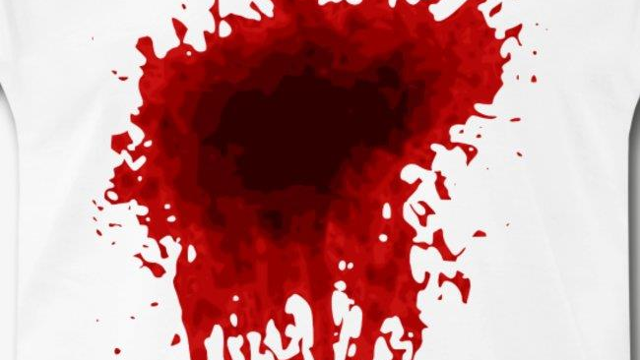
The Value of the Blood v. 9
“Because”
You were slain – with your blood.
His blood – the means of exchange.
His blood purchased for God - people.

Slide 8
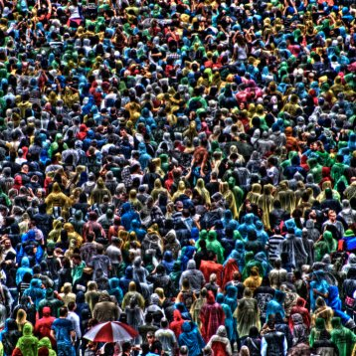
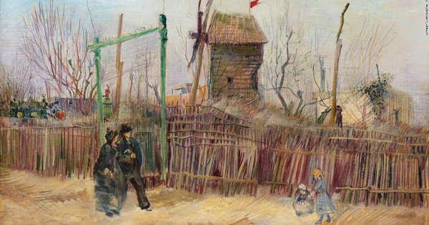
A Street Scene in Montmartre
Value is determined by what someone will pay for it
The Value of the Purchased v. 10

Slide 9
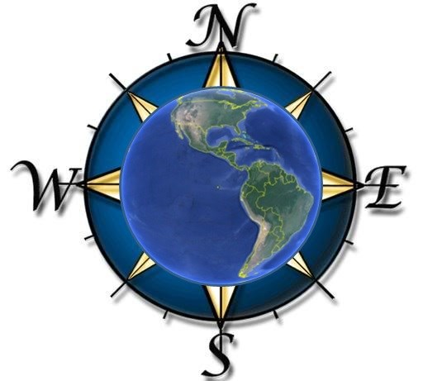
Tribe
Nation
People
Language
The Value of the Purchased v. 10

Slide 10
The Value of the Purchased v. 10

Slide 11
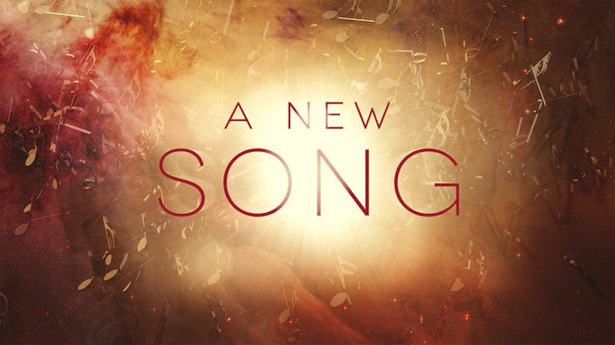
The Song of the Universe ~ 4:8
For you know that it was not with perishable things such as silver and gold that you were redeemed from the empty way of life
handed down to you from your forefathers.
But with the precious blood of Christ,
a lamb without blemish or defect.
The Song of Redeeming Savior ~ 5:9,10

