Slide 1
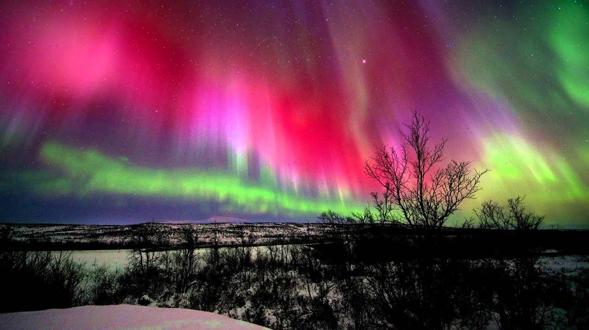
The Song of the Universe
Revelation 4:8b-11

Slide 2
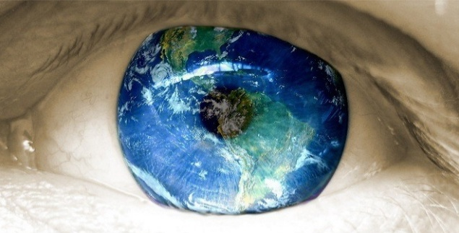
“Our studies show that Americans are neither deep
or sophisticated thinkers. We’ve become selfish and emotion-driven, leaving logic behind.”
The way we think is our worldview
“Most adults don’t even know what a worldview is, much less what the worldview alternatives are”

Slide 3
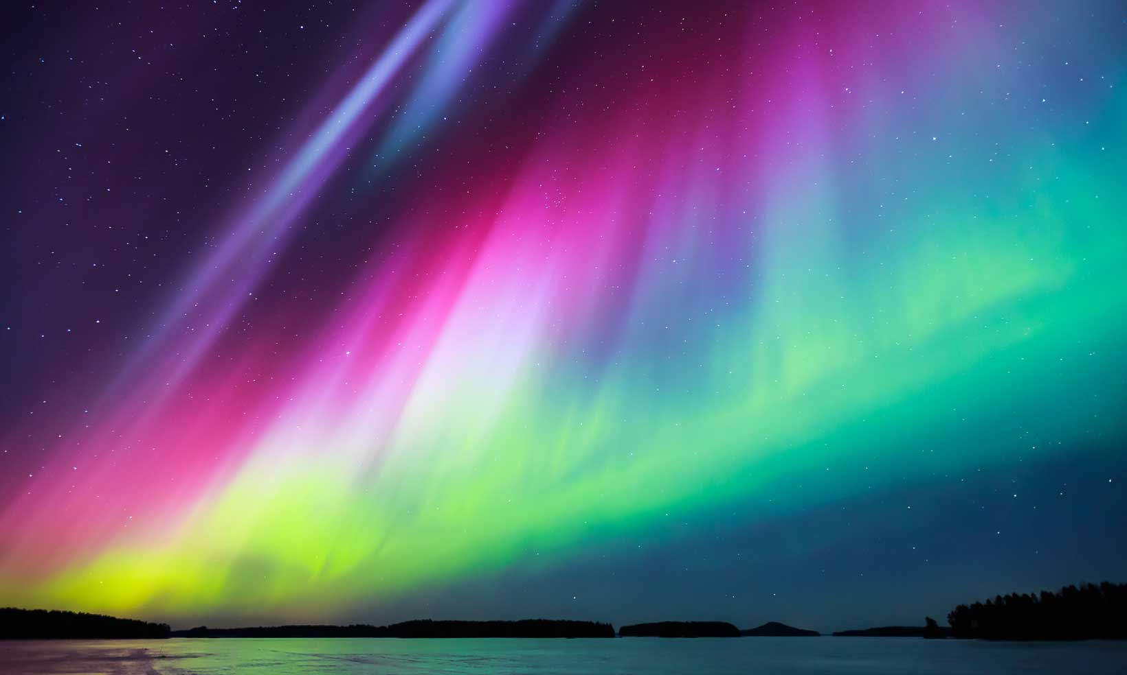
Day and night they never stop saying:
“Holy, holy, holy, is the Lord God Almighty, who was, and is, and is to come.” Whenever the living creatures give glory, honor and thanks to him who sits on the throne and who lives for ever and ever,

Slide 4
the twenty-four elders fall down before him who sits on the throne, and worship him who lives for ever and ever. They lay their crowns before the throne and say:
“You are worthy, our Lord and God, to receive glory and honor and power, for you created all things, and by your will they were created and have their being.

Slide 5
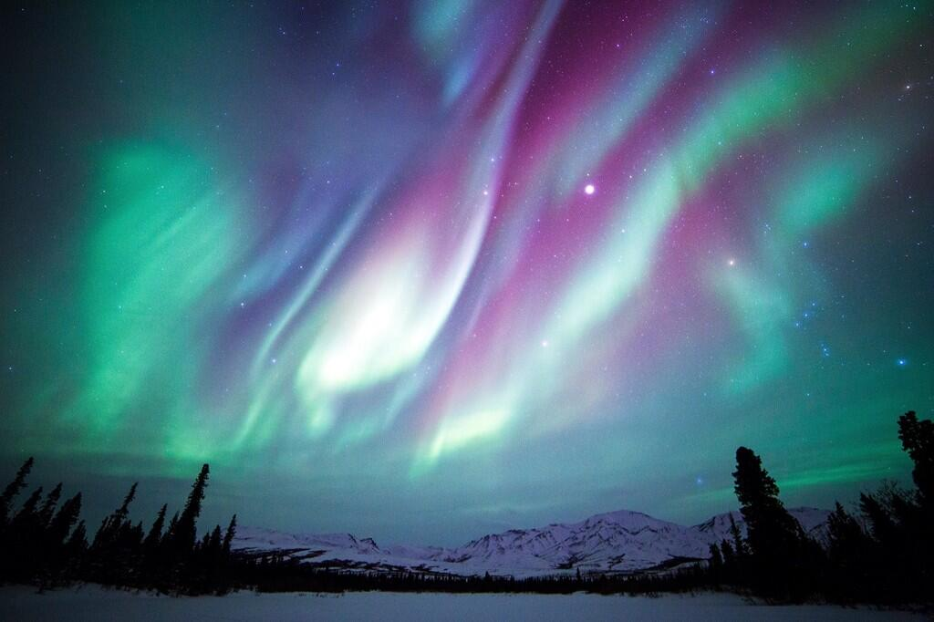
The Song
of the Universe
“They never stop saying”– without rest or respite.

Slide 6
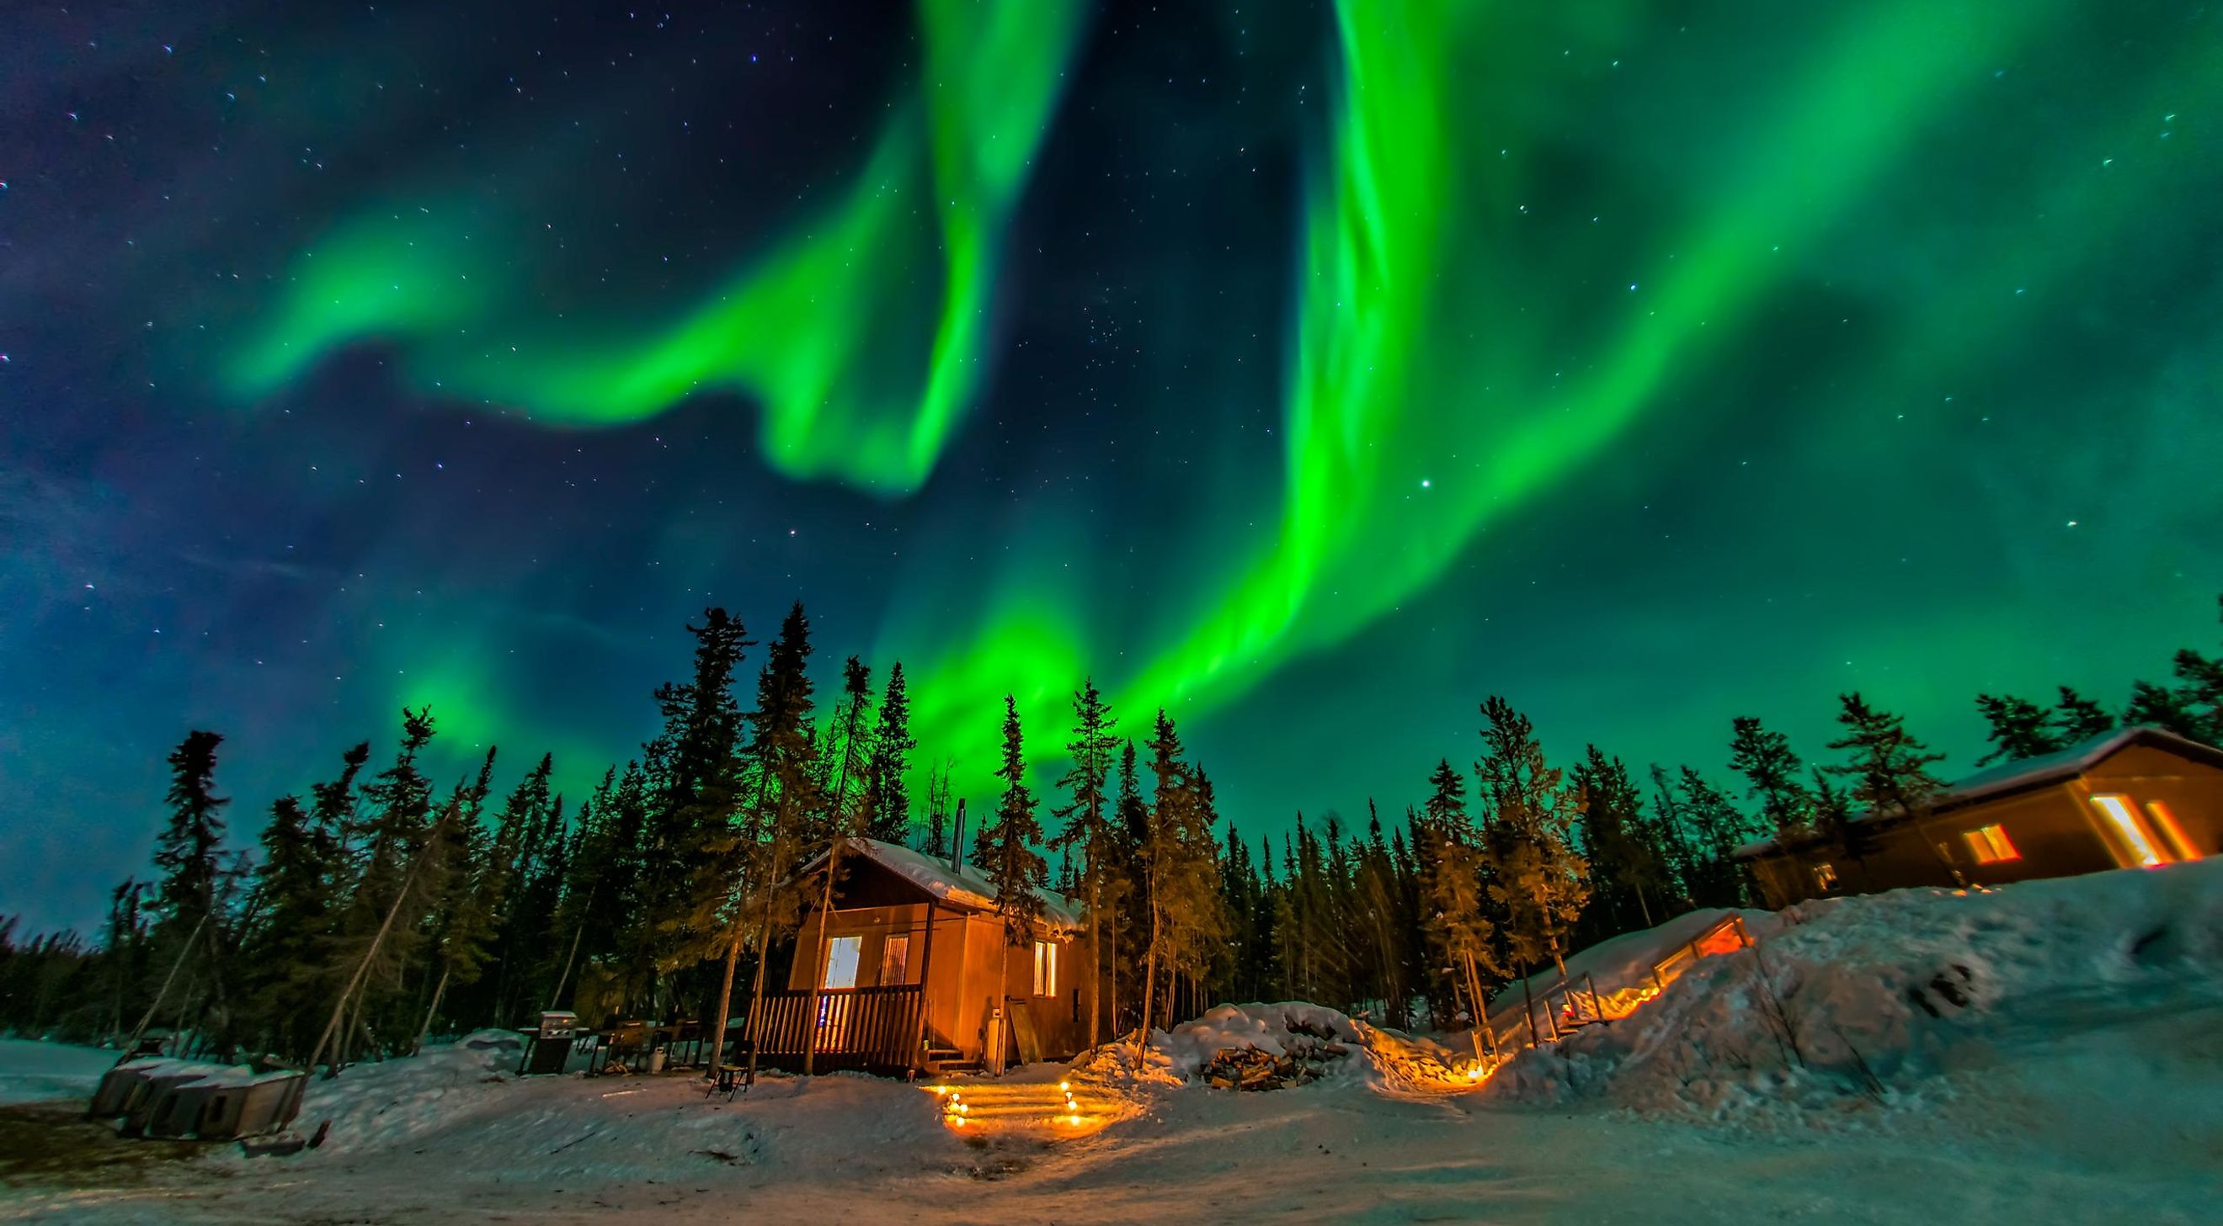
Holy, Holy, Holy
Oh, the depth of the riches of the wisdom and knowledge
of God! How unsearchable his judgments, and his paths beyond tracing out! Who has known the mind of the Lord? Or who has been his counselor? Who has ever given to God, that God should repay him? For from him and through him and to him are all things. To him be the glory forever! Amen.
Romans 11:33-36

Slide 7
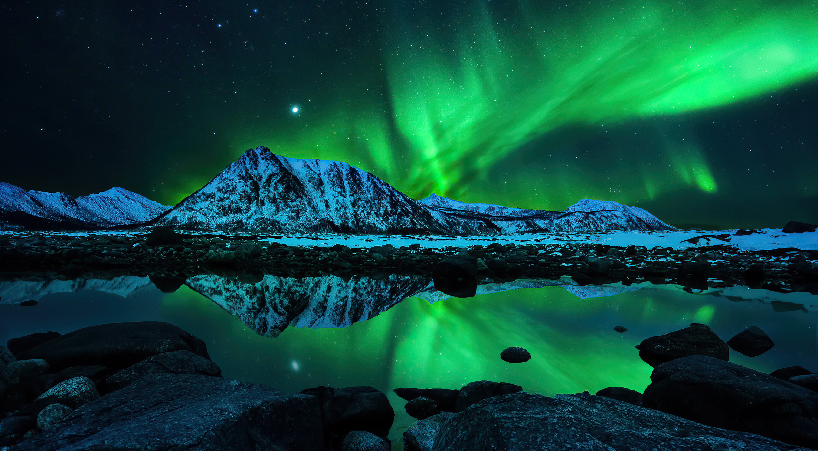
Lord
God
Almighty
Who was
and is
and is to come
Who was
and is
and is to come
Lord
God
Almighty

Slide 8
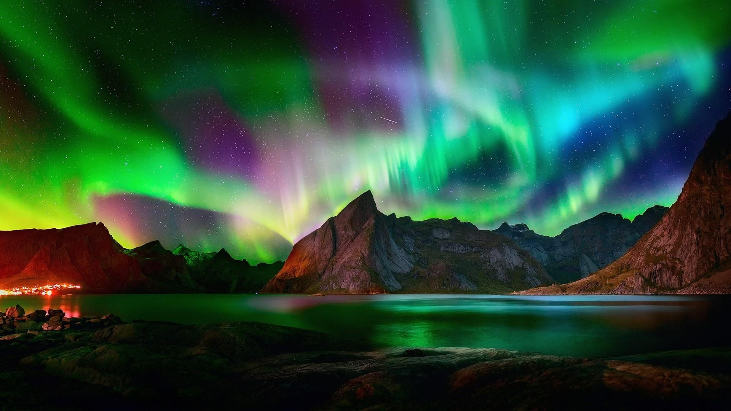
Fall down
Worthy are you
Glory
Worship
Honor
Cast their crowns
Power
The Redeemed One’s Response to the Song

Slide 9
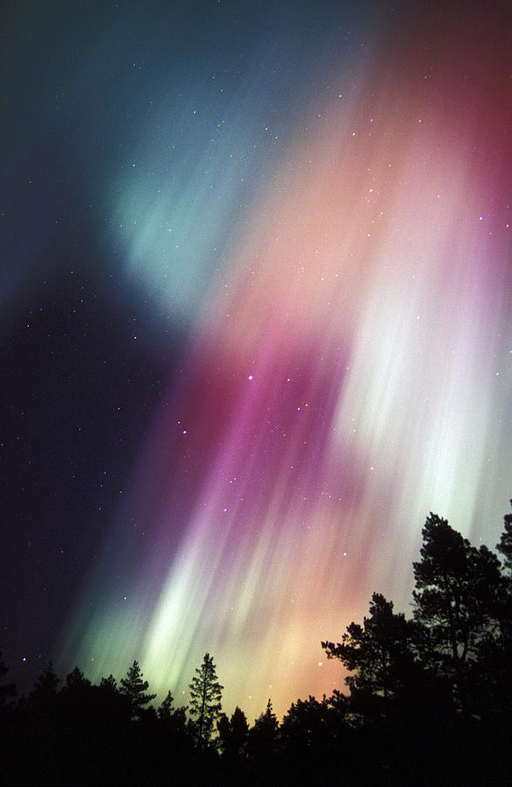
Psalm 148
Praise him, sun and moon, praise him, all you shining stars. Praise him, you highest heavens and you waters above the skies. Let them praise the name of the Lord,
Praise the Lord.
Praise the Lord from the heavens, praise him in the heights above.
Praise him all his angels, praise him all his heavenly hosts.

Slide 10
Psalm 148
Praise the Lord from the earth, you great sea creatures and all ocean depths, lightning and hail, snow and clouds, stormy winds that do his bidding
For he commanded and they were created. He set them in place for ever and ever; he gave a decree that will never pass away.

Slide 11
Psalm 148
You mountains and all hills, fruit trees and all cedars, wild animals and all cattle, small creatures and flying birds, kings of the earth and all nations,
You princes and all rulers on earth, young men and maidens, old men and children.

Slide 12
Psalm 148
Let them praise the name of the Lord, for his name alone is exalted; his splendor is above the earth and the heavens.
He has raised up for his people a horn, the praise of all his saints, of Israel, the people close to his heart. Praise the Lord

