Slide 1
Central’s
High School Graduates

Slide 2
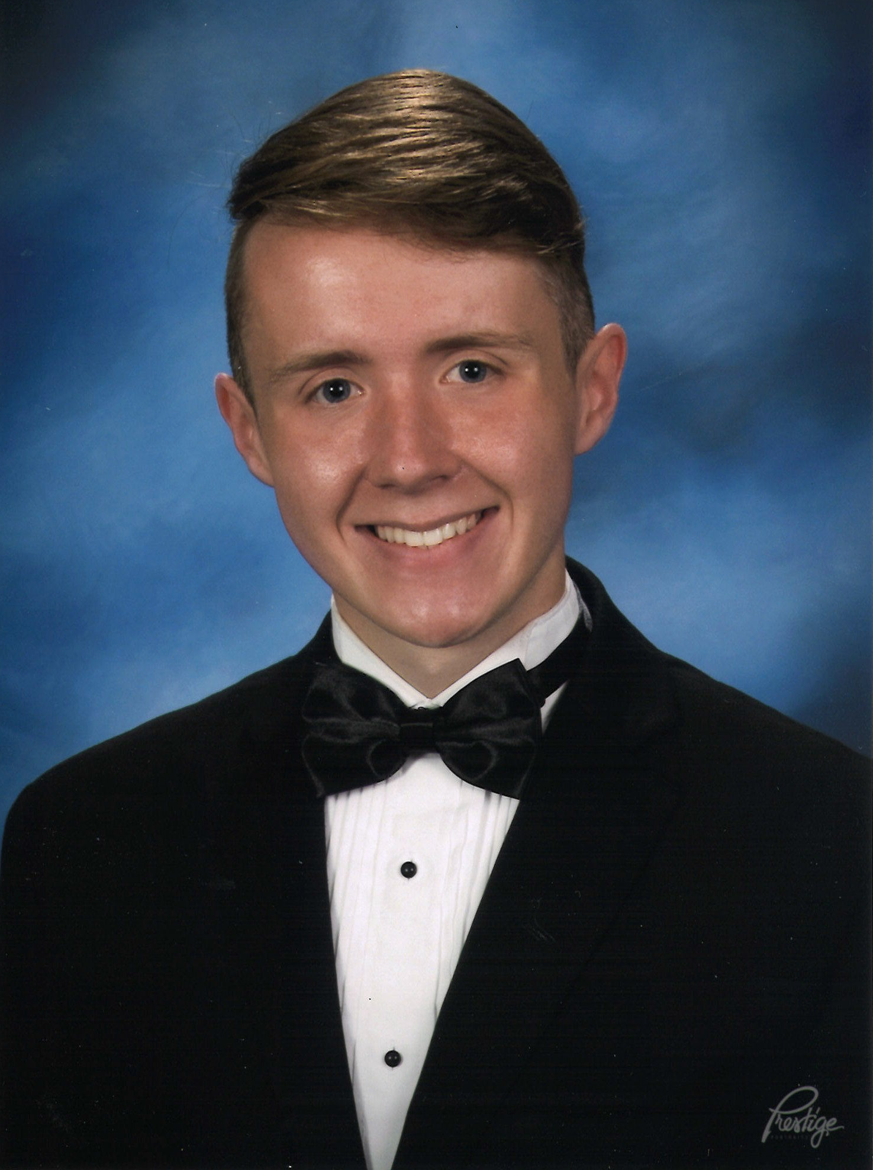
Andrew Baucum
Hazel Green
High School

Slide 3
Sija Headrick
Bob Jones
High School

Slide 4
John Kuhn
Life Christian Academy

Slide 5
Christopher Long
Columbia
High School

Slide 6
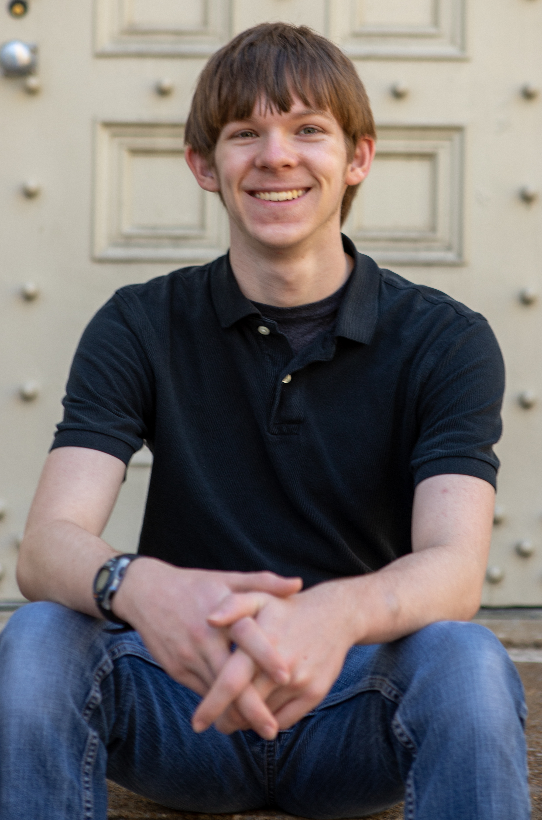
Joseph Nance
Life Christian Academy

Slide 7
Central’s
College Graduates

Slide 8
Jasmine Binford
Claremont Graduate University

Slide 9
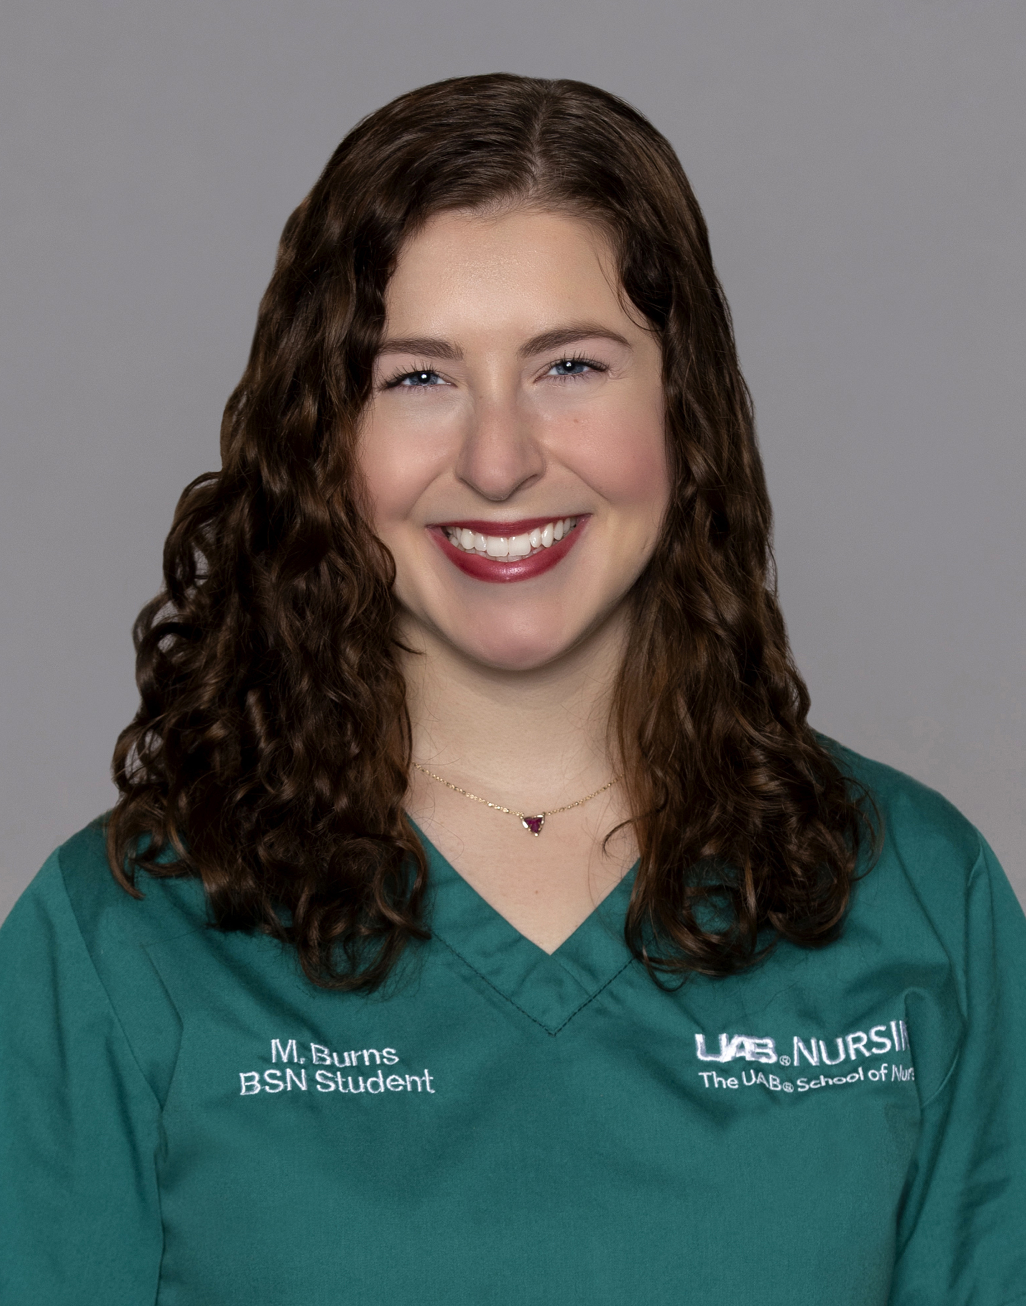
MaryBeth Burns
University of Alabama at Birmingham

Slide 10
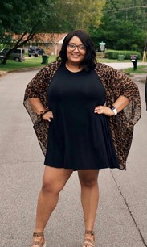
Alexandra Callins
University of North Alabama

Slide 11
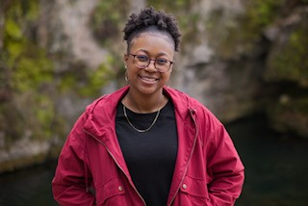
Rachel Franklin
University of Alabama in Huntsville

Slide 12
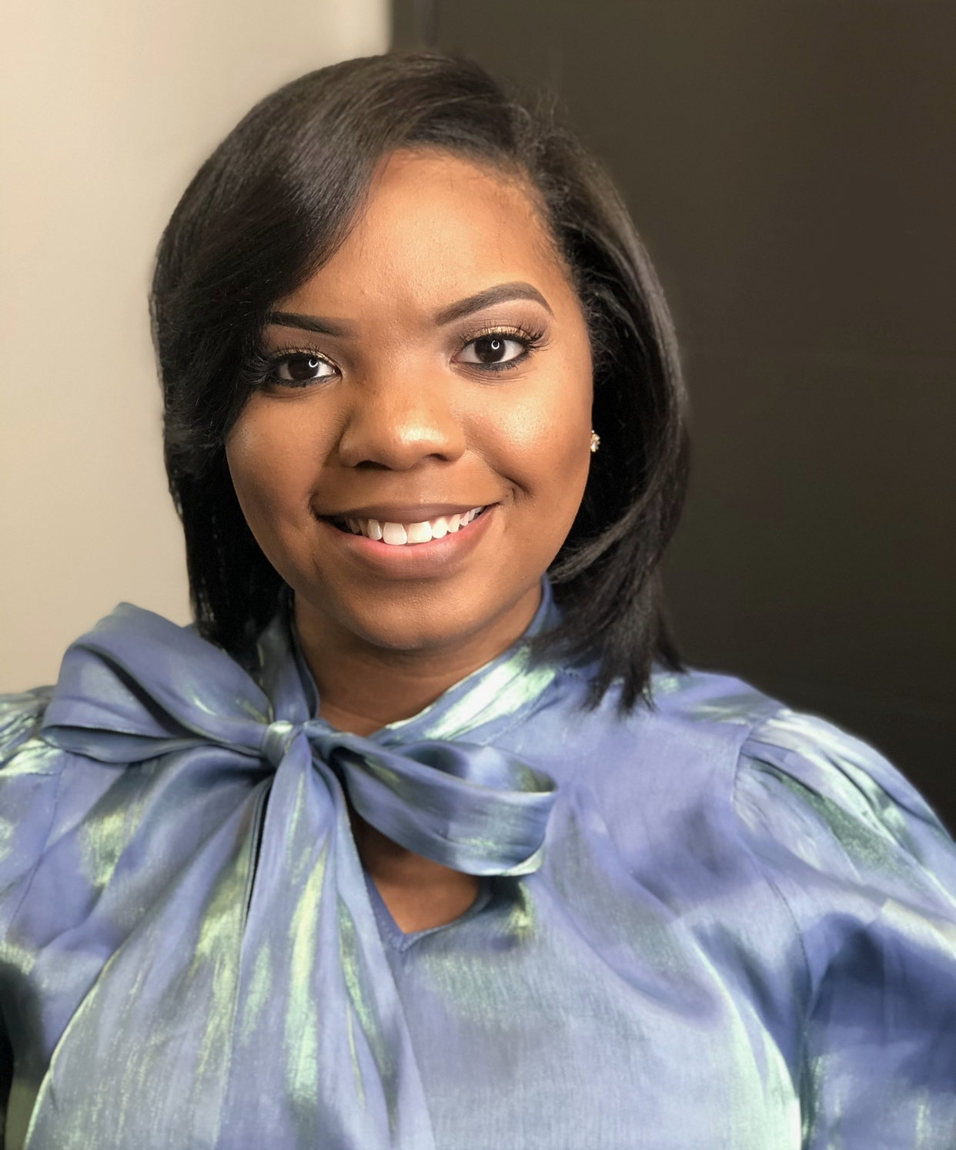
Selah Thompson
Athens State University

Slide 13
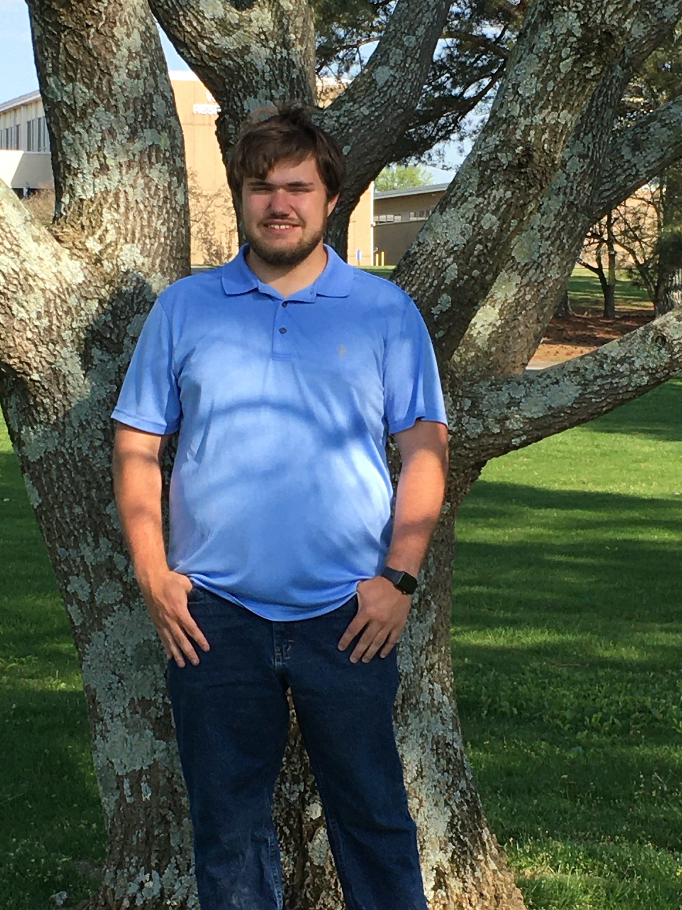
Nathanael Wade
University of Alabama in Huntsville

Slide 14
