Slide 1
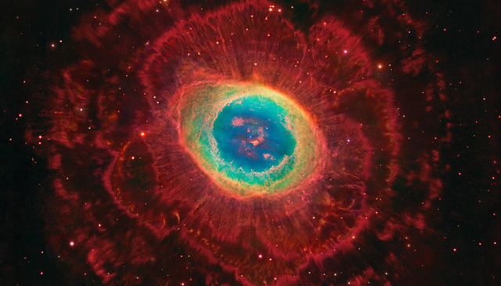
All
Creation Surround
the
Throne
Revelation 4:4, 6b-11

Slide 2
“Whenever in history the church is faithful to its calling and bears testimony concerning the truth, tribulation is bound to follow.”
For a few moments these words shimmered before our eyes:
‘In the Hands of these five men rests the destiny of the world.’
Many people seem to believe that this is actually the case. Chapters 4 and 5 teach us that our affairs rest in the hands not of men but of God! Hence, when the world is enkindling the flames of hatred and slaughter and when the earth is drenched with blood, may our tear-dimmed eye catch a vision of The Throne which rules the universe. In the midst of trial and tribulation may our gaze be riveted upon the One who is King of kings and Lord of lords.”
W. Hendriksen – “More Than Conquerors”

Slide 3
A copy that helps us understand the reality
We do have such a high priest, who sat down at the right hand of the throne of the Majesty in heaven, and who serves in the sanctuary, the true tabernacle set up by the Lord, not by man. They serve at a sanctuary that is a copy and shadow of what is in heaven. This is why Moses was warned when he was about to build the tabernacle: “See to it that you make everything according to the pattern show you on the mountain.
Hebrews 8:1,2, 5

Slide 4
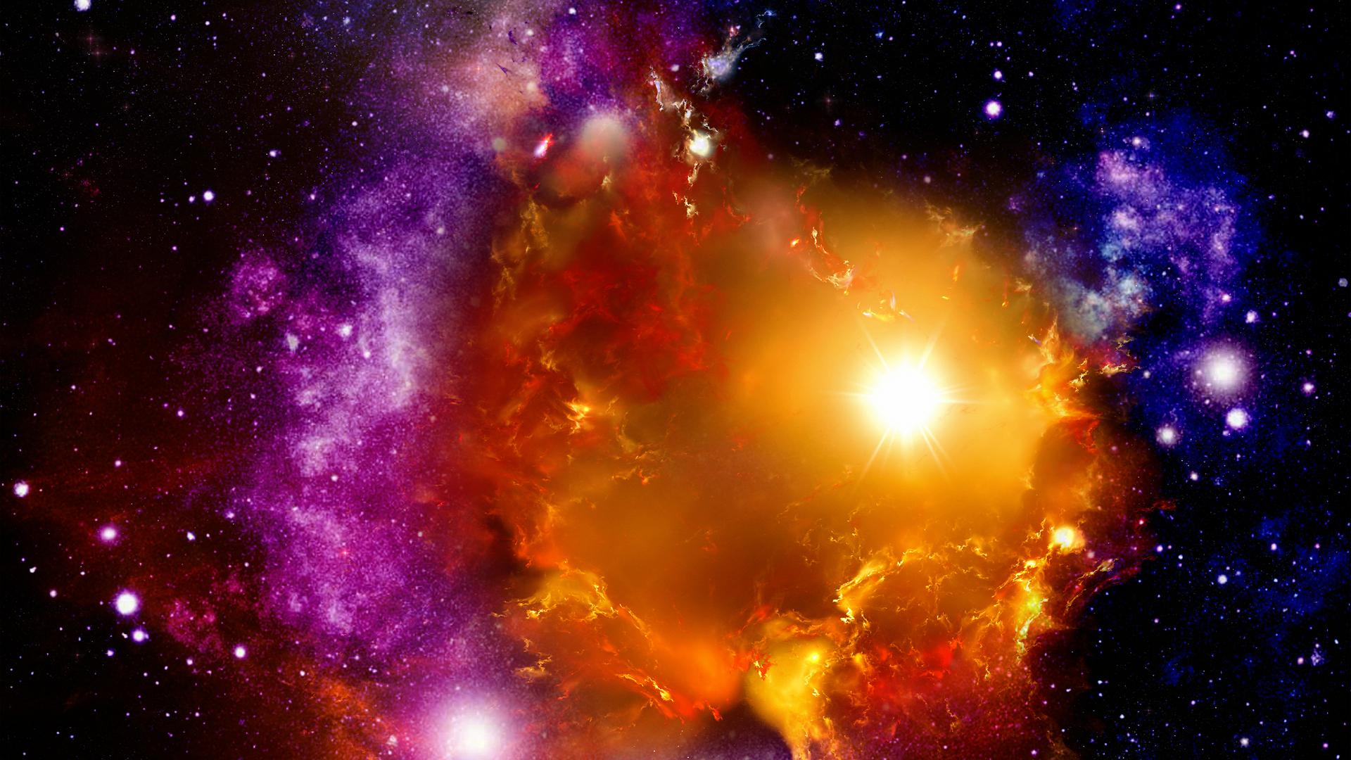
The Redeemed 4:4
White garments - Holiness, purity and righteousness
It is because of him you are in Christ Jesus, who has become for us wisdom from God – that is, our righteousness, holiness and redemption.1 Cor 1:30
Seated on thrones wearing golden victory crowns
And God raised us up with Christ and seated us with him in the heavenly realms in Christ Jesus Eph. 2: 6

Slide 5
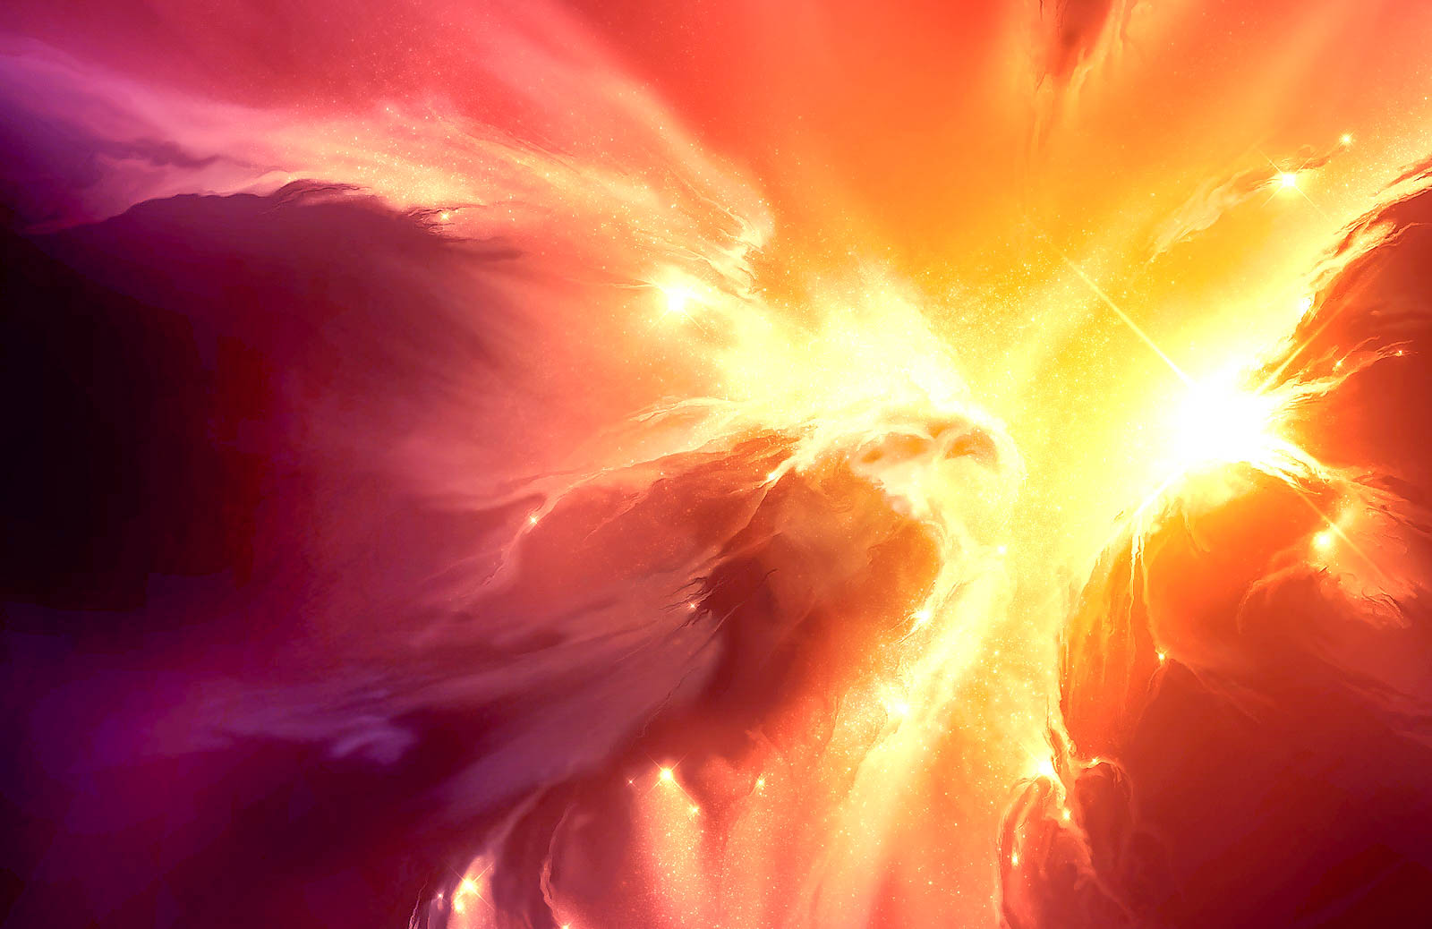
The Redeemed 4:4
Seated ~ we live in the rest of God
“We who have believed enter that rest…” Hebrews 4:3
Seated ~ we have been given rights from God
“heirs of God and co-heirs with Christ.” Rom. 8:17

Slide 6
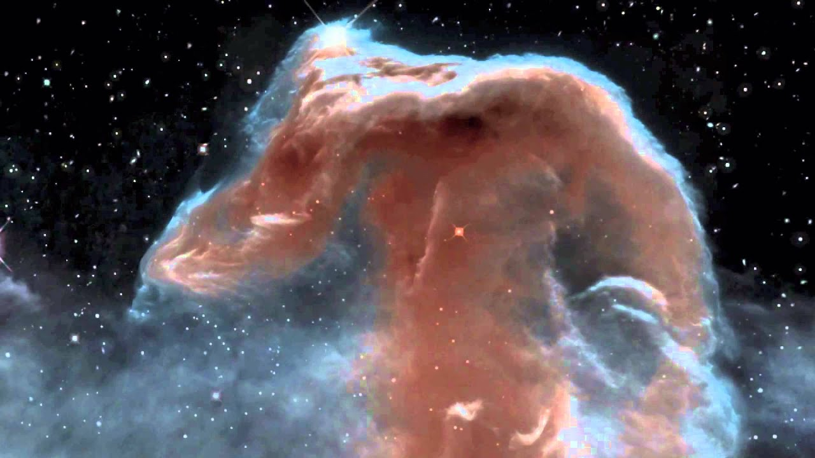
“Four living ones” ~ cherubim
Intelligence (man), strength (lion)
service (ox) swiftness (eagle). Ezekiel 1,10
The Heavenly Host 4:6-8

Slide 7
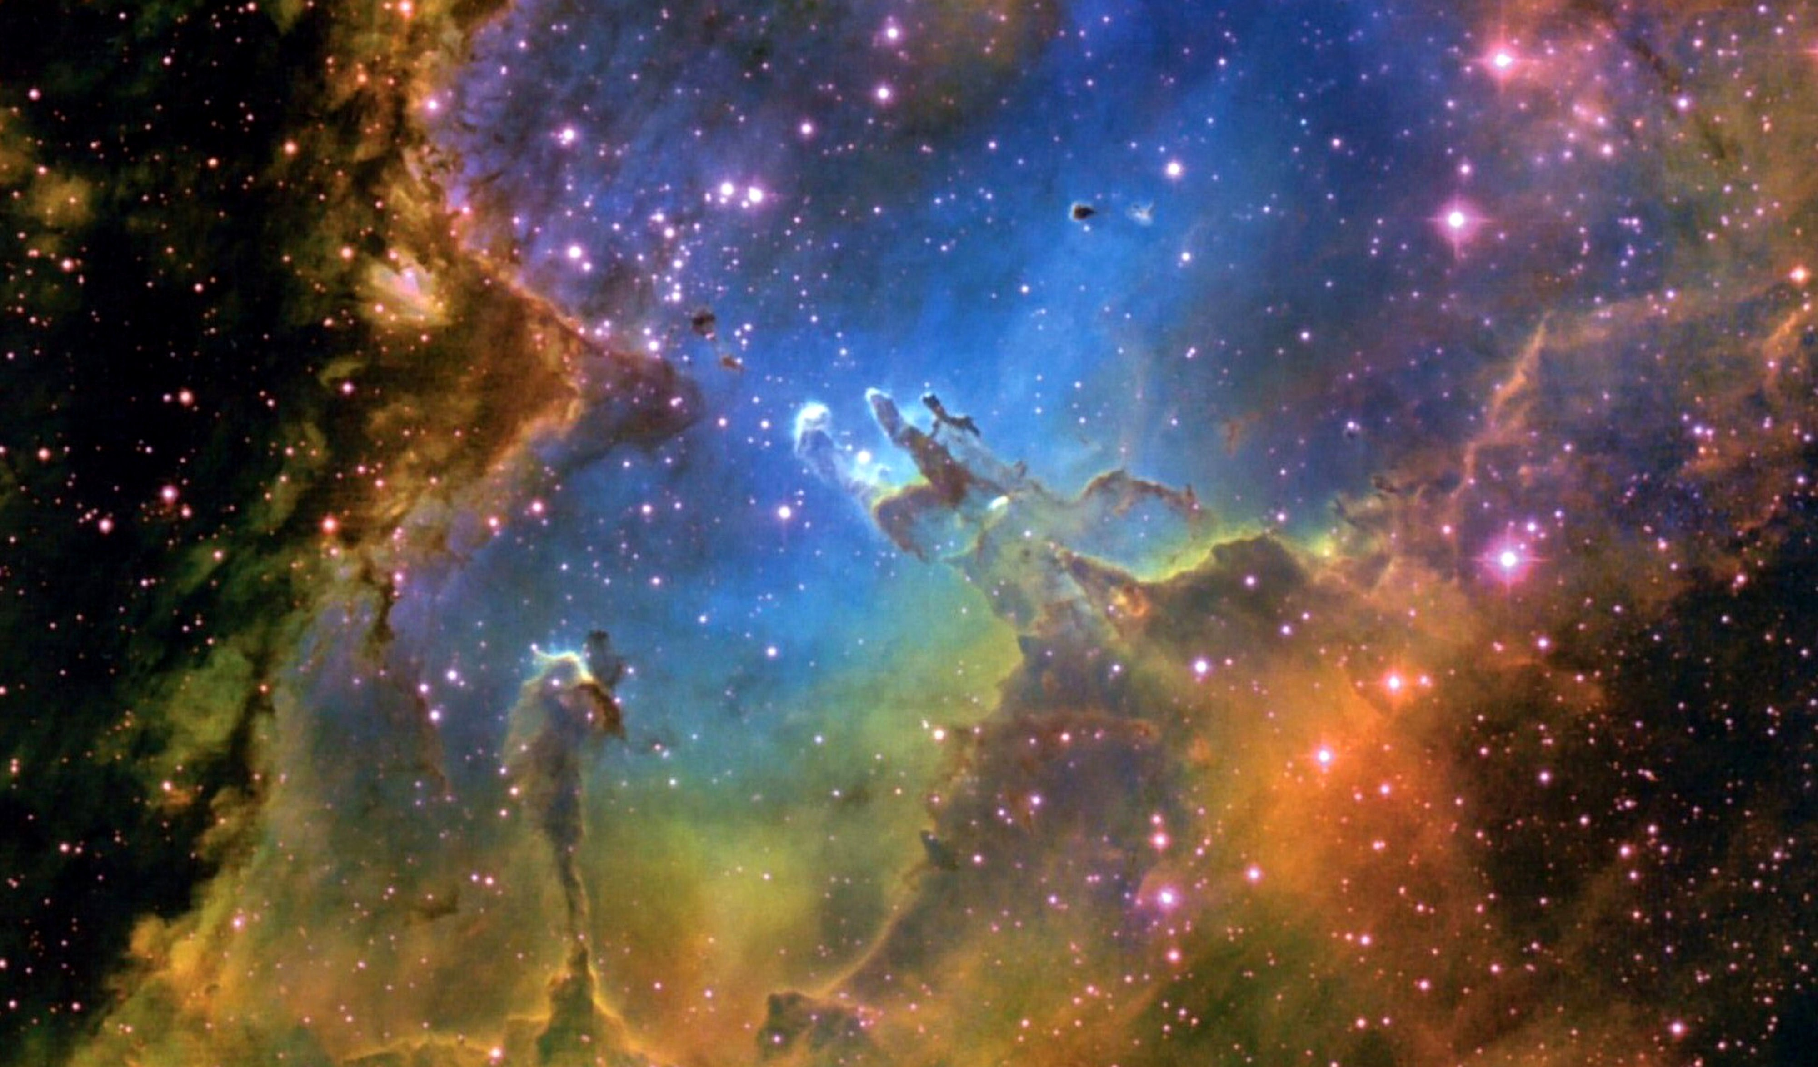
Day and night they never stop saying:
“Holy, holy, holy
is the Lord God Almighty,
who was, and is, and is to come.

Slide 8
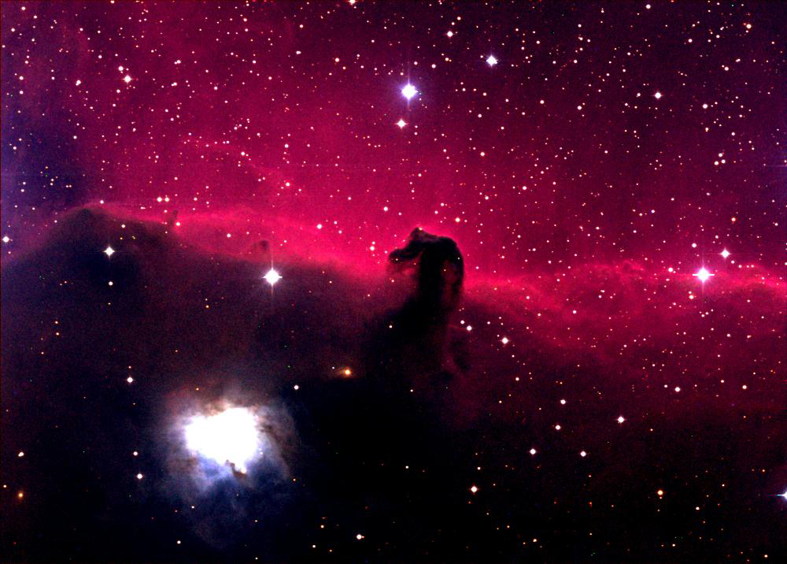
“You are worthy, our Lord and God,
to receive glory and honor and power,
for you created all things,
and by your will they were created
and have their being”

Slide 9
For this is what the Lord says – he who created
the heavens, he is God; he who fashioned and
made the earth, he founded it; he did not create
it to be empty, but formed it to be inhabited – he says: “I am the Lord and there is no other…
turn to me and be saved, all you ends of the earth; for I am God, and there is no other…there is
no God apart from me, a righteous God and
a Savior; there is none but me…

Slide 10
By myself I have sworn, my mouth has uttered
in all integrity a word that will not be revoked:
Before me every knee will bow; by me every
tongue will swear. They will say of me,
“In the Lord alone are righteousness and strength.”
All who have raged against him will come to him
and be put to shame. But in the Lord all the descendant of Israel will be found
righteousness and will exult.
Isaiah 45:18,19, 21,23,24

