Slide 1
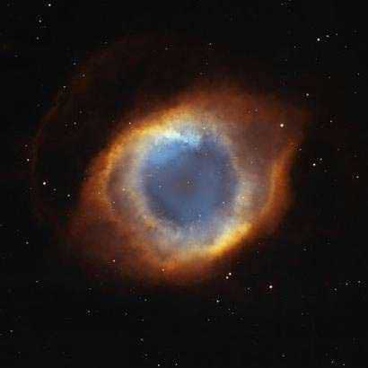
Who is this God on the throne?
Revelation 4:1-6

Slide 2
7 churches experiencing different mindsets, different struggles, joys and different persecutions.
0
5
10
Revelation 6 – 22: Every world power, of every sort, stands in opposition to God.
Our hope is only in the One who sits reigning
on the throne of the universe.

Slide 3
1 Peter 4
in persecution

Slide 4
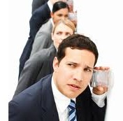
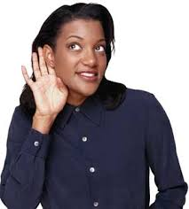
Revelation 4:1-6
Listen for “echoes”

Slide 5
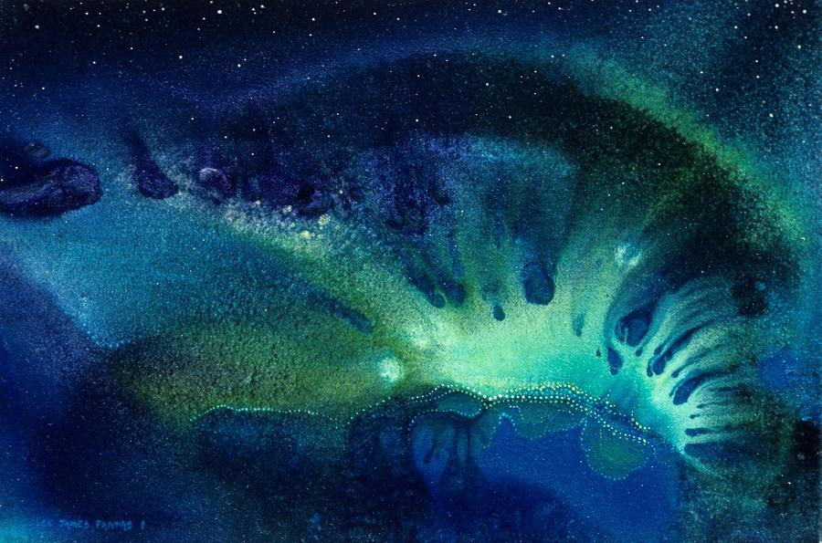
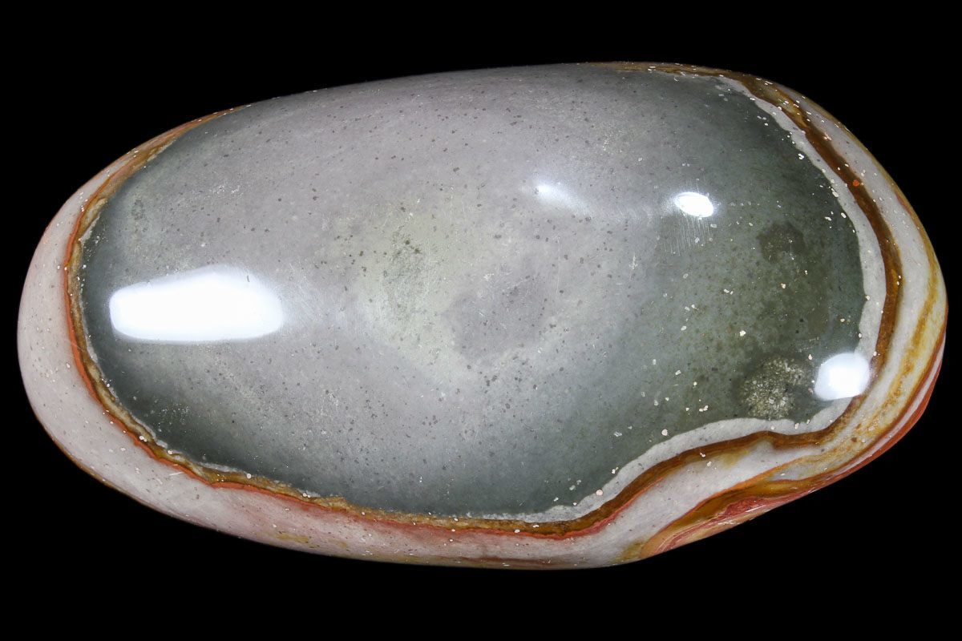
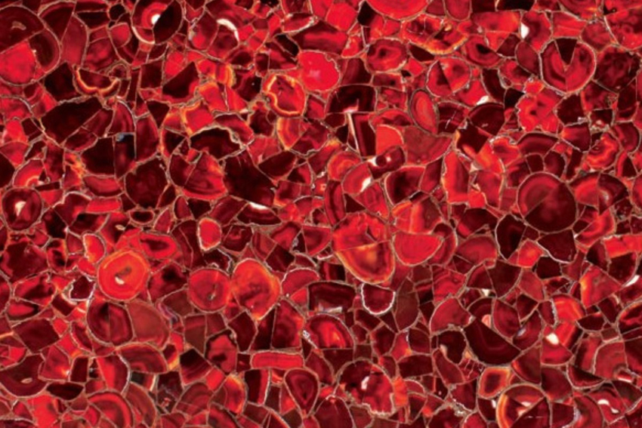
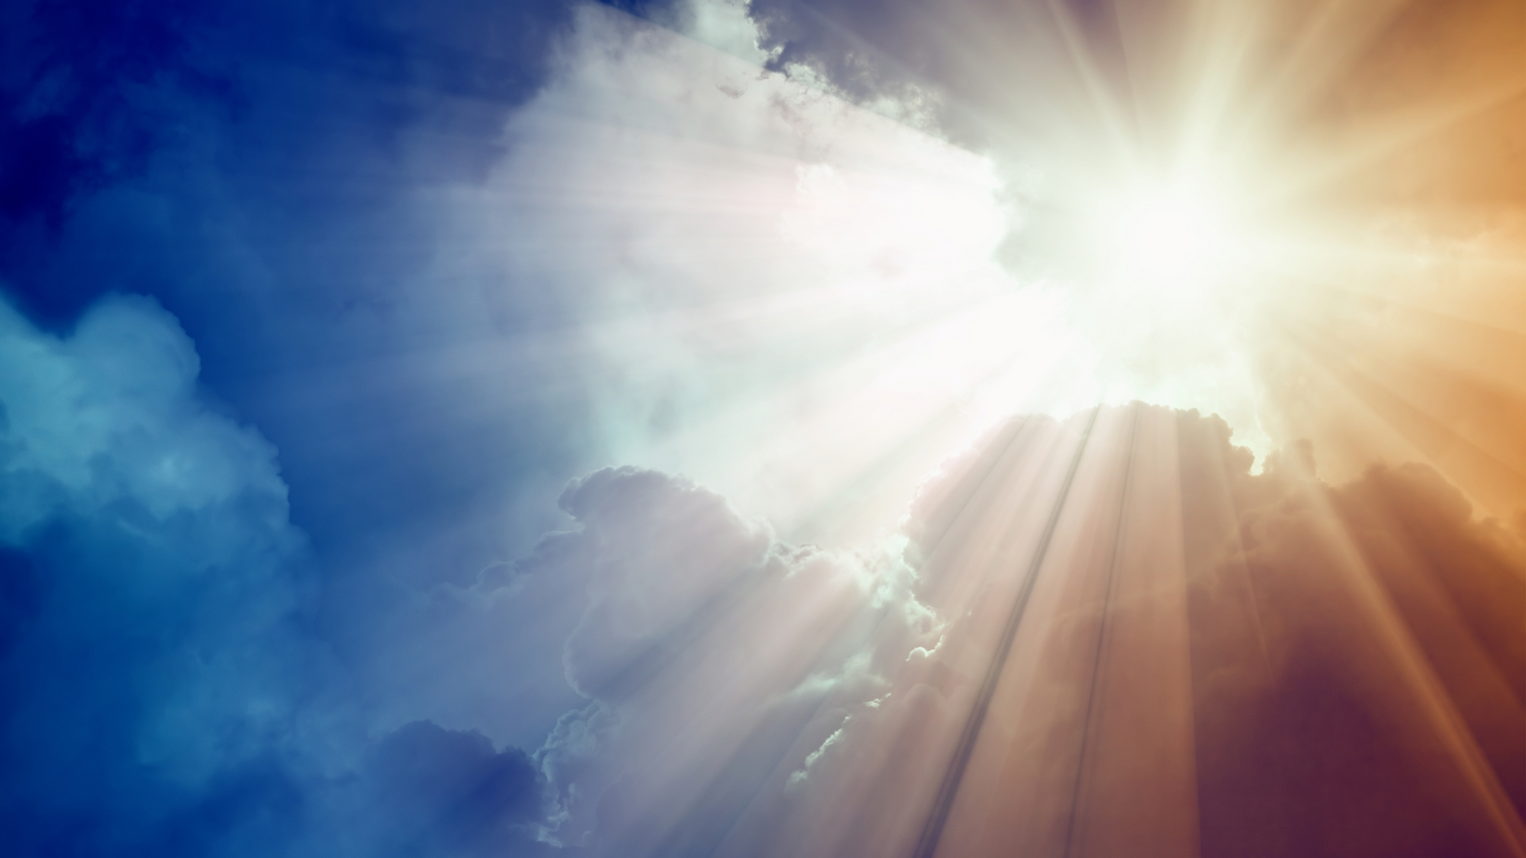
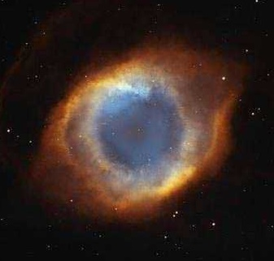
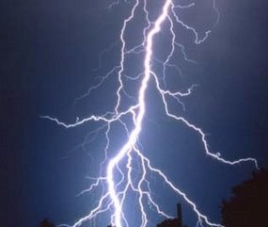
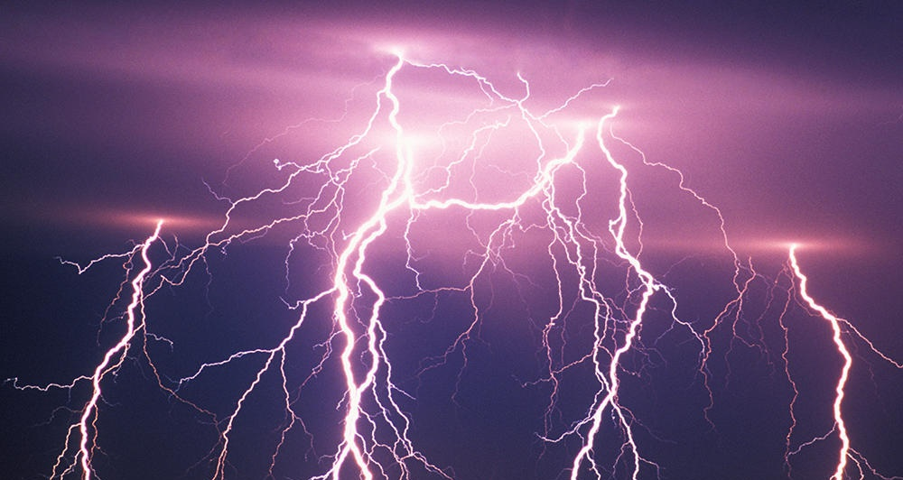
Who is this God on the throne?

Slide 6
After this I looked and…Look!
A door open and still open in heaven.
The trumpet-like voice I first heard was
talking saying,
“Come up here. I will spread out in front of you what absolutely unfolds after this.

Slide 7
At that instant I was in spirit and look!...
a throne set in heaven and on the throne
One enthroned.

Slide 8
The one who sat there was rock-solid, like stone. Blazing crystal and fiery red and an emerald rainbow were all around the throne.

Slide 9
Around that throne were thrones; twenty-four
of them. And seated on those thrones twenty-four aged ones with flowing robes of white and on their heads golden victory crowns.

Slide 10
Out of the depths of the throne:
flashes of lightening! Voices! Thunder!
In front of the throne seven blazing torches –
these are the seven Spirits of God.

Slide 11
Before the face of the throne something
sea-like, see-through as glass resembling crystal.

