Slide 1
An Exploration of Authority and Leadership
Robert’s Class Will Begin At 9:15
Gifts and the makeup of the Church Part II
Central Adult Class
28 March 2021

Slide 2
Robert’s Class Will Begin In
Class – Robert Wade
Notes:
Three Minute Countdown

Slide 3
An Exploration of Authority and Leadership
Gifts and the makeup of the Church Part II
Central Adult Class
28 March 2021

Slide 4
Welcome to class
Email Address: Robert.L.Wade@knology.net
Phone number: 256-651-8416
Put your full name on any communication, especially the first communication

Slide 5
Foundational understanding (so far) Week 1 (28 February)
Jesus Christ is the living, active head of the church and has all authority [Matthew 28:18]
We, as the church, are both individually and collectively submissive to His authority [Ephesians 1:22; 5:23]
No one, beyond no one, stands in between any of us and Him. [1 Timothy 2:5]

Slide 6
Foundational understanding (so far) Week 2-3 (7, 14 March)
Our objective is to build on the foundation of Jesus Christ, not on any person or group of people (church) in order to bring glory to our Lord.
We should strive to do as the Lord wants but remember that our motives to honor the Lord are more important than being right.
I grew up understanding that there are right ways. And those not right are wrong. I do not now believe that this is absolute.
Do not weep over a “shrunken temple”.

Slide 7
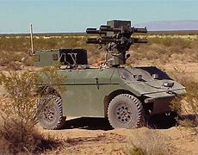
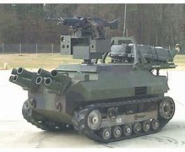
My personal leadership experience
Research and Development
High performing teams
Give a clear goal and understand the tasks
Find people who have the personal skills to perform the tasks
Hire people smarter and better than you and be OK with it
Give guidance focused on the objective
Encourage them to use their abilities

Slide 8
Functions I never delegated.
The objective and the culture
What skills were added to the team
I did delegate the selection of people with those desired skills
Where the money was spent
“The Golden Rule”
I did delegate the management of the money

Slide 9
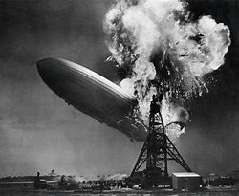
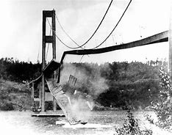
Lesson learned #1
The laws of physics do not answer to Man’s opinions or expectations.
Since God created the natural world, He therefore created the laws of physics.

Slide 10
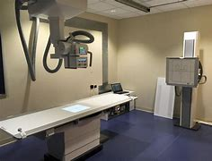
Lesson learned #2
Never underestimate the value of human factors
In team building
In system interaction

Slide 11
But does any of this translate into leadership in the body of Christ?

Slide 12
Gifts to Man since Creation
Body [Genesis 2:7a]
Life (time) [Genesis 2:7b]
Creation (wealth) [Genesis 1:28]
Produce of creation (income) [Genesis 1:29]

Slide 13
Parables of the talents and the minas
Matthew 25: 14-30 -- Parable of the talents
Luke 19:11-17 -- Parable of the minas

Slide 14
Summary understanding of the parables of the talents and the minas
Every person who has ever lived or will ever live has gifts given by God
Body, life, talents, money, …
Every person is expected to use those gifts to bring glory (gain) to the Lord
Tries and produces = reward
Fails to try = punishment
Against the Lord = execution
Serving yourself for your glory is opposition to the Lord

Slide 15
Common excuses
“It is not my gift so I do not have to do that.”
“I don’t want to do something.”
“Others are better so let them do it.”
Use of gifts to further only self or self first.
Direct opposition to the king (see minas)

Slide 16
But what if you tried to use your gifts for the Lord and failed?

Slide 17
1 Corinthians 3:10-15
¹⁰ By the grace God has given me, I laid a foundation as a wise builder, and someone else is building on it. But each one should build with care. ¹¹ For no one can lay any foundation other than the one already laid, which is Jesus Christ. ¹² If anyone builds on this foundation using gold, silver, costly stones, wood, hay or straw, ¹³ their work will be shown for what it is, because the Day will bring it to light. It will be revealed with fire, and the fire will test the quality of each person’s work. ¹⁴ If what has been built survives, the builder will receive a reward. ¹⁵ If it is burned up, the builder will suffer loss but yet will be saved—even though only as one escaping through the flames.

Slide 18
Gifts and the church
The Comforter, Helper, Advocate [John 14:15-28]
Encouragement, guidance and understanding
Uniquely given to the believers
People
Given different gifts with the common goal of carrying out God’s plan
Assembled by God into a group to work together

Slide 19
1 Corinthians 12: 4-11
⁴ There are different kinds of gifts, but the same Spirit distributes them. ⁵ There are different kinds of service, but the same Lord. ⁶ There are different kinds of working, but in all of them and in everyone it is the same God at work.
⁷ Now to each one the manifestation of the Spirit is given for the common good. ⁸ To one there is given through the Spirit a message of wisdom, to another a message of knowledge by means of the same Spirit, ⁹ to another faith by the same Spirit, to another gifts of healing by that one Spirit, ¹⁰ to another miraculous powers, to another prophecy, to another distinguishing between spirits, to another speaking in different kinds of tongues, and to still another the interpretation of tongues. ¹¹ All these are the work of one and the same Spirit, and he distributes them to each one, just as he determines.

Slide 20
Romans 12: 3-8
³ For by the grace given me I say to every one of you: Do not think of yourself more highly than you ought, but rather think of yourself with sober judgment, in accordance with the faith God has distributed to each of you. ⁴ For just as each of us has one body with many members, and these members do not all have the same function, ⁵ so in Christ we, though many, form one body, and each member belongs to all the others. ⁶ We have different gifts, according to the grace given to each of us. If your gift is prophesying, then prophesy in accordance with your faith; ⁷ if it is serving, then serve; if it is teaching, then teach; ⁸ if it is to encourage, then give encouragement; if it is giving, then give generously; if it is to lead, do it diligently; if it is to show mercy, do it cheerfully.

Slide 21
Team building
My Experience
Lord’s Method
Give a clear goal and understand the tasks
Find people who have the personal skills to perform the tasks
Give guidance focused on the objective
Encourage them to use their abilities
Go into all the world… [Matthew 28:18-20]
The Lord adds to the church and equips each with gifts to accomplish the task [Acts 2:47; 1 Corinthians 12:11]
The Holy Spirit gives guidance and encouragement [John 14: 15-28]

Slide 22
This reinforces the foundational principle that Jesus is the living, active head of the church

Slide 23
What have I learned about my role as an elder?
I have learned what I am not
I cannot offer a vision other than the one given by Jesus
I cannot give you gifts
I cannot determine if you have value because we all have value
I am not the head of the church

Slide 24
New understanding
Our Savior has given all of us a vision and tasks [Matthew 28:18-20]
Our Savior has given every believer gifts to execute His vision [Matthew 25:14-30; 1 Corinthians 12:11]
Our Savior has given every believer power, in the Holy Spirit, to use those gifts to perform those tasks. [John 14: 15-28]
Our Savior has assembled groups of believers together to work as a body to accomplish for God’s glory. [Romans 12: 3-8]

Slide 25
Easy to understand, difficult to implement
What about Hebrews 13:17?
¹⁷Have confidence in your leaders and submit to their authority, because they keep watch over you as those who must give an account. Do this so that their work will be a joy, not a burden, for that would be of no benefit to you.
What about the hiring of “paid staff”?
For me, we must all seek to understand the challenge to implement.

Slide 26
Be courageous in heart,
Strong in action and endurance,
Gentle in thought and speech

