Slide 1
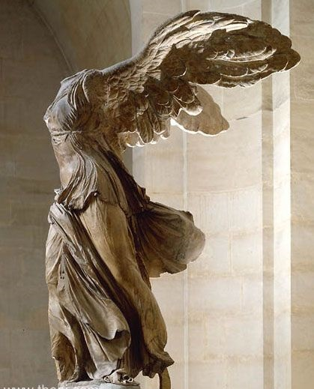
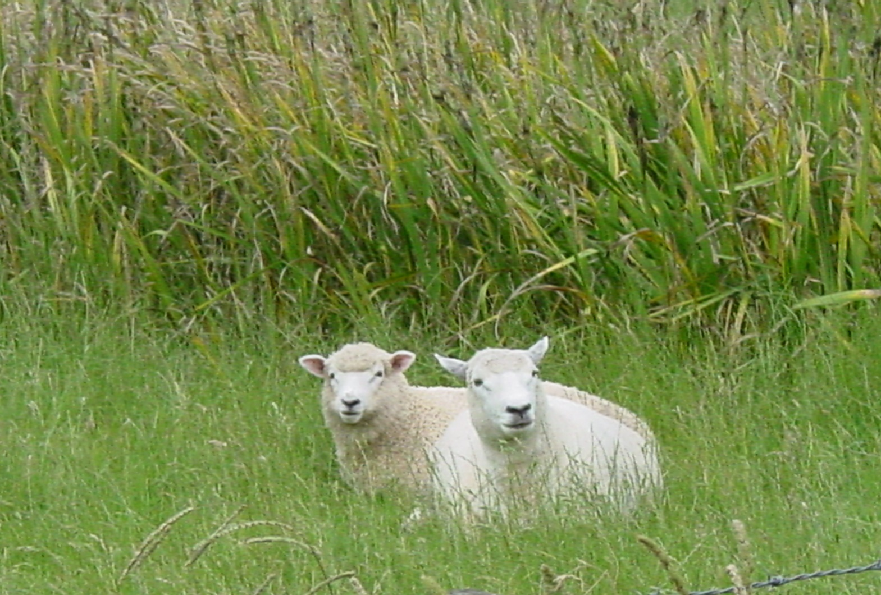
More than conquerors
Romans 8:37-39

Slide 2
No, in all these things we are more than conquerors through him who loved us.
For I am convinced that neither death nor life, neither angels nor demons, neither the present nor the future, nor any powers, neither height nor depth, nor anything else in all creation, will be able to separate us from the love of God that is in Christ Jesus our Lord.

Slide 3
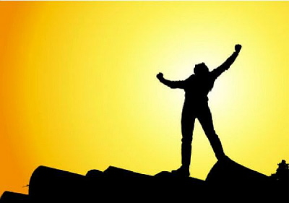
Super-conquerors
A holy arrogance of victory
The focus of victory is only in the work and love of Christ

Slide 4
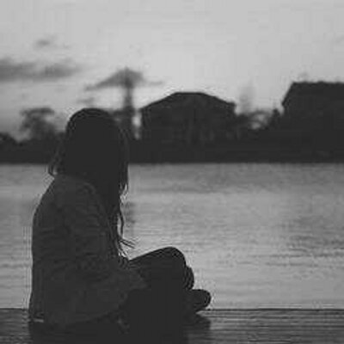
getting around Christ”
“In these things”
through the love of Christ
From troubles to death
(v. 35,36)

Slide 5
“I am convinced”
Death
Life
Angels
Demons
Present
Future
Powers
Height/Depth
Anything else in all creation

Slide 6
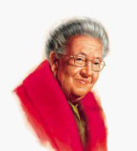
“I would look about us as Betsie read, watching the light leap from face to face. More than conquerors. It was not a wish. It was a fact. We knew it, we experienced it minute by minute in an ever widening circle of help and hope. Life at Ravensbruck took place on two separate levels. One, the observable, external life, grew every day more horrible. The other, the life we lived with God, grew daily better, truth upon truth, glory upon glory”

Slide 7
On top of all this we know that God blends together everything in our lives; all the ups and downs, from the best of times to the worst of times and like a Master Chef his final product
for us is “Good.” This is for God-lovers,
those who have heard God’s call and are
day-by-day and step-by-step moving
resolutely toward his ultimate purpose.
~28~

Slide 8
Here’s proof: observe those God knew in times past. He determined that their behavior would change into a mirror-like resemblance of his Son. His Son would thus lead a numberless family of brothers and sisters who would follow in his wake.
~29~

Slide 9
These ones whom God previously determined
to live in such a way, he invited and summoned them into this relationship. Those “called ones”
he thus credited them with the status of
“just-as-if-they-had-never-sinned” and these “saved ones” he deemed “glorious,” highly esteemed and of great value.
~30~

Slide 10
In view of all these things, what is left to be said?
Since God’s focus is on our interest and for our betterment, does it matter a whit who opposes us?
~31~

Slide 11
Grasp this! God did not cling to his own,
specially loved, and divine Son. But he turned
him over, gave him up for each one of us.
How could One with such sacrificial generosity, not graciously give us, along with him,
the totality of what we now need?
~32~

Slide 12
Who will bring an indictment with charges
against the choice ones of God?
God Himself continually renders the
verdict “right-with-God.”
~33~

Slide 13
Who are the ones crying out for a guilty verdict? Christ Jesus died and even more, was raised out of death! Now he is in partnership with God ruling the universe. He represents us, speaking and praying on our behalf.
~34~

Slide 14
Who will serve us divorce papers from the love of Christ? When the pressures of life lay heavy on you? When life’s walls seem to close in on you and crush you filling you with great turmoil, anguish, or anxiety? Or when others pursue you like a wild animal seeking your doom or when you’re hungry and find the cupboard bare or perhaps when you don’t even have a stitch of clothing? What if you were in absolute peril, your life in jeopardy with someone about to lop your head off?
~35~

Slide 15
The Scripture laid it all out in black and white
long ago: “For your sake, Lord, we stare death
in the face day in and day out. We are only
thought of as slaughter-sheep.
!~36~
But God turns that all on its head.
In all these things we are super-conquerors, victors above them all, through the One who loved us.
~37~

Slide 16
For I am absolutely sure, beyond a shadow of doubt, that neither death nor the rigors of life, angelic hosts nor earthly rulers, whatever is happening now or whatever will happen later, not weather calamities of the harshest kind,
~38~
nothing from the highest peak to the lowest depth nor anything else on God’s green earth has the strength or power to pry God’s love away from us. It all resides in Christ Jesus our Master!
~39~

