Slide 1
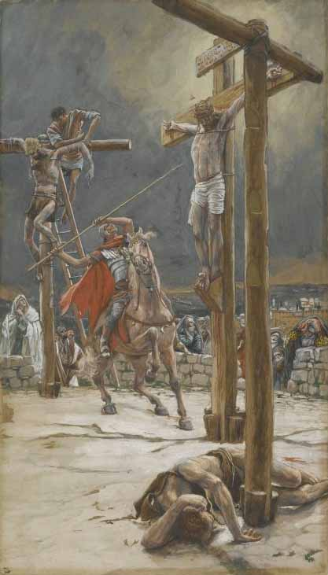
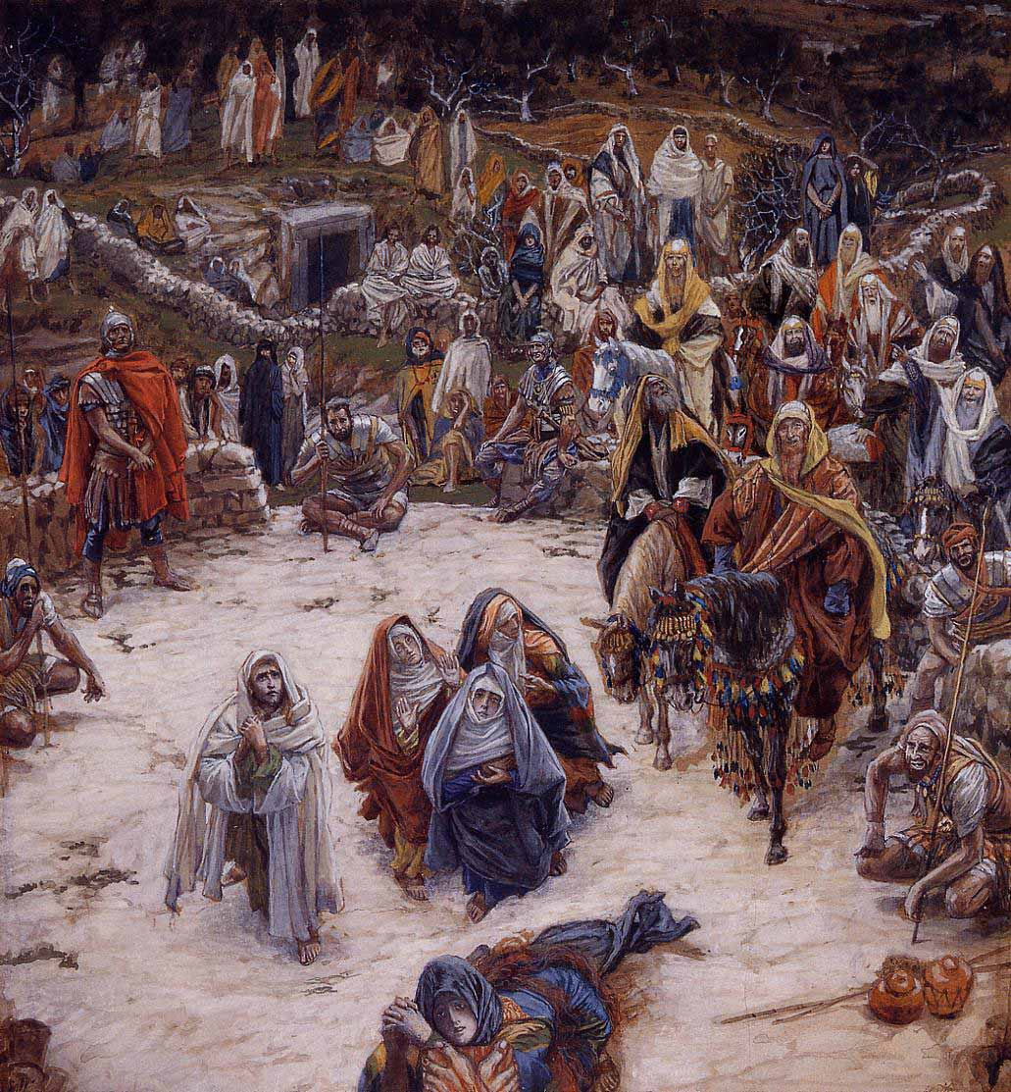
Romans 8:35,36
If Love…
then what?
Who shall separate us from the love of Christ?

Slide 2
Who shall separate us from the love of Christ? Shall trouble or hardship or persecution or famine or nakedness or danger or sword? As it is written: “For your sake we face death all day long;
we are considered as sheep
to be slaughtered.
Romans 8:35,36

Slide 3
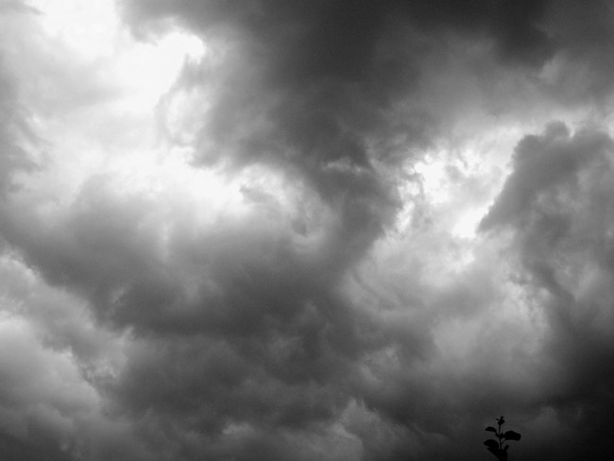
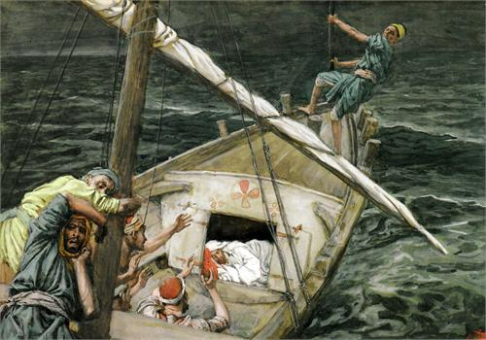
Christ’s Love for Us
Mark 4:38
“Don’t you care?”
Be quiet!
Put a muzzle on it!
“Why are you so afraid?”
Do you still have no faith?

Slide 4
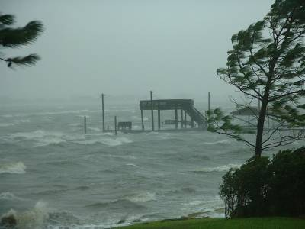
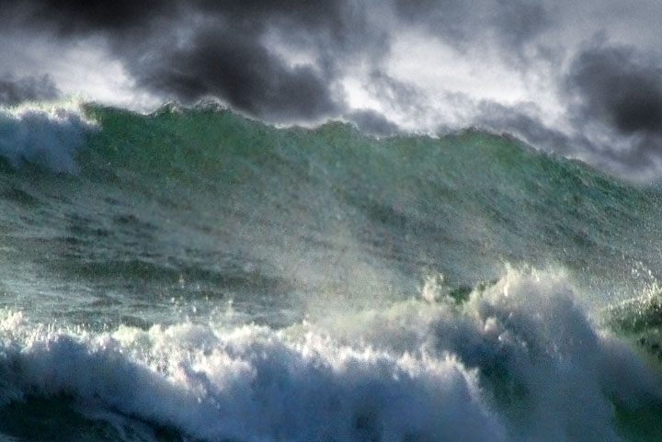
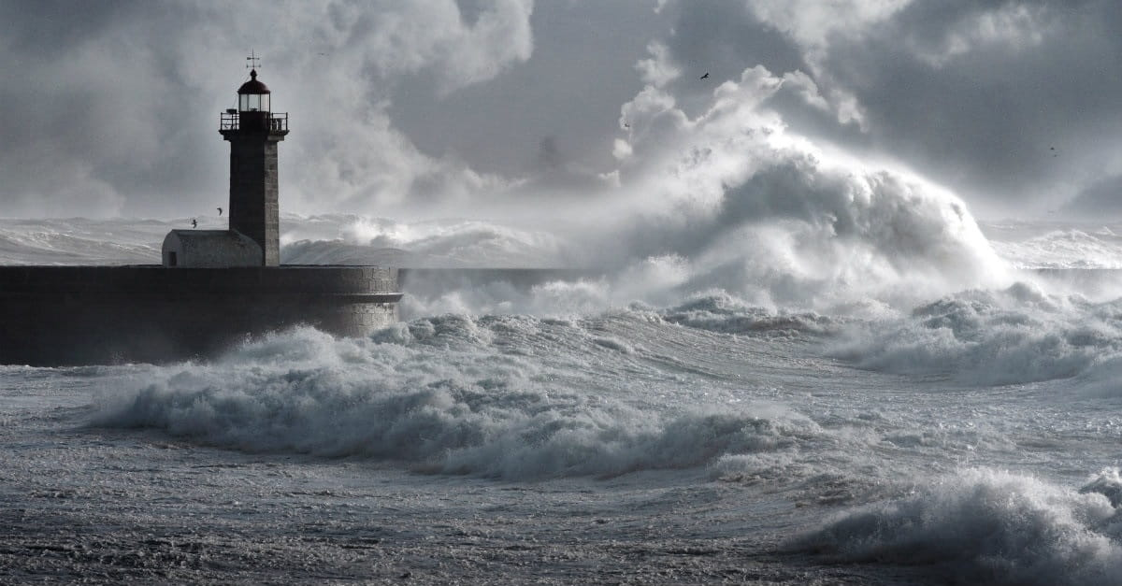
Seven Storms
of Life
Trouble
Hardship
Nakedness
Persecution
Danger
Famine
Sword

Slide 5
All this happened to us, though we had not forgotten you or been
false to your covenant. Our hearts had not turned back; our feet had not strayed from your path
Rejection (v9) retreat (v10) scattered (v.11) sold out (v.12) reproach to their neighbors (v13)
Mocked (v14) Disgrace, shame (v15)
taunts, revile, revenge (v.16)
Wake up, LORD!
For your sake we face death all day long;
We are considered as sheep to be slaughtered
For your sake
Psalms 44

Slide 6
If Love…
then what?
“Assythment”
Sometimes when we push away, that is when we most need to be resisted.”

Slide 7
If Love…
then what?
If Love…
then love.
“Assythment!”
Who shall separate us from the love of Christ?

Slide 8
In view of all these things, what is left to be said?
Since God’s focus is on our interest and for our betterment, does it matter a whit who opposes us?
v.31
Grasp this! God did not cling to his own, specially
loved, and divine Son. But he turned him over,
gave him up for each one of us. How could One with such sacrificial generosity, not graciously give us, along with him, the totality of what we now need?
v.32

Slide 9
Who will bring an indictment with charges against the choice ones of God? God Himself continually renders the verdict “right-with-God.”
v.33
Who are the ones crying out for a guilty verdict? Christ Jesus died and even more, was raised out of death! Now he is in partnership with God ruling the universe. He represents us, speaking and praying on our behalf.
v.34

Slide 10
Who will serve us divorce papers from the love of Christ? When the pressures of life lay heavy on you? When life’s walls seem to close in on you and crush you filling you with great turmoil, anguish or anxiety? Or when others pursue you like a wild animal seeking your doom or when you’re hungry and find the cupboard bare or perhaps when you don’t even have a stitch of clothing? What if you were in absolute peril, your life in jeopardy with someone about to lop your head off?
v.35

Slide 11
The Scripture laid it all out in black and white long ago:
“For your sake, Lord, we stare death in the face
day in and day out. We are only thought of as slaughter-sheep.”
v.36

