Slide 1
Welcome
We’re glad you’re with us!
GO

Slide 2
Class Will Begin In
Sermon – Allen Wright
Notes:
Three Minute Countdown

Slide 3
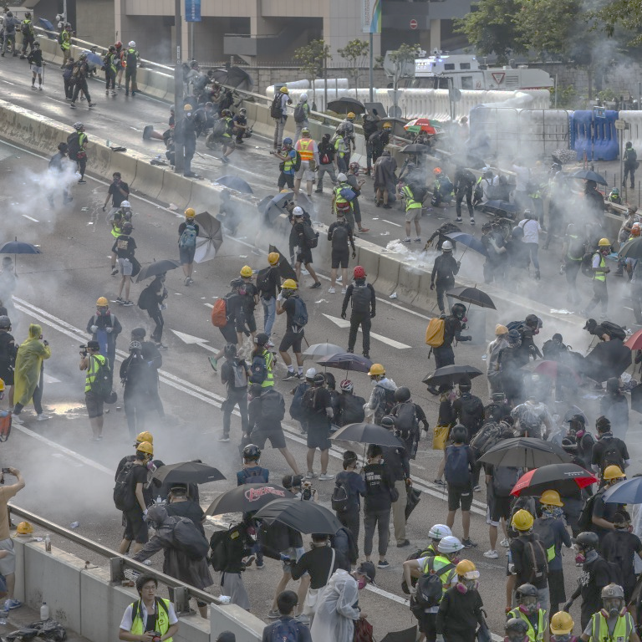
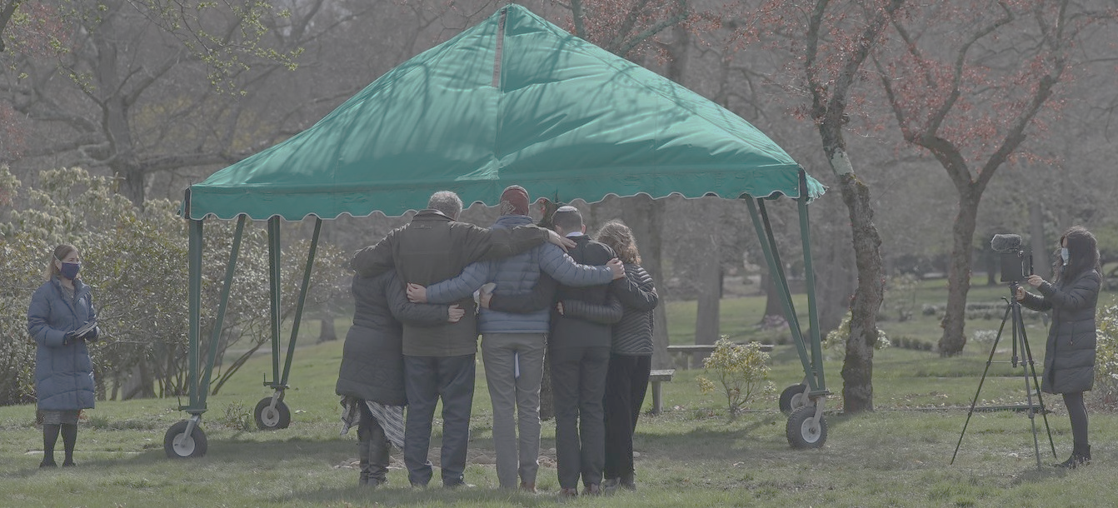
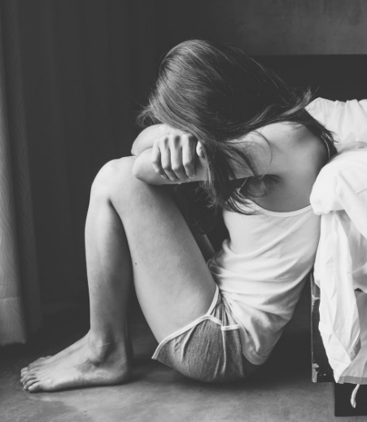
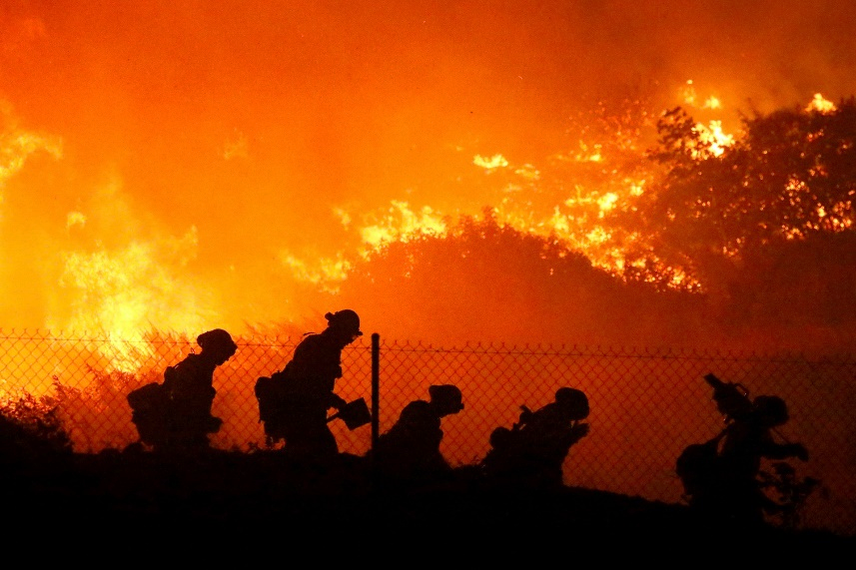
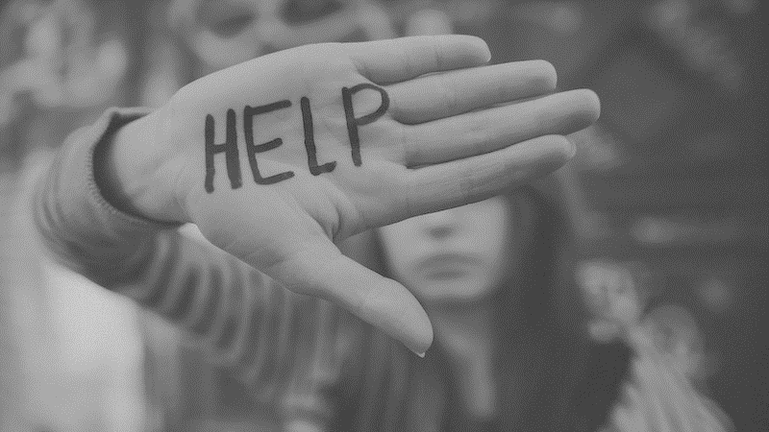
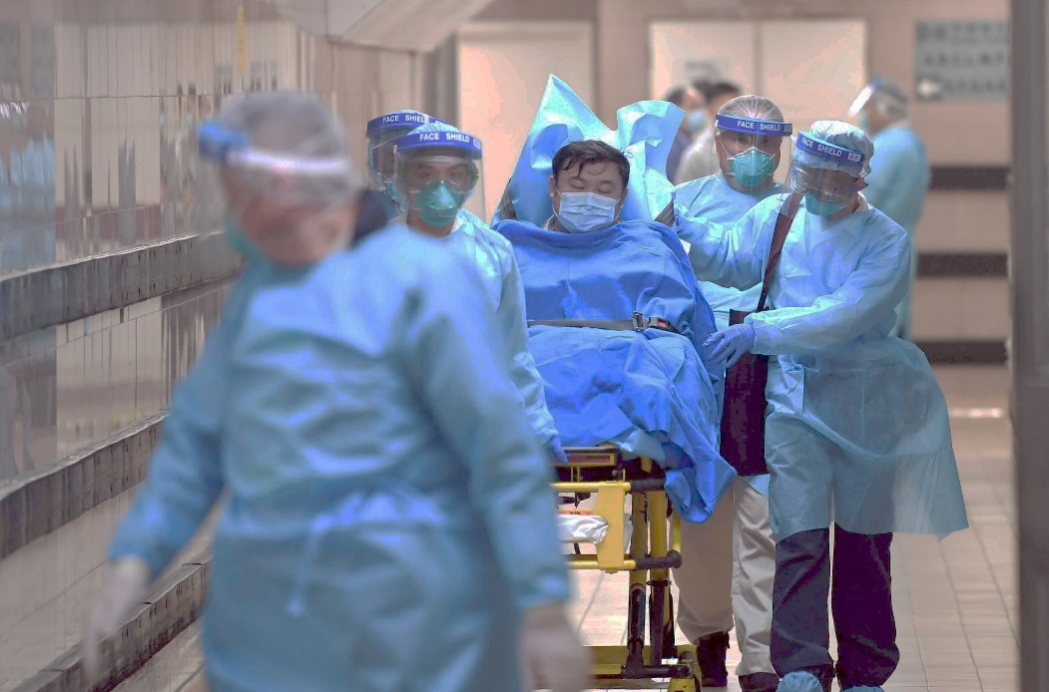
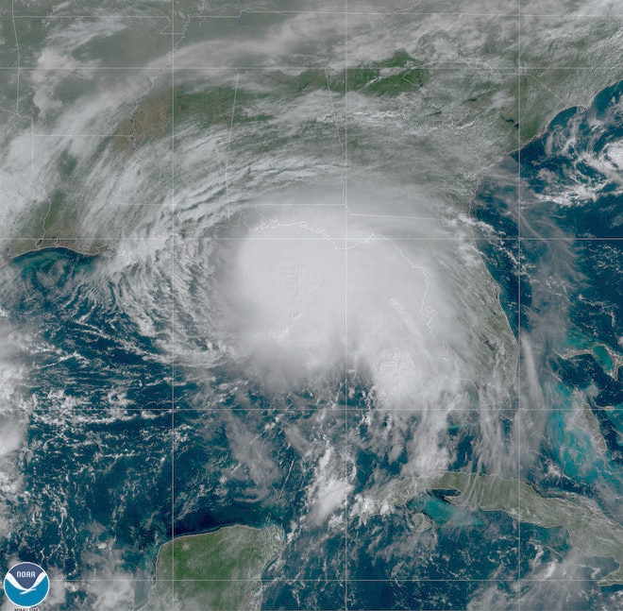
A Spiritual Debrief of our Social Crisis

Slide 6
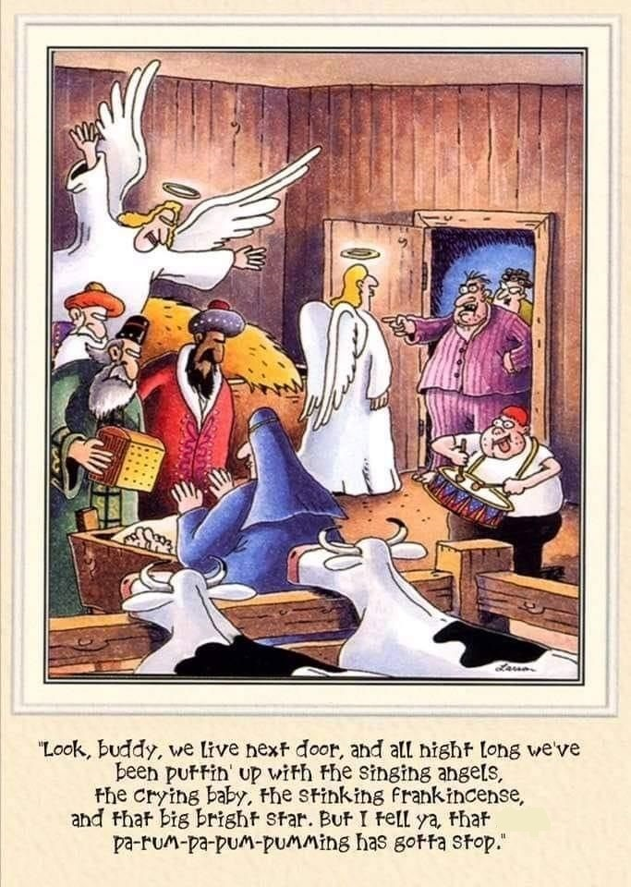

Slide 7
Do all things without grumbling or disputing, that you may be blameless and innocent, children of God without blemish in the midst of a crooked and twisted generation, among whom you shine as lights in the world, holding fast to the word of life, so that in the day of Christ I may be proud that I did not run in vain or labor in vain. Philippians 2:14-16

Slide 8
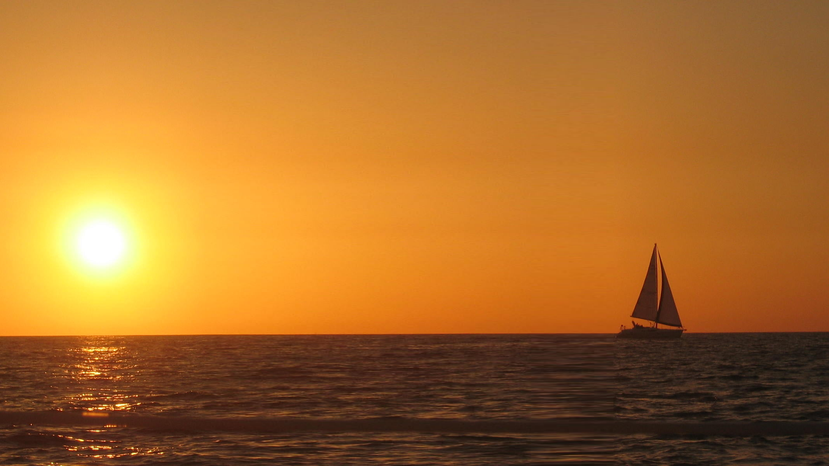
One Ship sails east,
another west!
both sail on the self-same blow.
It’s not the gales but the set of the sails that bids them where they go. And so it is in our lives.

Slide 10
+

Slide 12
Put on then, as God's chosen ones, holy and beloved, compassionate hearts, kindness, humility, meekness, and patience, bearing with one another and, if one has a complaint against another, forgiving each other; as the Lord has forgiven you, so you also must forgive. And above all these put on love, which binds everything together in perfect harmony. Colossians 3:12-14

Slide 13
And let the peace of Christ rule in your hearts, to which indeed you were called in one body. And be thankful. Colossians 3:15
And let the peace of Christ rule in your hearts, to which indeed you were called in one body. And be thankful. Colossians 3:15
ATTITUDES

Slide 14
Let the word of Christ dwell in you richly, teaching and admonishing one another in all wisdom, singing psalms and hymns and spiritual songs, with thankfulness in your hearts to God. Colossians 3:16
ADMONITIONS

Slide 15
And whatever you do, in word or deed, do everything in the name of the Lord Jesus, giving thanks to God the Father through him. Colossians 3:17
ACTIONS

Slide 16
God’s will for us is …
1 Thessalonians 5
a) “Rejoice Always” v.16
b) “Pray Continually” v. 17
c) “Thankful Always” v.18

Slide 17
What Gratitude do you have to God as we draw to the end of 2020?

Slide 18
Tom’s phone
256-656-6030

