Slide 1
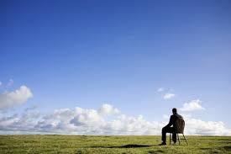
Where’s The Good in All the Bad?
And we know that in all things
God works for the good of those who love him, who have been called according to his purpose.
Romans 8:28

Slide 2
We don’t necessarily know
from experience
We Know!
Know – “See”
“Now I see what you mean”

Slide 4
We Know!
based in faith
based in who said it

Slide 5
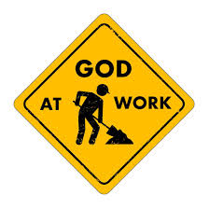
In the things?
In the work?
In the good?
Where’s the focus?
GOD!
All things work
together for good

Slide 6
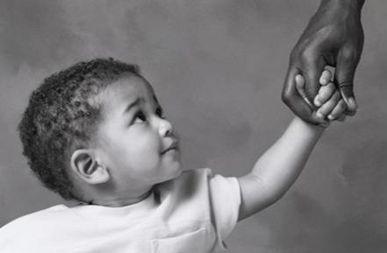
Loving God is a characteristic rather than
one’s current condition
To those loving God

Slide 7
according
called
to
been
his
have
What is the “good?”
who
PURPOSE
those
“to be conformed to the likeness of his son.”
to

Slide 8
Psalms 73
Surely God is good…
When I tried to understand all this, it was oppressive to me til I entered the sanctuary of God; then I understood their final destiny
But as for me, my feet almost slipped, I had nearly lost my foothold
For I envied the arrogant…
They have no struggles…
they are not plagued by human ills…
This is what the wicked are like – always carefree, they increase in wealth

Slide 9
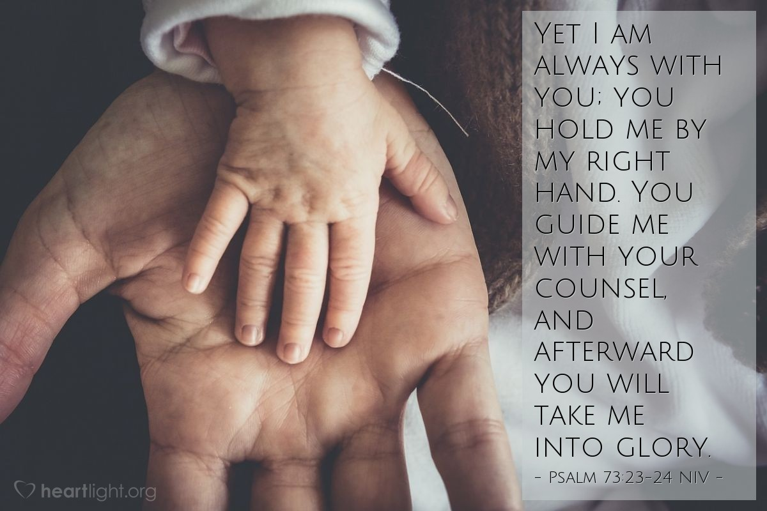
But as for me, it is good to be near God . I have made the Sovereign Lord my refuge; I will tell of all your deeds

Slide 10
On top of all this, we know that God blends
together everything in our lives; all the ups and downs, from the sublime to the horrid and like
a Master Chef his final product for us is “Good.” This is for God-lovers, those who have heard God’s call and are day-by-day and step-by-step moving resolutely toward his ultimate purpose.

