Slide 1
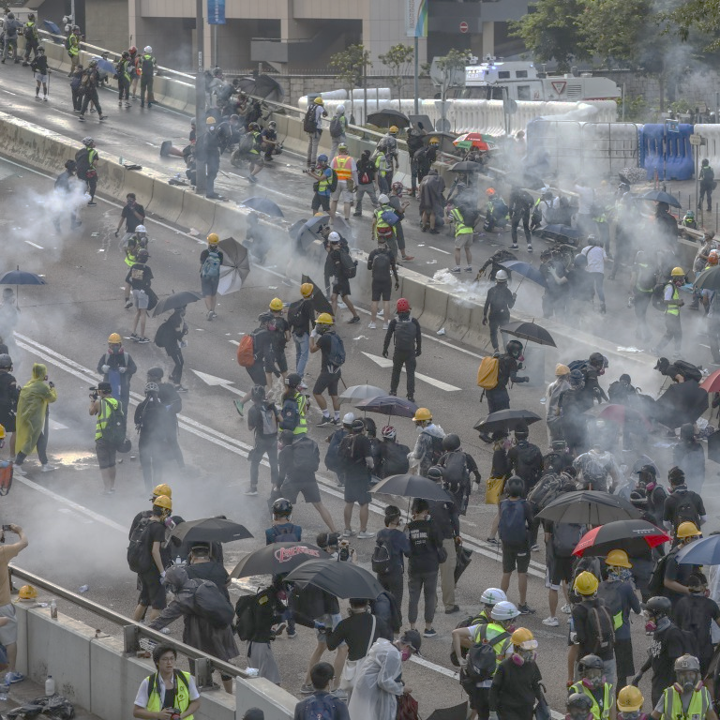
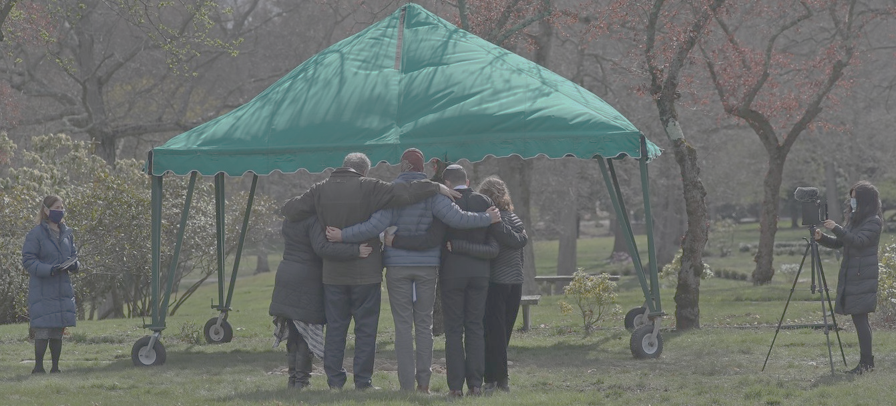
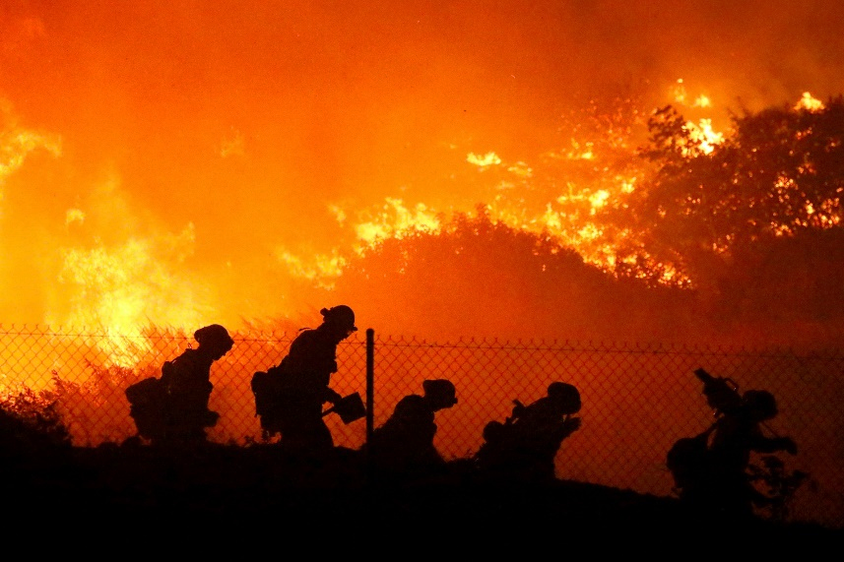
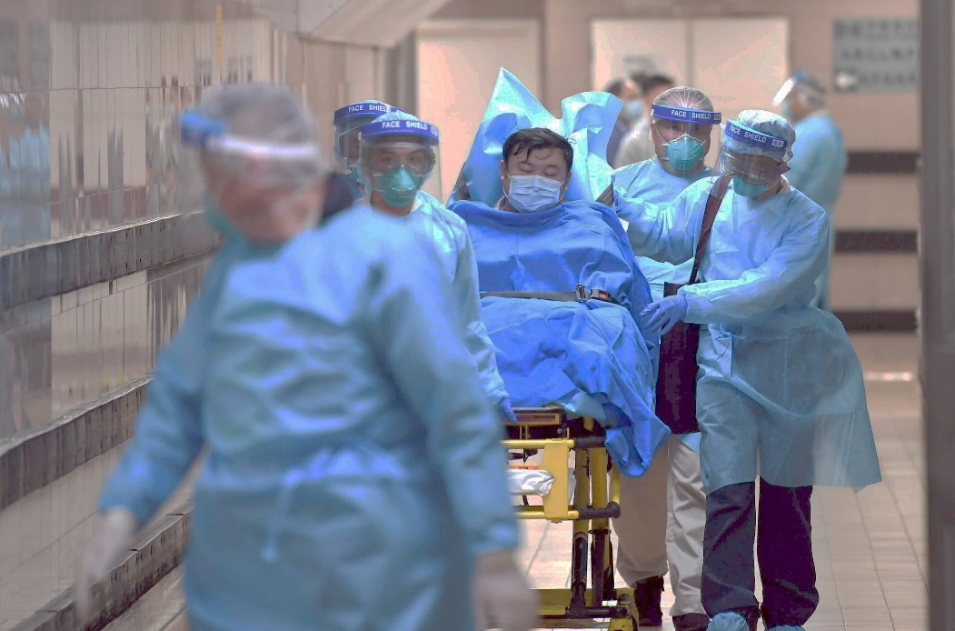
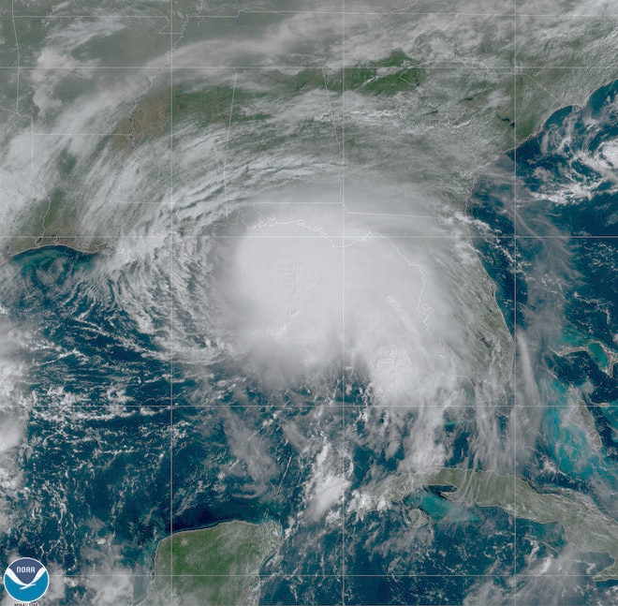
A Spiritual Debrief of our Social Crisis

Slide 2
What is Normal?

Slide 3
Jesus, as the image of God, reveals God’s Nature
Hebrews 1:3

Slide 4
He became like us that we could become like Him

Slide 5
How Do We Become Like Him?
New Birth
Blessed be the God and Father of our Lord Jesus Christ! According to his great mercy, he has caused us to be born again to a living hope through the resurrection of Jesus Christ from the dead 1 Peter 1:3
For in Christ Jesus you are all sons of God, through faith. For as many of you as were baptized into Christ have put on Christ. Galatians 3:26,27
As He was clothed in our flesh, we are now clothed in His divinity

Slide 6
How Do We Become Like Him?
New BIRTH
New MIND
Do not be conformed to this world, but be transformed by the renewal of your mind, that by testing you may discern what is the will of God, what is good and acceptable and perfect Romans 12:2
1. CONFORM – “Form With”
And we all, with unveiled face, beholding the glory of the Lord, are being transformed into the same image from one degree of glory to another. For this comes from the Lord who is the Spirit. 2 Corinthians 3:18
2. REFORM – “Form Again”
3. TRANSFORM – “Form Anew”

Slide 7
How Do We Become Like Him?
New BIRTH
New MIND
New MODEL
Beloved, we are God's children now, and what we will be has not yet appeared; but we know that when he appears[a] we shall be like him, because we shall see him as he is. 1 John 3:2
But to all who did receive him, who believed in his name, he gave the right to become children of God, who were born, not of blood nor of the will of the flesh nor of the will of man, but of God. John 1:12,13
For all who are led by the Spirit of God are sons of God. Romans 8:14

Slide 8
Jesus is God’s Original Normal for Us.

