Slide 1
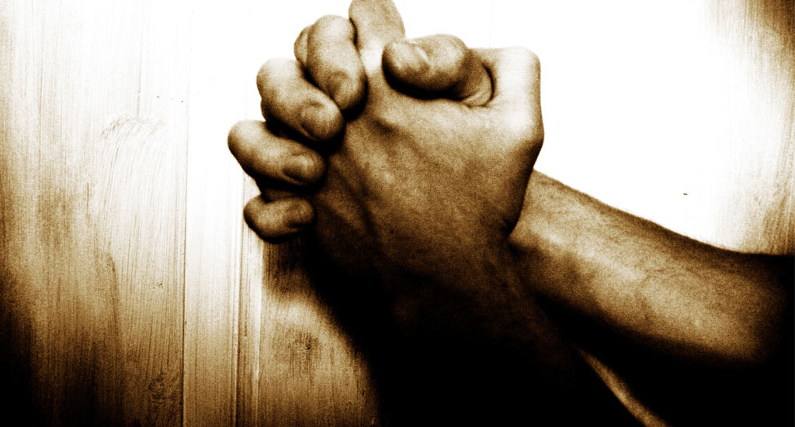
In the same way, the Spirit helps us in our weakness. We do not know what we ought to pray for, but the Spirit himself intercedes for us with groans that words cannot express. And he who searches our hearts knows the mind of the Spirit, because the Spirit intercedes for the saints in accordance with God’s will.
What Am I To Pray?
Romans 8:26-27

Slide 2
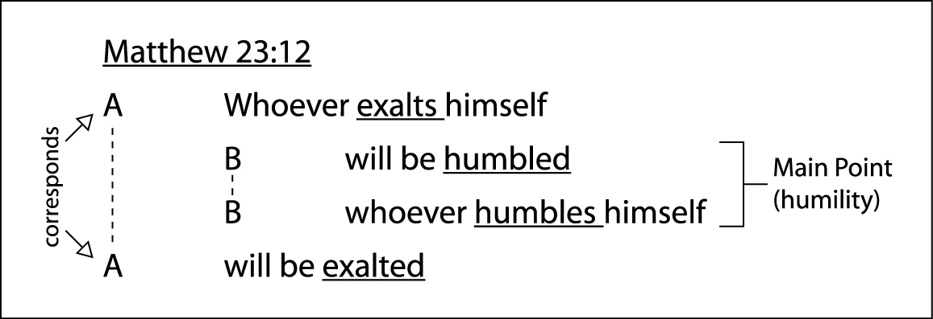
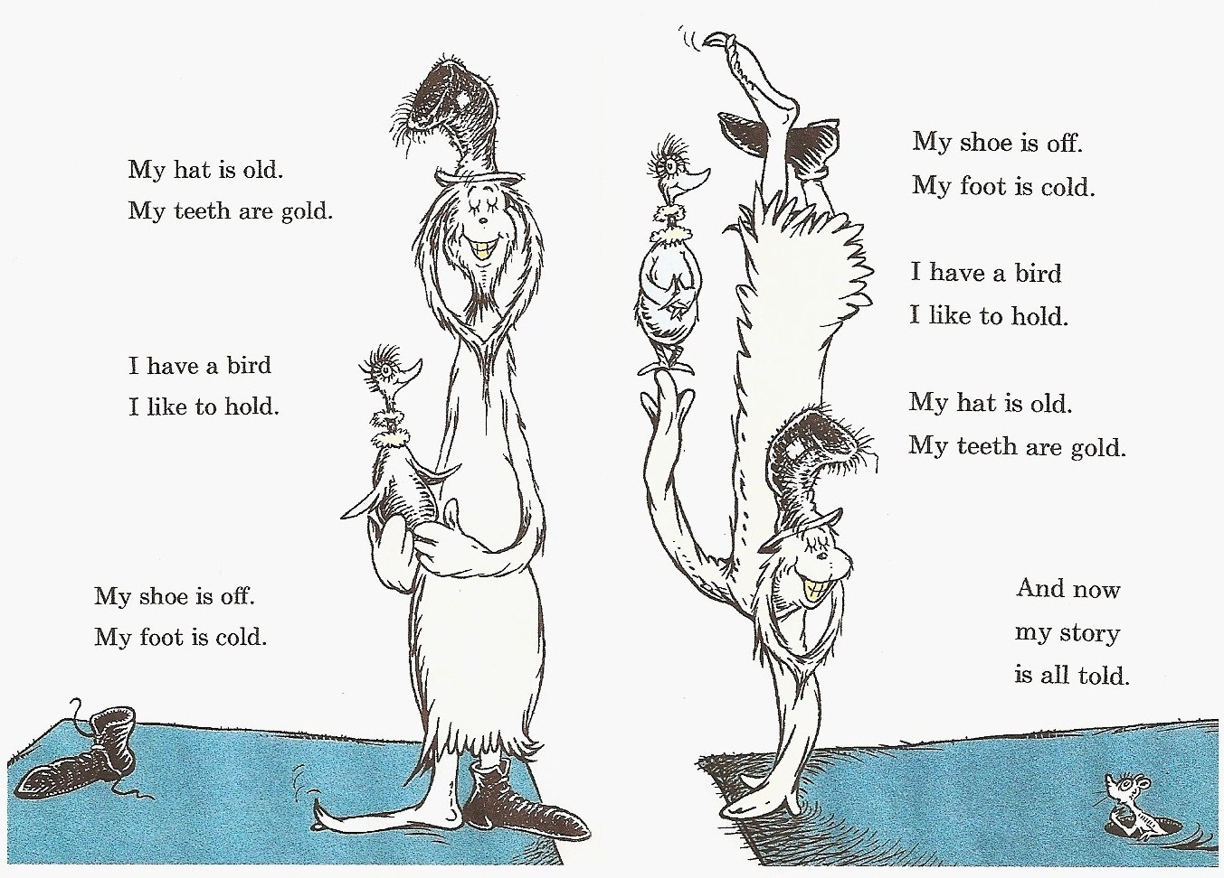
I don’t have a great example immediately on hand of the chiasm in Romans, but the bookends and center are fairly easy to see. Look at the first few verses and the last few verses of the book about the gospel and the obedience of faith. Then a few verses further in, look at the greetings to those in Rome in chapter 1 (just a half verse) and chapter 16 (almost the whole chapter). Then look at Romans 8:17-18 which you just taught on this month: sufferings and glory (v. 17) immediately followed by sufferings and glory (v. 18). For a book that begins and ends with the gospel and deeply explains the meaning of the gospel, the very center of the chiasm in 8:17-18 points to the heart of the gospel—suffering and glory—a set of general concepts most fully demonstrated in a set of historical events: the cross and the resurrection. The heart of Romans assumes that Christians will take up their cross and follow Jesus.
Chiasm

Slide 3
Let us fix our eyes on Jesus, the author and perfecter of our faith, who for the joy set before him endured the cross, scorning its shame, and sat down at the right hand of the throne of God ~ Hebrews 12:2

Slide 4
“so, because, for, so that, therefore, moreover”
No Condemnation
“In the same way”
3 linking words: “likewise, now, also”

Slide 5
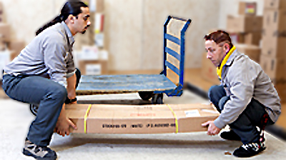
Helps by ‘interceding’
Rescue someone in very great danger with no resources of his own
“With, facing, lay hold”
Comforter, Counselor,
Helper

Slide 6
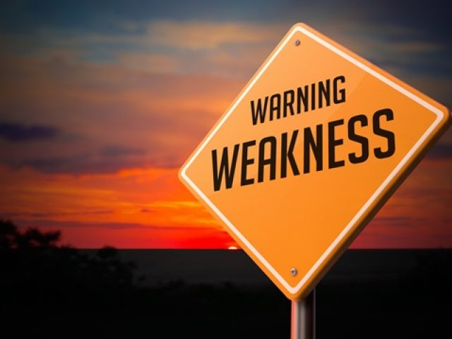
We neither suffer well nor wait as we should
We need to understand that we can’t live in salvation on our own
We know not what we ought to pray for

Slide 7
God of compassion 2 Cor. 1:3
a deep feeling about someone’s difficulties or misfortunes.
The Spirit Groans
I will tell of the kindnesses of the Lord, the deeds for which he is to be praised according to all the Lord has done for us - …according to his compassion and many kindnesses. In all their distress he too was distressed…In his love and mercy he redeemed them; he lifted them up and carried them all the days of old. ~ Isaiah 63:7, 9

Slide 8
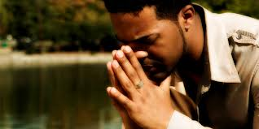
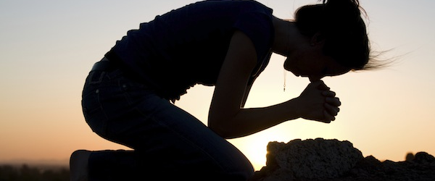
What Am I To Pray?
I don’t know…but the Spirit does!

Slide 9
Also, in the same way that hope keeps us going in
the middle of suffering, the Spirit is right by our side, grabbing hold of our burden with gusto and with just the right type of help we need. For we are frail.
In our human handicap we don’t know what is
necessary and thus we don’t know what we are to
pray for. Enter the Spirit Himself!
For our own benefit he hovers over us and
with sighs and groans inexpressible aligns our prayers.

Slide 10
Now the Heart Searcher intimately knows the
mindset and direction of the Spirit.
Namely that our Burden Bearer takes up our prayers, presenting them to God, in a manner that
harmonizes with God’s ultimate will.
His intercession is spot on, hits the mark exactly,
for the benefit and betterment of saints

