Slide 1
The suffering and glory
of the Creation
Romans 8:19-21

Slide 2
Romans: Salvation
The Need of Salvation
The Path of Salvation
The Results of Salvation
The Application of Salvation
Romans 8: Freedom from Death (in Christ)
I.
A.
B.
II.
From Gallows to Glory 8:1-17
In Christ we are freed from the gallows 8:1-4
How the Spirit gives life to freed people 8:4-17
The Blessings of Freed People 8:18-39

Slide 3
Romans 8:
Freedom from
Death
(in Christ)
In Christ we are freed from the gallows 8:1-4
What follows in this situation is this:
None! Right now! Absolutely no verdict of guilt and not one payment meted out in punishment to those in the ever-safe confines of Christ Jesus!
v.1
From Gallows to Glory 8:1-17

Slide 4
Romans 8:
Freedom from
Death
(in Christ)
In Christ we are freed from the gallows 8:1-4
For the power-principle of the Spirit of Life has fully exempted and released you from the liability of living under the burdensome law of a self-centered life that is a daily and forever death-sentence.
v.2
From Gallows to Glory 8:1-17

Slide 5
Romans 8:
Freedom from
Death
(in Christ)
In Christ we are freed from the gallows 8:1-4
For God’s law (holy and perfect as it was) was impossibly weak in that it was working with unholy and imperfect humans. Enter God himself! He sent his Son to humankind, real humanity himself but sinless. Covering all the bases concerning the power of sin over our lives, he pronounced condemnation on sin and carried out the sentence in Christ’s body.
v. 3
From Gallows to Glory 8:1-17

Slide 6
Romans 8:
Freedom from
Death
(in Christ)
In Christ we are freed from the gallows 8:1-4
The whole purpose of this is so that you could stand in the courtroom of Justice and by God himself be declared, not only acquitted, but right with God; thus measuring up to the Law’s perfect standard. This is granted to those whose day-by-day walk through life is no longer in human, self-centered living, but is a day-by-day life centered in God’s Spirit.
v. 4
From Gallows to Glory 8:1-17

Slide 7
Romans 8:
Freedom from
Death
(in Christ)
How the Spirit Gives Life to Freed People 8:5-17
Indeed those who are wrapped up in
self-centered living can only see life centered around themselves. They are ‘gods’ in their own little universe. But those who look outward to the Spirit and who are shaped by the breath of God, his Word, have a worldview bent toward Him and see things in the clear light of what the Spirit desires.
v.5
From Gallows to Glory 8:1-17

Slide 8
Romans 8:
Freedom from
Death
(in Christ)
How the Spirit Gives Life to Freed People 8:5-17
For those whose mind-set is centered in Me: Death! But to those who are swayed and bent by the gentle breath of God’s Spirit:
Life and Peace! V.6
On account of that, the one whose mindset is centered on Self is at war with God. “Me-centered” cannot follow God’s way or imitate his character. With sight focused on “Me”, he has no power to see God. V. 7
From Gallows to Glory 8:1-17

Slide 9
Romans 8:
Freedom from
Death
(in Christ)
How the Spirit Gives Life to Freed People 8:5-17
Indeed those who exist in the realm of Me have no idea how to please or serve God.
v.8
You, on the other hand, are not centered on Self but centered on the Spirit since the Spirit of God has made his home in you. However, those not centered on the Spirit of Christ are not a part of him.
v. 9
From Gallows to Glory 8:1-17

Slide 10
Romans 8:
Freedom from
Death
(in Christ)
How the Spirit Gives Life to Freed People 8:5-17
Moreover we affirm if Christ is in you, the physical body is dead, wearing out, because of sin. However, for our spirit, Life!... on account of righteousness
v.10
From Gallows to Glory 8:1-17

Slide 11
Romans 8:
Freedom from
Death
(in Christ)
How the Spirit Gives Life to Freed People 8:5-17
On top of all this, if the Spirit who raised Jesus from death has made his home in you, he who raised Christ Jesus from his grave will one day infuse Life in your mortal body because his Spirit is currently inhabiting you! v. 11
-
So then, we are in debt! We don’t owe our Selfish and Self-centered Self a nickel. We don’t deserve or owe anything to Me! V.12
From Gallows to Glory 8:1-17

Slide 12
Romans 8:
Freedom from
Death
(in Christ)
How the Spirit Gives Life to Freed People 8:5-17
For if one lives and exists for Me, then that person is knocking on the door of Death. But the one who is outward focused toward God’s Spirit and his ways are in a constant battle. You continually put up a fight to the death each time Selfish Me raises its head in defiance of God. And this daily battle isn’t through one’s own power, but by the Spirit’s strength in you. By fighting Selfish Me, you will live!
V. 13
From Gallows to Glory 8:1-17

Slide 13
Romans 8:
Freedom from
Death
(in Christ)
How the Spirit Gives Life to Freed People 8:5-17
For all those who are walking hand in hand with the Spirit, going from one daily fight with Self to the next, ever moving toward Christlikeness – these (and only these) are sons and daughters of God. v. 14
Because you are sons and daughters of God, you absolutely did not cling, as you once did, to a disposition of slavish fear. On the contrary, you embraced the temperament of an adoptive child in which the whole of your being swells up in a cry of joy, “Oh, daddy, Father!” v. 15
From Gallows to Glory 8:1-17

Slide 14
Romans 8:
Freedom from
Death
(in Christ)
How the Spirit Gives Life to Freed People 8:5-17
The Holy Spirit himself daily stands as a co-witness with our spirit in the court of heaven and earth declaring: “Children of God!” v. 16
Since we are indeed children of God, we have an inheritance – a portion of God himself! We have a joint inheritance with Christ as we jointly suffer with him to the culminating time of joint glorification with him. V. 17
From Gallows to Glory 8:1-17

Slide 15
Romans 8:
Freedom from
Death
(in Christ)
Glory and Suffering Contrasted 8:18-30
I have thought long and hard about this and have finally settled on this conclusion:
I place suffering on one side of a balance scale; all the pain, heartaches and persecutions that we are currently experiencing… and it is only feather-dust. The coming glory is on the other side of the scales; a Christlikeness unimaginable, a homecoming unheard of, the smile of the Father as I walk through the door hearing his voice say, “Well done, lad!
Well done, lass!” A weight of glory! V. 18
From Gallows to Glory 8:1-17
The Blessings of Freed People
8:18-39

Slide 16
The Suffering and Glory of the Creation 8:19-21
The Creation waits in eager expectation
for the sons of God to be revealed.
For the creation was subjected to frustration,
not by its own choice, but by the will of the one who subjected it, in hope that the creation itself will be liberated from its bondage to decay and brought into the glorious freedom of the children of God

Slide 17
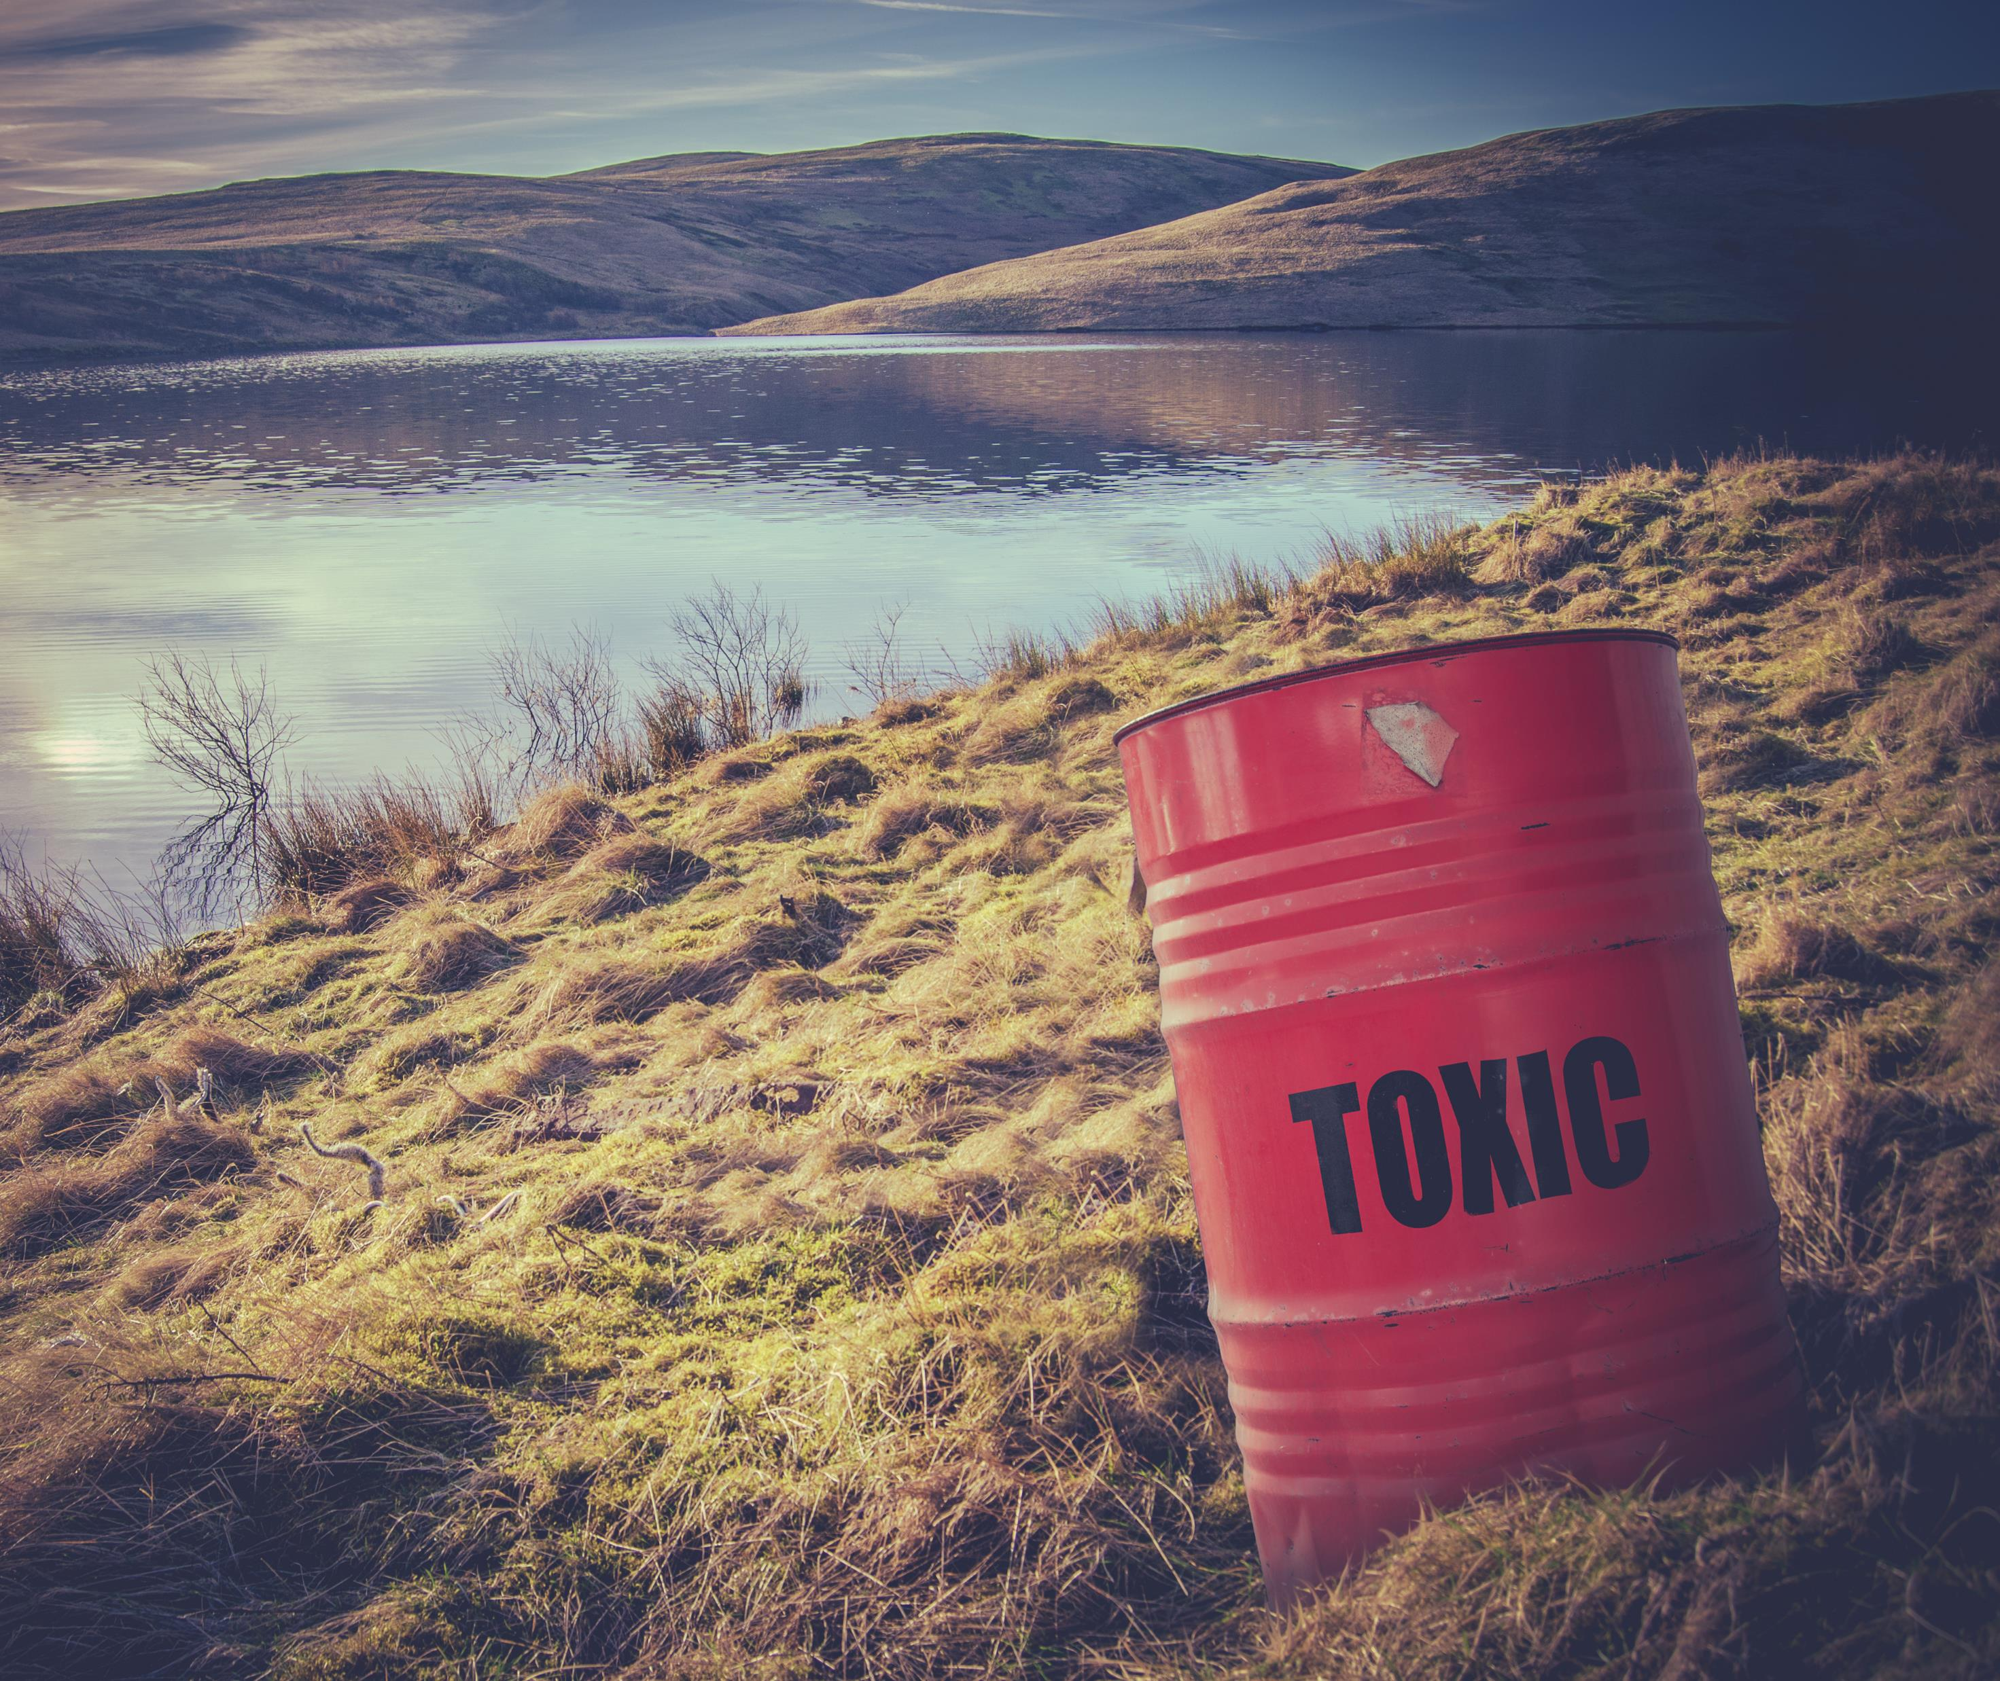
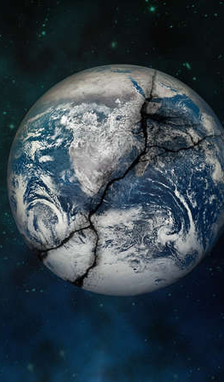
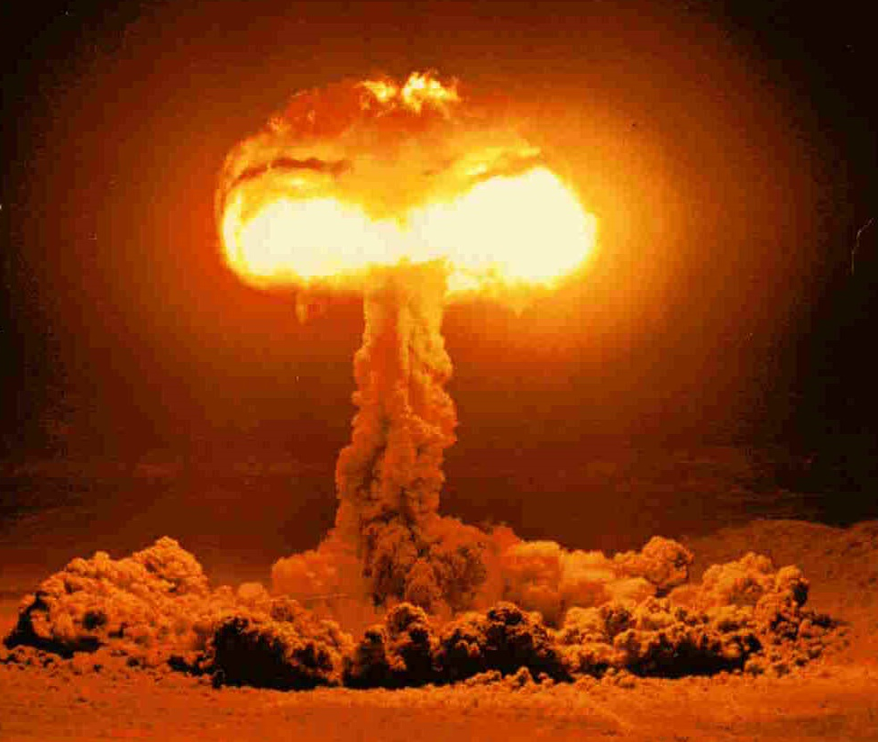
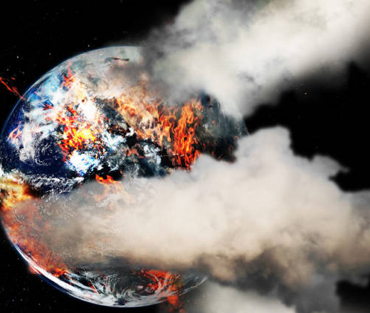
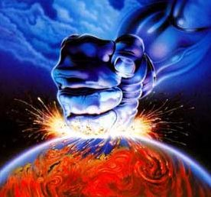
What is the future
for the earth?

Slide 18
The Scripture tells us of creation’s
present suffering & coming glory
The mountains and hills will burst into song before you, and all the trees of the field will clap their hands.
Isaiah 55:12
Frustration: “vain” or “purposelessness” or “futility”
Eagar expectation: a visual picture of a person intensely looking with head outstretched.

Slide 19
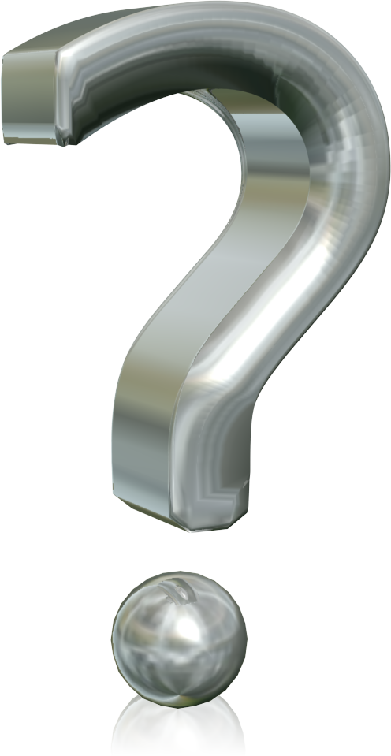
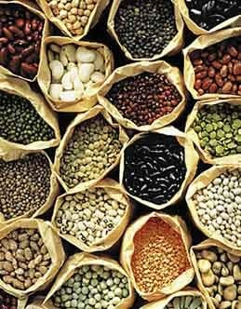
1 Corinthians 15:32ff

Slide 20
For with neck craning, eyes opened wide and ears pricked up in attention, the creation with eager anticipation waits for the final curtain to rise
revealing the sons and daughters of God.
For it so happened that the creation long ago
was locked under a sort of tyrannical aimlessness,
an instability, a wandering in purposeless meaning.
Not of its own accord, but because God
ordered creation into this submission.

Slide 21
Now, on the basis of hope, the creation lives in a
sure and certain expectation that it will be emancipated from this slavery of decay and destruction that now runs rampant all through its system and will one day merge into the freedom of the glory of the children of God.

