Slide 1
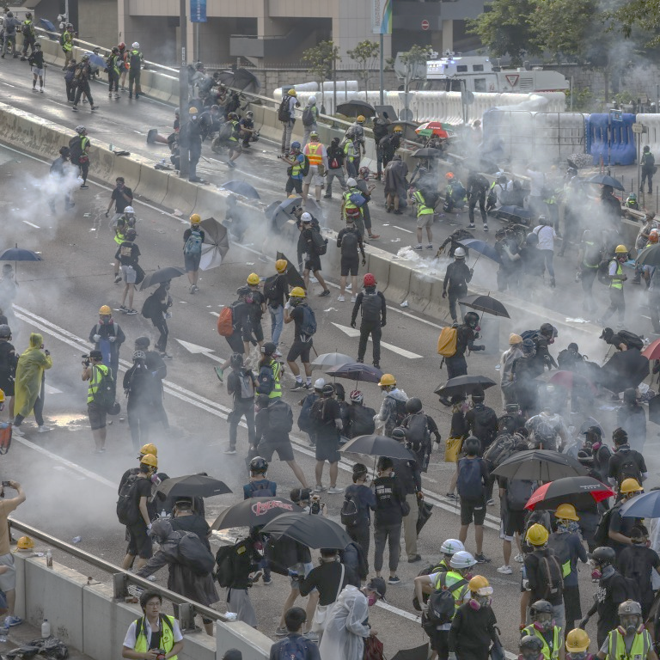
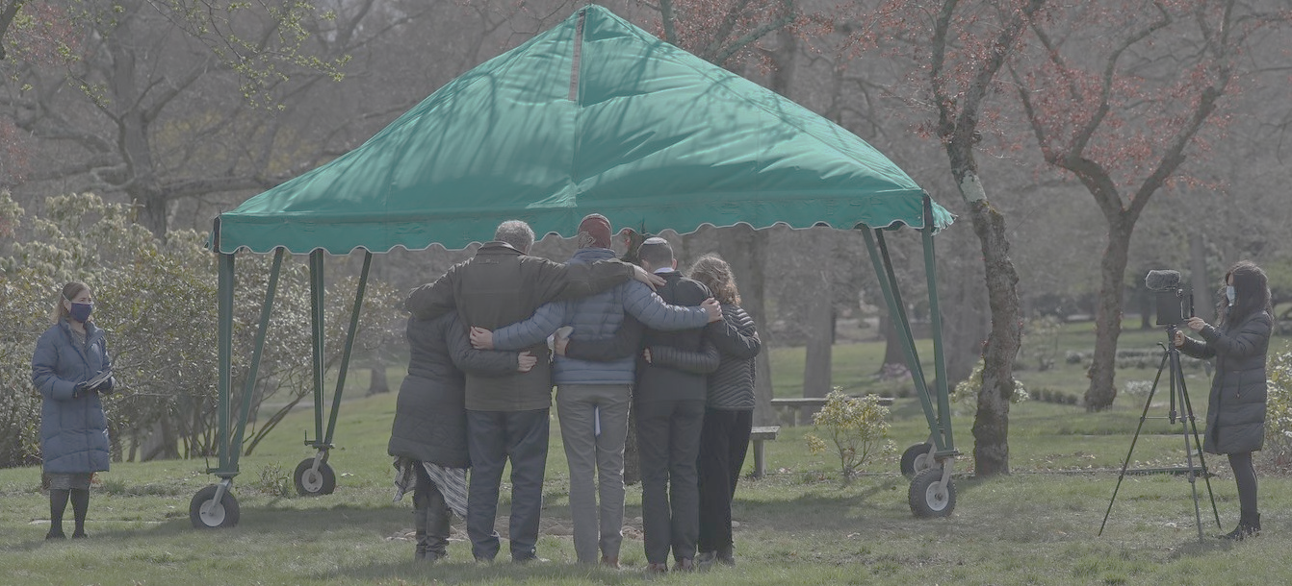
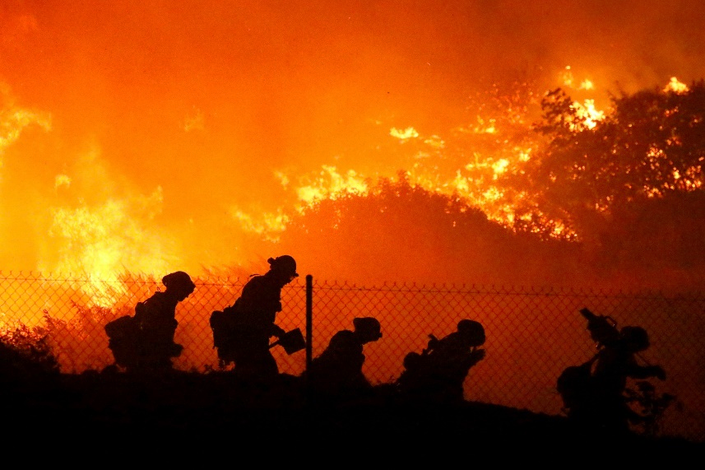
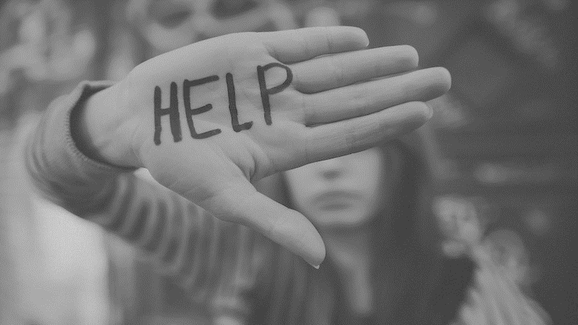
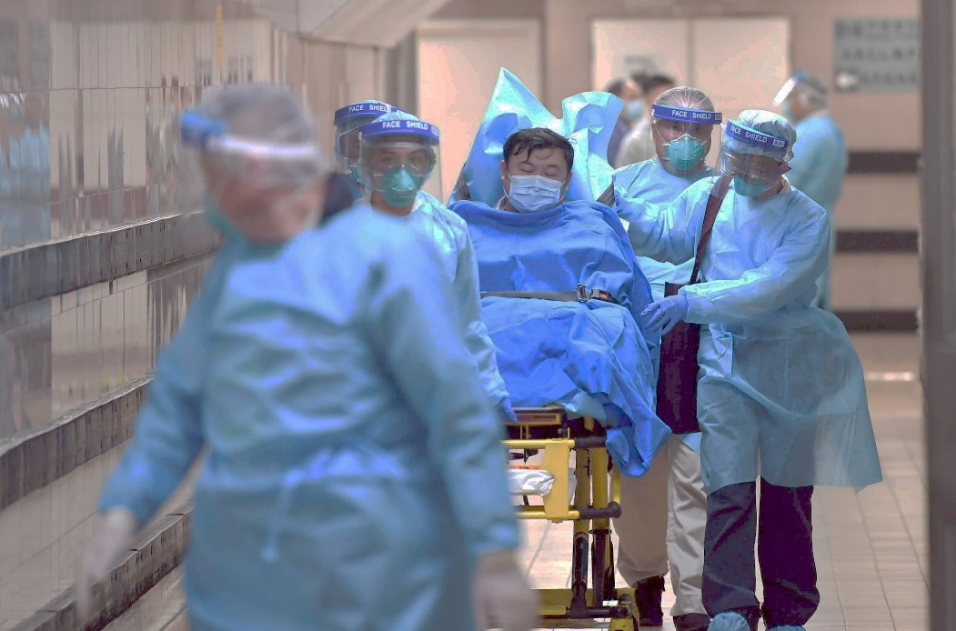
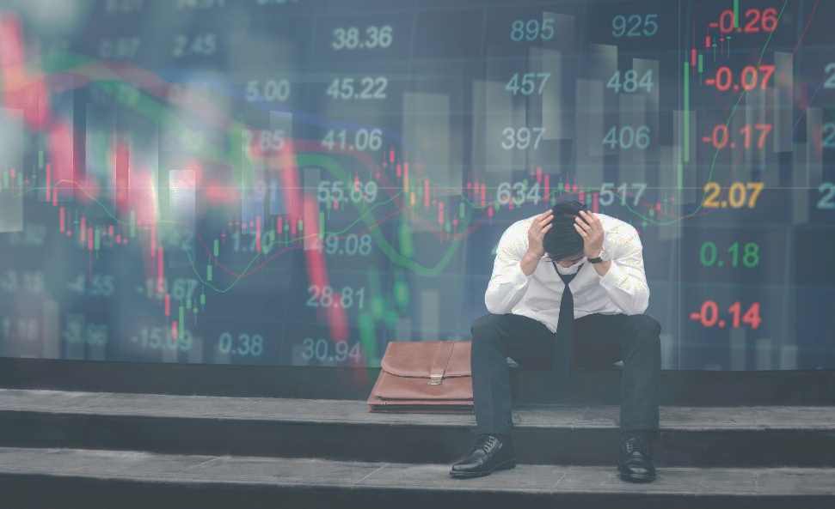
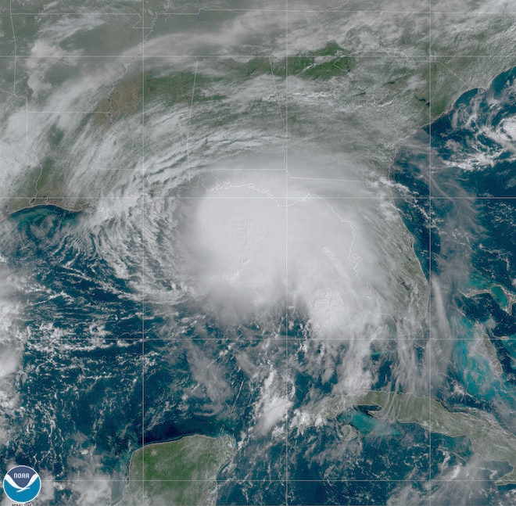
A Spiritual Debrief of our Social Crisis

Slide 2
Count it all joy, my brothers, when you meet trials of various kinds, for you know that the testing of your faith produces steadfastness. And let steadfastness have its full effect, that you may be perfect and complete, lacking in nothing. -- James 1:2-4

Slide 3
If any of you lacks wisdom, let him ask God, who gives generously to all without reproach, and it will be given him. But let him ask in faith, with no doubting, for the one who doubts is like a wave of the sea that is driven and tossed by the wind. For that person must not suppose that he will receive anything from the Lord; he is a double-minded man, unstable in all his ways. -- James 1:5-8

Slide 4
The Key to Surviving a Storm is to “Bend without Breaking”

Slide 5
ADAPTABILITY

Slide 6
And he gave the apostles, the prophets, the evangelists, the shepherds and teachers, to equip the saints for the work of ministry, for building up the body of Christ, until we all attain to the unity of the faith and of the knowledge of the Son of God, to mature manhood, to the measure of the stature of the fullness of Christ, -- Ephesians 4:11-13

Slide 7
so that we may no longer be children, tossed to and fro by the waves and carried about by every wind of doctrine, by human cunning, by craftiness in deceitful schemes. -- Ephesians 4:14

Slide 8
Rather, speaking the truth in love, we are to grow up in every way into him who is the head, into Christ, from whom the whole body, joined and held together by every joint with which it is equipped, when each part is working properly, makes the body grow so that it builds itself up in love.
-- Ephesians 4:15,16

Slide 10
When neither sun nor stars appeared for many days, and no small tempest lay on us, all hope of our being saved was at last abandoned. -- Acts 27:20

Slide 11
Since they had been without food for a long time, Paul stood up among them and said, “Men, you should have listened to me and not have set sail from Crete and incurred this injury and loss. Yet now I urge you to take heart, for there will be no loss of life among you, but only of the ship. For this very night there stood before me an angel of the God to whom I belong and whom I worship, and he said, ‘Do not be afraid, Paul; you must stand before Caesar. And behold, God has granted you all those who sail with you.’ So take heart, men, for I have faith in God that it will be exactly as I have been told. But we must run aground on some island.” -- Acts 27:21-26

Slide 12
Paul said to the centurion and the soldiers, “Unless these men stay in the ship, you cannot be saved.” -- Acts 27:31

Slide 13
And when he had said these things, he took bread, and giving thanks to God in the presence of all he broke it and began to eat. Then they all were encouraged and ate some food themselves.
-- Acts 27:35,36

Slide 14
So they cast off the anchors and left them in the sea, at the same time loosening the ropes that tied the rudders. Then hoisting the foresail to the wind they made for the beach. But striking a reef, they ran the vessel aground. The bow stuck and remained immovable, and the stern was being broken up by the surf.
-- Acts 27:40,41

Slide 15
… And so it was that all were brought safely to land.
-- Acts 27:44

Slide 16
“Stay With The Ship”

Slide 17
because they formerly did not obey, when God's patience waited in the days of Noah, while the ark was being prepared, in which a few, that is, eight persons, were brought safely through water.
-- 1 Peter 3:20

Slide 18
holding faith and a good conscience. By rejecting this, some have made shipwreck of their faith, -- 1 Timothy 1:19

Slide 19
“Stay With The Ship”

Slide 20
We have this as a sure and steadfast anchor of the soul, a hope that enters into the inner place behind the curtain, where Jesus has gone as a forerunner on our behalf, having become a high priest forever after the order of Melchizedek. -- Hebrews 6:19,20

Slide 21
“Anchor Versus Cultural Currents”

Slide 22
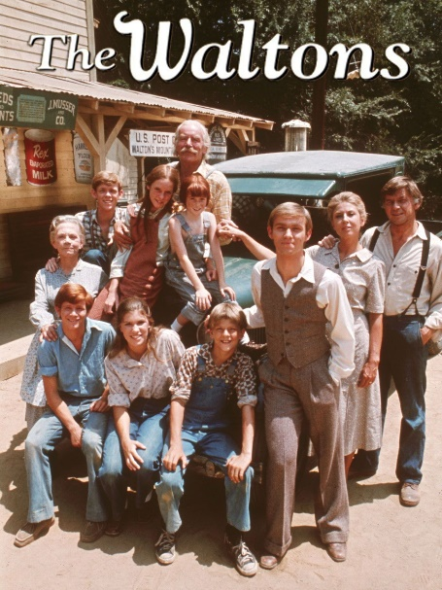

Slide 23
Therefore we must pay much closer attention to what we have heard, lest we drift away from it.
-- Hebrews 2:1

Slide 24
“Anchor Versus Cultural Currents”

Slide 25
“Anchor Versus Heart Winds”

Slide 26
“Some of us measure our insides to everyone else’s outsides”

Slide 27
“Anchor Deep In Jesus”

Slide 28
Blessed is the man who
WALKS not in the counsel of the wicked, nor
STANDS in the way of sinners, nor SITS in the seat of scoffers; -- Psalm 1:1

Slide 29
but his delight is in the law of the Lord, and on his law he meditates day and night. -- Psalm 1:2

Slide 30
He is like a tree planted by streams of water that yields its fruit in its season, and its leaf does not wither.
In all that he does, he prospers. -- Psalm 1:3

Slide 31
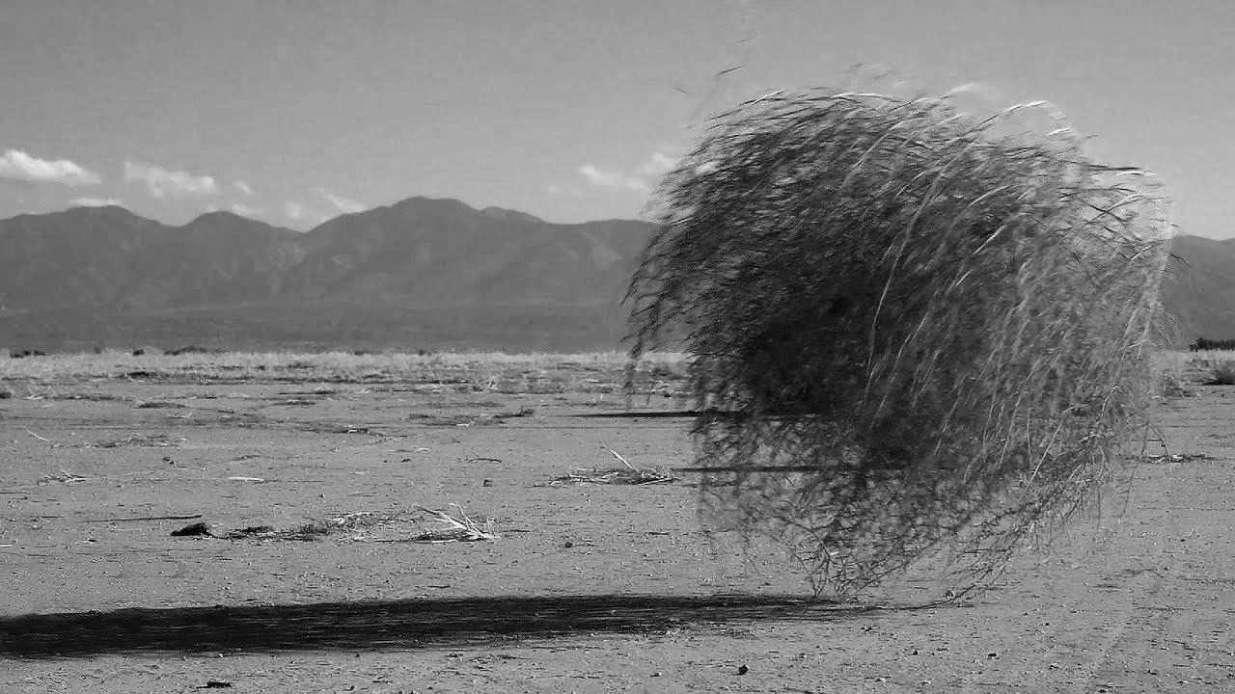
The wicked are not so but are like chaff that the wind drives away.
-- Psalm 1:4

Slide 32
“Let Jesus Be The Anchor of Your Soul.”

