Slide 1
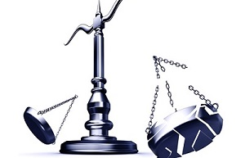
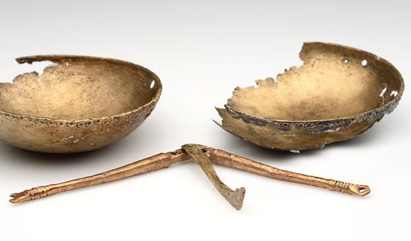
I consider that our present sufferings are not worth comparing with the glory that will be revealed in us
Broken
Balance Scales
Romans 8:18

Slide 2
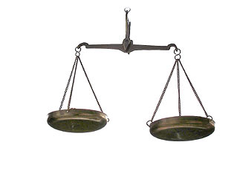
Our suffering placed on a scale
…not worth comparing

Slide 3
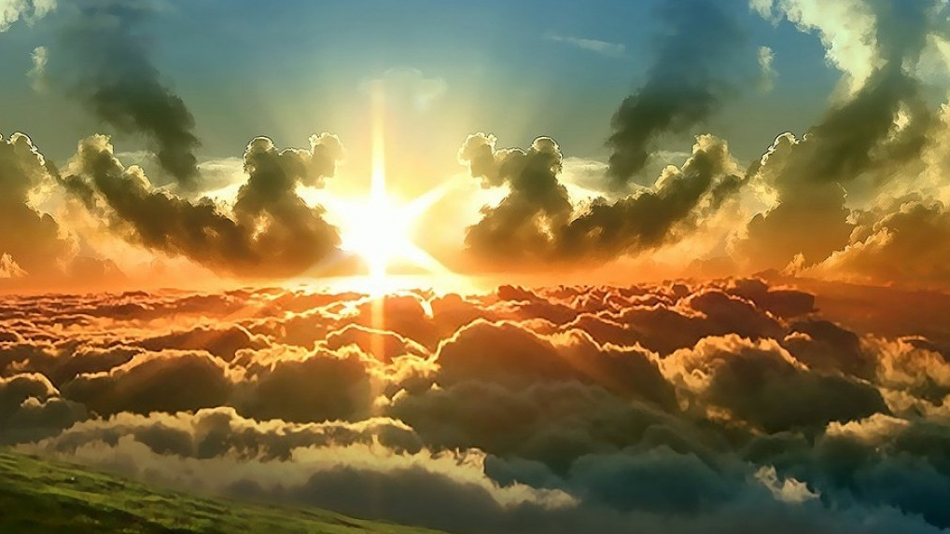
A cultural memory of glory lost
Glory
Adam & Eve:
From glory to Ichabod

Slide 4
Glory is life in Christ
The god of this age has blinded the minds of unbelievers, so that they cannot see the light of the gospel of the glory of Christ, who is the image of God. For we do not preach ourselves, but Jesus Christ as Lord, and ourselves as your servants for Jesus’ sake. For God, who said, “Let light shine our of darkness,” made his light shine in our hearts to give us the light of the knowledge of the glory of God in the face of Christ. If the ministry that condemns men is glorious, how much more glorious is the ministry that brings righteousness! For what was glorious has no glory now in comparison with the surpassing glory. And if what was fading away came with glory, how much greater is the glory of that which lasts! Ad we, who with unveiled faces all reflect the Lord’s glory, are being transformed into his likeness with ever-increasing glory, which comes from the Lord, who is the Spirit ~ 2 Cor. 4:4-6; 3:9-11, 18

Slide 5
Glory is being Noticed by God
But the man who loves God is known by God
1 Cor. 8:3
“Guilt was not my problem as I felt it. What I felt most was a glob of unworthiness that I could not tie down to any concrete sins I was guilty of. What I needed more than pardon was a sense that God accepted me, owned me, held me, affirmed me, and would never let go of me even if he was not too much impressed with what he had on his hands”

Slide 6
The Glorious work of Christ will be
brought to a glorious end
Therefore we do not lose heart. Though outwardly we are wasting away, yet inwardly we are being renewed day by day. For our light and momentary troubles are achieving for us an eternal glory that far outweighs them all. So we fix our eyes not on what is seen, but on what is unseen. For what is seen is temporary, but what is unseen is eternal. ~ 2 Cor. 4:16-18

Slide 7
Wake up, O sleeper, rise from the dead and Christ will shine on you
Eph. 5:14
But our citizenship is in heaven. And we eagerly await a Savior from there, the Lord Jesus Christ, who by the power that enables him to bring everything under his control, will transform our lowly bodies so that they will be like his glorious body.
Phil. 3:20,21

Slide 8
I have thought long and hard about this and
have finally settled to this conclusion:
I place suffering on one side of a balance scale; all the pain, heartaches and persecutions that we are currently experiencing… and it is only feather-dust.
The coming glory is on the other side of the scales:
a Christlikeness unimaginable, a homecoming unheard of,
the smile of the Father as I walk through the door
hearing his voice say, “Well done, lad! Well done, lass!”
A weight of glory!

