Slide 1
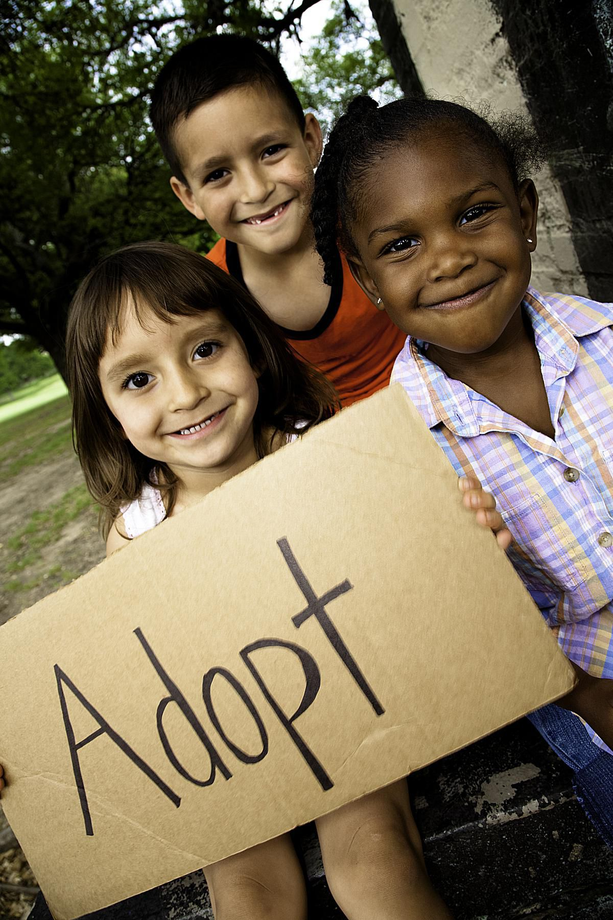
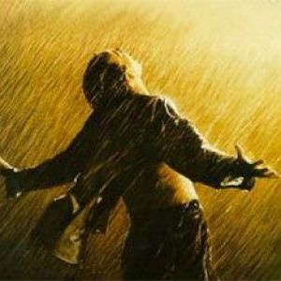
The Cry of Adoption
Romans 8:15

Slide 2
(we) are sons of God.
For you did not receive a spirit that makes
you a slave again to fear, but you received the Spirit of sonship. And by him we cry,
“Abba, Father.”
Romans 8:14b, 15

Slide 3
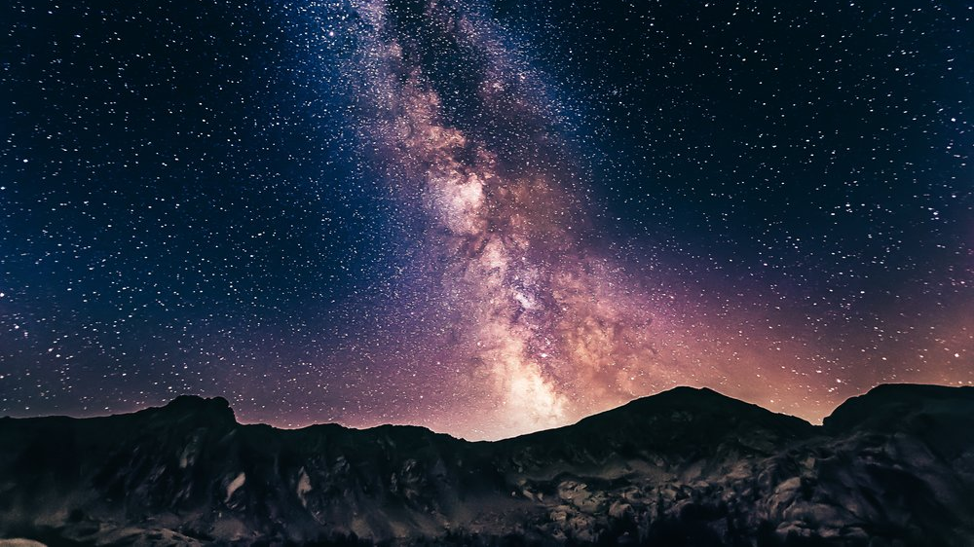
Adam: son of God Luke 3:38
Israel: son of God “Israel is my first-born son Ex. 4:22
Kings: sons of God “I will be his father, and he will be my son” 2 Samuel 7:14
Jesus: Son of God “This is my beloved Son Matt. 3:17
“You are the Son of the living God Matt. 16:16
“The Son is the radiance of God’s glory…you are my Son…Hebrews 1.
SONS
and daughters
Relationship, inheritance, carrying on a family line

Slide 4
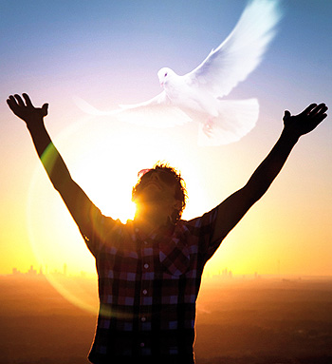
For you did not receive a spirit that makes you a slave again to fear, but you received the Spirit of sonship.
Romans 8:15a
Two Spirits
God gave them a “spirit” of stupor – Romans 11:8
You did not receive a disposition of fear, but you received an attitude of adoption
For you did not receive a spirit … to fear, but you received a spirit of sonship (or adoption).
Romans 8:15a

Slide 5
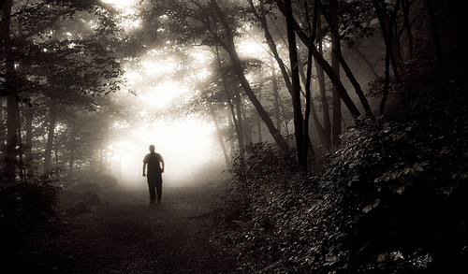
For God did not give us a spirit of timidity, but a spirit of power, of love and of self-discipline
2 Timothy 1:7
Attitude not of fear
but of adoption
There is no fear in love. But perfect love drives out fear, because fear has to do with punishment
1 John 4:18

Slide 6
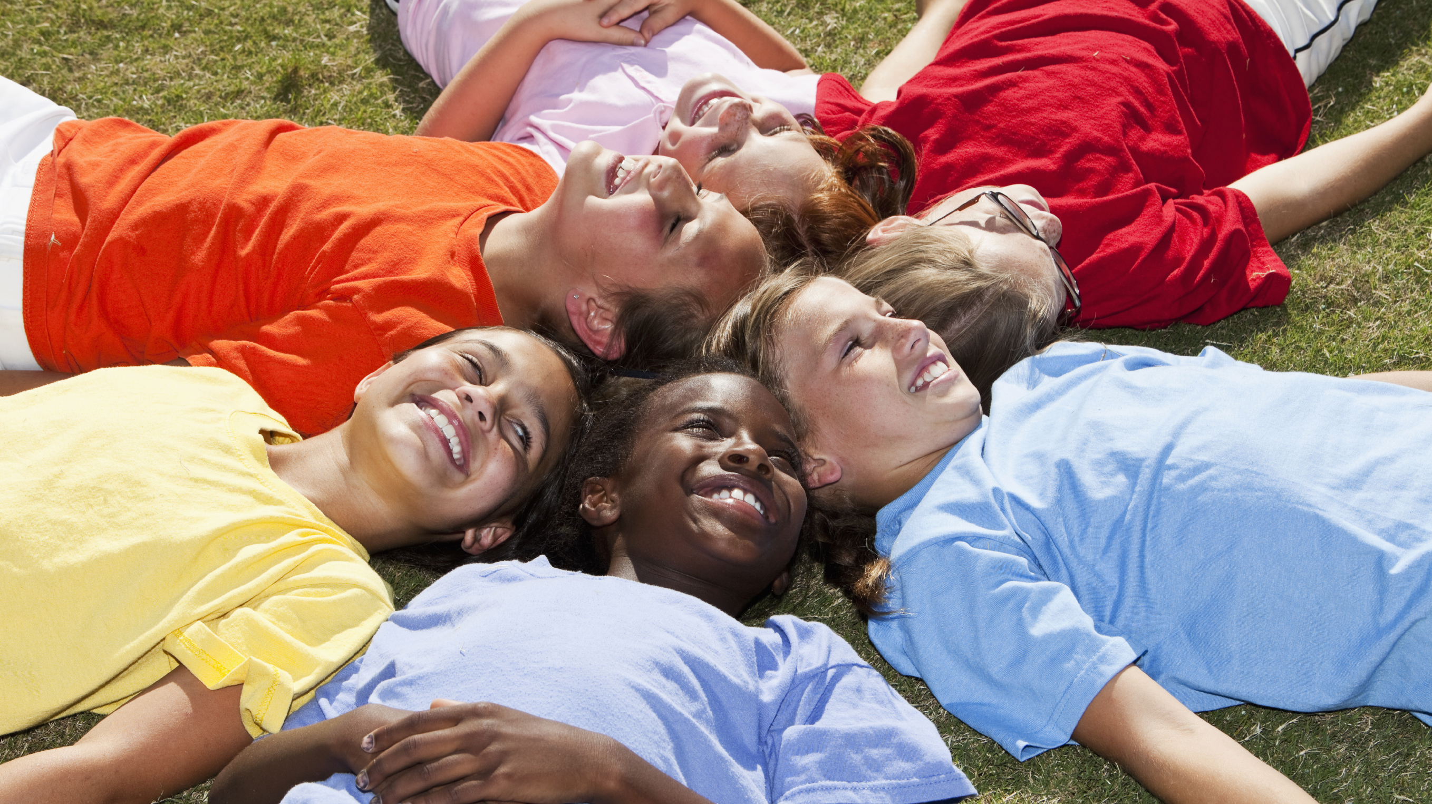
As for you, you were dead…when you followed the ways of this world…gratifying the cravings…objects of wrath. But because of his great love for us…
Ephesians 2:1-4
How great is the love the Father has lavished on us, that we should be called children of God! And that is what we are!
1 John 3:1
The Emotions of the Adopted

Slide 7
…God has poured out his love into our hearts
by the Holy Spirit, who he has given us.
You see, at just the right time, when we were still powerless, Christ died for the ungodly. Vary rarely
will anyone die for a righteous man, though for
a good man someone might possibly dare to die.
But God demonstrates his own love for us in this: While we were still sinners, Christ died for us.
Romans 5:5b-8

Slide 8
So, then – We are in debt!
We don’t owe our Selfish and Self-centered Self a nickel. We don’t deserve or owe anything to Me!
For if one lives and exists for Me, then that person is knocking on the door of Death.

Slide 9
But the one who is outward focused toward
God’s Spirit and his ways are in a constant battle.
You continually put up a fight to the death
each time Selfish Me raises its head in defiance of God. And this daily battle isn’t through one’s own power
but by the Spirit’s strength in you.
By fighting Selfish Me, you will live

Slide 10
For all those who are walking hand-in-hand
with the Spirit, going from one daily fight with
Self to the next, ever moving toward Christlikeness – these (and only these) are sons and daughters of God.

Slide 11
Because you are sons and daughters of God you absolutely did not clasp, as you once did,
to a disposition of slavish fear.
On the contrary, you embraced the
temperament of an adoptive child in which
the whole of your being swells up in a cry of joy,
“Oh, Daddy, Father!”

