Slide 1
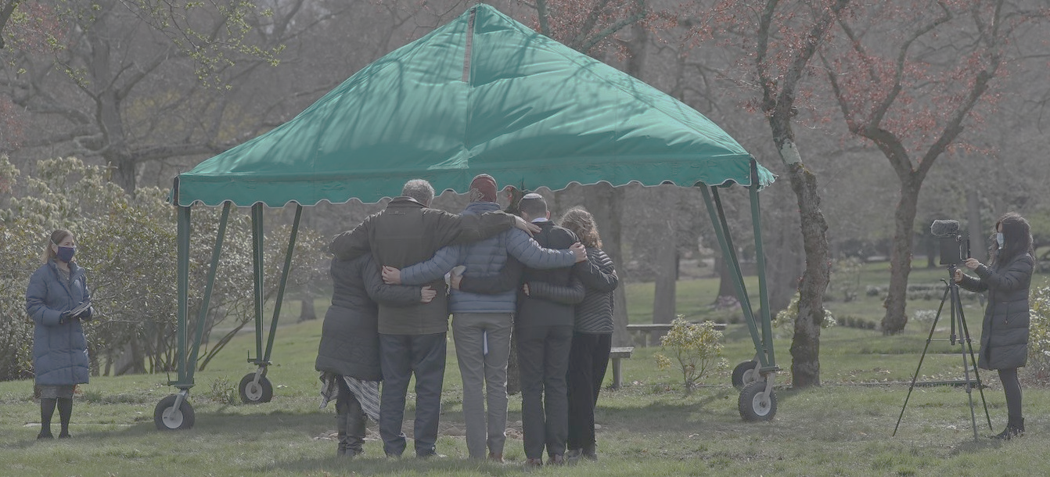
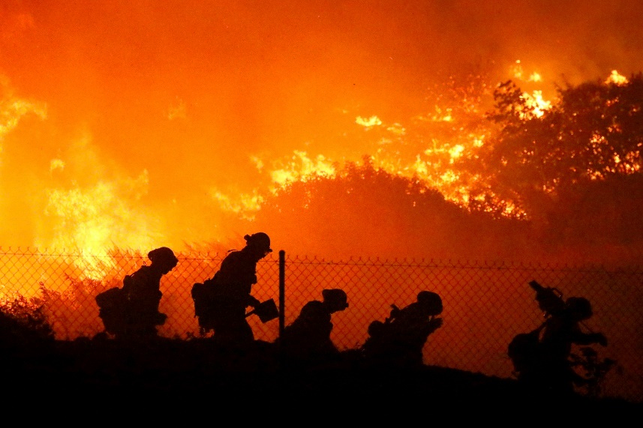
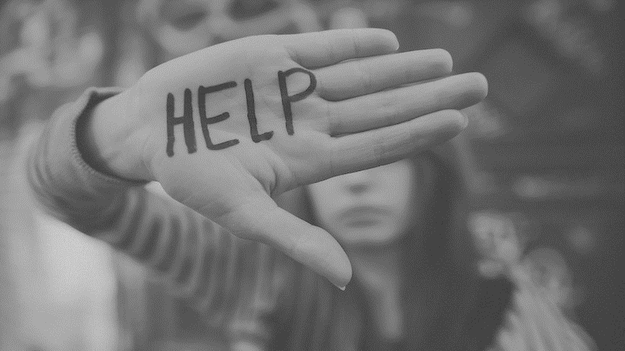
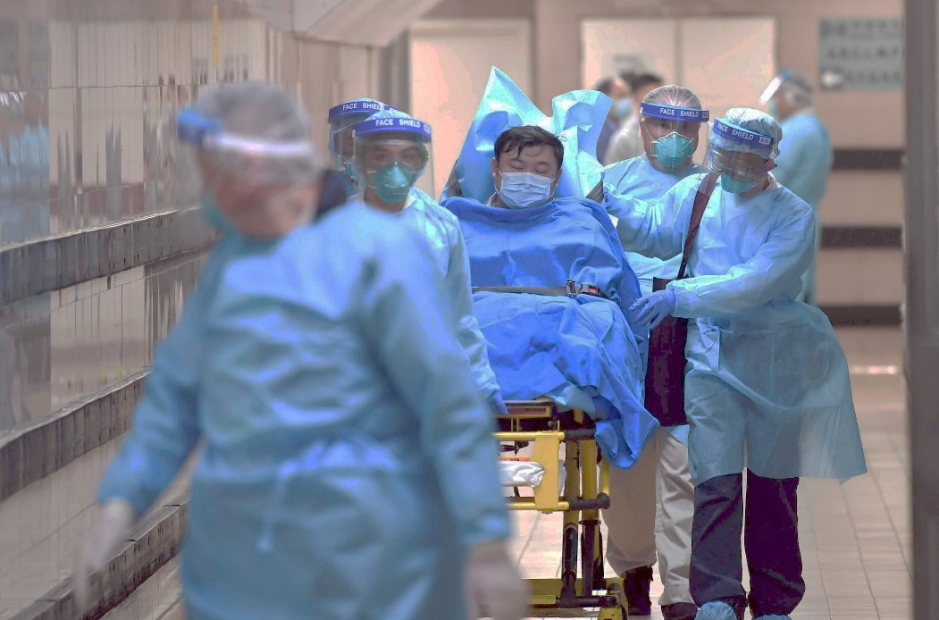
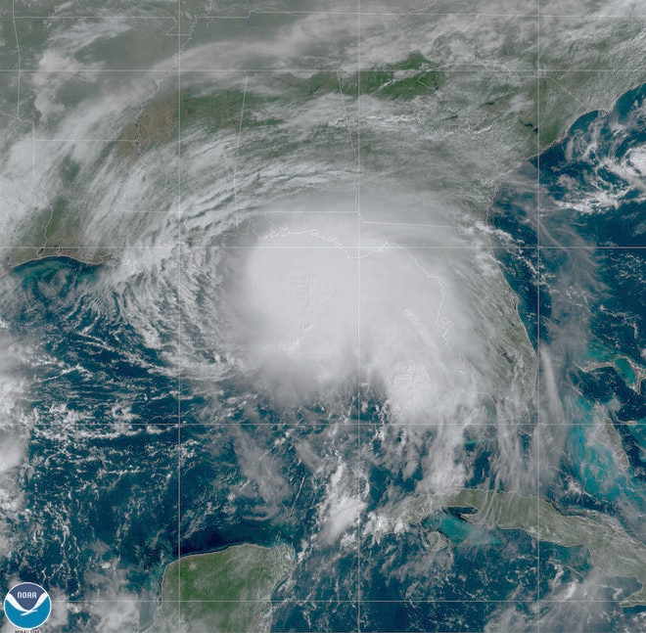
A Spiritual Debrief of our Social Crisis

Slide 2
Therefore let us be grateful for receiving a kingdom that cannot be shaken, and thus let us offer to God acceptable worship, with reverence and awe, for our God is a consuming fire. – Hebrews 12:28,29

Slide 3
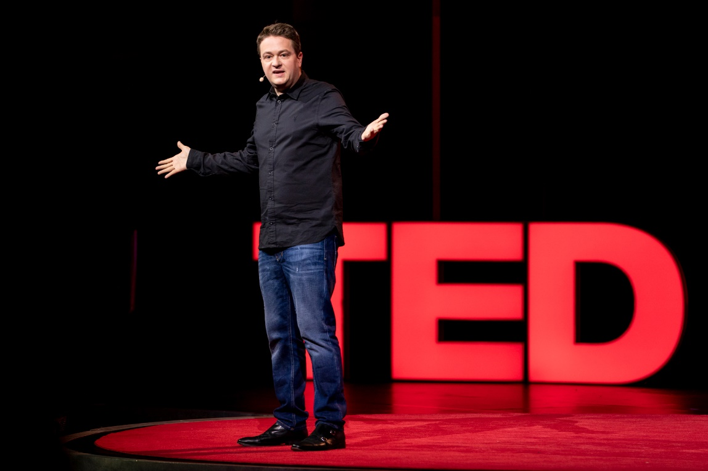
“The opposite of addiction is not sobriety. The opposite of addiction is connection.”
-Johann Hari (TED Talk 2015)
Author of New York Times Best Seller “Lost Connections”

Slide 4
And the Lord God commanded the man, saying, “You may surely eat of every tree of the garden, but of the tree of the knowledge of good and evil you shall not eat, for in the day that you eat of it you shall surely die.” – Genesis 2:16,17

Slide 5
Now the serpent was more crafty than any other beast of the field that the Lord God had made. He said to the woman, “Did God actually say, ‘You shall not eat of any tree in the garden’?” And the woman said to the serpent, “We may eat of the fruit of the trees in the garden, but God said, ‘You shall not eat of the fruit of the tree that is in the midst of the garden, neither shall you touch it, lest you die.” But the serpent said to the woman, “You will not surely die. For God knows that when you eat of it your eyes will be opened, and you will be like God, knowing good and evil.”
-- Genesis 3:1-5

Slide 6
Then the Lord God said, “Behold, the man has become like one of us in knowing good and evil. Now, lest he reach out his hand and take also of the tree of life and eat, and live forever—” -- Genesis 3:22

Slide 7
Behold, the Lord's hand is not shortened, that it cannot save, or his ear dull, that it cannot hear; but your iniquities have made a separation between you and your God, and your sins have hidden his face from you so that he does not hear. – Isaiah 59:1-2

Slide 8
“For God so loved the world, that he gave his only Son, that whoever believes in him should not perish but have eternal life.” – John 3:16

Slide 9
The thief comes only to steal and kill and destroy. I came that they may have life and have it abundantly. – John 10:10

Slide 10
I am the vine; you are the branches. Whoever abides in me and I in him, he it is that bears much fruit, for apart from me you can do nothing. – John 15:5

Slide 11
These things I have spoken to you, that my joy may be in you, and that your joy may be full.
– John 15:11

Slide 12
All Scripture is God-breathed and is useful for teaching, rebuking, correcting and training in righteousness -- 2 Timothy 3:16

Slide 13
Then the Lord God said, “Behold, the man has become like one of us in knowing good and evil. Now, lest he reach out his hand and take also of the tree of life and eat, and live forever—” -- Genesis 3:22

Slide 14
Then the angel showed me the river of the water of life, bright as crystal, flowing from the throne of God and of the Lamb through the middle of the street of the city; also, on either side of the river, the tree of life with its twelve kinds of fruit, yielding its fruit each month. The leaves of the tree were for the healing of the nations. – Revelation 22:1,2

Slide 15
Blessed are those who wash their robes, so that they may have the right to the tree of life and that they may enter the city by the gates. – Revelation 22:14

Slide 16
“The opposite of addiction is not sobriety. The opposite of addiction is connection.”
-Johann Hari (TED Talk 2015)
Author of New York Times Best Seller “Lost Connections”
“Sobriety is ultimately the connection to life.”

