Slide 1
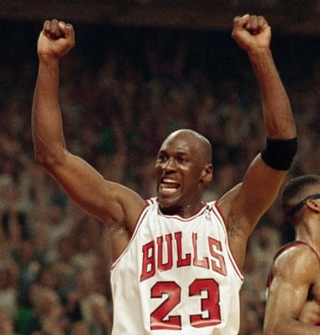
God
Did
It!
Romans 8:3,4
Thoughts? Questions? sermonthoughts@yahoo.com

Slide 2
For what the law was powerless
to do in that it was weakened by
the sinful nature, God did by sending his own Son in the likeness of sinful man to be a sin offering. And so he condemned sin in sinful man, in order that the righteous requirements of the law might be fully met in us, who do not live according to the sinful nature but according to the Spirit.
Romans 8:3,4
God Did It!

Slide 3
Chapter 5 Free from Wrath
Chapter 6 Free from Sin
Chapter 7 Free from Law
Chapter 8 Free from Death

Slide 4
If only we had died by the Lord’s hand in Egypt!
There we sat around pots of meat and ate all the food we wanted, but you have brought us out into this desert to starve this entire assembly to death
Exodus 16:3
Therefore, there is now no condemnation
for those who are in Christ Jesus because through Christ Jesus the law of the Spirit of life set me free from the law of sin and death
Romans 8:1,2

Slide 5
God
Did
It!

Slide 6
VIDEO

Slide 7
God
Did
It!
The two things we wish so badly to get rid of:
sin and death
- we were powerless to do.
God did it.
“God himself”
The law was powerless to help us

Slide 8
“My food,” said Jesus, “is to do the will of him who sent me and to finish his work”
John 4:34
How God
Did
It!
He who does not honor the Son does not honor the Father, who sent him.
John 5:23
God sent: “My Sender”

Slide 9
How God
Did
It!
“I tell you the truth, whoever hears my word and believes him who sent me has eternal life and will not be condemned, he has crossed over from death to life
John 5:24
God sent: “My Sender”

Slide 10
“By myself I can do nothing; I judge only as I hear, and my judgement is just, for I seek not to please myself but him who sent me.” ~ John 5:30
How God
Did
It!
And this is the will of him who sent me, that I shall lose none of all that he has given me, but raise them up at the last day
John 6:38
God sent: “My Sender”

Slide 11
Condemned Sin
What God
Did !
Law was broken –
justice must be served,
or God is not just.
God, did not condemn you,
but condemned the sin
placed on Christ
(Two things)

Slide 12
Righteousness fulfilled in YOU!
What God
Did !
The positive side of justice: restoration, completion, fullness – life as it was meant to be
Unbelievable Good News!
(Two things)

Slide 13
Therefore, if anyone is in Christ, he is a new creation; the old has gone, the new has come! All this is from God, who reconciled us to himself through Christ and gave us the ministry of reconciliation; that God was reconciling the world to himself in Christ, not counting men’s sins against them. And he has committed to us the message of reconciliation. We are therefore Christ’s ambassadors, as though God were making his appeal through us. We implore you on Christ's behalf: Be reconciled to God. God made him who had no sin to be sin for us, so that in him we might become the righteousness of God
2 Cor. 5:17-21

Slide 14
What follows in this situation is this:
None! Right now! Absolutely no verdict of guilt
and not one payment meted out in punishment to those in the ever-safe confines of Christ Jesus!
For the power-principle of the Spirit of Life has fully exempted and released you from the liability of living under the burdensome law of a self-centered life that is a daily and forever death-sentence.

Slide 15
For God’s law (holy and perfect as it was)
was impossibly weak in that it was working
with unholy and imperfect humans.
Enter God himself!
He sent his Son to humankind,
real humanity himself, but sinless.
Covering all the bases concerning the power of sin
over our lives, he pronounced condemnation
on sin and carried out the sentence in Christ’s body.

Slide 16
The whole purpose of this was so that you
could stand in the courtroom of Justice and by God himself be declared, not only acquitted, but right
with God; thus measuring up to the Law’s perfect standard. This is granted to those whose day-by-day walk through life is no longer in human, self-centered living but is a day-by-day life centered in God’s Spirit.

