Slide 1
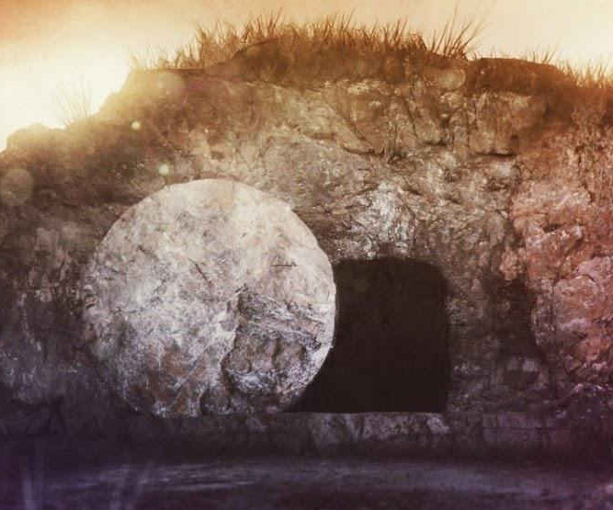
Romans 8:1,2

Slide 2
Therefore, there is now no condemnation for those who are in Christ Jesus, because through Christ Jesus the law of the Spirit of life set me free from the law of sin and death
Romans 8:1,2

Slide 3
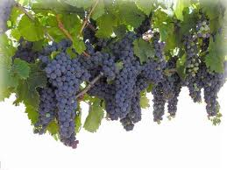
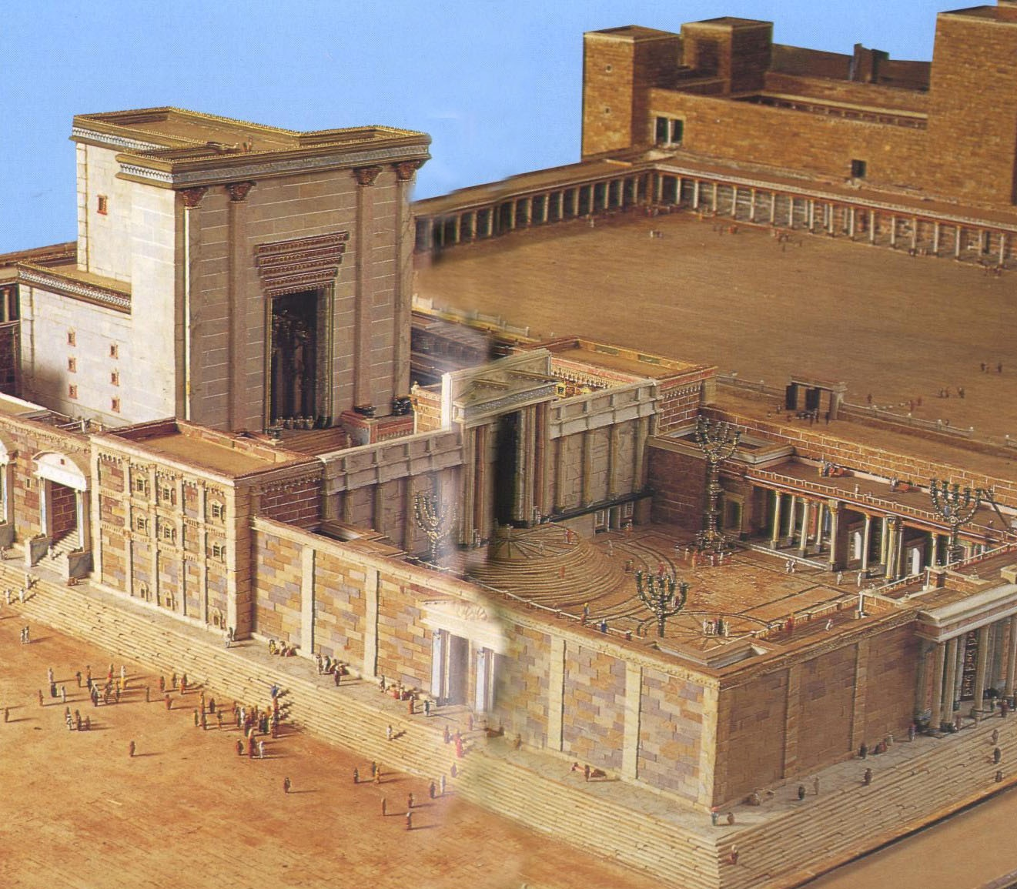
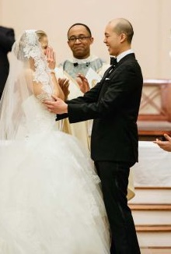
The answer is a person, not one’s ability
“Who shall deliver me?” not “What do I need to do”.
“In Christ”
vine and branches
body
Temple
Marriage

Slide 4
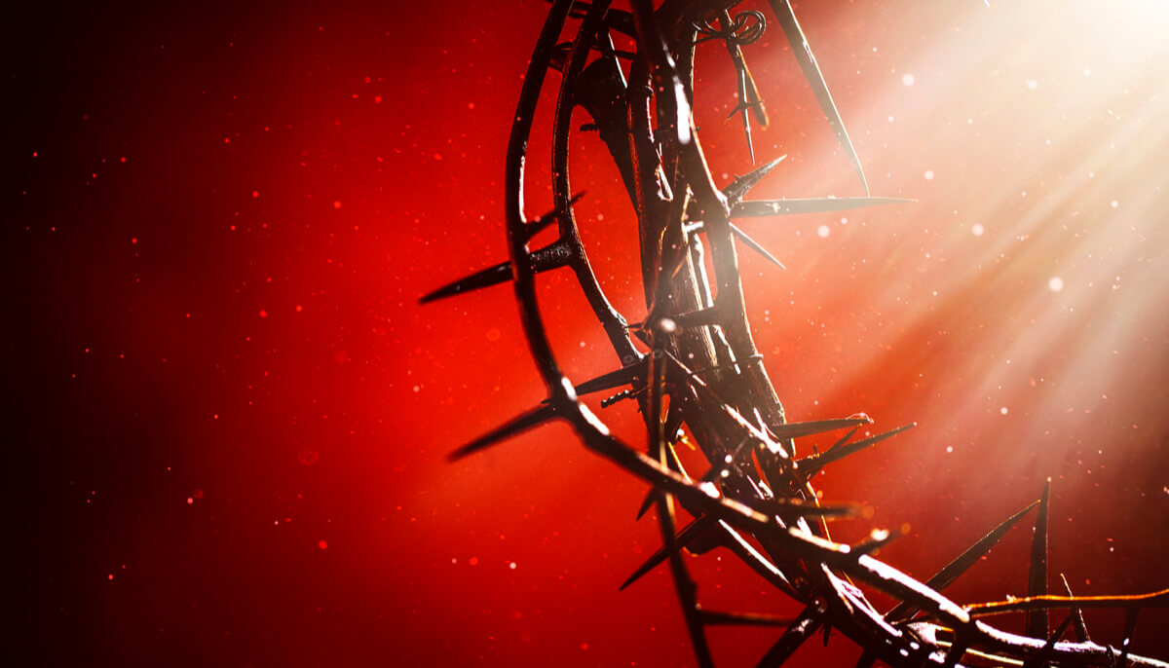
What is in Christ?
1 John 4:18
There is no fear in love. But perfect love drives out fear, because fear has to do with punishment. The one who fears is not made perfect in love
Romans 3:20
“no one will be declared righteous in his sight by observing the law; rather, through the law we become conscious of sin.”
No!
No Condemnation

Slide 5
Hebrews 10:14
By one sacrifice he has made perfect forever those who are being made holy.
Now!
When does this
take place?

Slide 6
because through Christ Jesus the law of the Spirit of life set me free from the law of sin and death
is there no condemnation?
8:2

Slide 7
What follows in this situation is this: None! Right now! Absolutely no verdict of guilt and not one payment meted out in punishment to those in the
ever-safe confines of Christ Jesus!
For the power-principle of the Spirit of Life has fully exempted and released you from the liability of living under the burdensome law of a self-centered life that is a daily and forever death-sentence.
Disappointed in self
Self-Condemned
I myself in my mind am a slave to God’s law, but in the sinful nature a slave to the law of sin
Romans 7:25b

Slide 8
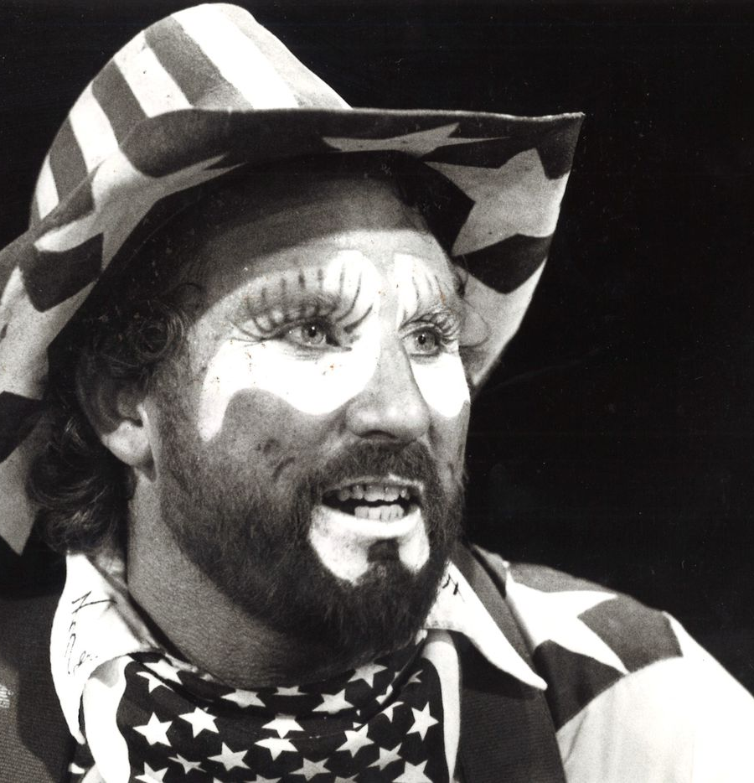
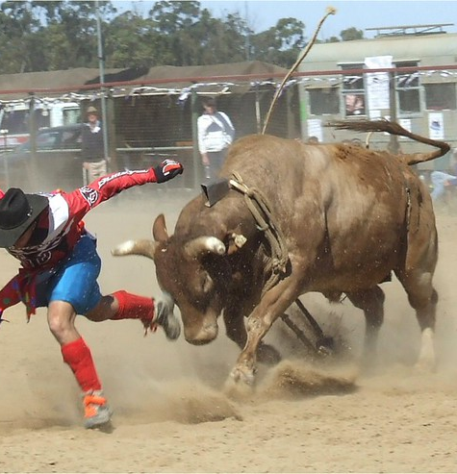
Frank McIlvain Jr
I always knew that God made me and loved me, but I was pretty sure he wasn’t always proud of me..

