Slide 2
²⁵ Shortly before dawn Jesus went out to them, walking on the lake. ²⁶ When the disciples saw him walking on the lake, they were terrified. “It’s a ghost,” they said, and cried out in fear. ²⁷ But Jesus immediately said to them: “Take courage! It is I. Don’t be afraid.”²⁸ “Lord, if it’s you,” Peter replied, “tell me to come to you on the water.” ²⁹ “Come,” he said Then Peter got down out of the boat, walked on the water and came toward Jesus. ³⁰ But when he saw the wind, he was afraid and, beginning to sink, cried out, “Lord, save me!” ³¹ Immediately Jesus reached out his hand and caught him. “You of little faith,” he said, “why did you doubt?”³² And when they climbed into the boat, the wind died down. ³³ Then those who were in the boat worshiped him, saying, “Truly you are the Son of God.”
Matthew 14:25-32

Slide 3
Faith is being sure of what we hope for &
certain of what we do not see.
Hebrews 11:1
Show me your faith without deeds, I will show you my faith by what I do.
(Abraham) You see that his faith and his actions were working together, and his faith was made complete by what he did.
James 2:18, 22

Slide 4
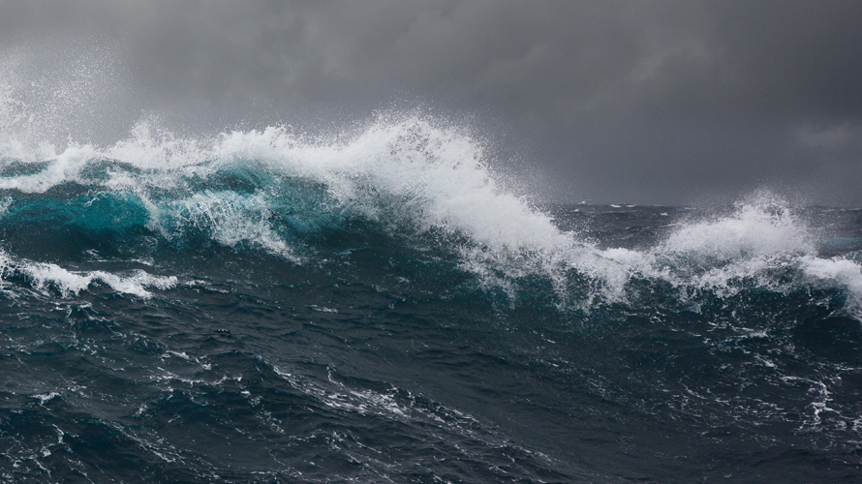
Where DOUBT increases,
FAITH decreases.
FEAR is the seed of DOUBT.

Slide 6
CLING TO GOD

