Slide 1
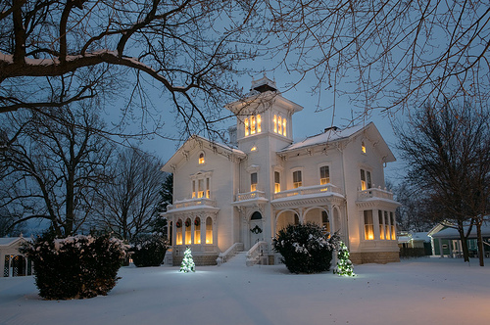
Where’s Your Home?
Romans 6:20-22

Slide 2
When you were slaves to sin, you were free from the control of righteousness. What benefit did you reap at that time from the things you are now ashamed of? Those things result in death! But now that you have been set free from sin and have become slaves to God, the benefit you reap leads to holiness, and the result is eternal life.
Romans 6:20-22

Slide 3
Free from Righteousness!
6:20
Suppression of truth by wickedness
Freedom!
Romans 1:18

Slide 4
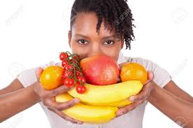
Enjoying Death
6:21
Death or Life choices.
Fruit of the Spirit Gal 5:22 Fruit of the light Eph 5:9
Fruit of righteousness Phil. 1:11
Unfruitful works Eph 5:11
Don’t be unfruitful Titus 3:14.
That was your past life!

Slide 5
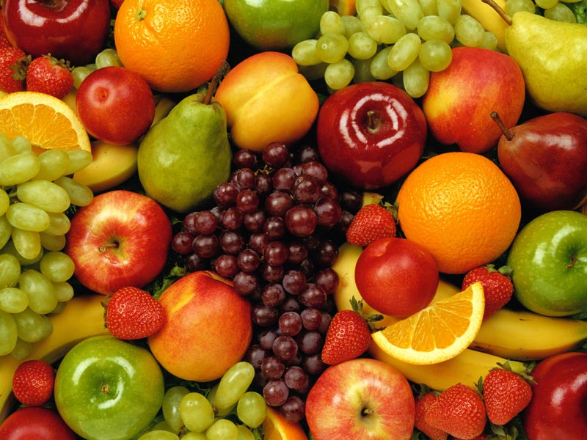
Enjoying Life!
6:22
“But now…”
“You have been set free” “You have become
slaves to God”
God did this to you.
True fruit
“The benefits you reap”
“You have your fruit”
“You possess or hold your fruit”

Slide 6
When I was enslaved to The Sin of Me, I turned my
nose up at anything termed “righteous” and was elated
to throw myself totally in the life of “Selfish Me.”
Being control by correct and right living
meant nothing to me
What fruit did I enjoy with that type of living?
No fruit at all! Just shame at the memory of it.
It was a dead-end life of death.

Slide 7
But now I am liberated!
Emancipated from Selfish and Sinful Me!
I’m now bound to God and willingly enslaved to him. The fruit I enjoy is a harvest of becoming more like him. The path that I’m on can only be
described as “Eternal Life”

