Slide 1
Romans 6:1-4
Life changing decisions

Slide 2
The theme of Romans
I am not ashamed of the gospel, because
it is the power of God for the salvation of everyone who believes: first for the Jew,
then for the Gentile. For in the gospel a righteousness from God is revealed, a righteousness that is by faith from
first to last, just as it is written:
“The righteous will live by faith.”
1:16,17

Slide 3
Romans 6:1-4
What shall we say, then? Shall we go on sinning so that grace may increase? By no means!
We died to sin; how can we live in it any longer?
Or don’t you know that all of us who were
baptized into Christ Jesus were baptized into his death? We were therefore buried with him
through baptism into death in order that, just as Christ was raised from the dead through the glory of the Father, we too may live a new life.

Slide 4
Main point:
When we joined ourselves with Christ’s historical death and resurrection it directly affects how we live, think and act in what we don’t do (sin) and what we do (live transformed lives).

Slide 5
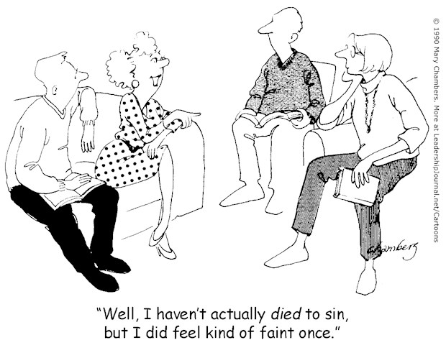

Slide 6
With superabundance grace
available, does sin matter?
6:1-2a

Slide 7
Our union with Christ
separated us from sin
6:2b

Slide 8
A reminder: My baptism
changed my residence
6:3

Slide 9
The point: Living a new life
6:4

Slide 10
What shall I say to this? Should I
live under the same roof as Sin just
so that there will be a superabundance
of Grace? Ridiculous! I forever left
the dominion of sin; how can I say it’s still my home? It is quite clear that
when I was immersed into Christ Jesus
I was plunged into his death and
bonded to every benefit of his death.

Slide 11
Let me connect the dots for you:
I was buried with him (through a
dipping under water) into death,
a total separation from my old life,
so that just as Christ was raised from
the dead by the glory of the Father
so also I am raised up so that I
might live my changed life in a
uniquely new way.

