Slide 1
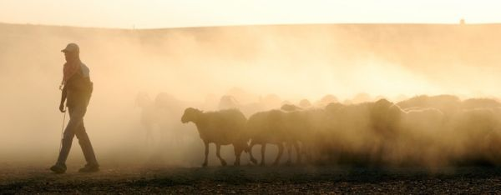
Shepherds Serving Sheep

Slide 2
Biblical Description
Character
Elders - Presbuteros
“one who is older”
Age, experience, wisdom
Intangibles –
Patience, Compassion, Gentleness

Slide 3
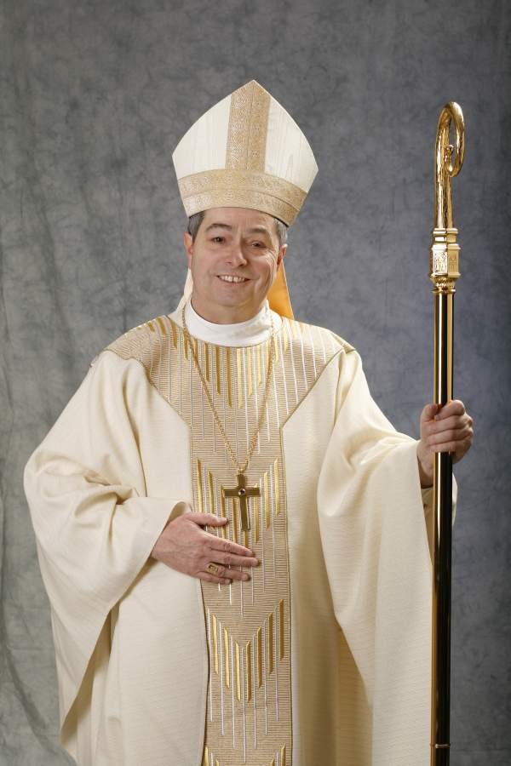
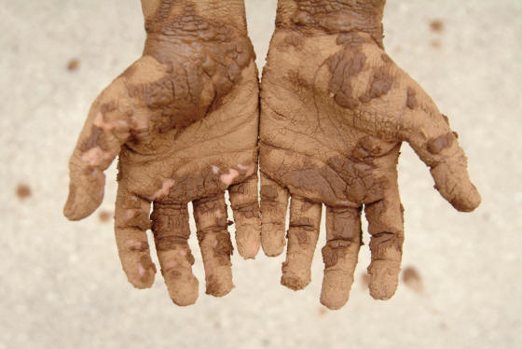
Biblical Description
Overseer – Episcopos
“one who looks after”
Guardian, inspector, heedful
He “gets his hands dirty”
Intimately involved
Luke 1:35; 19:44

Slide 4
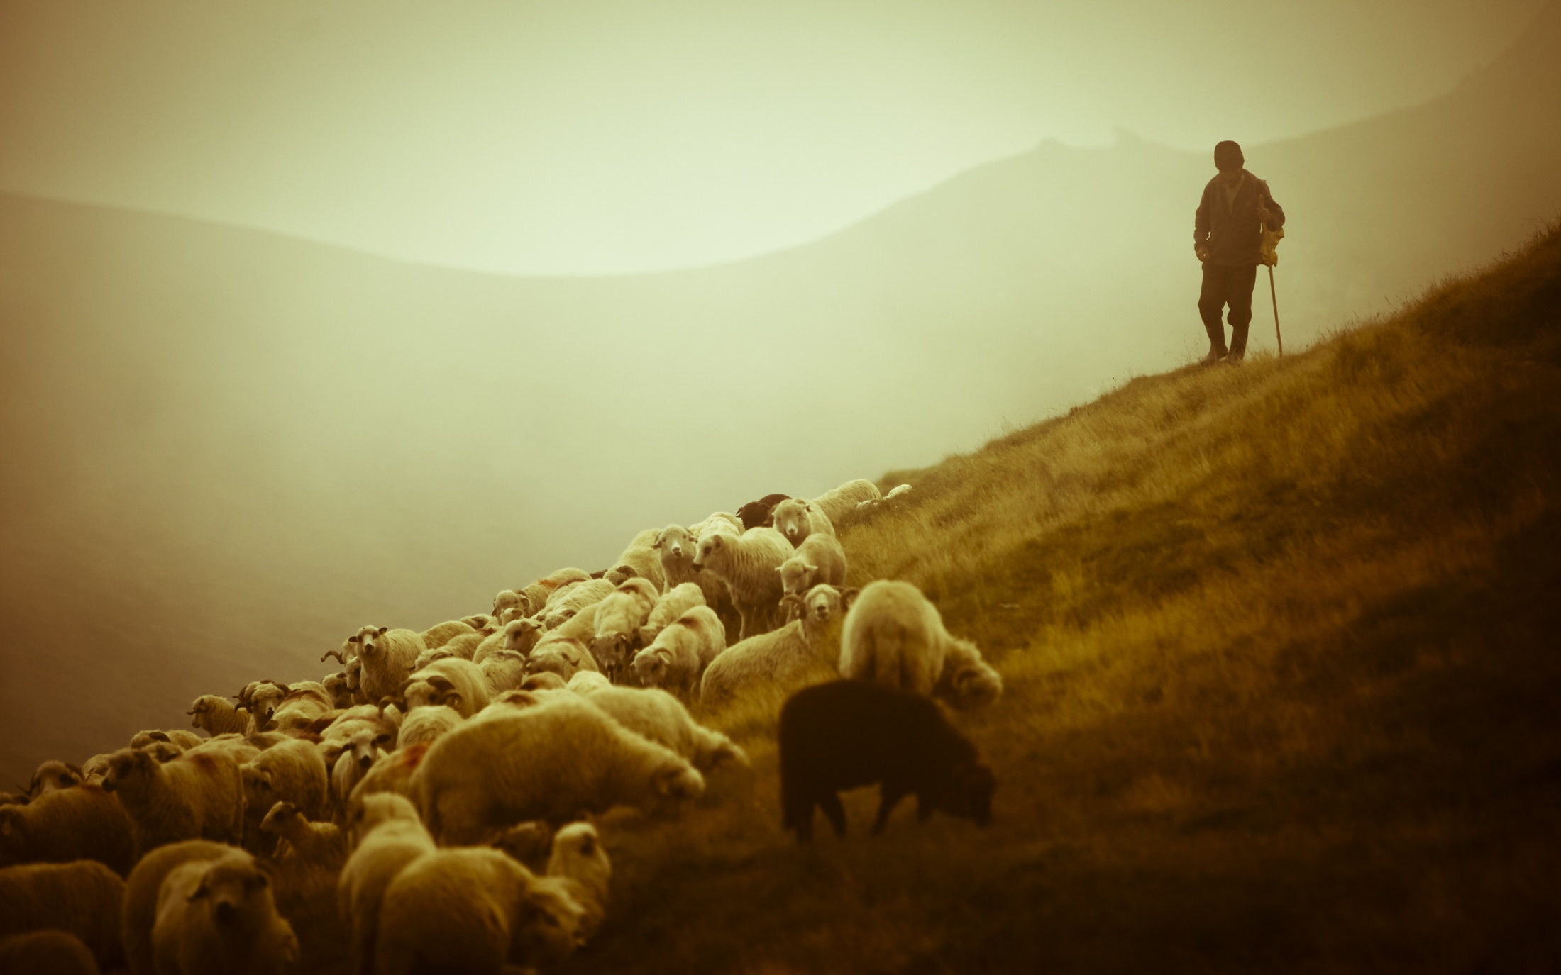
Biblical Description
Shepherd – poimen
“one who cares for & feeds sheep”
Psalms 23
Protection, nurturing, care, feeding

Slide 5
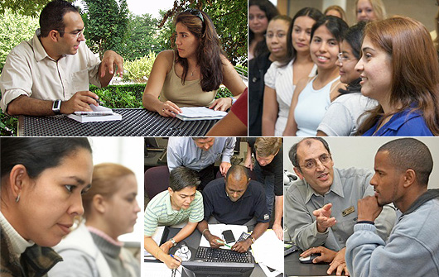
Biblical Emphasis
People
1 Timothy 3:1-7; Titus 1:5-9

Slide 6
Biblical Heart
Desire to serve
1 Tim. 3:1
Desire to follow
in the steps of Jesus
1 Peter 2:23-25
Desire to imitate
the heart of God
Isaiah 40:11

Slide 7
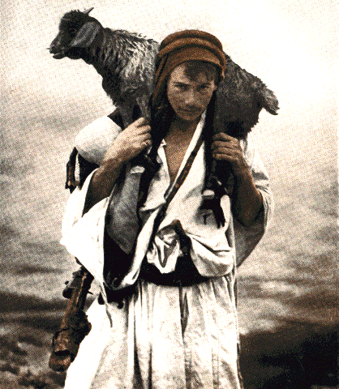
Sheep stray and get lost:
they need to be
rescued and restored.
Luke 15; Matt 9:36;
Isaiah 53:6
When he saw the crowds he had compassion on them, because they were harassed and helpless, like sheep
without a shepherd
Matt 9:36
We all like sheep have gone astray…Isaiah 53:6

Slide 8
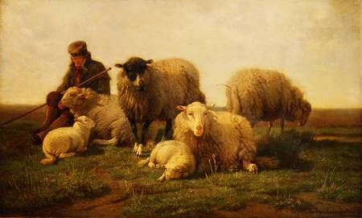
“Feed my sheep”
Sheep need feeding –
they need to be lead
to where the
good food is located.
John 21:15, 17
“Feed my lambs”

Slide 9
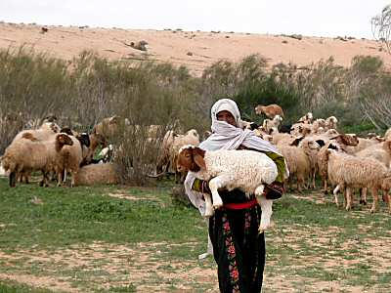
Warn those who are idle, encourage the timid, help the weak, be patient with everyone
Sheep get sick and injured–
they need care and healing
1 Thess. 5:14

Slide 10
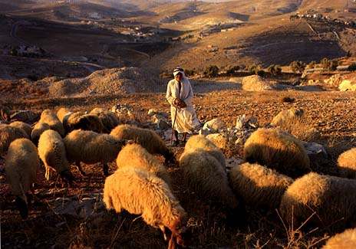
He should call the elders of the church to pray over him…
Sheep get frightened–
they need comforting and encouragement
James 5:14, 15

Slide 11
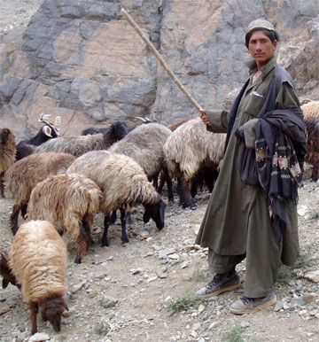
Sheep venture into danger–
they need to be warned
2 Tim. 4:2
Correct, rebuke and encourage – with great patience and careful instruction.

Slide 12
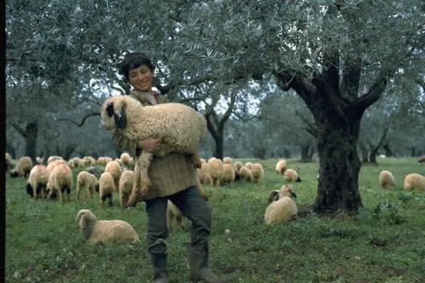
Your enemy the devil prowls around like a roaring lion looking for someone to devour.
Sheep are vulnerable to attack–
they need to be protected and guarded
1 Peter 5:8

Slide 13
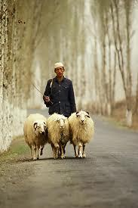
Sheep lose hope and need to be pointed in the right direction
Revelation 5:1-5

Slide 14
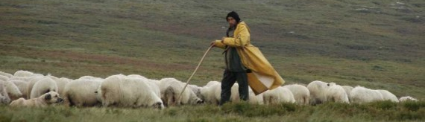
To the elders among you, I appeal as a fellow elder….Be shepherds of God’s flock that is under your care, serving as overseers – not because you must, but because you are willing, as God wants you to be; not greedy for money but eager to serve; not lording it over those entrusted to you, but being examples to the flock. And when the Chief Shepherd appears, you will receive the crown of glory that will never fade away 1 Pet 5:1-4

