Slide 1
The Character of an Elder
1 Timothy 3:1-7

Slide 2
Jesus the standard
For you were like sheep going astray, but now you have returned to the Shepherd
and Overseer of your souls.
1 Peter 2:25

Slide 3
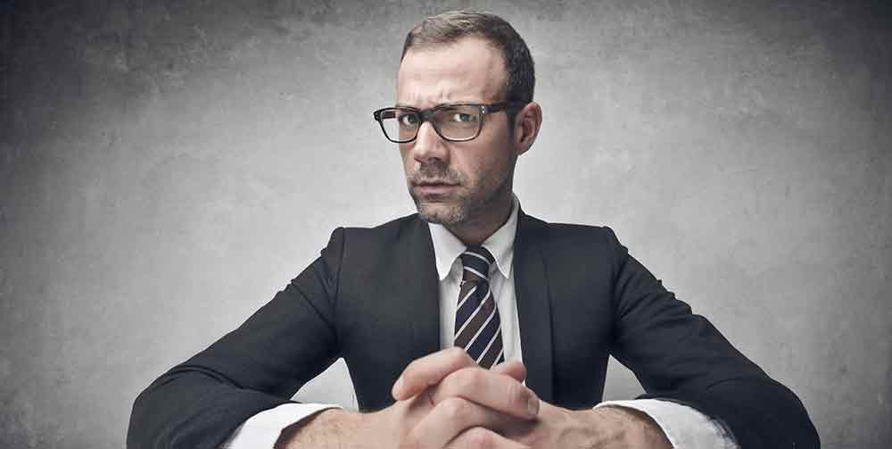
Overseer
Office
Greek:
“If anyone of oversight aspires to a good work he desires”
A close, intense look
at someone in order
to provide care and attention that is appropriate to the personal visitation.

Slide 4
1 Timothy 3:1-7 |  |  | Titus 1:5-7
Greek | English | English | Greek | English
 |  |  | Presbyterous | Elder 1:5
Episkopon | Overseer | Overseer | Episkopon | Overseer 1:7
Anepilempton | Above Reproach | Above Reproach
Mais gunaikos andra | The husband of but one wife | The husband of but one wife | Mais gunaikos andra | The husband of but one wife
Nephalion | Temperate | Temperate
Sophrona | Self-controlled | Self-controlled | Sophrona | Self-controlled
Kosmion | Respectable | Respectable
Philoxenon | Hospitable | Hospitable | Philoxenon | Hospitable
Didaktikon | Able to teach | Able to teach
Me paroinon | Not given to drunkenness | Not given to drunkenness | Me paroinon | Not given to drunkenness
Me plekten | Not violent | Not violent | Me plekten | Not violent
Epieike | Gentle | Gentle
Amachon | Not quarrelsome | Not quarrelsome
Aphilargyron | Not a lover of money | Not a lover of money
Neophyton | Not a recent convert | Not a recent convert
Martyrian kalen | Good reputation | Good reputation
 |  |  | Anenkletos | Blameless 1:6 & 1:7
 |  |  | Me authade | Not self-willed
 |  |  | Me orgilon | Not quick-tempered
1 Tim. 3:4,5 expounds on the concept of relationship in his family as a test of his relationship with the church |  |  | Me aischrokerde | Not greedy of base gain
 |  |  | Philagathon | Lover of good
 |  |  | Dikaion | Upright
 |  |  | Hosion | Holy
 |  |  | Enkrate | Disciplined

Slide 5
The Character of an elder
The husband of but one wife
“of one-woman man” or a “one woman man”
Self-controlled
Thinking clearly, sane,
temperate and discreet.
Hospitable
a friend of strangers.
Not given to wine
Staying beside wine.

Slide 6
The Character of an elder
Not violent
A person ready for a fight
Above reproach
Not laying a hold of, or not seizing.
Temperate
Abstaining from alcohol; being clear-headed, alert, refraining from any excesses
Respectable
“Orderly” and “decent.” Opposite: chaotic.

Slide 7
The Character of an elder
Able to teach
Skillful in teaching.
Gentle
Fair and not overly strict.
Not quarrelsome
Originally spoke of hand-to-hand combat; developed into fighting with words.

Slide 8
The Character of an elder
Not a lover of money
This person’s mind and heart
will be centered in materialism
Not a recent convert
Not a new Christian, recently come to faith.
Good reputation
A good witness or a good testimony.

Slide 9
This is a worthwhile statement:
If anyone has a strong inclination
and yearns to be involved in the
lives of others and desires to care,
help and give them personal attention according to their needs – he has a passionate desire for a noble
and beautiful task.

Slide 10
Therefore, one who is keeping an eye on the flock in such a personal way must
be someone who, if blamed of wrong doing the accusation won’t stick to him, he’s a one woman man, clear-thinking and free from life-dominating
influences, he is safe because he is
well-balanced by God, well-ordered
and decent, generous in his friendship
to strangers, has a knack to teach;

Slide 11
not the type to be associated with drinking alcohol, not the
quarrelsome type looking for a fight.
On the other hand, he is a fair and reasonable person, not overly strict but striving for justice beyond ordinary justice, seeking the spirit of the law;

Slide 12
you won’t find him in the middle of
a war of words, he’s not dominated by
getting ahead in this world and loving money; you hang around his family and you’ll find a model to follow, he has a respectable
track-record with his children who know
their place in the family looking up to their father because of his godly character.
Indeed, if a man can’t properly lead and
direct his own family how can take
care of God’s called out ones?

Slide 13
He can’t be a new Christian.
This is in order that as a novice he
won’t be blowing smoke and muddling
about in pride or he might fall into the judgement of the devil.
Now, it is necessary that those outside
God’s church speak well of him otherwise
he may be tripped up into a disgraced reputation and be caught in the
snare the devil set for him.

