Slide 1
According to One’s Abilities
Matthew 25:14-30
Forward
UPWARD
Outward
WARD
IN

Slide 2
Parable of the Talents
Matthew 25:14-30

Slide 3
Watch!
24:4 ~ Blepo
Seeing something physical but
applying to spiritual to it.
24:25; 25:6 ~ idou
To experience and see in your mind
with spiritual implications.
24:42, 43; 25:13 ~ gregoreuo
“Don’t go to sleep; stay awake”
“be responsible.”

Slide 4
Talents
Not natural abilities
25:14 – “his property”
Something God-given
25:15 ~ distributed “according to
each one’s ability”
It can be invested. There is a degree of risk.
The gain or loss would all be the Masters.
No personal profit.

Slide 5
Solving the puzzle
“Opportunities”
Exclusively Christian.
To God’s glory and not my own.
Making the most of every opportunity
Eph 5:15,16

Slide 6
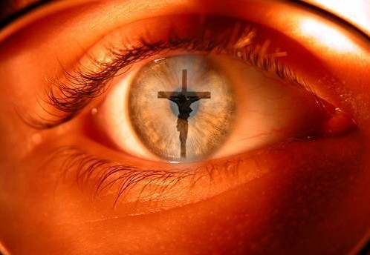
This forces us to look at life through spiritual eyes.
Faith Decisions
God is calling us to make “faith decisions” of our opportunities– decide on the physical based in spiritual thinking.

Slide 7
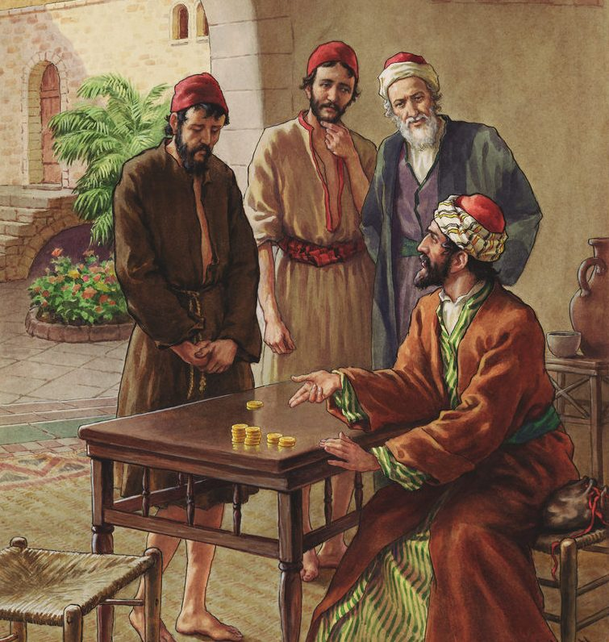
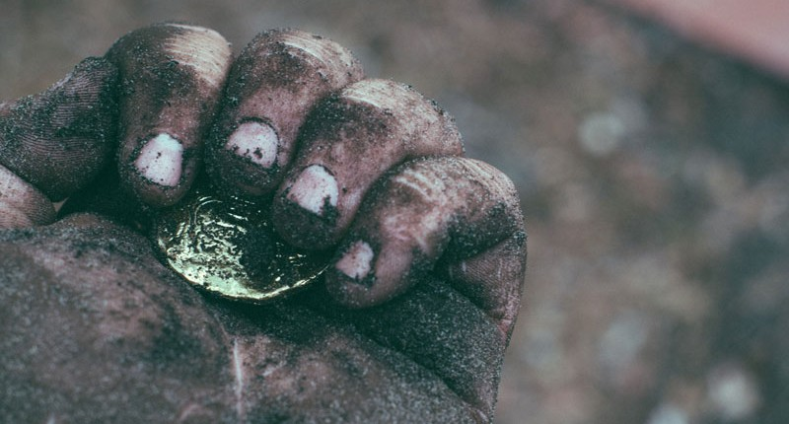
Results
Both had the same reward.
Harsh or hard –
means rough and violent.
His words display
his attitude
toward Christ
“I was afraid”

Slide 8
I know what kind of person you are – quick-tempered, harsh and mean-spirited. You want everyone else to work for you while you are off living it up. What else should I be but afraid? If I took any risk, I stood the chance of being punished so I just kept to myself. Here’s what you gave me – now we are all even-Steven.

Slide 9
Remember your leaders, who spoke
the word of God to you. Consider the outcome of their way of life and imitate their faith
Hebrews 13:7

