Slide 1
A Multi-generational Family
Bridging the Generations: the Central Family

Slide 2
Paul’s words to Timothy…
“Don’t be harsh or impatient with an older man. Talk to him as you would your own father, and to the younger men as your brothers. Reverently honor an older woman as you would your mother, and the younger women as sisters.”
(1 Timothy 5:1-2)
This week’s call – unity across generations…
Today’s church suffers a “generational gap” problem.
Truth is, today’s world suffers a “general gap” problem.
Culture presents an amazingly difficult challenge in bridging the generations…

Slide 3
Today’s Generations Identified…
From Neil How and William Strauss: Generations:
1900-1924: G.I. Generation
1925-1945: the Silent Generation
1946-1964: Baby Boomers
1965-1979: Generation X (Thirteeners)
1980-2000: Generation Y (Millenials)
2000-today: Generation Z (New Silent?)
NOTE: First time in history we have churches with as many as 6 distinctive generations

Slide 4
Challenges to Education…
Each generation (all generational studies are general by nature – there are always exceptions) has a different learning style…
Generation Z presents new challenges:
Recession Scarred – depression prone (high anxiety)
Wi-Fi Enabled – world (for them) has never been without
Multiracial
Identity Fluid – they are cultural products of decisions made - greatest value is individual freedom – expressive individualism…
Post-Christian – not “anti-Christian.” 78% claim belief in God, but largest group is either “nones” or “agnostic”
Anti-institutional…

Slide 5
What Research Points Out…
Every distinct generation has its own:
Influencers
Core values
Attributes
Family experience (normative)
Understanding of education (epistemology)
Work ethic
View on work/life balance
Values
Assets/liabilities
Leadership style preference
Vision for life…

Slide 6
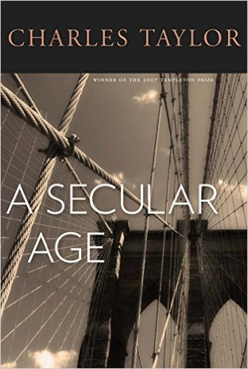
Another Challenging Layer…
Charles Taylor’s A Secular Age:
SECULAR ₁ (Renaissance)
SACRED vs SECULAR “PLANES”
NECESSARY FOR BOTH TO CO-EXIST
SECULAR ₂ (post-Enlightenment)
RELIGIOUS vs A-RELIGIOUS SPACES
SECULAR is a-religious space
SACRED are institutions and sacred actions
Divine action difficult to acknowledge
SECULAR ₃ (post-modern)
NEGATING OF TRANSCENDENCE
SCIENTISM AND SECULARITY WIN

Slide 7
My Point? Intergenerational Relationships are Essential But Extremely Challenging
What we need via intergenerational discourse and fellowship:
Wisdom – all have contributions
Wonder – all have experiences to share
Godliness – in listening and appreciating one another we come to understand our callings in a deeper way
What it requires?
Willingness to listen and seek to understand
Willingness to work through discomfort…

Slide 8
Questions/Thoughts that Inhibit:
Why can’t they be satisfied with what they have?
Why can’t they just accept what I have accepted?
Why do they want more? The church gives me all I need as it currently functions…
They should submit to our leaders like I have always done…
NOTE: As long as there is a “they” you will never experience unity…

Slide 9
Biblical solutions?
Psalm 145:4 “One generation comments your works to another; they tell of your mighty acts. They speak of the glorious splendor of your majesty…”
Ephesians 4: “I urge you to live a life worthy of the calling you have received. Be completely humble and gentle, be patient, bearing with one another in love. Make every effort to keep the unity of the Spirit through the bond of peace. There is one body…

Slide 10
Challenges Ahead…
Most young people desire meaningful relationships with older generations.
Cannot be on “my own terms.”
Seek to understand before attempting to be understood…
“People believe what they believe because they believe it.”
We must respect one another, love one another, and seek to build up one another.
Do all out of our love for God…

