Slide 1
Clear Eyed
Looking at people through the eyes of Jesus

Slide 2
I Corinthians 9:19-23
19 Though I am free and belong to no one, I have made myself a slave to everyone, to win as many as possible. 20 To the Jews I became like a Jew, to win the Jews. To those under the law I became like one under the law (though I myself am not under the law), so as to win those under the law. 21 To those not having the law I became like one not having the law (though I am not free from God’s law but am under Christ’s law), so as to win those not having the law. 22 To the weak I became weak, to win the weak. I have become all things to all people so that by all possible means I might save some. 23 I do all this for the sake of the gospel, that I may share in its blessings.

Slide 3
2 Corinthians 5:16
¹⁶ So from now on we regard no one from a worldly point of view. Though we once regarded Christ in this way, we do so no longer.

Slide 4
How do we look at people?
C

Slide 5
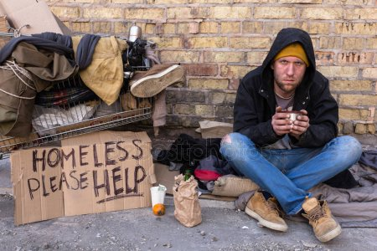
Legion
Mark 5:1 – 15

Slide 6
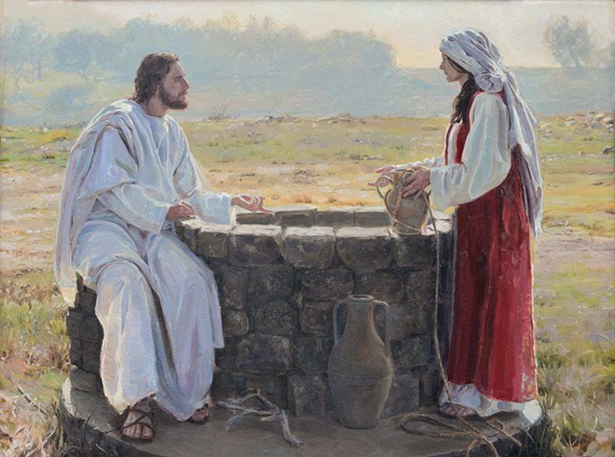
Woman at the Well
John 4: 1 – 26

Slide 7
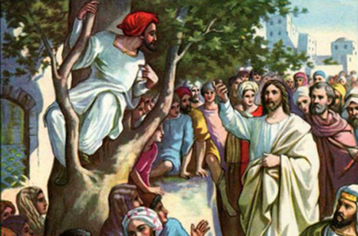
Zacchaeus and Jesus
Luke 19: 1 – 10

