Slide 1
Preventing “crib deaths”
1 Peter 2:1-3
Forward
UPWARD
Outward
WARD
IN

Slide 2
Therefore, rid yourselves of all malice
and all deceit, hypocrisy, envy and
slander of every kind. Like newborn babies, crave pure spiritual milk
so that by it you may grow up in your salvation, now that you have tasted that the Lord is good.
1 Peter 2:1-3

Slide 3
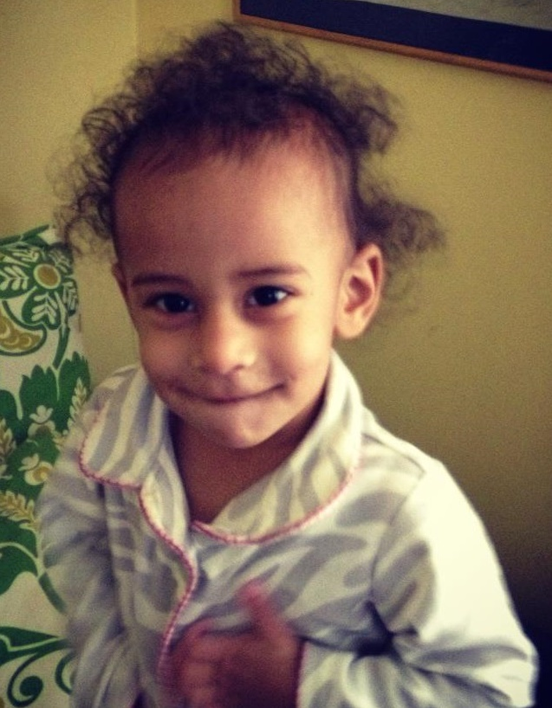
We are all spiritual “Babies”
“like” new born babies
What/who you are:
a new condition, you have crossed over from death to life, you are a new creation, you are a spiritual baby
1:3 – he has given us a new birth
1:23 – for you have been born again

Slide 4
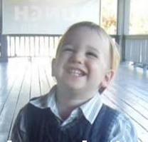
We are all spiritual “Babies”
Faith is not mindlessness – faith is mindfulness
Take responsibility
1:13 –
Prepare your minds for action

Slide 5
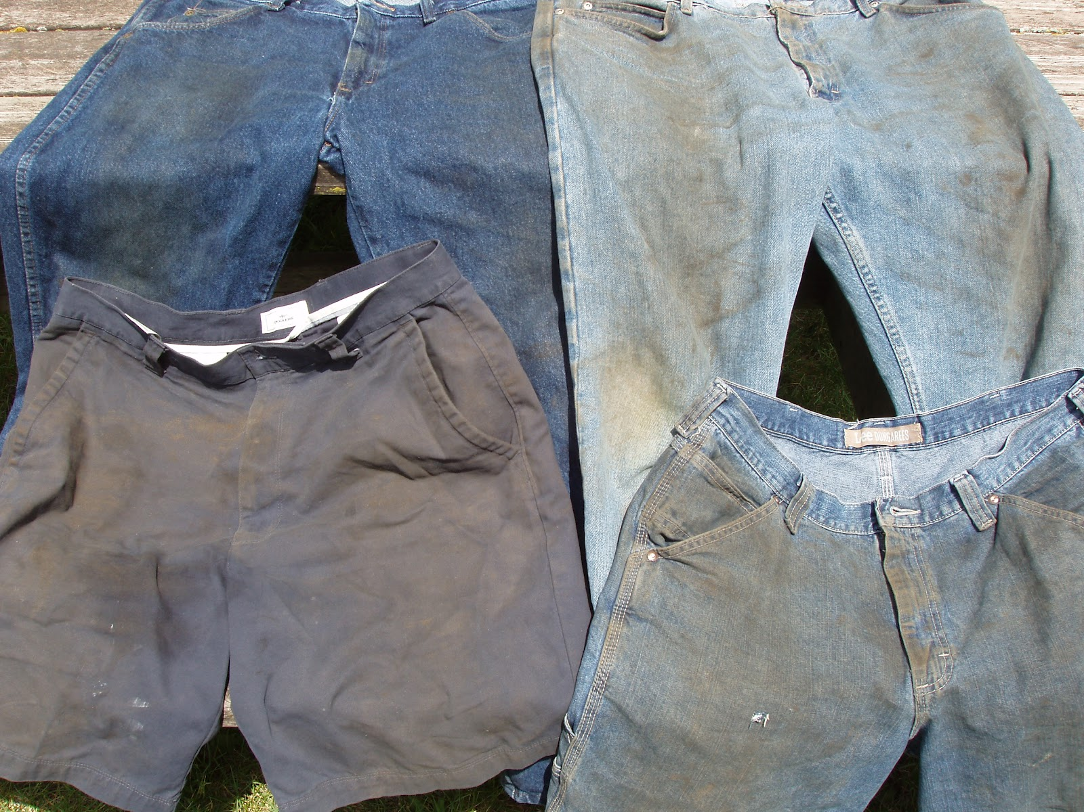
How to Prevent Spiritual Death
Relational
sins
2:1
Rid yourself
Put away once for all – be done with it!
Craving
spiritual
milk

Slide 6
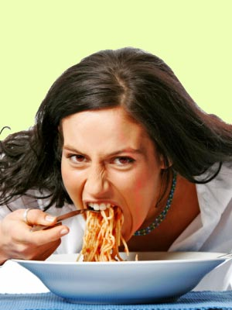
WHAT ARE YOU EATING?
Nourishing Food
Sickening food
Tasted that the Lord is good

Slide 7
Malice
Deceit
Hypocrisy
Envy
Slander
The things that kill you;
the things that cure you
Fling off the filthy ways of having it in for someone and twisting words to get your own way. Be done with two-faced living and wanting what others have and resenting them because they have it. And quit stabbing people in the back in subtle and not so subtle ways.

Slide 8
Be like newborns
Crave
The things that kill you;
the things that cure you
Pure Milk
Spiritual Milk

Slide 9
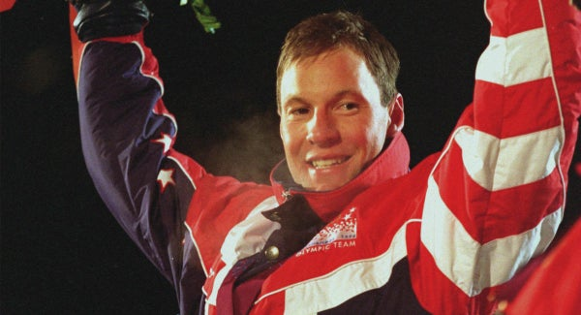
“I kept it simple”
“I remembered to breathe”

Slide 10
This is discipleship:
Sharing God’s word with new Christian.
This is discipleship:
Feeding on God’s word.
This is how to prevent spiritual death:
Learning to get rid of sin
and feed on God’s word

