Slide 1
The Aroma of Christ:
The Joy of Influence
2 Corinthians 2:14ff
UPWARD
Outward
WARD
IN

Slide 2
2 Cor. 2:14-3:18
Who we are
Who we are not

Slide 3
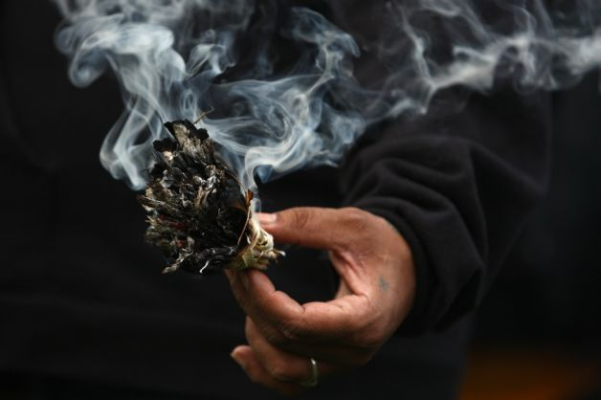
God’s Aroma 2:14-16a
We are the
aroma of Christ
I have been crucified with Christ and I no longer live, but Christ lives in me. The life I live in the body, I live by faith in the Son of God, who loved me and gave himself for me.
Gal 2:20

Slide 4
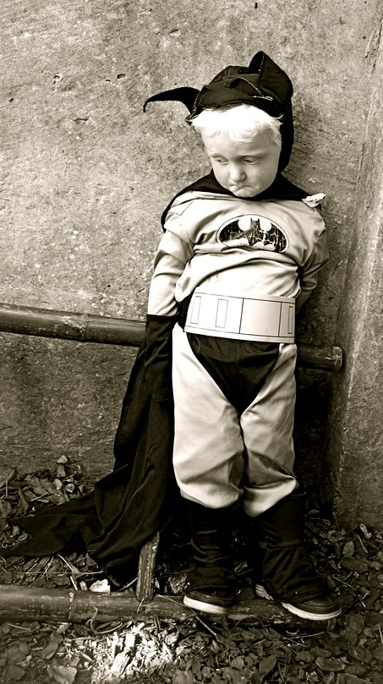
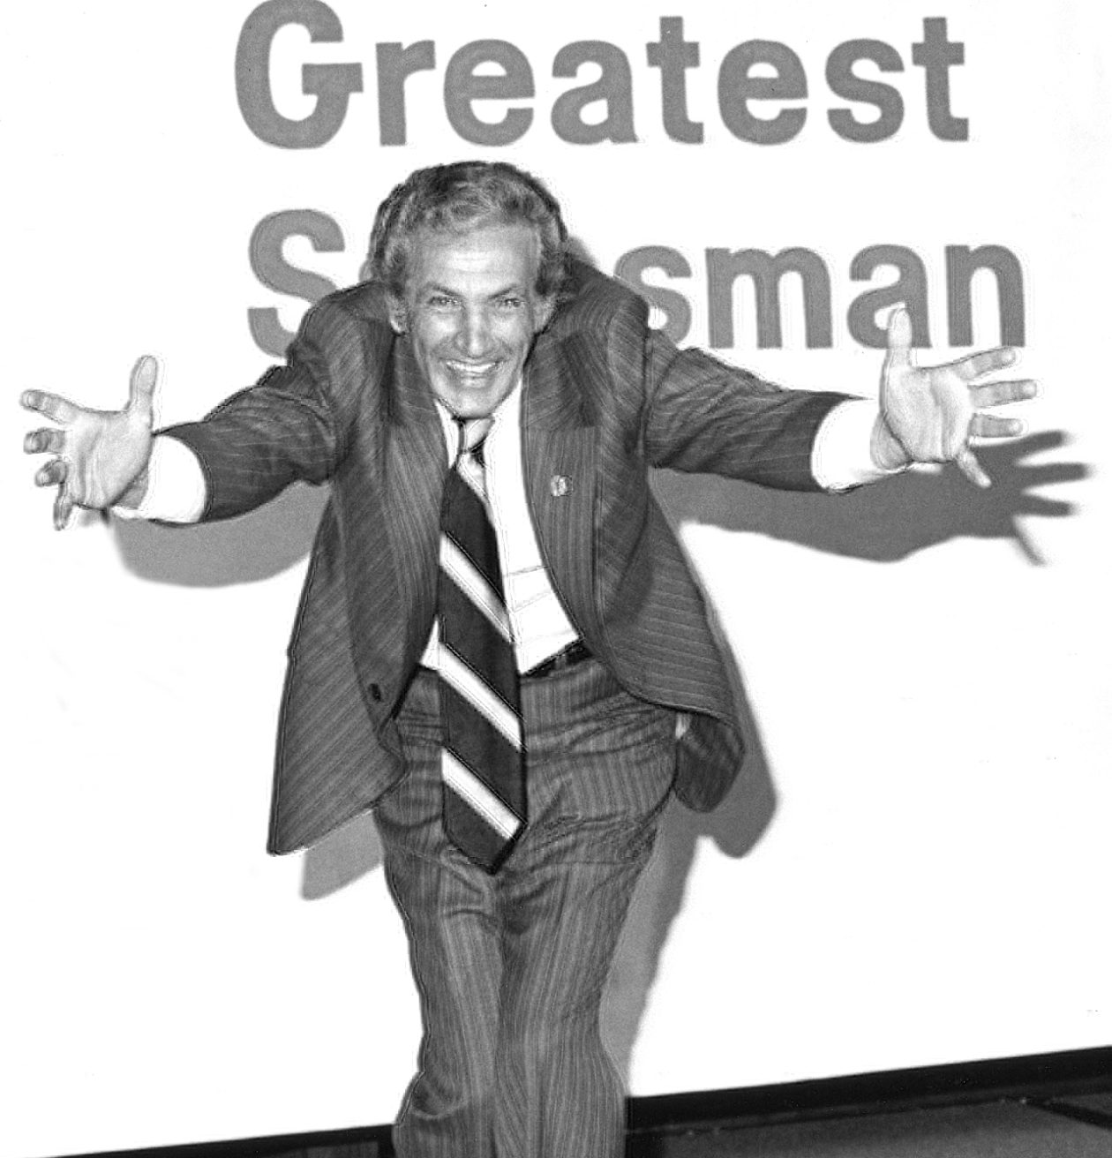
The temptation of salesmanship
Who’s Up
for
the Task?
2:16b, 17
Recognize: you are sent from God.
Speak: words must be said
Know: in whose presence you speak
Sincerely

Slide 5
God-centered living
God-centered competency
Our confidence
3:4.5
Live Boldly
3:12
Live in Freedom
3:17
Lives being transformed
3:18

Slide 6
Great Commission
Matthew 28/Mark 16
Aroma of Christ
2 Cor. 2:14ff
I’ll be with you always
Christ always leads us
Spreads everywhere the fragrance of him
Go into all the world
Believe and baptized are saved – believe not condemned
Smell of death – fragrance of life
All authority
Sent from God

