Slide 1
Hospitality in the 21st Century
Mark 9:41
UPWARD
Outward
WARD
IN

Slide 2
– xenos – stranger
phobia – fear
philoxenia
Xenophobe!
philo – Love
xenos – stranger

Slide 3
“No stranger had to spend the night in the street, for my door was always
open to the traveler.”
Job 31:32
A warm and friendly attitude
toward others, especially those you
don’t know, that is displayed
in welcoming people into your home.

Slide 4
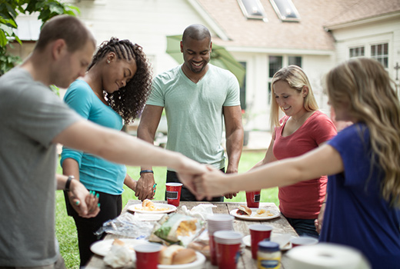
Hospitality
Pursuing Hospitality
Home is our haven, our retreat, our castle and only those close
to us are allowed within the border.
“Practice hospitality”
Romans 12:13
“pursue”
“prosecute”
“persecute”

Slide 5
Pursuing Hospitality
“Offer hospitality to one another without grumbling” ~ 1 Peter 4: 9
Ungrudgingly
Some folks make you feel at home. Others make you wish you were.
“love each other deeply, because love covers
over a multitude of sins,” 1 Peter 4:8
Cheerfully share your home with those who need
a meal or a place to stay.
Be hospitable to each other without secretly
wishing you hadn't got to be!

Slide 6
Breaking
out
of
the
Atmosphere
Hospitality must
be planned
We have to think and work in order
for our homes to be places of
strategic hospitality

Slide 7
God-centered hospitality
Leviticus 19
“For I am Yaweh, your God.”
Live this way for it is my character
God’s gift of hospitality
Grace is God’s gift of himself to strangers
and aliens, those outside invited in.
Ephesians 2:12-18

Slide 8
3 ways to
put hospitality into practice.
1) Look for people to greet at our assemblies.
2) Invite people into your home.
3) College students and His Way families.

