Slide 1
As Though You Were With Them
Hebrews 13:3
UPWARD
Outward
WARD
IN

Slide 2
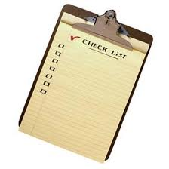
Kingdom Attitudes
Attitude of love and grace
Seeing others with “kingdom eyes”
“Do not conform any longer
to the pattern of this world but be transformed by the renewing of you mind. Then you will be able to test and approve
what God’s will is – his good, pleasing and perfect will.”
Romans 12:2
A new heart being transformed
Not a check list

Slide 3
Remember those in prison as if you were
their fellow prisoners and those who are
mistreated as if you yourselves were suffering
Hebrew 13:3

Slide 4
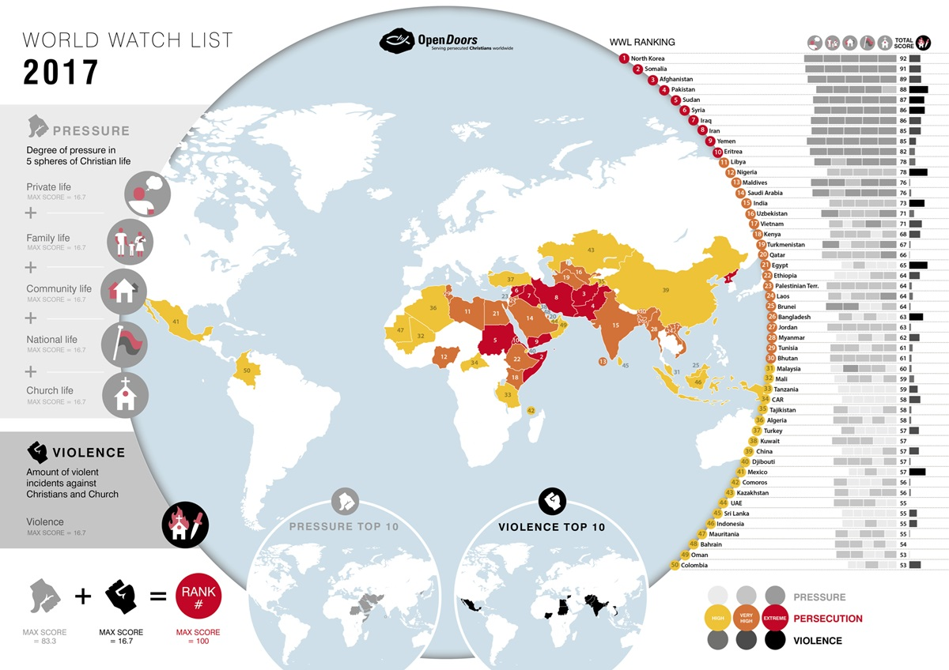
We live in a ‘world of hurt’
Persecution on Universities

Slide 5
God’s Encouragement
in the middle of hurt
“Remember”
Place yourself in their shoes
“Remember” implies relationship
When you remember someone you have a relationship with then you will do what is right

Slide 6
Kingdom Attitude
In Relationships
“Since we are receiving a kingdom that cannot be shaken…”
Hebrews12:28
Kingdom Attitude: “Let brotherly love continue”
Hebrews13:1

Slide 7
“Remember”
whomever you desire in other parts of the world
BUT
“Remember”
those of our own number who are
being persecuted here.

