Slide 1
Who’s on our invitation list?
Luke 14:12-14
UPWARD
Outward
WARD
IN

Slide 2
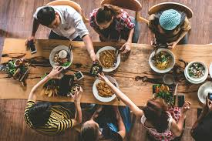
Luke 14-17
Kingdom Attitude 14:12
Actions
Actions
Attitude
Kingdom Characteristics
Actions
Actions
Grace and love are absent;
pride and selfishness are present.

Slide 3
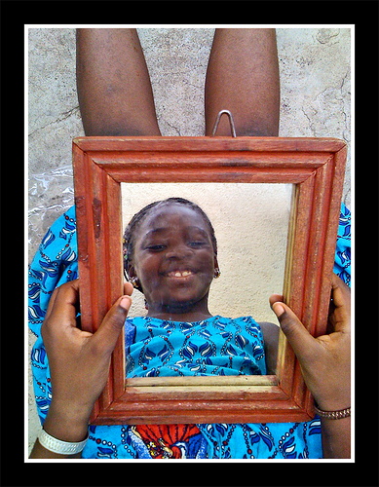
Luke 14-17
Kingdom People
14:13
Kingdom Characteristics
“Invite the poor,
crippled, lame, blind.”
There is a tendency to seek other like yourself

Slide 4
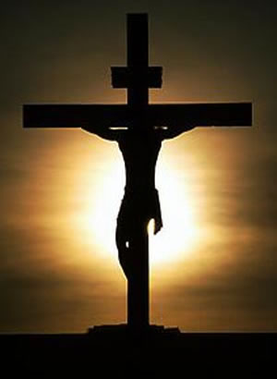
Kingdom People must invite those on the fringes of society.
The kingdom person’s identity is not based in who they hang out with but in the one who hung on a cross for them.
Where you are not comfortable
Those with whom you don’t have much in common
We should invite anyone – those like us and those unlike us.

Slide 5
Luke 14-17
People outside
the kingdom
14:13
Literally poor, crippled, lame and blind.
A literal meal
But it is more!
Kingdom Characteristics
Who outside of Christ is rich in spirit?
Who outside of Christ has sight?
All need to be invited
Who outside of Christ walks through
life without fault?

Slide 6
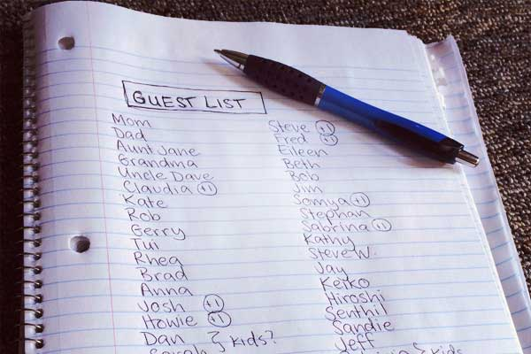
Being a kingdom person means having the spirit of Christ living out in our lives.
Who’s on my invitation list?
Everyone I am
able to invite.

Slide 7
Are they part of God’s Kingdom?
If not – they need an invitation
Do this and you will be blessed – v.14
Happy, overjoyed, fortunate.
An inward contentment regardless of what is happening in the world around us

