Slide 1
Jesus is seen in how we treat one another
Part 1 – “The One Another Heart”
Part 2 – “Living a Life Worthy of our Calling”
Part 3 – “Showing Concern for the weak and fallen”
UPWARD
Galatians 6:1,2
WARD
IN

Slide 2
Live Worthy of our Calling
As a prisoner for the Lord, then, I urge you
to live a life worthy of the calling you have received
Ephesians 4:1
“Then”
Based on what I have been telling you, now live this way.
Who God is and what he has done for you in Christ.

Slide 3
“There is a way to show your gratitude”
Live worthy of your calling.
For you died, and your life is now hidden with Christ in God. When Christ, who is your life…
Col. 3:2,3
This drives us to Christ-centered living
Calling: Out of Something and into Something else

Slide 4
How to Live Worthy of Your Calling
Eph. 4:1-3
Humble
Gentle
This is what unity looks like
This is what unity looks like
Patient
Love
Result: Protect the Unity of the Spirit

Slide 5
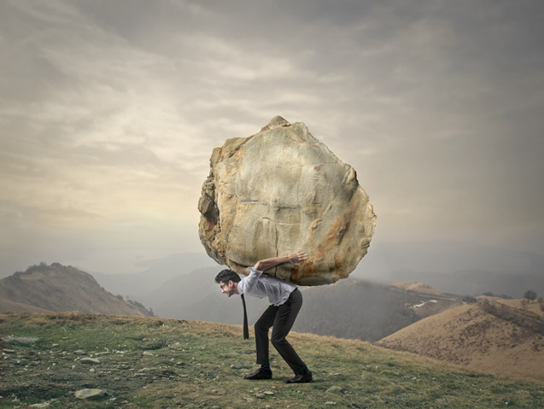
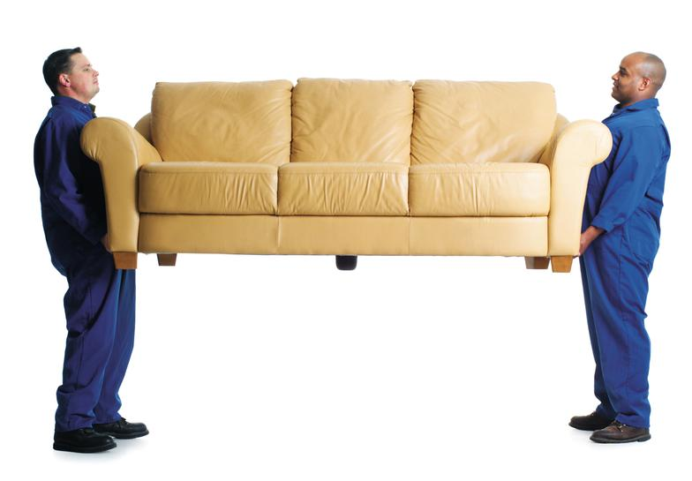
Bear One Another’s Burdens
Galatians 6:1,2
Sin: ‘lapses from the truth” or “a slip-up”
Bearing a burden: helping the other mature in Christ

Slide 6
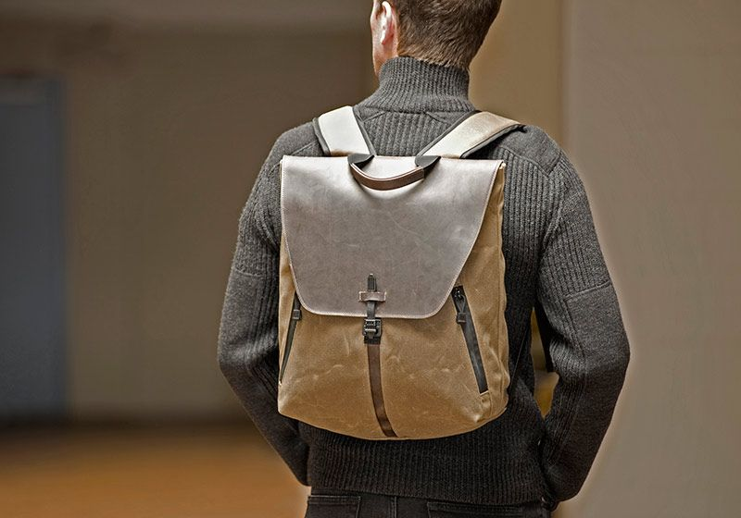
Take responsibility – physically, emotionally,
financially and spiritually
Praise be to the Lord, to God our Savior, who daily bears our burdens
Psalms 68:19
Galatians 6:5 “each one should carry his own load.”

