Slide 1
Welcome. TAB ENTER to launch Opening Announcements. ESC to return.
Welcome
GO
Notes:
1

Slide 2
3 Min Countdown – Blink Lights 3 time at start
Service Will Begin In
GO
Notes:
2
Blink lights at 3 minutes

Slide 3
Welcome. TAB ENTER to launch Welcome charts. ESC to return.
Welcome
Welcome Charts
Notes:
3

Slide 4
Child Care & Blue Cards
➢ Child Care (2 & under)
➢ Blue Cards
Notes:
4
Child Care (2 & under)

Slide 5
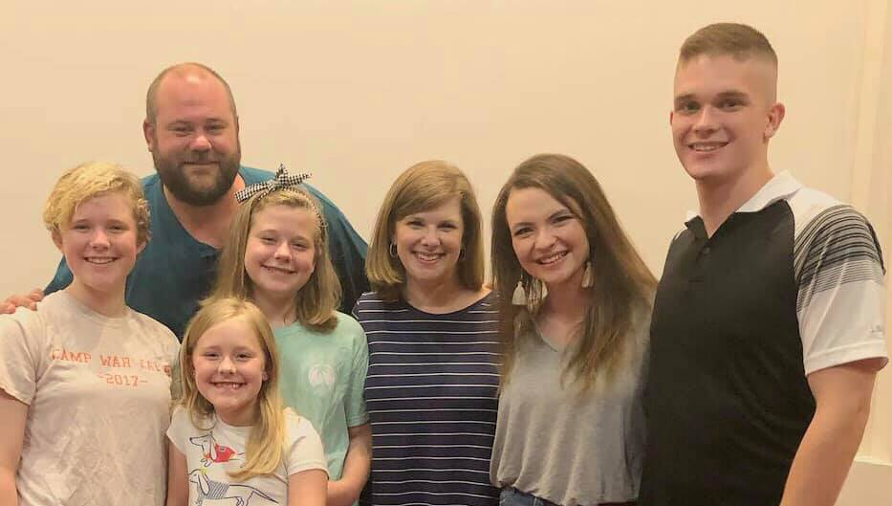
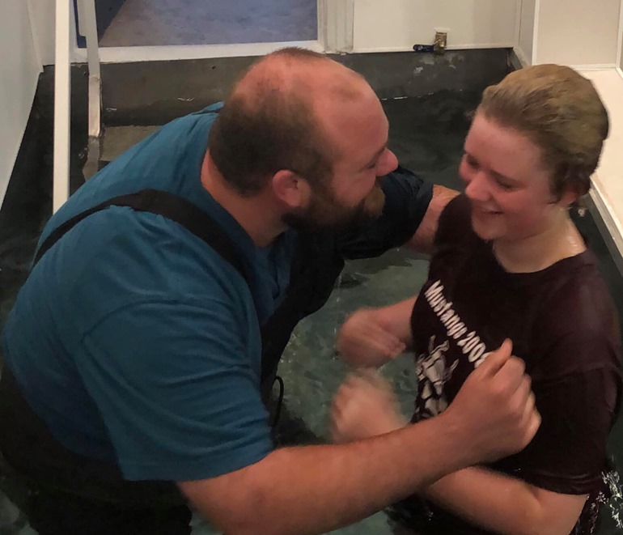
Mary Carolyne Bell
Baptized Monday, July 1st

Slide 6
Happy birthday to you
Happy birthday to you
Happy birthday, everybody
Happy birthday to you.
Notes:
Jon talk

Slide 7
Happy birthday to you
To Jesus be true
May God richly bless you
Happy birthday to you.
Notes:
Jon talk

Slide 8
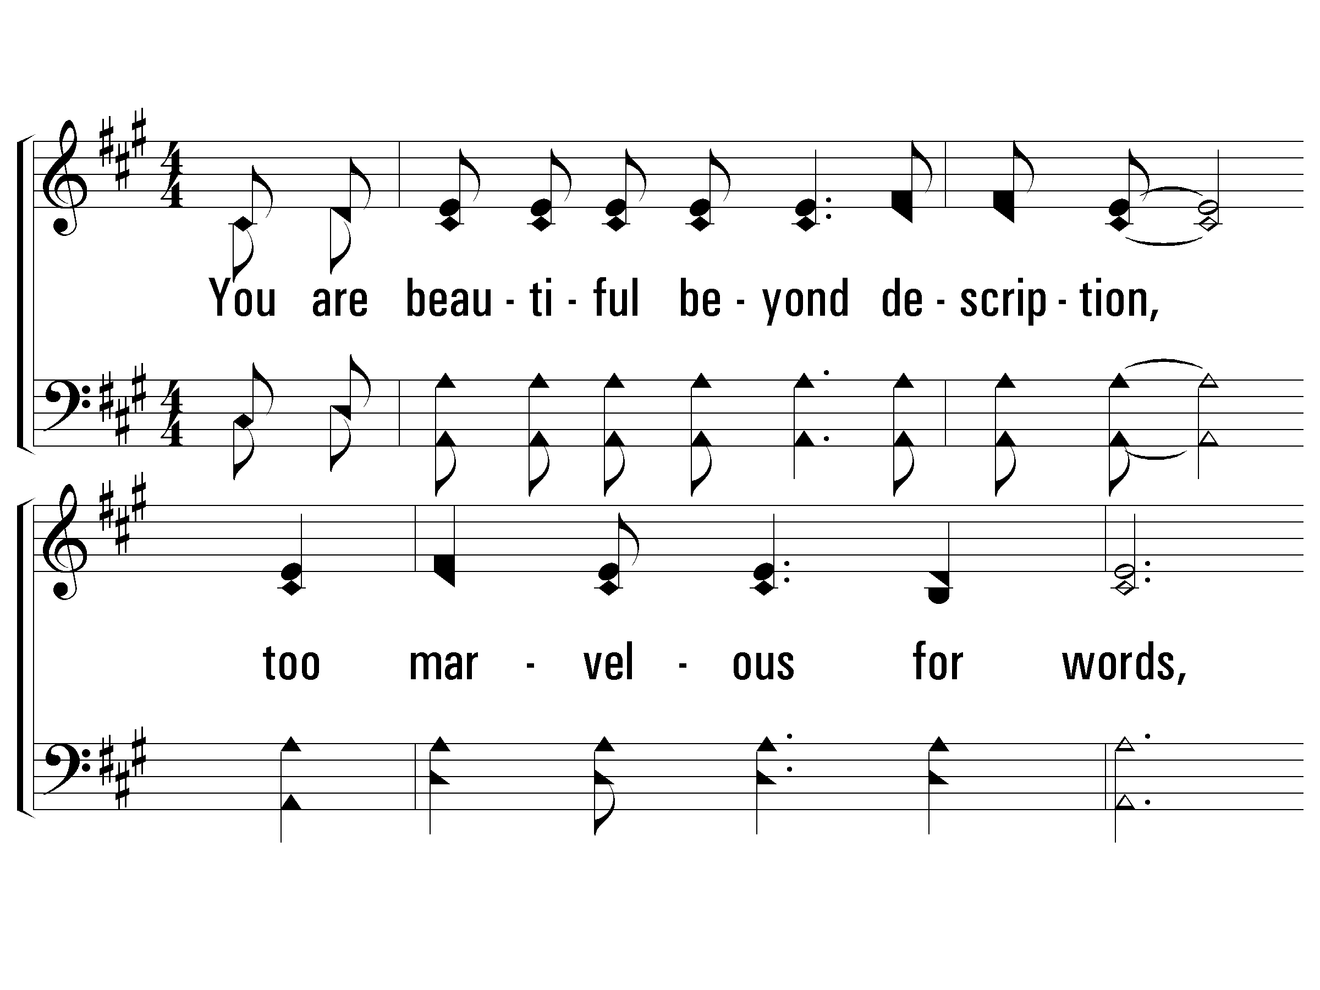
I Stand In Awe
A / C#
Words and Music by: Mark Altrogge / Arr: Reid Lancaster / Copyright © 1988 by People of Destiny International
(Administrated by CopyCare USA c/o The Copyright Company, Nashville, TN)
All Rights Reserved. International Copyright Secured. Used By Permission
© 2001 The Paperless Hymnal™
8 / 12
Notes:
A/C#
Adoration, Call To Worship, Dedication, Devotion, Holiness, Lordship, Majesty, Names, Power Of God

Slide 9
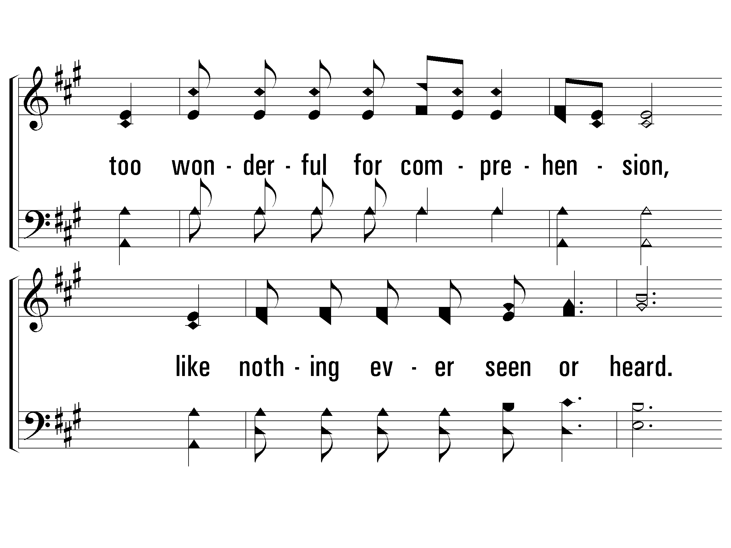
I Stand In Awe
9 / 12

Slide 10
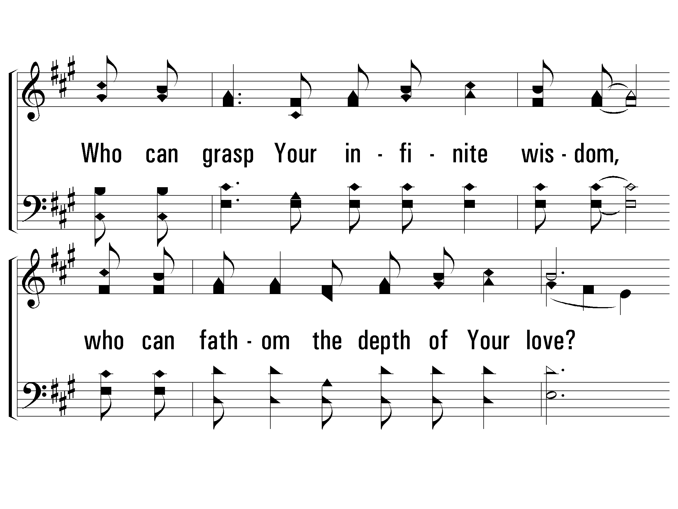
I Stand In Awe
10 / 12

Slide 11
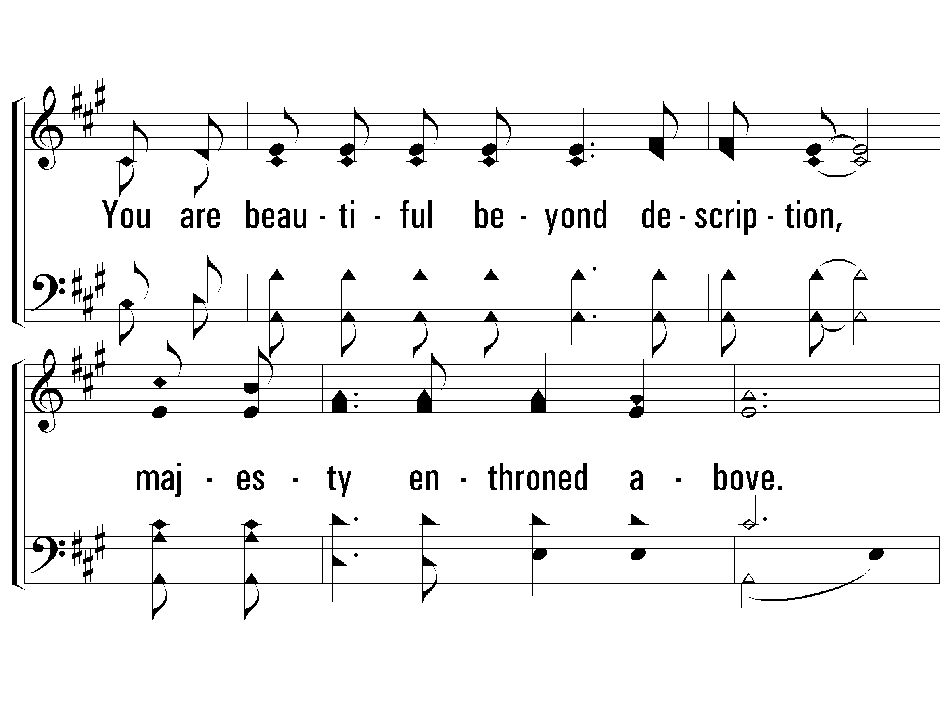
I Stand In Awe
11 / 12

Slide 12
I Stand In Awe
END
12 / 12

Slide 13
A-He is Wonderful
C / E
Alto
All prai - ses be to the King of kings and
the Lord our God! He is won - der - ful
repeat +Soprano
13 / 24
Notes:
C/E
King, Praise

Slide 14
S-He is Wonderful
Hal - le - lu - jah, Hal - le - lu - jah
Soprano
All prai - ses be to the King of kings and
Hal - le - lu - jah, He is won - der - ful
the Lord our God! He is won - der - ful
repeat +Tenor
14 / 24

Slide 15
T-He is Wonderful
Hal - le - lu - jah, Hal - le - lu - jah
All prai - ses be to the King of kings and
Hal -le - lu - jah! Sal - va -tion and glo-ry
Tenor
15 / 24

Slide 16
T-He is Wonderful
Hal - le - lu - jah, He is won - der - ful
the Lord our God! He is won - der - ful
hon - or and pow - er, He is won - der - ful
repeat +Bass
16 / 24

Slide 17
B-He is Wonderful
Hal - le - lu - jah, Hal - le - lu - jah
All prai - ses be to the King of kings and
Hal -le - lu - jah! Sal - va -tion and glo-ry
Oh the Lord our God is might-y, The Lord our God is om - ni -
Bass
17 / 24

Slide 18
B-He is Wonderful
Hal - le - lu - jah, He is won - der - ful
the Lord our God! He is won - der - ful
hon - or and pow - er, He is won - der - ful
- po - tent Oh our God, He is won - der - ful
segue to
“O Thou Fount”
18 / 24

Slide 19
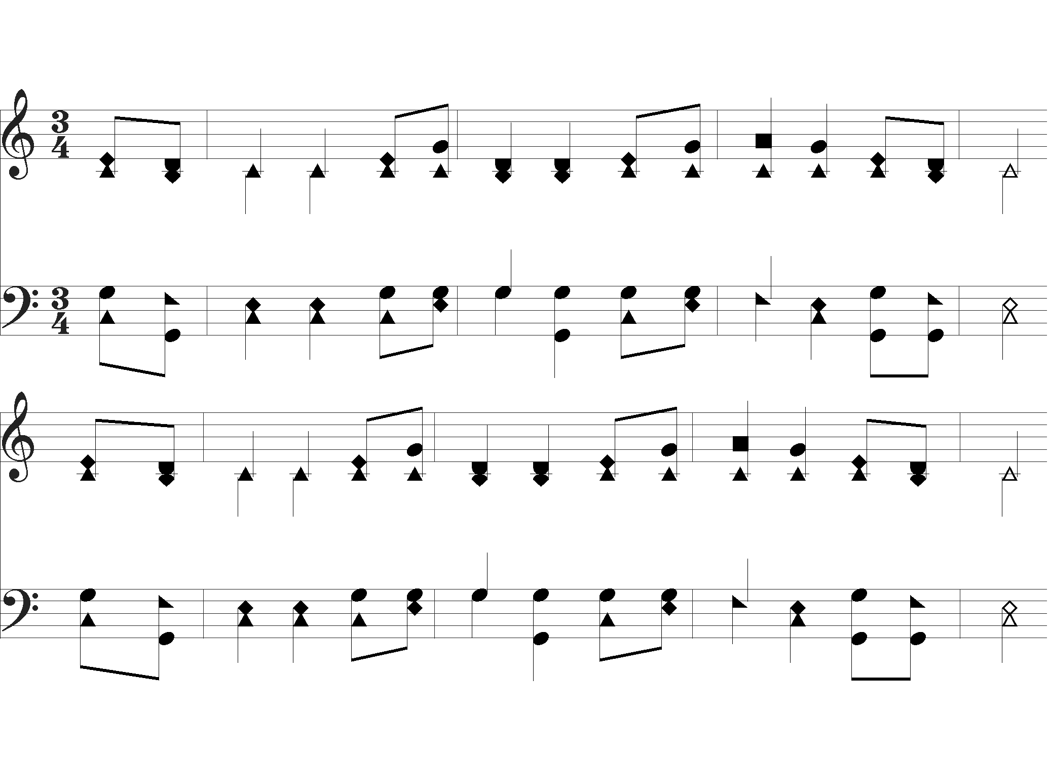
O Thou Fount of Every Blessing
O Thou Fount of ev- ’ry bles-sing,Tune my heart to sing Thy grace
Streams of mer-cy nev-er ceas-ing, Call for songs of loud-est praise
Words by: Robert Robinson
Music by: A. Nettleton
19 / 24

Slide 20
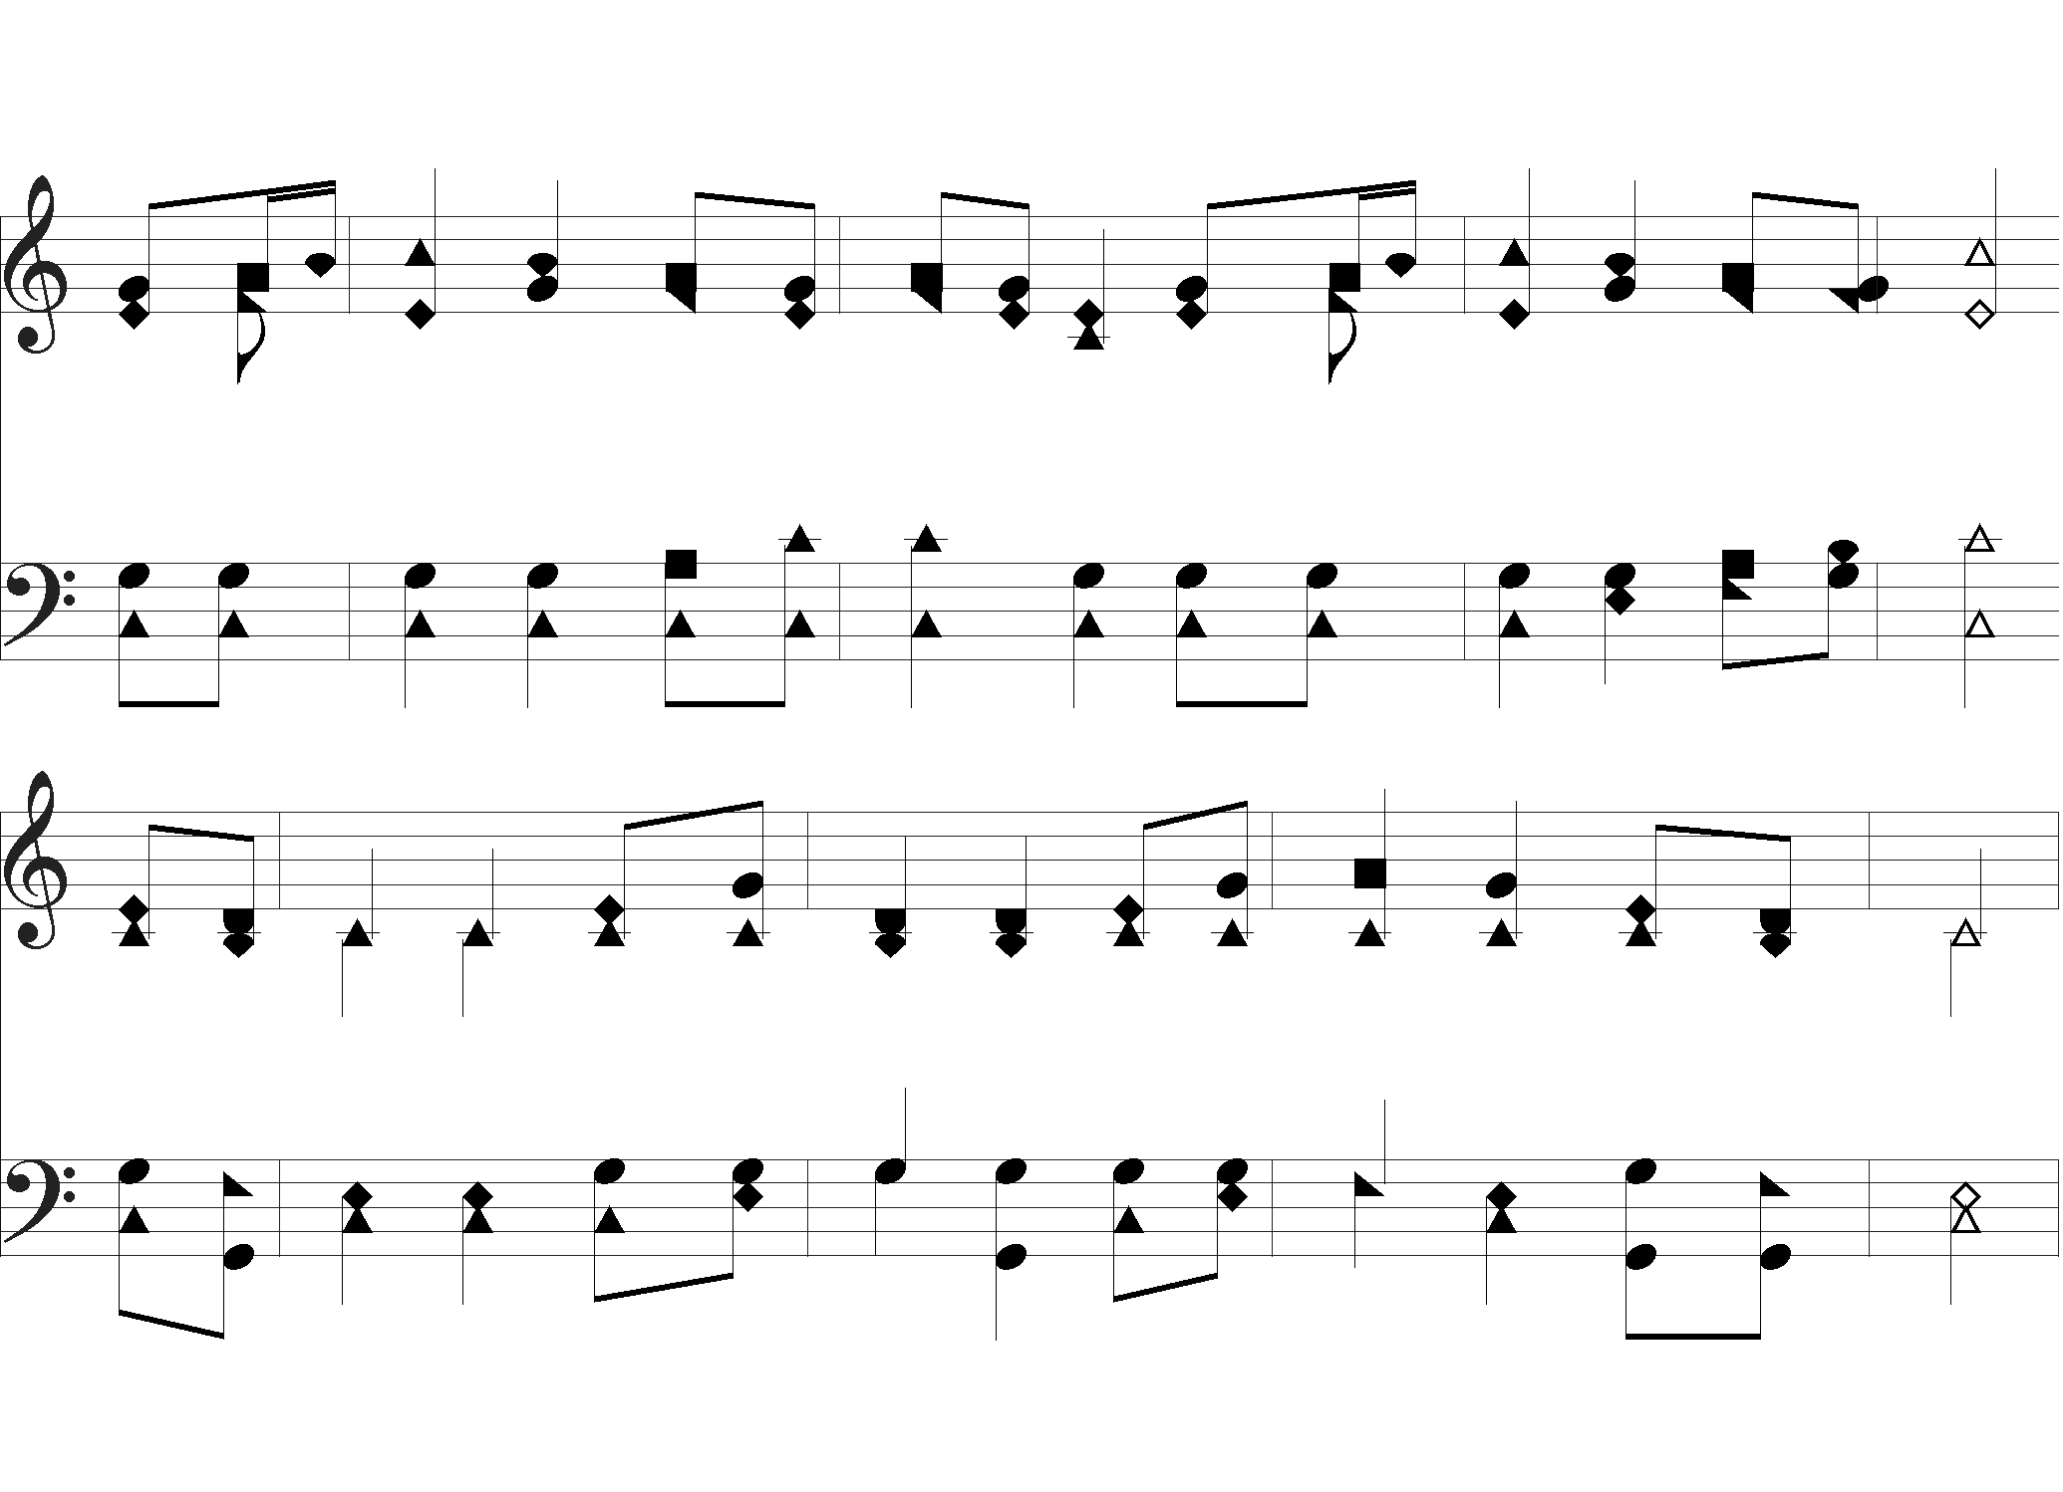
O Thou Fount of Every Blessing
Teach me ev - er to a - dore Thee, May I still Thy good-ness prove
While the hope of end -less glo- ry, Fills my heart with joy and love
segue to
“He is Wonderful”
20 / 24

Slide 21
He is Wonderful
Hal - le - lu - jah, Hal - le - lu - jah
All prai - ses be to the King of kings and
Hal -le - lu - jah! Sal - va -tion and glo-ry
Oh the Lord our God is might-y, The Lord our God is om - ni -
21 / 24

Slide 22
He is Wonderful
Hal - le - lu - jah, He is won - der - ful
the Lord our God! He is won - der - ful
hon - or and pow - er, He is won - der - ful
- po - tent Oh our God, He is won - der - ful
repeat
22 / 24

Slide 23
He is Wonderful
Hal - le - lu - jah, Hal - le - lu - jah
All prai - ses be to the King of kings and
Hal -le - lu - jah! Sal - va -tion and glo-ry
Oh the Lord our God is might-y, The Lord our God is om - ni -
23 / 24

Slide 24
He is Wonderful
END
rit.
Hal - le - lu - jah, He is won - der - ful
the Lord our God! He is won - der - ful
hon - or and pow - er, He is won - der - ful
- po - tent Oh our God, He is won - der - ful
24 / 24

Slide 25
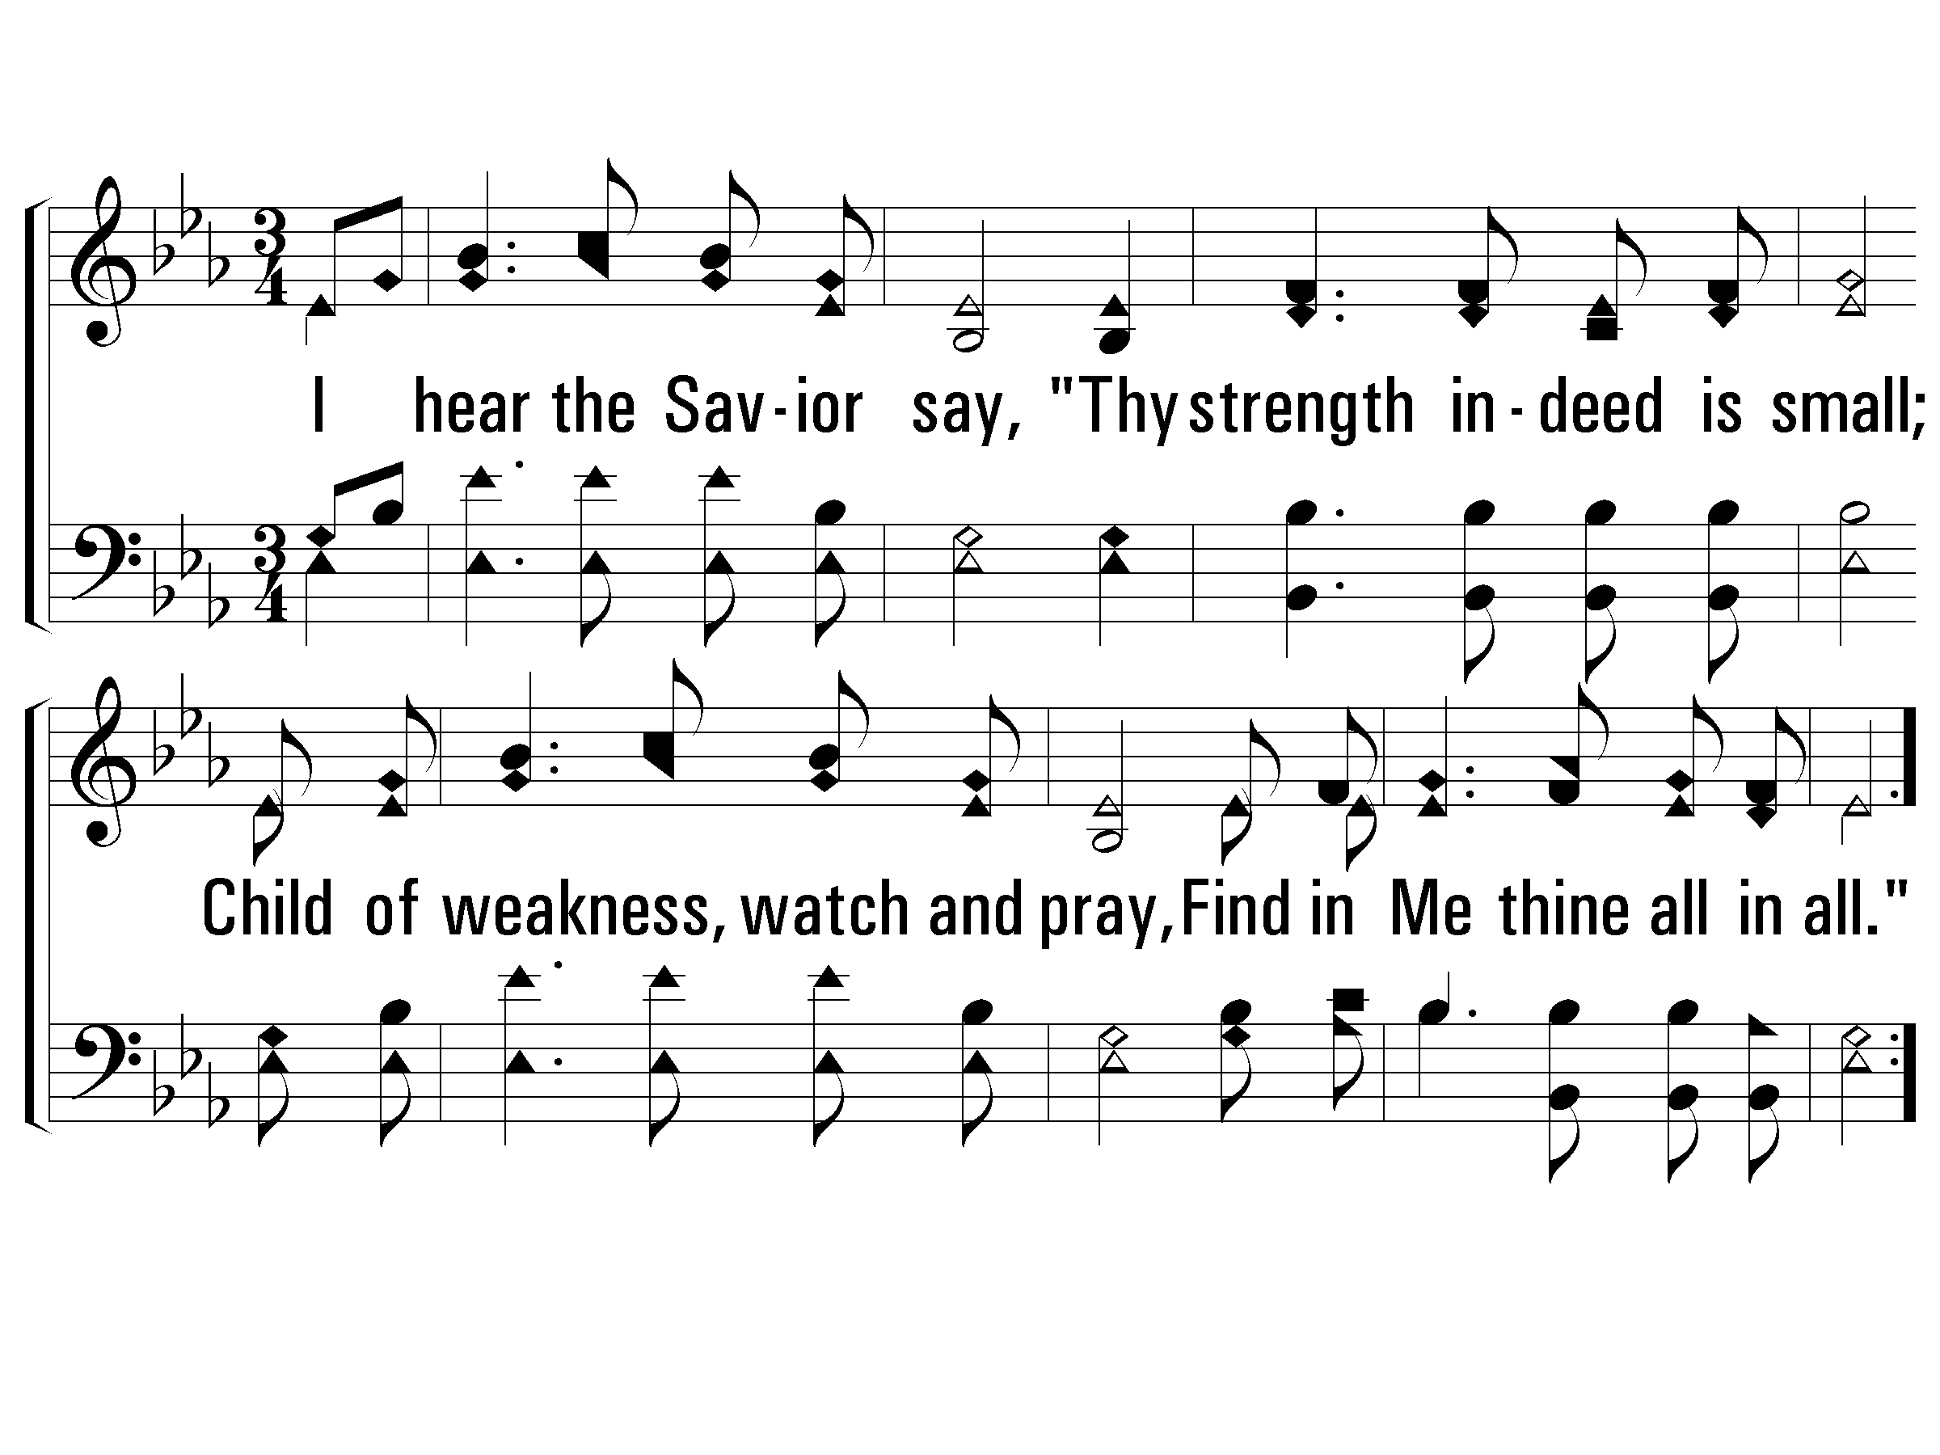
1-Jesus Paid It All
E^{b} / E^{b}
Words: Elvina M. Hall
Music: John T. Grape
© 2001 The Paperless Hymnal™
25 / 30
Notes:
Eb
Assurance, Blood, Communion, Cross, Heaven, Sacrifice

Slide 26
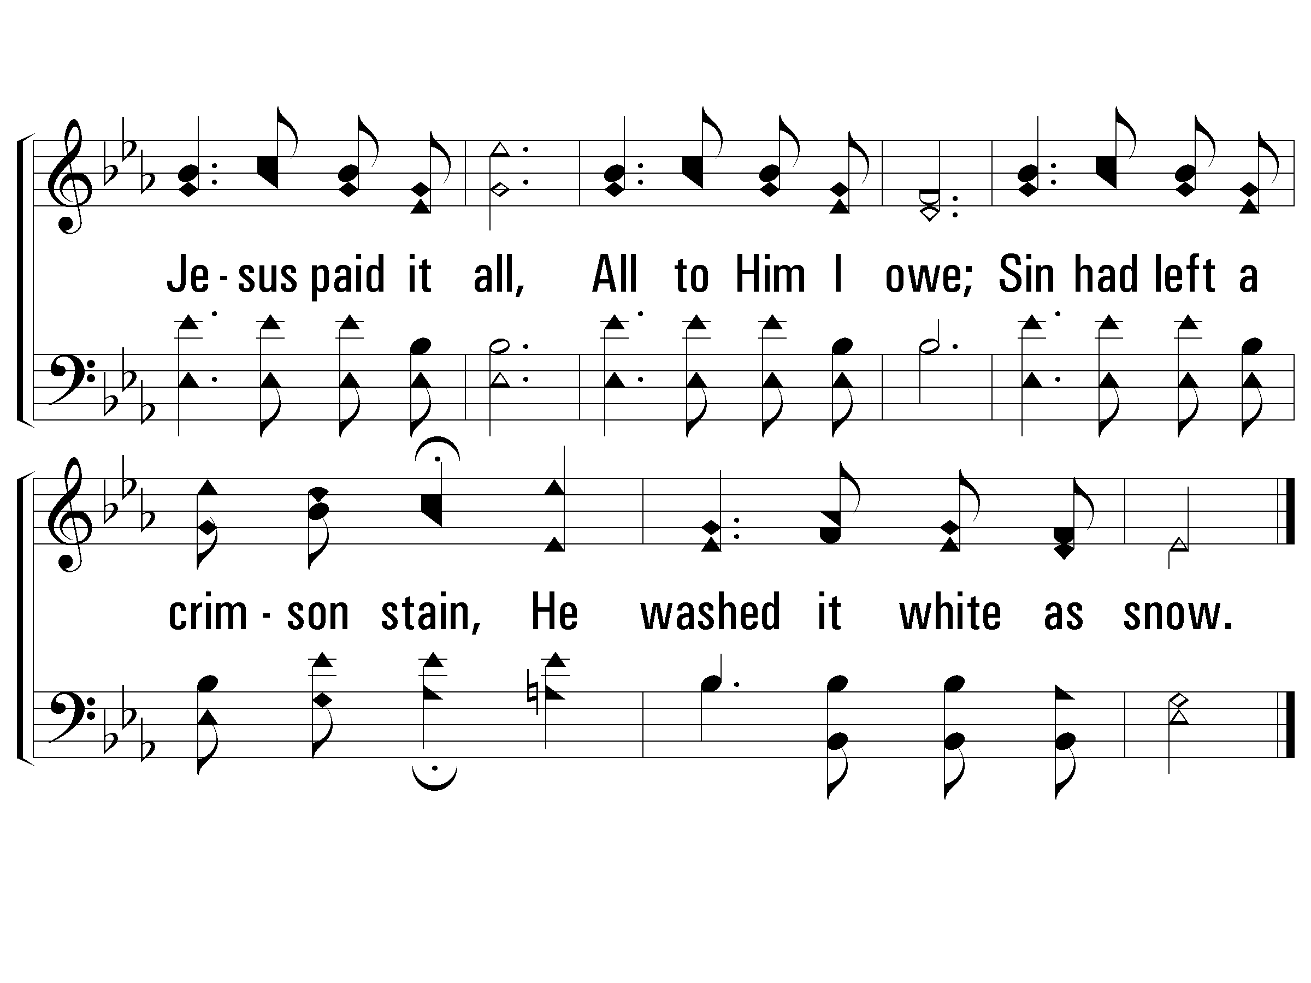
C-Jesus Paid It All
3: 29
26 / 30

Slide 27
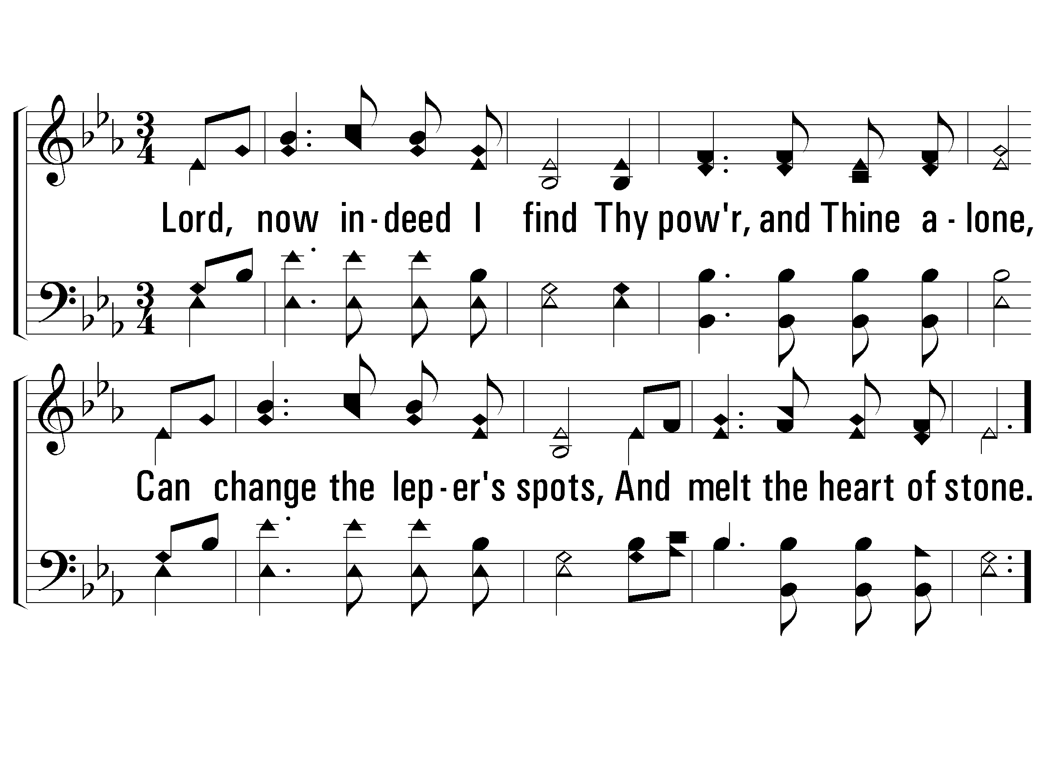
2-Jesus Paid It All
27 / 30

Slide 28
C-Jesus Paid It All
28 / 30

Slide 29
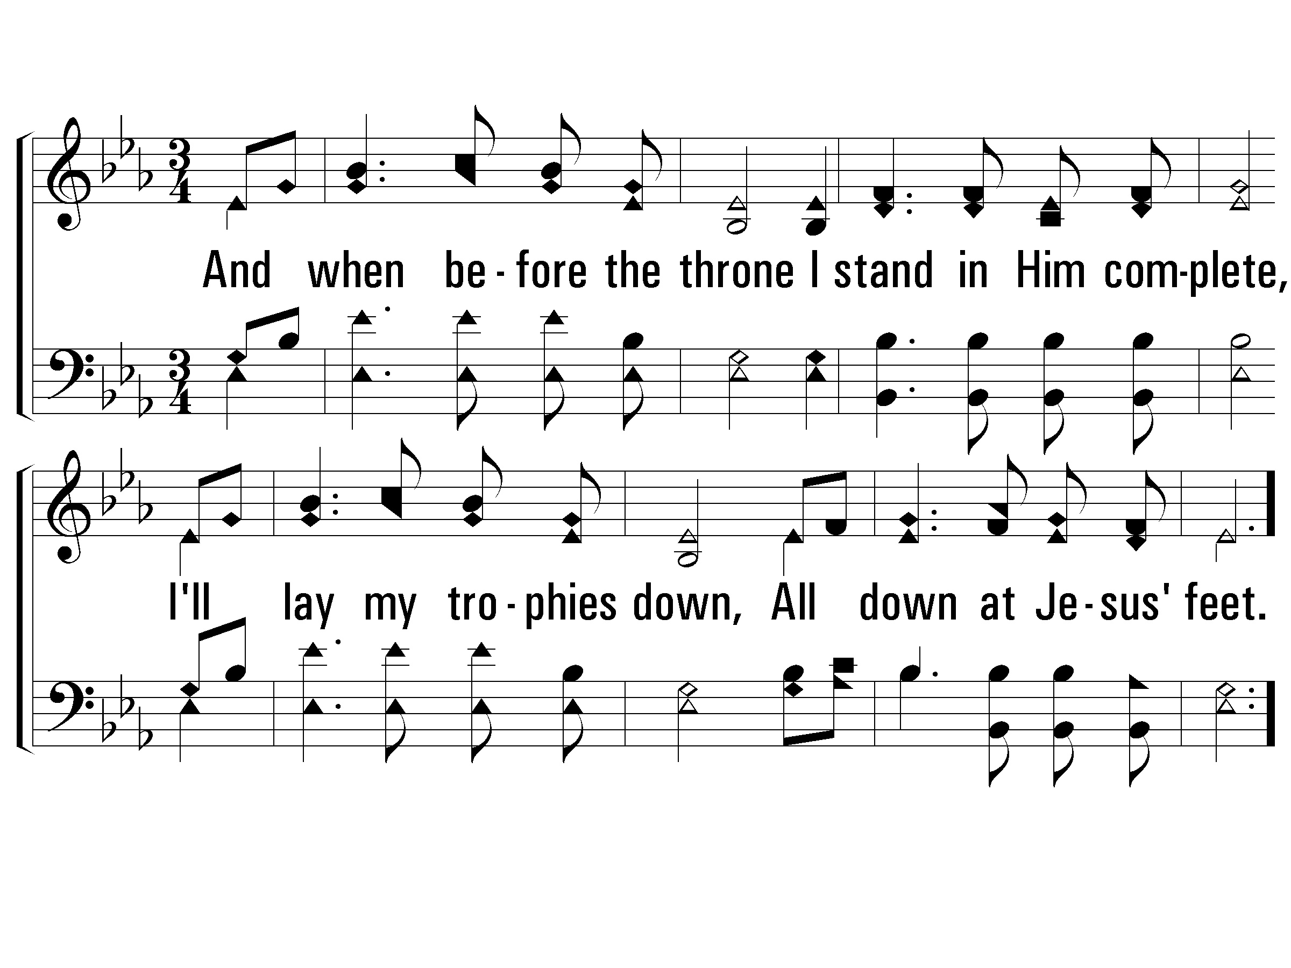
3-Jesus Paid It All
29 / 30

Slide 30
C-Jesus Paid It All
END
LC: 28
30 / 30

Slide 31
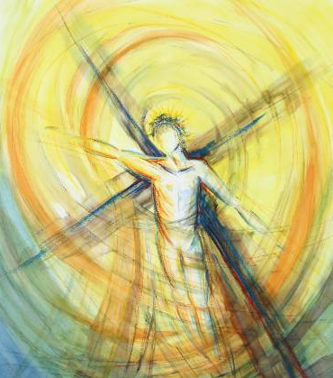
Communion. TAB ENTER to launch Communion charts. ESC to return.
Tab Enter to Communion slides
Notes:
Communion

Slide 32
1-Here We Are But Straying Pilgrims
G / G
Words by: I. N. Carman
Music by: W. O. Perkins
32 / 40
© 2001 The Paperless Hymnal™
Notes:
G
Faith, Guidance, Heaven, Protection

Slide 33
C-Here We Are But Straying Pilgrims

Slide 34
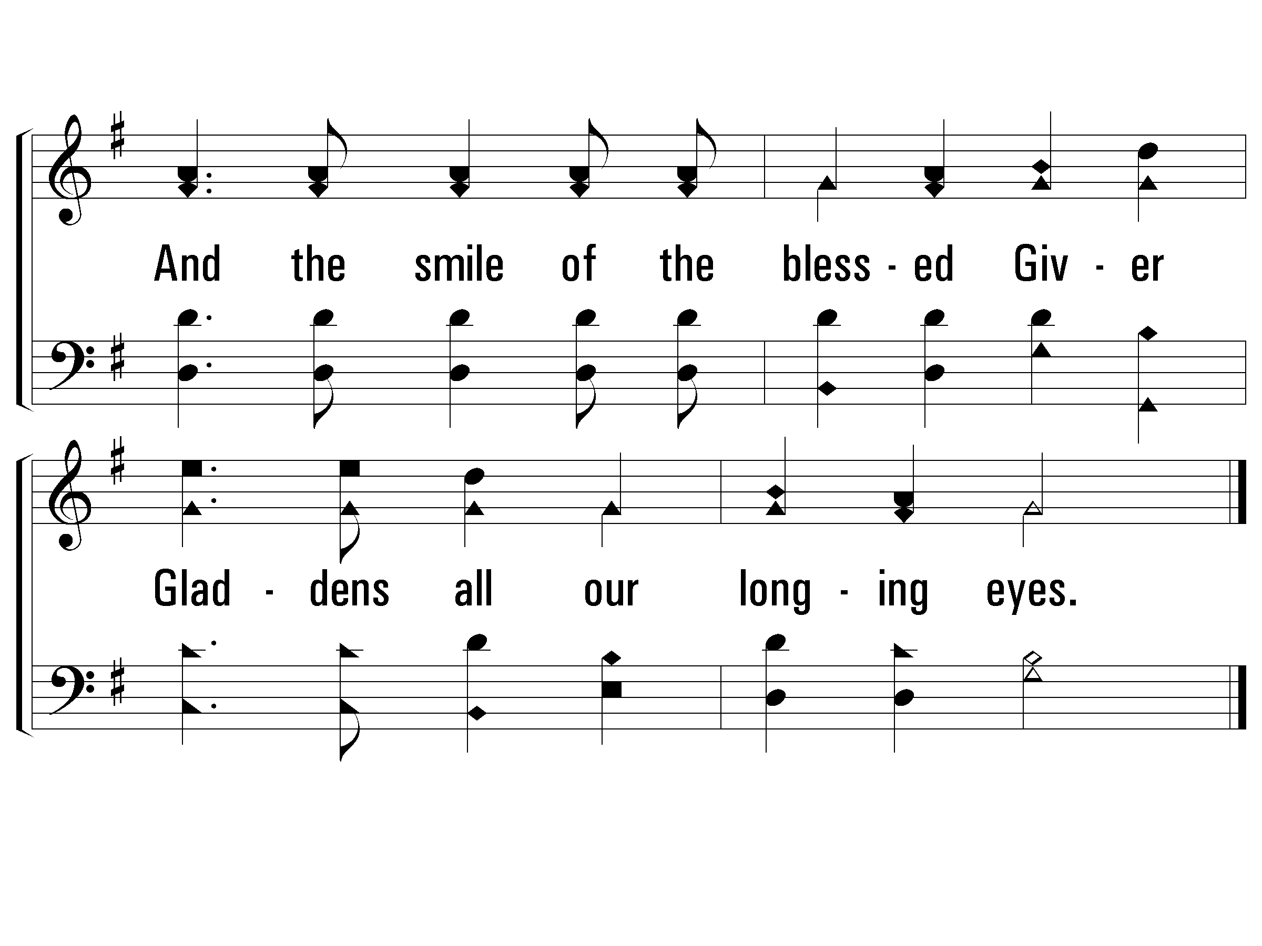
C-Here We Are But Straying Pilgrims
3: 38

Slide 35
2-Here We Are But Straying Pilgrims

Slide 36
C-Here We Are But Straying Pilgrims

Slide 37
C-Here We Are But Straying Pilgrims

Slide 38
3-Here We Are But Straying Pilgrims

Slide 39
C-Here We Are But Straying Pilgrims

Slide 40
C-Here We Are But Straying Pilgrims
END

Slide 41
Journey. TAB ENTER to launch Journey charts. ESC to return
Journey Point
July 7, 2019
Ed Smith
Journey Point Slides

Slide 42
Key Words Memory Verse Intro
Our Life Together
Jesus is seen in
how we treat one another
Key Words: Bear with and Forgive
Memory Verse: Colossians 3:13

Slide 43
Memory Verse
Bear with each other and forgive one another if any of you has a grievance against someone. Forgive as the Lord forgave you. Colossians 3:13
If you Fall link

Slide 44
Sermon. TAB ENTER to launch Sermon charts. ESC to return.
Reading

Slide 45
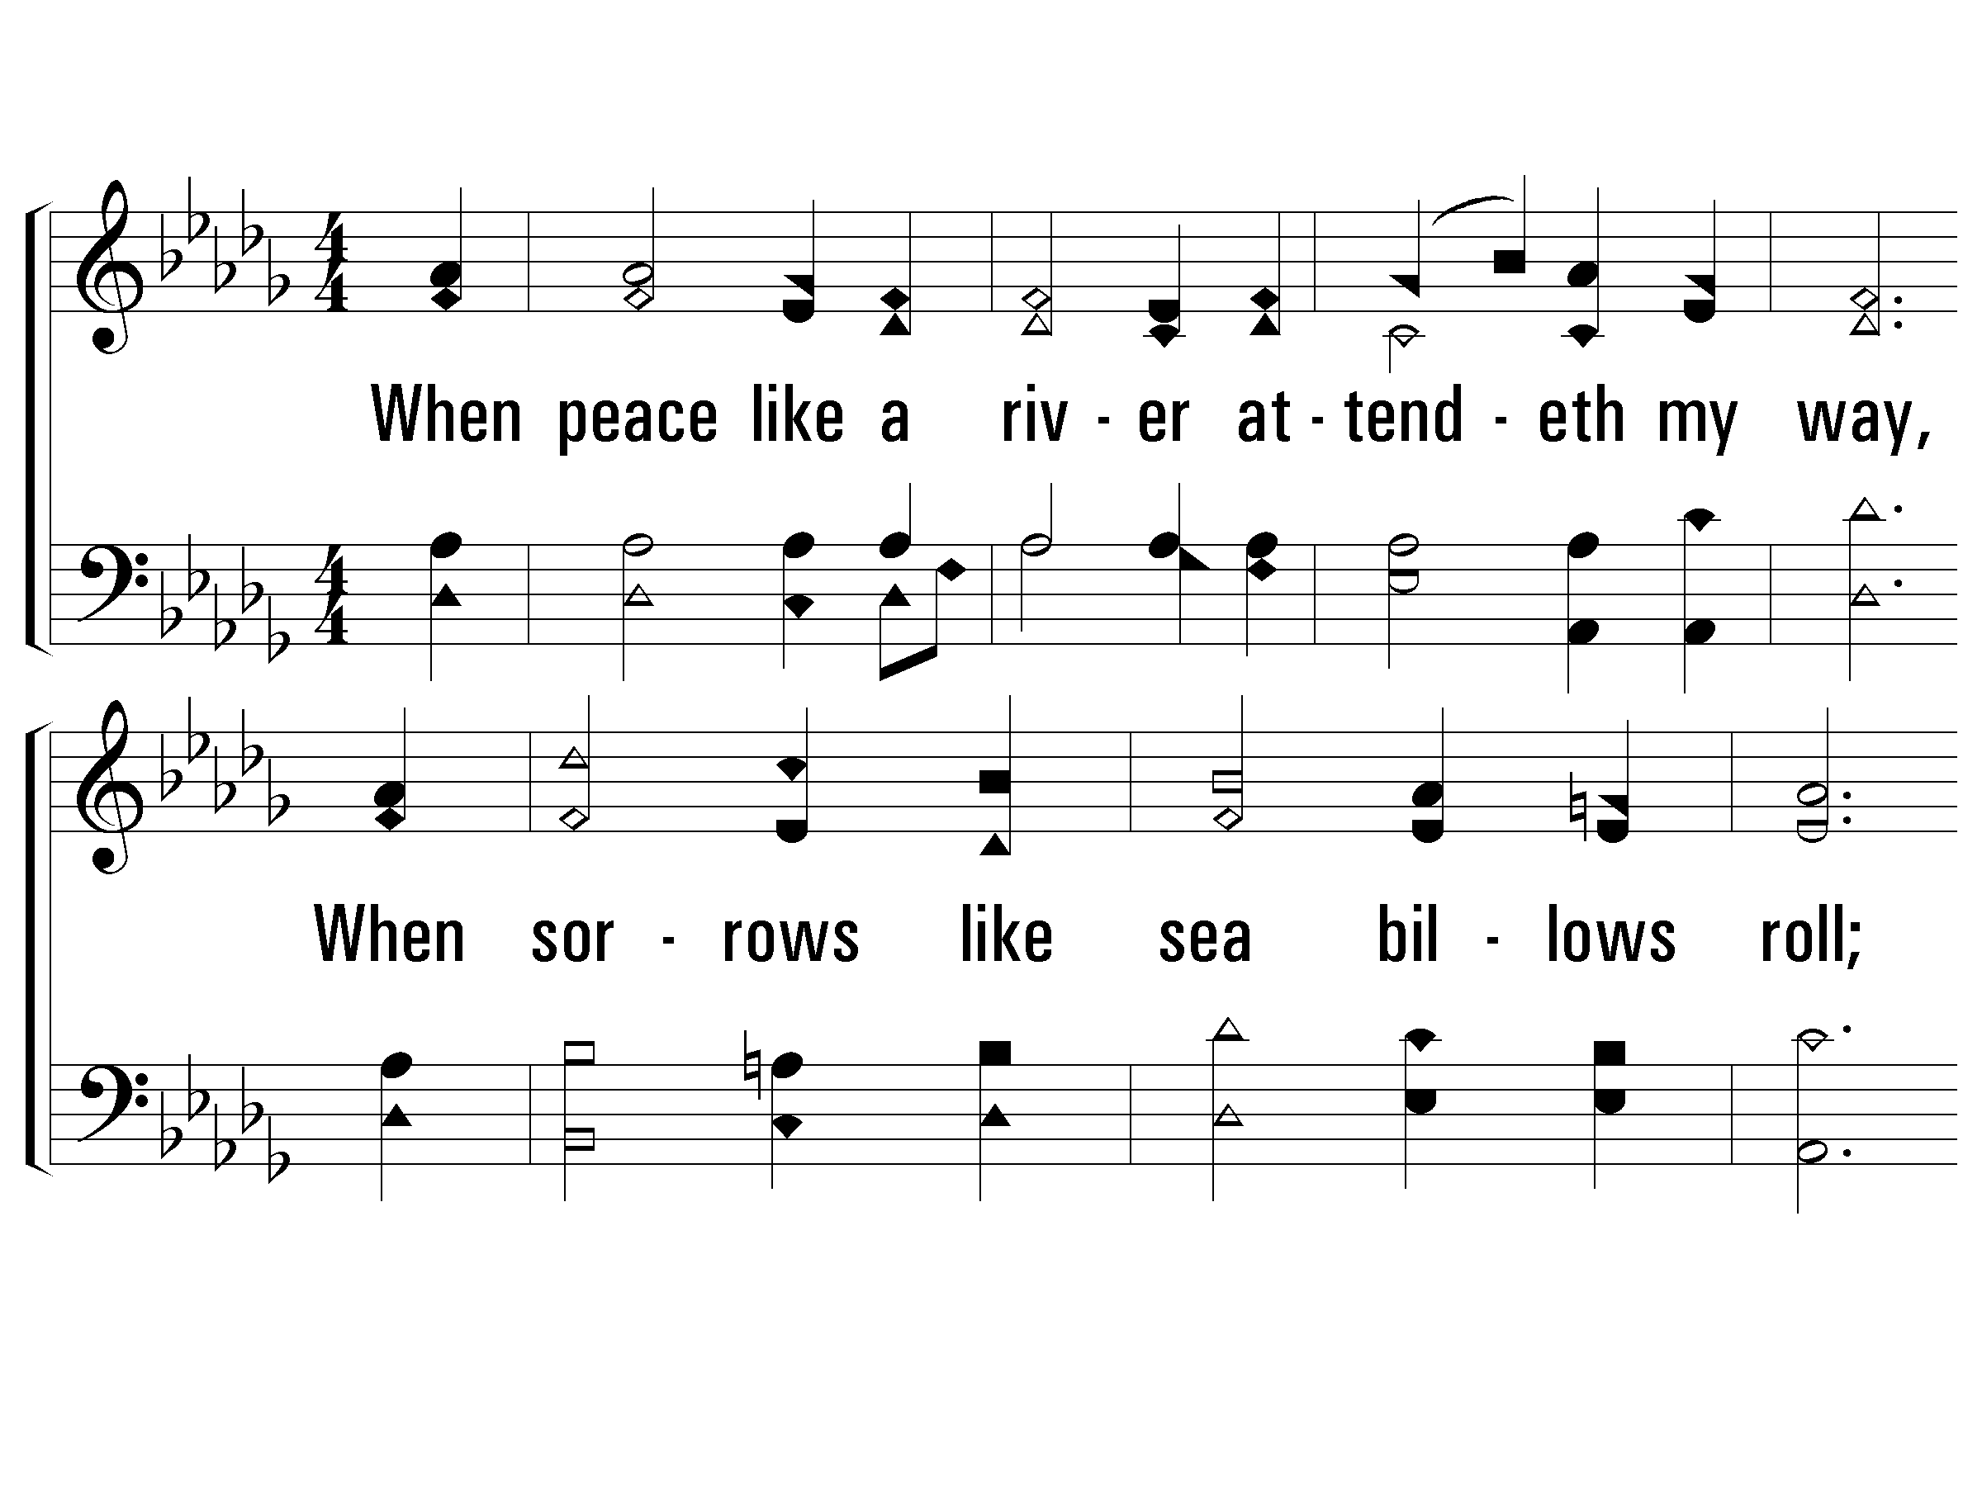
1-It Is Well With My Soul
D^{b} / A^{b}
Words by: H. G. Spafford
Music by: P. P. Bliss
© 2001 The Paperless Hymnal™
45 / 56
Notes:
Db/Ab
Assurance, Atonement, Comfort, Encouragement, Hope, Love Of Jesus, Peace, Sacrifice, Second Coming

Slide 46
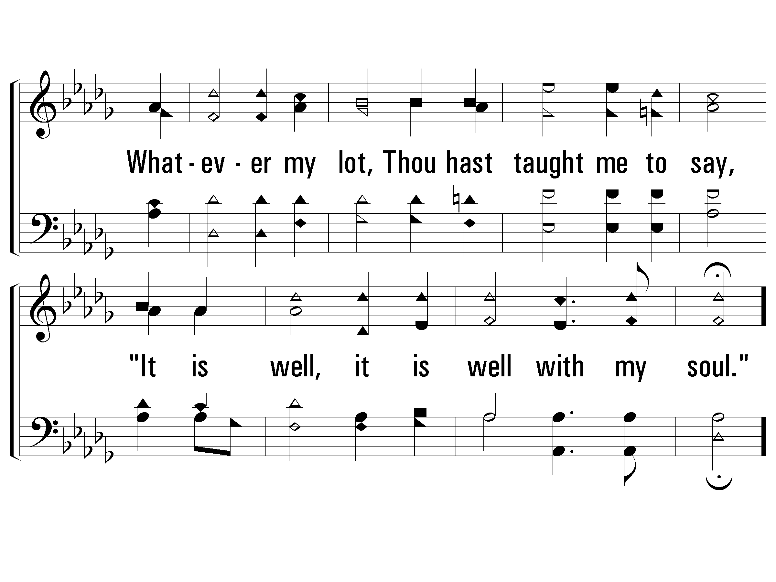
1-It Is Well With My Soul
46 / 56

Slide 47
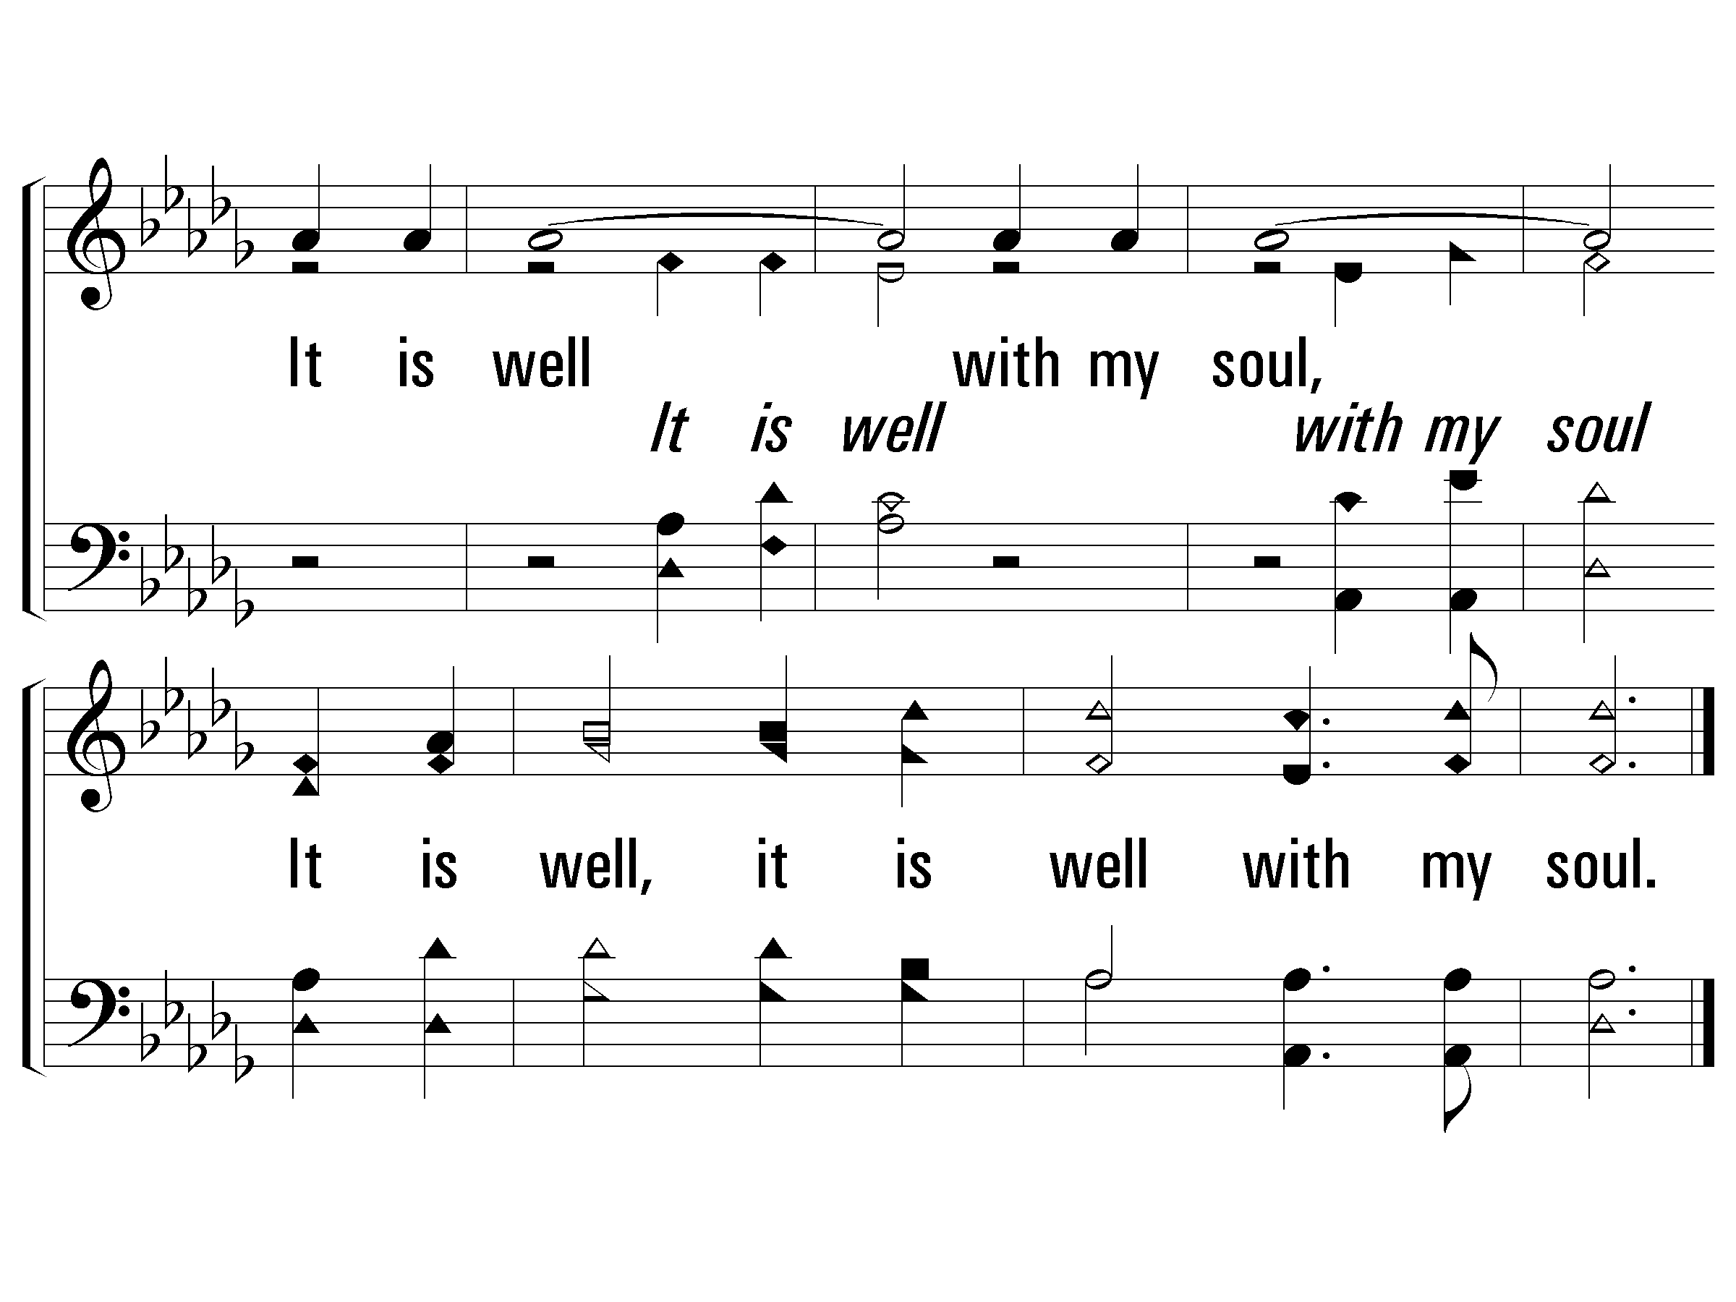
C-It Is Well With My Soul
3: 51
4: 54
47 / 56

Slide 48
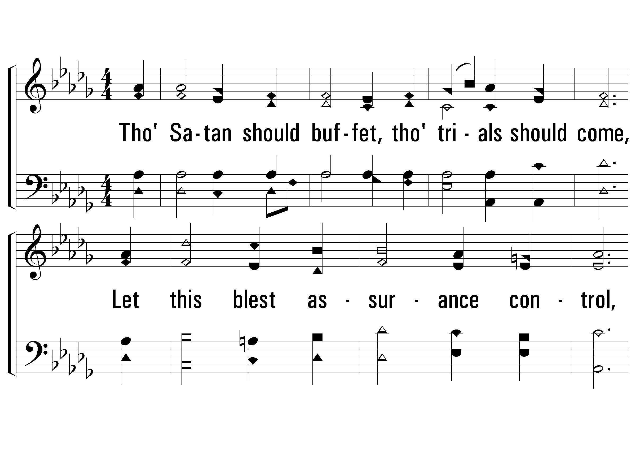
2-It Is Well With My Soul
48 / 56

Slide 49
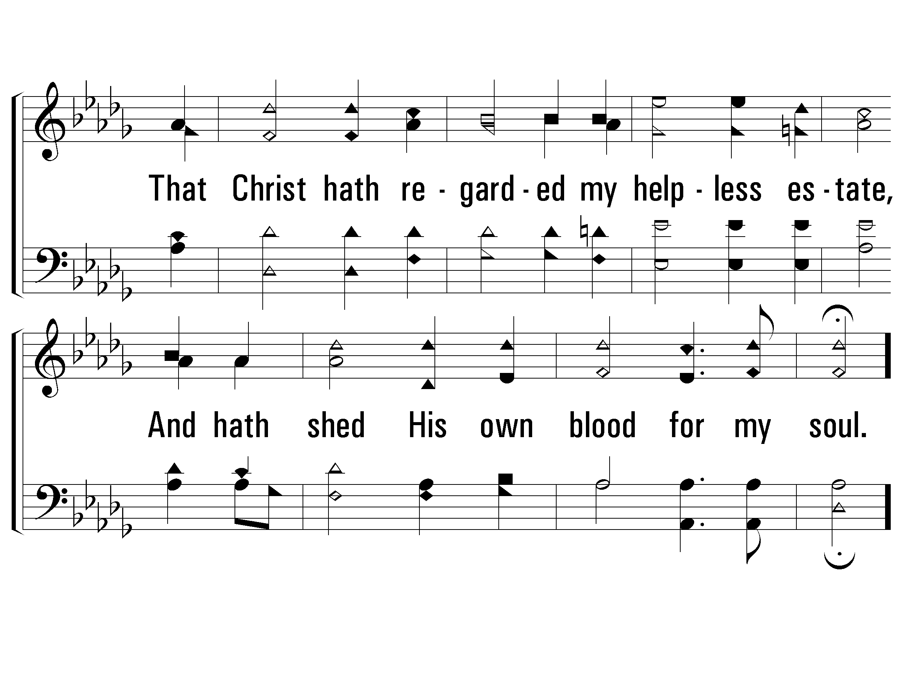
2-It Is Well With My Soul
49 / 56

Slide 50
C-It Is Well With My Soul
4: 54
50 / 56

Slide 51
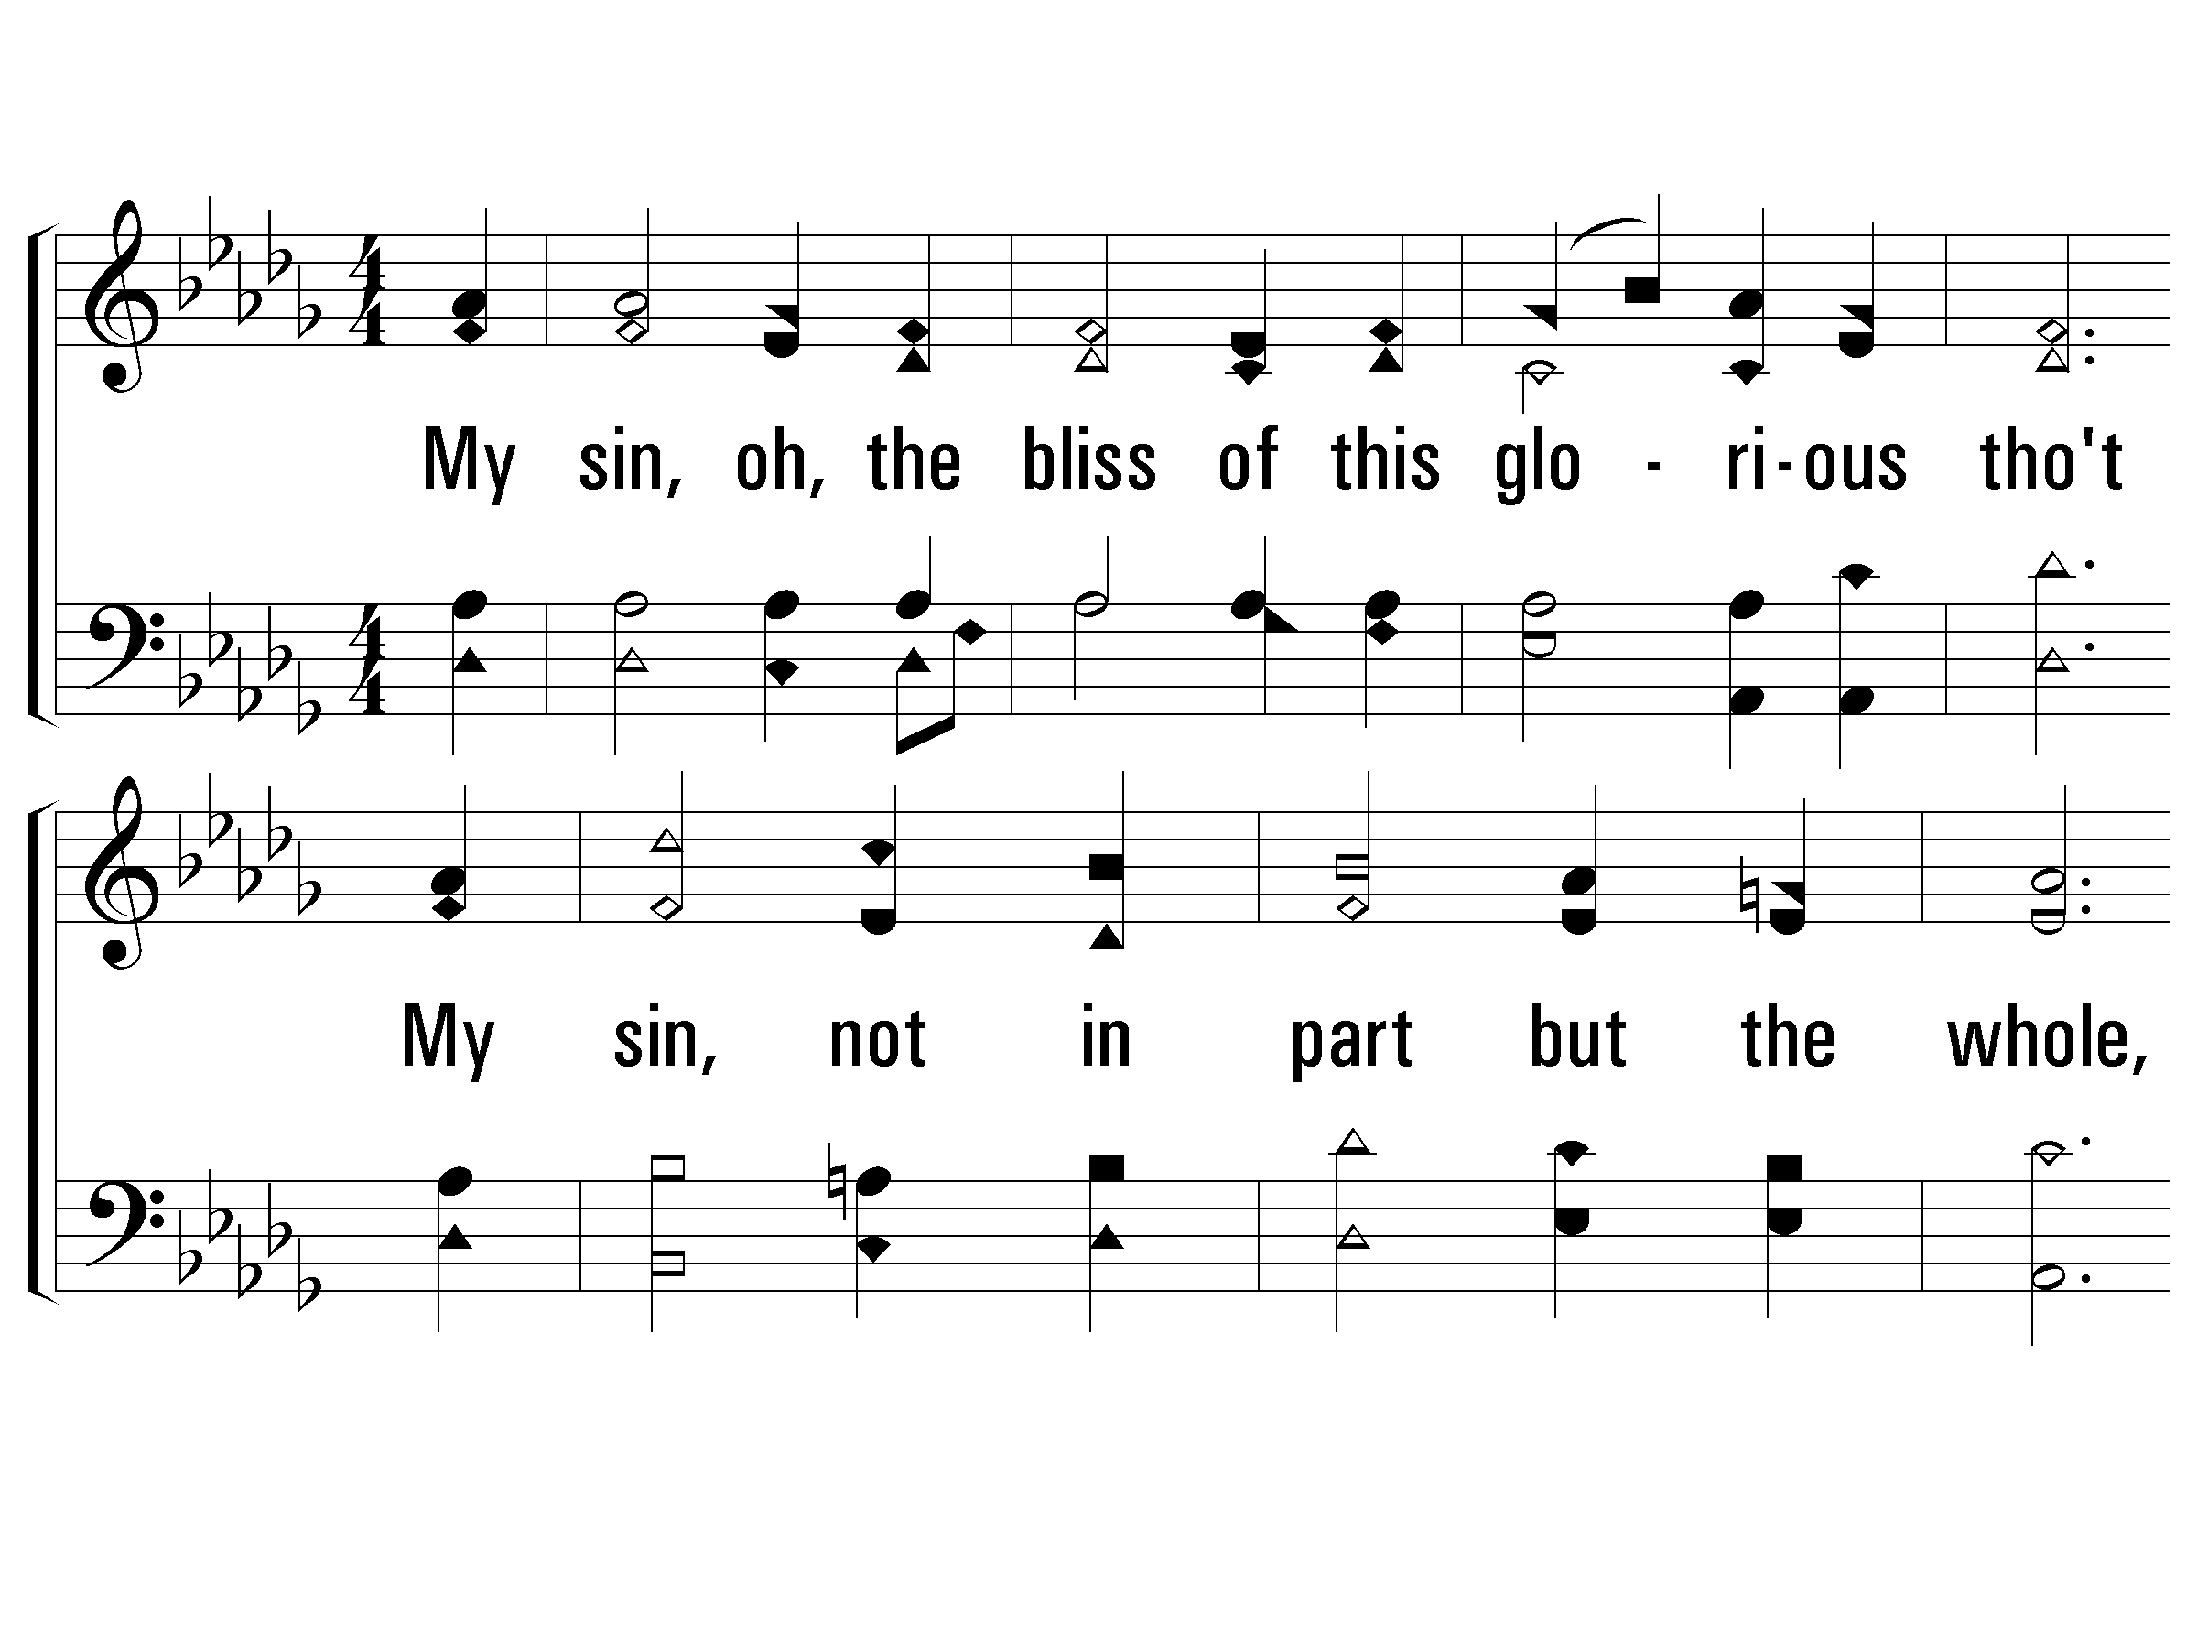
3-It Is Well With My Soul
51 / 56

Slide 52
3-It Is Well With My Soul
52 / 56

Slide 53
C-It Is Well With My Soul
53 / 56

Slide 54
4-It Is Well With My Soul
54 / 56

Slide 55
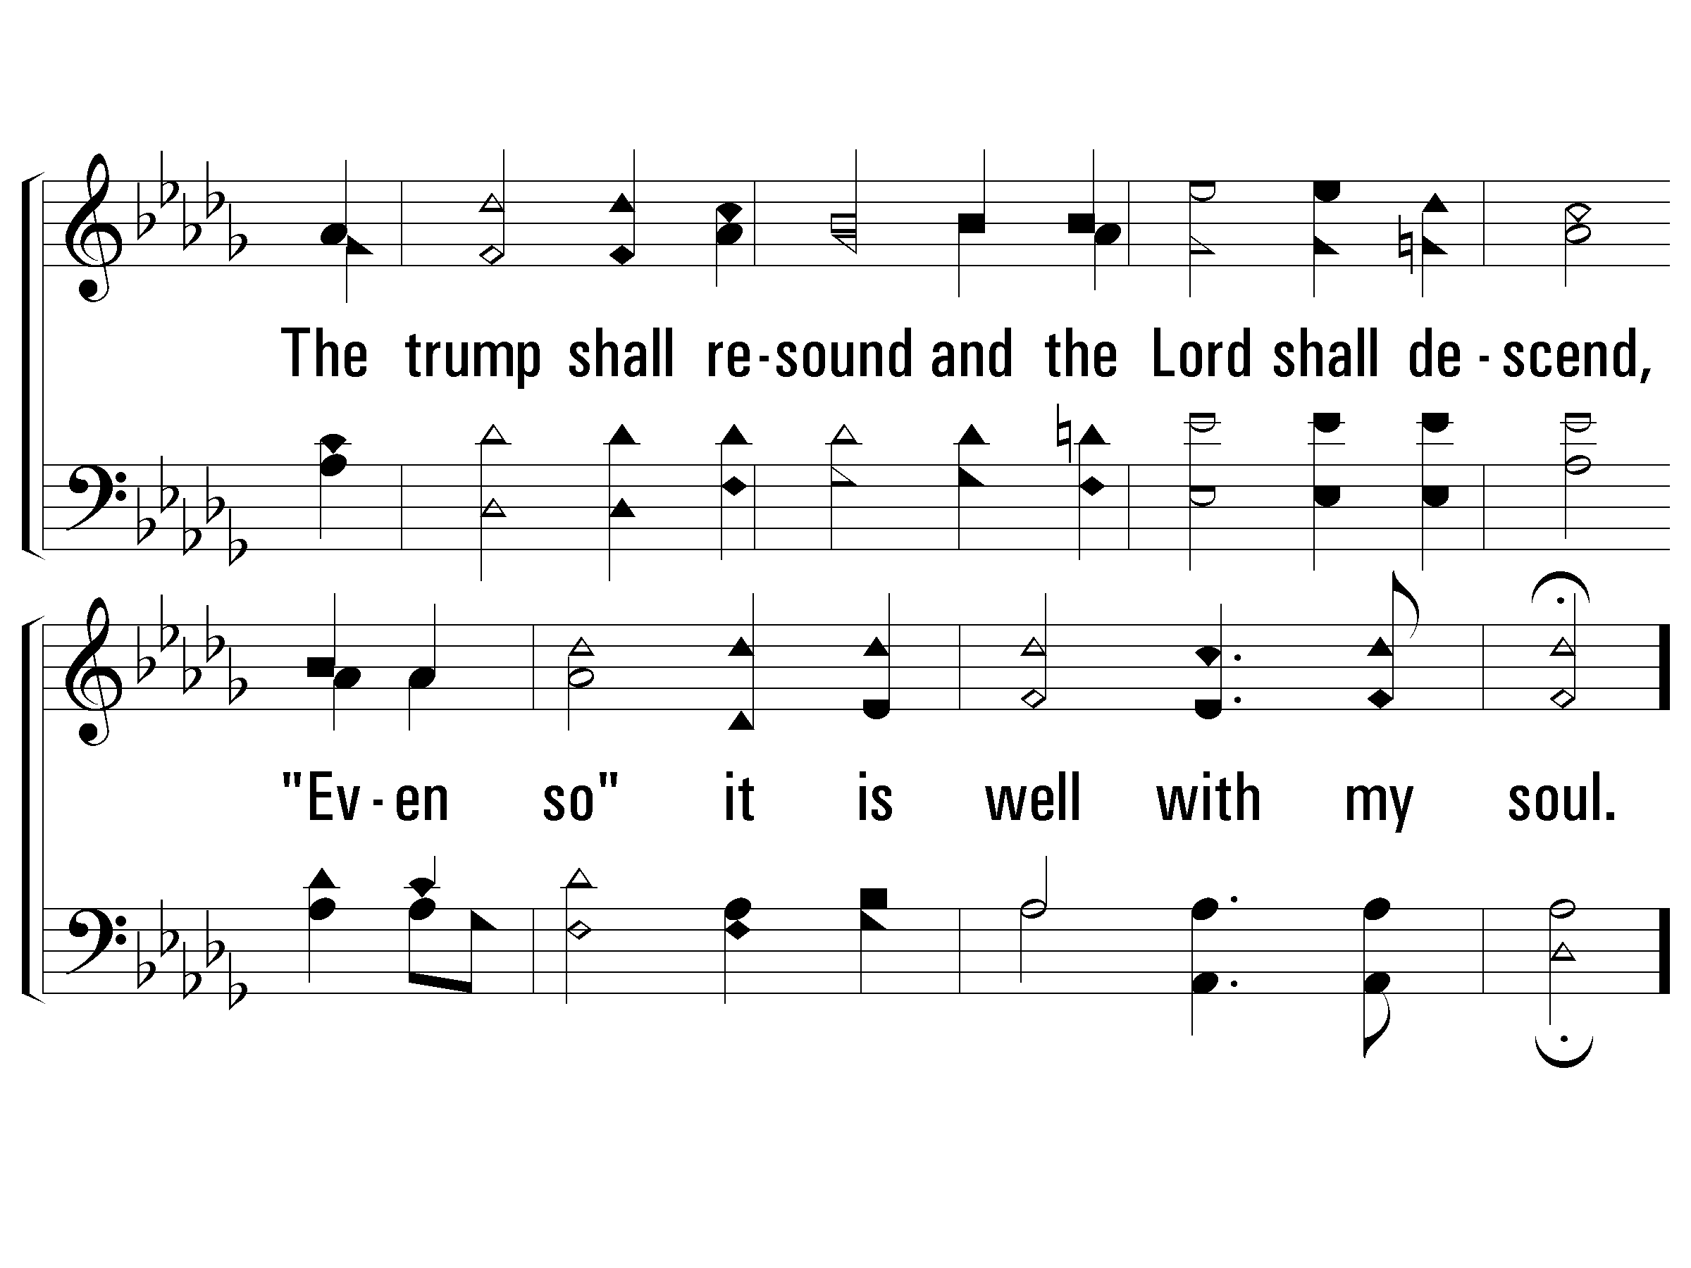
4-It Is Well With My Soul
55 / 56

Slide 56
C-It Is Well With My Soul
END
56 / 56

Slide 57
Sermon. TAB ENTER to launch Sermon charts. ESC to return.
Reading

Slide 58
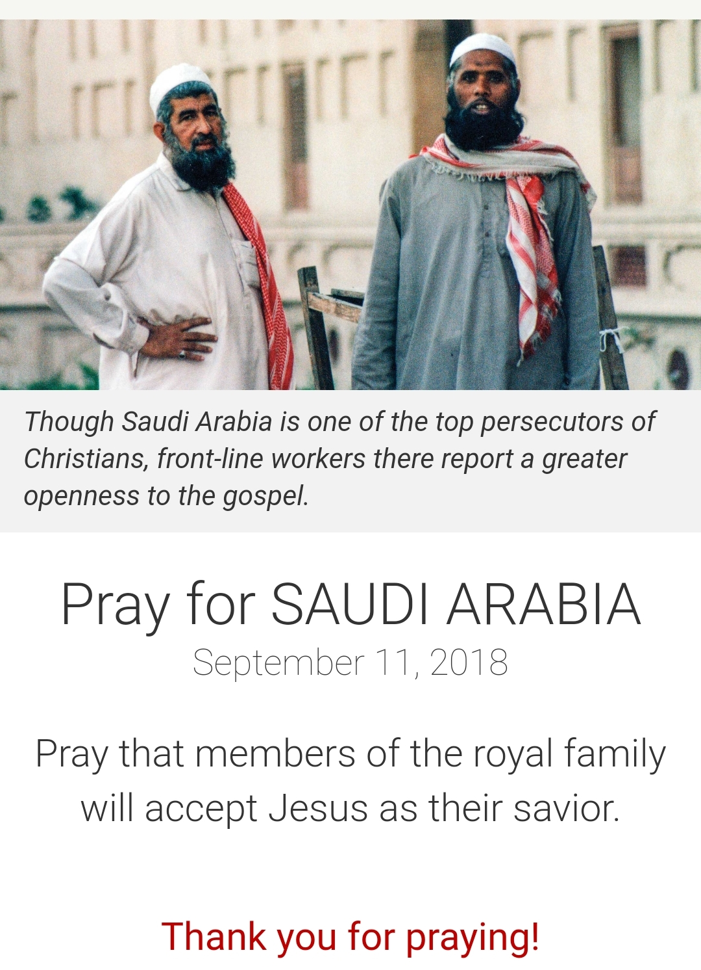
Remember those who are in prison, as though in prison with them, and those who are mistreated, since you also are in the body.
Hebrews 13:3
Pray for Saudi Arabia
Notes:
Pray for Saudi Arabia

Slide 59
Journey. TAB ENTER to launch Journey charts. ESC to return.
FOUNDATIONS
Journey Thoughts
Notes:
Richard slides tab enter

Slide 60
Journey. TAB ENTER to launch Journey charts. ESC to return.
Journey Thoughts
Notes:
Richard slides tab enter

Slide 61
Song Library Link Slide
Song Library
Central PowerPoint Song Library
This slide appears blank
Press <TAB+ENTER> to Launch Library
<ESC> in Library to return to this slide
Notes:
Press <TAB> then <ENTER> to Launch Song Library. <ESC> to return to this slide.

