Slide 1
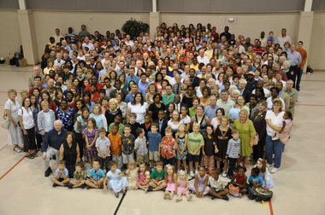
A Body in Motion
Inward -- Our Life together in Christ
A Sharing, Caring, Christ Centered, Biblically Guided, Community of Believers
All parts are essential: 1 Corinthians 12
April 28, 2019

Slide 2
Deep Concern Among Sociologists: Radical Individualism
Our culture is moving toward irresponsible radical individualism
Non-believing sociologists and behavioral psychologists are deeply concerned. Multiple studies showing trends…
Unfortunately, the church has followed culture – in a sense we have done to community what biology teachers do to frogs – we have dissected our churches into dead parts on lab table.
What could we do together?
This is God’s design for humanity. Consider a theology of creation. All created in beautiful interdependency.
Paul’s favorite metaphor for the church? A body of many parts with the same heartbeat and only one command center – Jesus!

Slide 3
What I learned from coaching…
Coached professional baseball, coached basketball on various levels, coached university track and field, 15 years coached Cross Country.
Takes a strong team to win – individual stars are less important than strong team play.
Individualism destroys the team dynamic.
I coached according to biblical principles – regard each as more important than self.
Individual athletes had to be involved in holistic training – all parts of the body developed – not just those needed in that particular sport.

Slide 4
1 Corinthians 12 as a model for the church
Different gifts, same Spirit; different ministries, same Lord.
Different kinds of working – but same God at work (Triune)
Each part designed for common good.
Distribution of gifts are by the Spirit’s design and determination
Baptism forms us into ONE unified body.
Spiritual inferiority? NO! Foot “not a hand…” Ear “not an eye”?
Spiritual superiority? NO! Eye “I don’t need hand!” Head “feet?”
There is no part of which can be said, “We don’t need you!”
Weaker are indispensable – treat with special honor.
Pain? All suffer; honor? All rejoice!

Slide 5
Argument – “Spiritual Gifts” Thus, this is not applicable today
This is the design of the church – many parts, all different
Early church needed a jump start to understand the need for interdependency – supernatural gifts or not do not change God’s design for the church...
Our responsibility? To find what we have to offer and where we fit.
A body that is not united cannot function…
We are where we are by divine placement.
The eye without the body is useless.
The hand without the eye cannot function well…
What unites us in the mind of Christ (Ephesians 4:15,16)
Philippians 2:4-11 is our anthem as the body of Christ

