Slide 1
Walking-in-life Prayer
Ephesians 1:15-19a
UPWARD

Slide 2
I, Paul, (Christ Jesus’ messenger by God’s design), write those made holy in Christ Jesus and who exercise their faith
in the city of Ephesus.
Grace and peace come to you from God our Father and the Lord Jesus Christ.
Paul’s Letter To
The Ephesian Christians

Slide 3
Shout Hallelujah and brag about
the God and Father of our
Lord Jesus Christ!
He has blessed us with every single spiritual blessing in Christ.
Paul’s Panoramic
view of God’s Great Plan
1:3-14
For, before the creation of the world, God decided that when he looked upon those in Christ, he would see
them as holy and blameless people. In his love he
decided long before creation that he would
adopt us through Jesus Christ because it
gave him great pleasure and he wanted to do it.

Slide 4
Paul’s Panoramic
view of God’s Great Plan
1:3-14
Oh, we can brag about this tremendous grace! He gave us this grace, this gift, without cost to us
in the One he loves. In him we have been purchased by his blood and
in accordance to God’s great riches he has completely forgotten about the wrongs we have done against
him. He lavished his free and beautiful gift on
us because he knew that that was exactly
what we needed.

Slide 5
Then, he let us in on a secret, his own personal secret, because it gave him good pleasure and he had planned this all along in Christ.
Here’s his “open secret:”
Paul’s Panoramic
view of God’s Great Plan
1:3-14
Under Christ’s management and control (at just the right moment and with precise timing) all things
in heaven and on earth are brought back
once again, under his rule.

Slide 6
Paul’s Panoramic
view of God’s Great Plan
1:3-14
In him we were also made heirs, having been destined long ago to receive our inheritance according to His perfect plan (he works out everything, like a Master musician
leading a choir in perfect harmony according to his will) so that we, the first ones to place our hope
in Christ might be a song of praise, of rightful braggadocio to his glory.

Slide 7
Paul’s Panoramic
view of God’s Great Plan
1:3-14
And you, too, were included in Christ when you heard his truth, the good news of your salvation.
Having completely turned your
trust over to him, a seal was
permanently imbedded in you, the promised Holy Spirit. He is a down payment to you, which guarantees
that you will receive an inheritance when God finally closes the books on all that are his.
Praise His Glory!

Slide 8
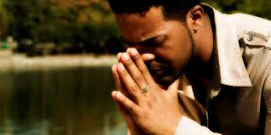
Distractions of life – busy-ness – worries and concerns
Time of Prayer
Paul’s life of prayer
“I have not stopped”
“Please help me get out of this situation”
A lifestyle, a way of thinking,
a pattern of life

Slide 9
“Walking-in-life prayer”
Pray continually
~ 1 Thess. 5:16
Time of Prayer
Smart phones that keep us dumb;
time-saving devices and we have no time;
involved with sports that we have quenched the Spirit;
TV’s have caused our minds to shift into idle
so that we no longer think.

Slide 10
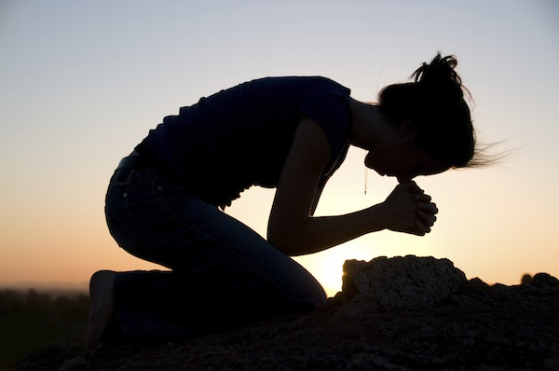
Their faith
in the Lord Jesus
The daily exercise of faith
Trigger for Prayer
Faith penetrates one’s life & invokes positive change.
Often it is an event or an appointment
Faith is centering one’s
life in Jesus.
Faith is placing allegiance
in him

Slide 11
Their love
for all God’s people
How people know you’re Jesus’ disciples
Trigger for Prayer
The opposite of thankfulness…
is taking things for granted

Slide 12
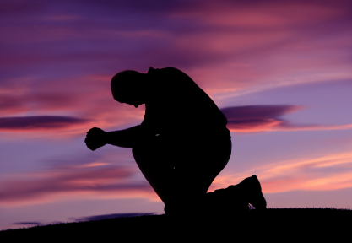
God may give you the spirit of wisdom and revelation
This is a prayer for growth
Subject of Prayer
Know him better
Know what is in store for them
Know incomparable power

Slide 13
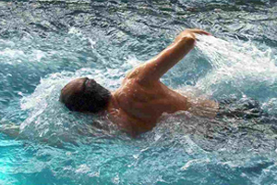
ASWIM
Go for
A. S.W.I.M.
pply these to your life.
urround yourself with God’s people
alk through life in prayer
mmerse yourself in God’s word
editate on the goodness of God and
the person of Christ,

