Slide 1
Not An Open Secret
Ephesians 1:7-10
UPWARD

Slide 2
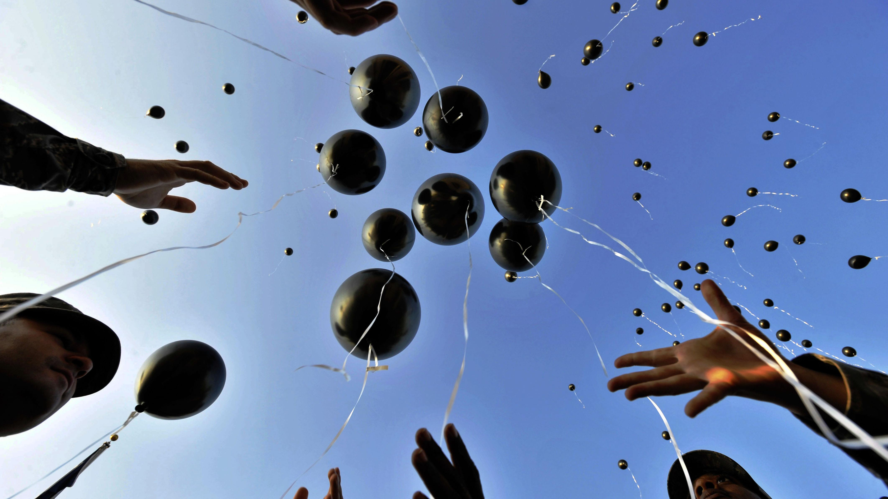
Redeemed & Forgiven v. 7
Ps. 103:12 ~As far as the east is from the west he removed our transgressions from us
Micah 7:19 ~ hurl our iniquities into the depths of the sea.
To let go, send away
Power of the Blood of Christ
God made him who had no sin to be sin for us, so that
in him we might become the righteousness of God
2 Cor. 5:21

Slide 3
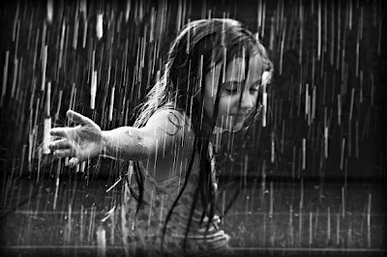
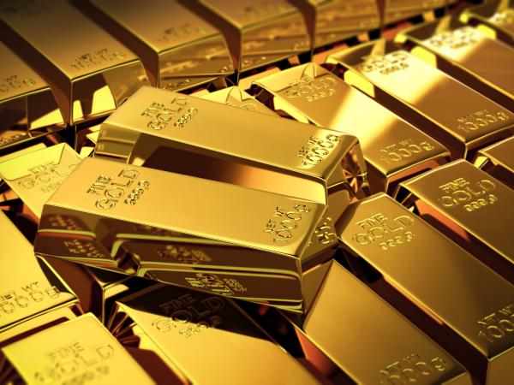
Source of Redeemed & Forgiven
Riches of God’s grace
LAVISHED
An abundance that goes beyond the expected measure
“On us” - God’s grace penetrates into
our very being – becomes a part of us – changes us

Slide 4
Wisdom & Understanding v.8b-10
True wisdom: God’s insights
Understanding: Practical application
The Mystery
Not something that can’t be understood
God revealed it
An Open Secret

Slide 5
What is the Mystery of his will?
to be put into effect when the times reach their fulfillment—to bring unity to all things in heaven and on earth under Christ.
Oikonomia – managing a house or stewardship
that in the dispensation of the fullness of times
He might gather together in one all things in Christ, both which are in heaven and which are on earth, even in Him.
Under Christ’s management and control,
(at just the right time and with precise timing)
all things, in heaven and on earth,
are brought back, once again,
under his rule.
Right moment – perfect timing
“sum up”
ανακεφαλαιωσασθαι
again

Slide 6
Now - - Not Yet
At the cross all things began anew
In him we have redemption through his blood, the forgiveness of sins, in accordance with the riches of God’s grace that he lavished on us
Our past: Redeemed!
Our Present: Forgiven!
Our Future: Assured!

