Slide 1
Ephesians:
Pointing us Upward

Slide 2
The “Queen of the Epistles” “
The crown of Paul’s writings” “Marvelous,” “The most profound book in all the bible”
“God the Father”
“If read receptively, it is a bombshell.”

Slide 3
God-centered/Christ Focused
“By the will of God”
You’ll be amazed at God’s will
“Of Christ Jesus”
Center our thoughts and teachings
around the words of Christ.
God our Father and Lord Jesus Christ

Slide 4
The Bible is God’s book, it is the revelation of God, and our thinking must always start with God. Much of the trouble
in the Church today is due to the fact that we are so subjective, so interested in ourselves, so egocentric….Having forgotten God, and having become so interested in ourselves, we become miserable and wretched…The message of the Bible from beginning to end is designed to bring us back to God, to humble us before God, and to enable us to see our true relationship with him. And that is the great theme
of this Epistle; it holds us face to face with God, and what God is, and what God has done; it emphasizes throughout the glory and the greatness of God – God the Eternal One,
God the everlasting, God over all and the
indescribable glory of God.
Martin
Lloyd
Jones

Slide 5
GRACE & PEACE
Grace is a gift we don’t deserve.
Love extended to the unlovely.
It is kindness given to those who do not deserve kindness. Grace is riches given to the beggarly poor, health given to
those with incurable sickness;
forgiveness extended to those
who deserve punishment.
Peace:
“union” – a bringing together, tying everything together into a whole; reconciliation.

Slide 6
Who We Are
Saints:
“set apart” or “holy ones”
Saints are no longer in union and in step with the world but in union and in step with God.
Faithful:
“believing ones”
“I believe!
Lord, help my unbelief”

Slide 7
I will make a covenant of peace with them;
it will be an everlasting covenant. I will establish them and increase their numbers, and I will put my sanctuary among them forever. My dwelling place will be with them; I will be their God, and they will be my people. Then the nations will know that I the Lord make Israel holy, when my sanctuary is among them forever.
Ezekiel
37:
24-28

Slide 8
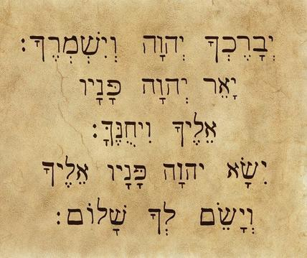
And keep you The Lord Bless you
The Lord bless you
and keep you;
The Lord make his face shine upon you; and be gracious to you
His face The Lord make shine
And be gracious on you
Unto you His face The Lord Lift up
The Lord turn his face toward you and give you peace
Peace you and give

