Slide 1
God’s Vision for His People
A Humanity Who Has a Restored Relationship with the Creator, as Modeled by Jesus Christ
January 13. 2019

Slide 2
Why are we doing this?
What’s the problem? None we know of.
Help spiritual growth -- life-long journey
  Guard against becoming dormant or distracted
Improve spiritual leadership
Be more unified – Better serve each other
    Unity not optional: 1 Corinthians 1:10; Ephesians 4:3-4

Slide 3
Spiritual Growth Is A Personal Matter

Slide 4
Elders’ Guidance Paper
Foundations Paper
  Section 1 – Things we cannot compromise
  Section 2 – Biblical principles that govern how we function
  The Section 3, -- Christian characteristic
    Where the Journey takes place
    Where the “rubber meets the road.”

Slide 5
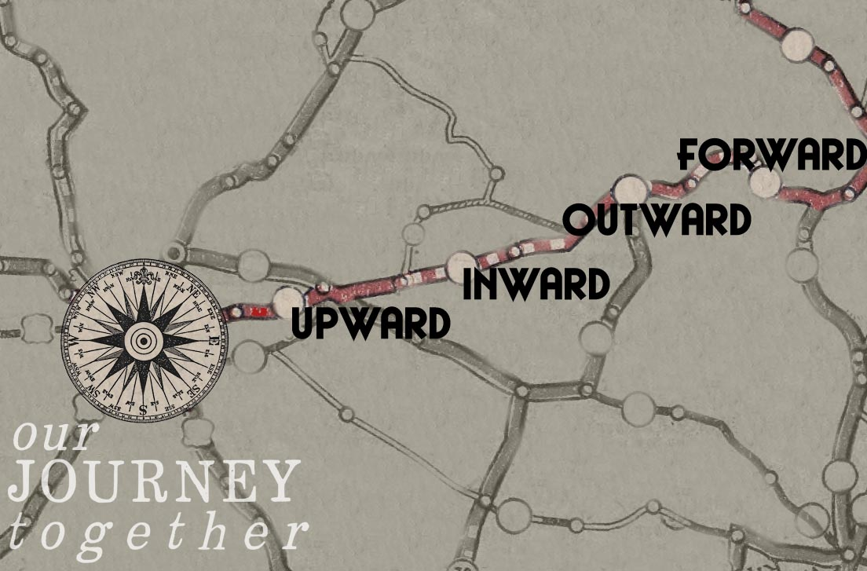
FOUNDATIONS

Slide 6
Focus, Five Spiritual Growth Area
  Upward-- My personal walk with God & Christ (RELATIONAL)
  Inward -- Our life together in Christ
  Outward -- My compassion for seeking the lost & persecuted
  Forward –- My commitment to Equipping the saints for service & preparing the next generation
  Oversight, guidance/care -- my concern for Godly leaders
  Why are these important?

Slide 7
Much, much more than information transfer.
It is about coming to conviction regarding what the scriptures are calling you (me) be and do

Slide 8
Basic Questions to Ask For Our Bible Studies

Slide 9
Things to Explore at the First Stop - Upward
Nine characteristic at the first stop (nine weeks)
Today begins week 1 of Our Journey
Topic for the week (Wk 1): My walk With God

Slide 10
Helps (Example)
  Key word, Relationship
  Memory verse: James 4:8
  Question for the week:” How am I doing in my relationship with God?”

Slide 11
A different characteristic for each of the nine weeks

Slide 12
Example

Slide 13
  Reminder: Study with out conviction of heart that leads to action is dangerous
  (James 4:17

Slide 14
As We Rush Around to “Do church”, Let Us Remember --

Slide 15
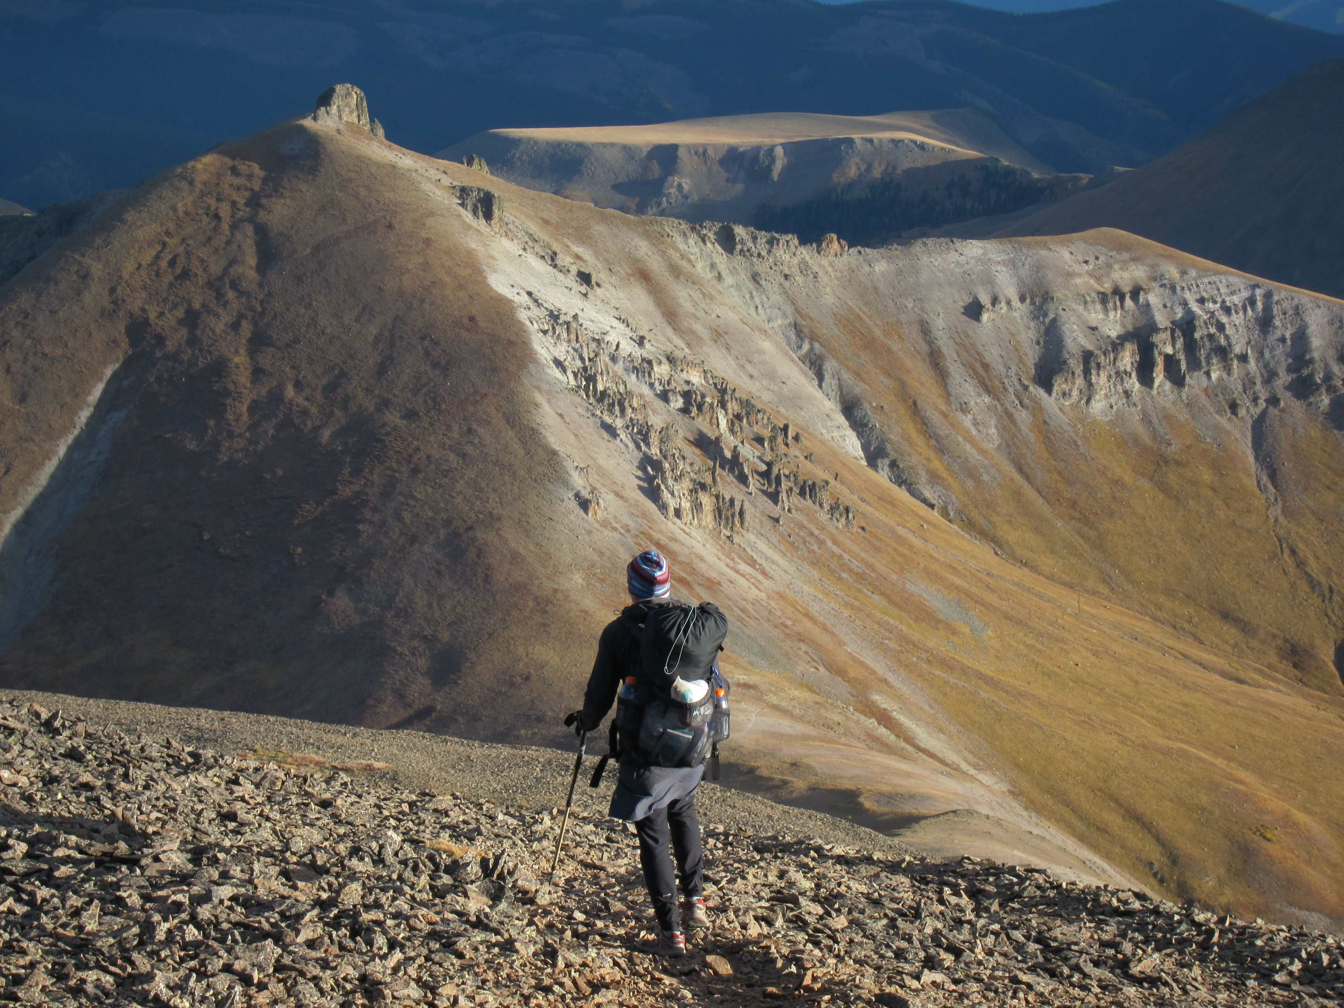
Global perspective –

Slide 16
In Humility and by God’s Grace
Let us pray together, grow together and work together in the unity envisioned by the Holy Spirit in 1 Corinthians 1:10 and Eph. 4:3-4
Let us commit to having the kind of relationships within this church that will:
  Engender the work of the Holy Spirit
  In no way grieve the Holy Spirit or quench His fire.

Slide 17
In Humility and by God’s Grace
Pray with us that this journey will:
  Bear much fruit
  Bring glory to the Father, the Son and the Holy Spirit.
Pray that,, when we get to the end of 2019 we will have
  A unified, integrated leadership team
  The church will experience the unity of the Spirit through the bond of peace.
  Each one has a closer walk with God, a deeper love for one another and greater compassion for the lost, helpless and harassed and the persecuted

Slide 18
FOUNDATIONS

Slide 19
The End

Slide 21
Spiritual Growth Areas
Spiritual Growth Areas are defined by characteristics
Drawn directly from the Scriptures
Thus, the whole process is to be driven by specific scriptures
  Conviction
  What is this scripture calling me to in my attitudes and life style
Most of the scriptures are familiar to many,
  The point: the emphasis in Our Journey is what we do with what we know from the scriptures.

Slide 22
Most of the scriptures are familiar to many, the point being that the emphasis in this series of studies is what we do with what we know from the scriptures.

Slide 23
A Personal Matter
There is one mediator between God and man
Relationship with God is not:
  Though or to an institution
  Through the elders, preacher, ministry leaders/teachers
It is a personal relationship with God and Christ 2:12
Study, think, meditate on the scripture(s)
  How am I being called to show my faith by my deeds

Slide 24
Spiritual Growth Area
Intent: Actionable, Personalized & Shared Experience
Not just information dissemination
Focus: Five Spiritual Areas
  Upward-- My personal walk with God & Christ (RELATIONAL)
  Inward -- Our life together in Christ
  Outward -- My compassion for seeking the lost & persecuted
  Forward –- My commitment to Equipping the saints for service & preparing the next generation
  Oversight, guidance/care -- my concern for Godly leaders
  Why are these important?

Slide 25
  Section 3, -- Christian characteristic
    Indicate to the watching world who we are in Christ
    Five spiritual growth areas
      Within each are individual Christian characteristics
      Directly related to specific scriptures
    Personalized; actionable; shared experience

Slide 26
Roadmap for First Stop -- Upward
Wk 1.My Personal Walk With God (January 20, 2019)
Here’s how this week will unfold
  Journey begins when you leave here
  Refrigerator/invite card in the bulletin
  Key word, Relationship
  Memory verse: James 4:8
  Thought for the week: How am I doing in my relationship with God?
  Next Sunday
  Combined class and sermon on this subject –
  Guest speaker, Earl Lavender
  Family Gathering with Earl – Open forum Q&A, instruction & equipping
  Again, it what you do with the Scripture you know

Slide 27
First Stop – Upward How’s My Relationship with God Doing
Wk 1.My Personal Walk With God (Key word, Relationship)
  Combined class -- Guest speaker
Wk 2 - Characteristics of the God I serve (Key words, loving and just)
    Creator of all and sovereign over all
    Ultimate accountability to Him
    A God who is loving (agape) and just
Wk 3 – My reverence, respect and gratitude for who He is (Key word, attitudes)
  Wk 4 – My adoration and gratitude for what God has done for me (Gratitude)

Slide 28
Wk 5 – My abiding with the Holy Spirit (Holy Spirit)
Wk 6 – My submission to Christ (Key words, Lord and Savior)
Wk 7 - Intimacy with God in pray (Key word, intimacy)
  Basic elements in drawing closer to God
      Study of the Scriptures -- His will of God for mankind
      Meditation on the Scriptures (internalize)
      Prayer
      Fasting

Slide 29
  Wk 8 - Purity of heart (Key word, heart)
  Wk 9 – My worship, a living sacrifice (Key words: my life, my worship)
  Really want to move from the page, to the head, to conviction in the heart to action
  Subject each week announced in advance
  Key Word
  Thought for the week (usually a memory verse)

Slide 30
Please Note
We are not to force something on someone else’s conscience
Don’t share our convictions on some or all of these matters? Believe that something is left off?
Talk to us
  We don’t presume that we have all knowledge
  Welcome the opportunity for further discussion
  Ask that you don’t create disunity with your views
  Discord does not serve the Lord’s purposes

