Slide 1
A New Year in the Lord ~2019

Slide 2
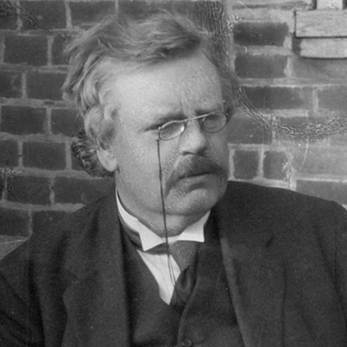
A New Year’s Resolution is something that
goes
in one year
The object of a New Year is not that we should have a new year.
It is that we should
have a new soul”
and
out
the
other

Slide 3
Therefore, if anyone is in Christ, he is a new creation; the old has gone, the new has come! – 2 Cor. 5:17
I will give you a new heart and put a new spirit in you
Ezk 36:26
If I could change one thing…
…a mature heart in Christ.
…you would be the person you are meant to be in Christ.
…to grow in your compassion.

Slide 4
Outsiders looking in
8 components
Jesus Christ lived a sinless life.
God is all-powerful, all-knowing and he still rules the world.
Salvation is a gift
Satan is real
I am compelled to share my faith.
The Bible is accurate
Moral truth exists
Moral truth is defined by the Bible.
They’ve come, examined
and left dissatisfied

Slide 5
Romans 12:2 –
Do not conform any longer to the pattern of this world, but be transformed by the renewing of your mind.
How to transform our lives
Prayer and Bible study
Spiritual friendship with fellow believers
Pursuing your faith in a church family.
Intentionally find ways to help you grow spiritually.
Serve others
Invest time and money
Spiritual conversations with outsiders.

Slide 6
In our thinking
In our loving
In our listening
3 ways in which we need to transform our lives.

