Slide 1
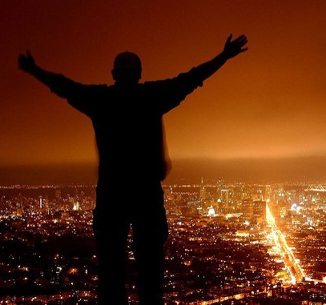
Tell Aaron and his sons, ‘This is how you are to bless the Israelites,
Say to them:
‘The LORD bless you and keep you; the LORD make his face to shine upon you and be gracious to you; the LORD turn his face toward you and give you peace.’
So they will put my name on the Israelites, and I will bless them.
Numbers 6::23-27

Slide 2
SONG
Notes:
Song PPT video The Lord be

Slide 3
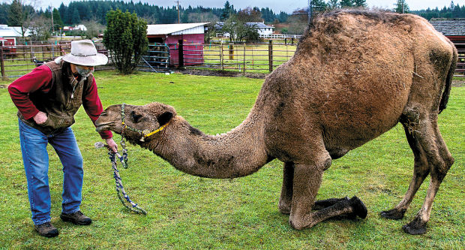
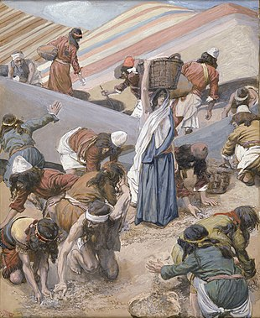
He blesses
Barakh: to kneel down
He had the camels kneel down
Genesis 24:11
Manna –collect for today
Blessing is daily

Slide 4
I will be like dew to Israel
Hosea 14:5
He blesses
Yet this I call to mind and therefore I have hope:
Because of the Lord’s great love we are not consumed,
for his compassion never fail. They are new every morning; great is your faithfulness. I say to myself, ‘The Lord
is my portion; therefore I will wait for him’
Lamentation 3:21-24

Slide 5
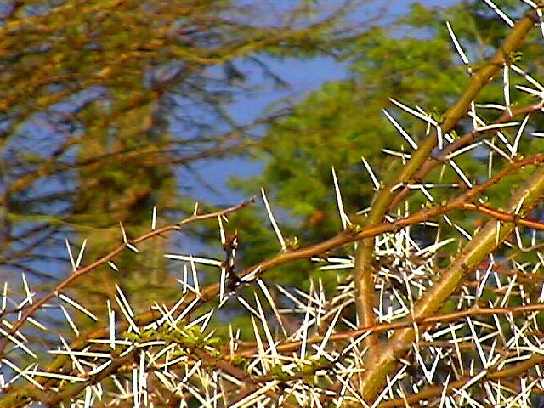
Hebrew: Shamar
To hedge about with thorns – to protect and guard.
And Keep You
His promise of protection:
We are hard pressed on every side, but not crushed; perplexed, but
not in despair; persecuted, but not abandoned;
struck down, but not destroyed.
2 Corinthians 4:8-9

Slide 6
And Keep You
His promise of protection:
God is our refuge and strength,
an ever-present help in trouble.
Ps. 46:1
Spiritually:
But the Lord is faithful, and he will strengthen and protect
you from the evil one
2 Thessalonians 3:3

Slide 7
And Keep You
Spiritually
No temptation has seized you except what is
common to man. And God is faithful; he will not
let you be tempted beyond what you can bear.
But when you are tempted, he will also provide
a way out so that you can stand up under it
1 Corinthians 10:13

Slide 8
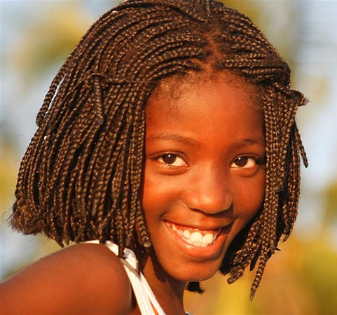
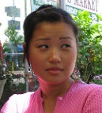
Make his face shine upon you
“Face” = presence
Exodus 33:14 – My presence will go with you
The face is your emotions visibly displayed to everyone
“Everyone over 40 is responsible for his face.”
Abraham Lincoln

Slide 9
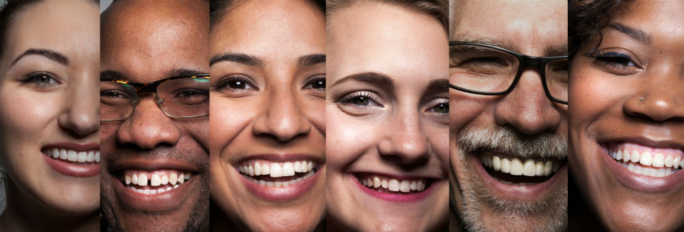
Make his face shine upon you
Shine – glow, brilliance, brightness
The Lord you God is with you, he is mighty to save.
He will take great delight in you, he will quiet you
with his love, he will rejoice over you with singing
Beaming – a smile
Zephiniah 3:17

Slide 10
Make his face shine upon you
The nature of light: Reveal
1 John 1:5
“Show us the Father and that will be enough for us.”
“Don’t you know me, Philip, even after I have been among you such a long time? Anyone who has
seen me has seen the Father”
John 14:8-9

Slide 11
He Makes
For he chose us in him before the creation of
the world to be holy and blameless in his sight.
In love he predestined us to be adopted as his sons though Jesus Christ, in accordance with his pleasure and will – to the praise of his glorious grace which
he has freely given us in the One he loves.
Ephesians 1:4-6

Slide 12
His face is toward you - but you can turn your face away from him.
All these blessings cannot reach their full potential until you put them into practice.

Slide 13
The smile of God has broken into the darkness of the world

