Slide 1
The Church is like a Family
Chip Jones
Presented to Central Nov 18 2018
Notes:
I’m Chip Jones, one of the elders
Allen is still in Fiji, and I’m really miss him about now
Thank you for this opportunity
The elders believe that Central has a strong family atmosphere, and we want to encourage everyone to continue to make it even better.

Slide 2
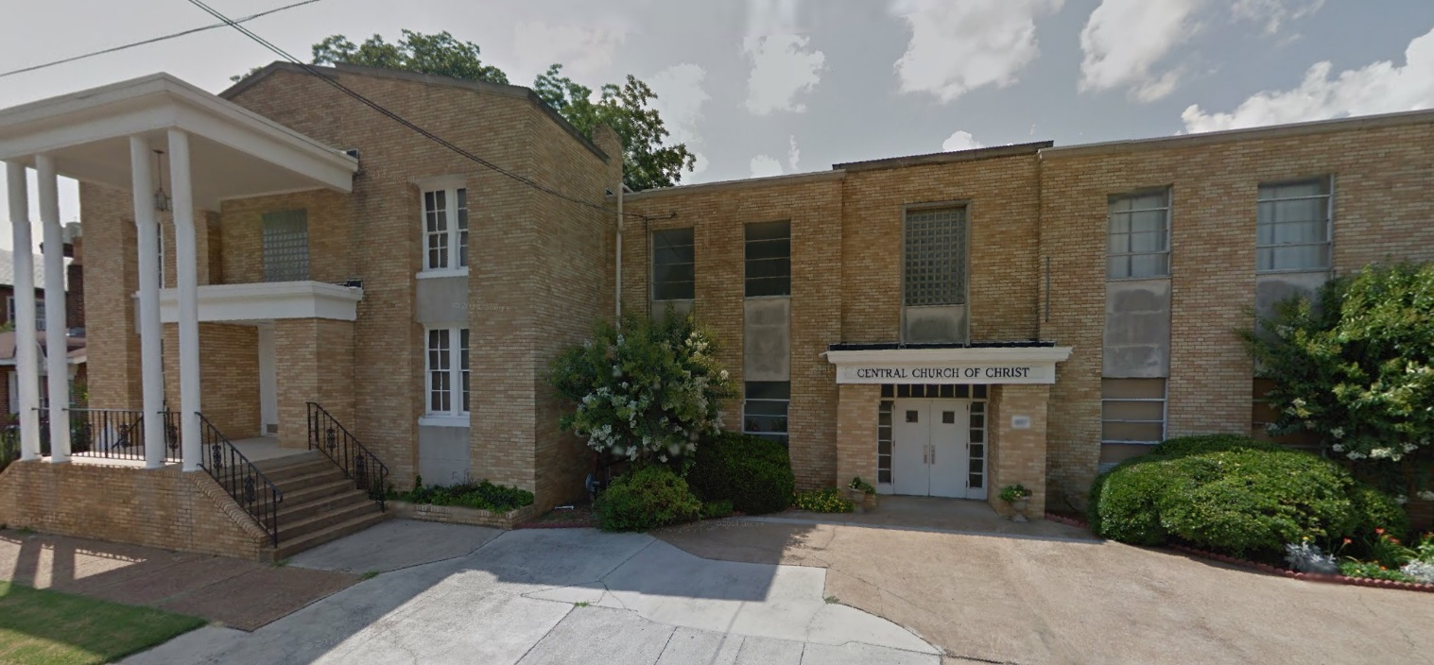
Church is like a Building
“... For we are the temple of the living God. As God has said: “I will live with them and walk among them, and I will be their God, and they will be my people.” Therefore, “Come out from them and be separate, says the Lord. Touch no unclean thing, and I will receive you.” And, “I will be a Father to you, and you will be my sons and daughters, says the Lord Almighty.””
2 Corinthians‬ ‭6:16-18‬
(Lev. 26:12, Jer. 32:38,
Ezekiel 37:27)

Slide 3
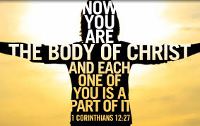
Church is like a Body
Because there is one loaf, we, who are many, are one body, for we all share the one loaf.
1 Corinthians 10:17‬
For we were all baptized by one Spirit so as to form one body—whether Jews or Gentiles, slave or free—and we were all given the one Spirit to drink...Now you are the body of Christ, and each one of you is a part of it.
1 Corinthians 12:12‬-13, 27
Notes:
I want to fulfill the function of my part of the body
Everyone has some natural talents and abilities, which ones are your sharing with others?

Slide 4
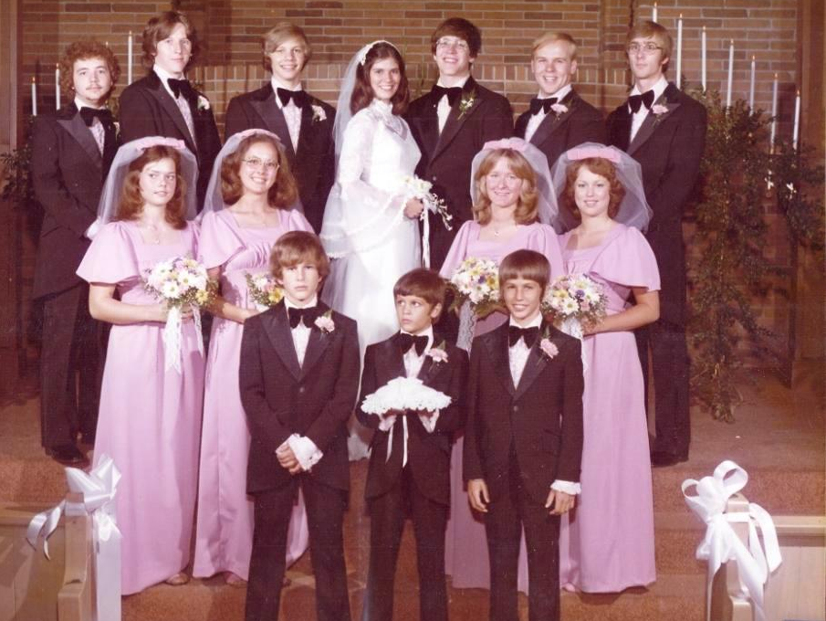
Church is like a Marriage
“... For the wedding of the Lamb has come, and his bride has made herself ready. Fine linen, bright and clean, was given her to wear.” (Fine linen stands for the righteous acts of God’s holy people.) Then the angel said to me, “Write this: Blessed are those who are invited to the wedding supper of the Lamb!” And he added, “These are the true words of God.”
Revelation‬ ‭19:7-9‬
Submit to one another out of reverence for Christ.
Ephesians 5:21
Notes:
Training to love others and submit to each other

Slide 5
The Church is like a Family
“...God’s household, which is the church of the living God, the pillar and foundation of the truth.”
‭‭1 Timothy‬ ‭3:15‬‬‬
“For whoever does the will of my Father in heaven is my brother and sister and mother.”
Matthew‬ ‭12:50‬ ‭NIV‬‬
Notes:
My family was a great experience, many benefits
Favorite Food, Jack Raby (chaperone duty)
Working in a large family can be messy & difficult
Easier to watch a preacher on TV

Slide 6
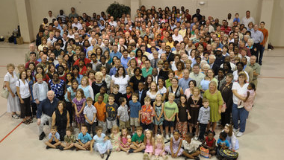
The Church is like a Family
Let us hold unswervingly to the hope we profess, for he who promised is faithful. And let us consider how we may spur one another on toward love and good deeds, not giving up meeting together, as some are in the habit of doing, but encouraging one another and all the more as you see the Day approaching.
Hebrews 10:24
Resist the devil, and he will flee from you. Come near to God and he will come near to you
James 4:7-8
Notes:
LIFE Talk experience
Pete Taft family
Ralston testimony (singing)
Get involved to get the family treatment
Joe Bryan and Bondurant twins

Slide 7
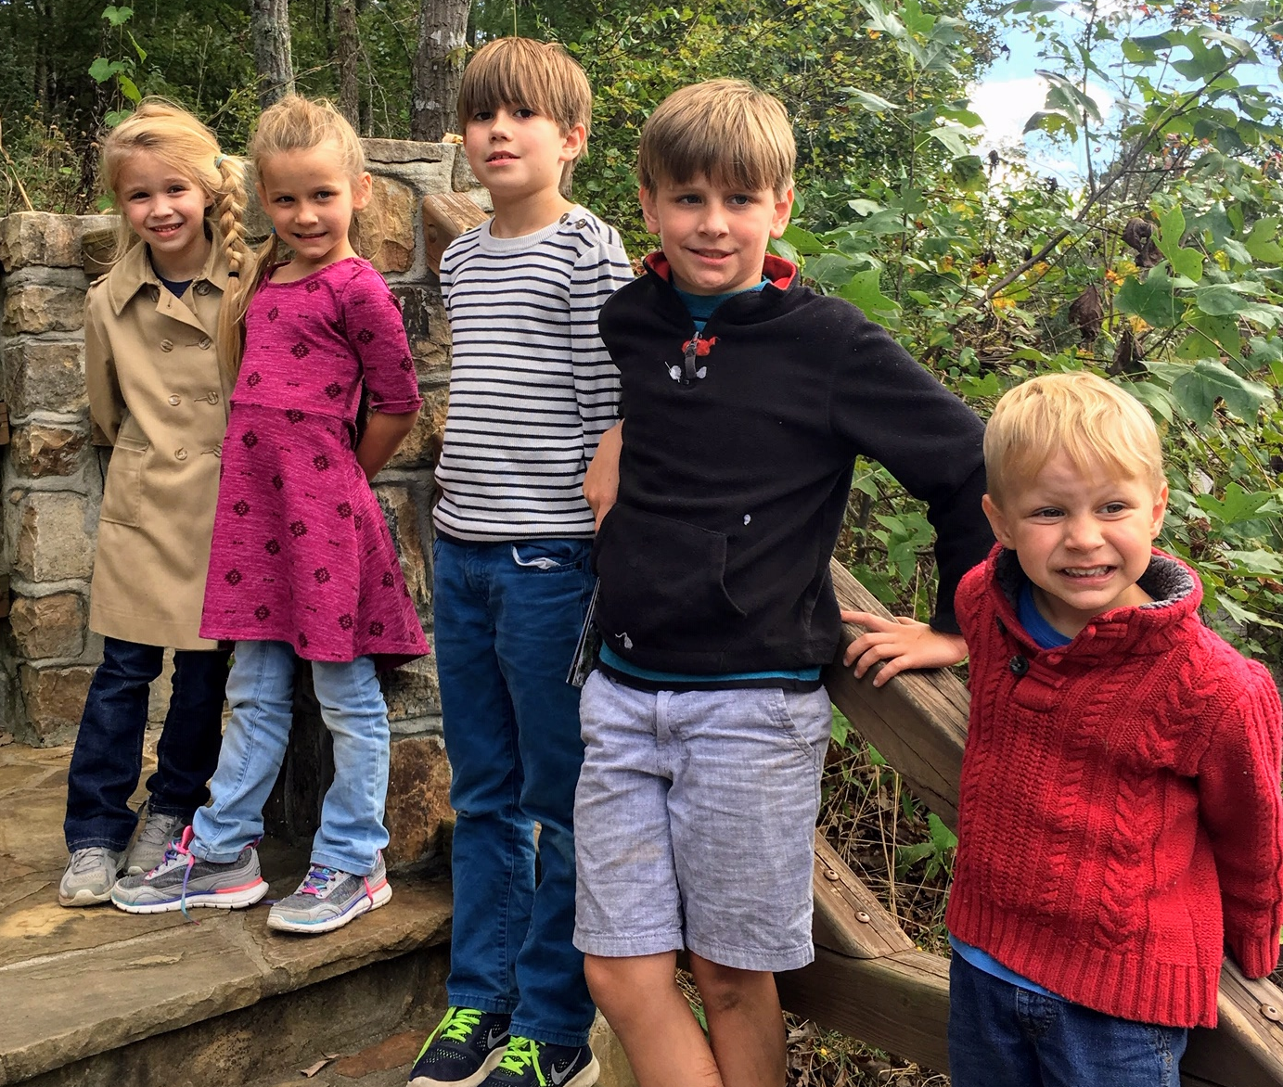
The Church is like a Family
Start children off on the way they should go, and even when they are old they will not turn from it.
Proverbs 22:6
Children are a heritage from the Lord…
Psalm 127:3
Do not rebuke an older man harshly, but exhort him as if he were your father. Treat younger men as brothers, ² older women as mothers, and younger women as sisters, with absolute purity
1 Timothy 5:1-2
Notes:
HUGS, Happy Times, Classes need investment of time
I have a responsibility to show how “God has delivered me”

Slide 8
Learn to Work Together, Better
What can we do?
Welcome new members with celebration
Make sure members are fed and loved
Protect Each other
Help each other resist the devil and his schemes
What can I do?
Be devoted to fellowship
Work to resolve differences in a Christian way
Love must be sincere. Hate what is evil; cling to what is good. Be devoted to one another in love. Honor one another above yourselves. Never be lacking in zeal, but keep your spiritual fervor, serving the Lord. Be joyful in hope, patient in affliction, faithful in prayer. Share with the Lord’s people who are in need. Practice hospitality.
Romans 12: 9-13
Notes:
Make sure we don’t simply try to keep peace in the family

Slide 9
The Church is like a Family
Chip Jones
Presented to Central Nov 18 2018
Notes:
If you are a member, and would like to be more involved, please resolve today to take action
If something is keeping you from becoming more involved, let us help you
If you would like to be a member of this family, please let one of the elders know, and we will welcome you with great celebration
But you have to be born again to be in this family. If we can help you in any way, please come forward as we stand and sing

