Slide 1
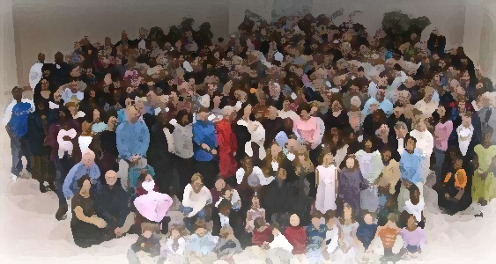
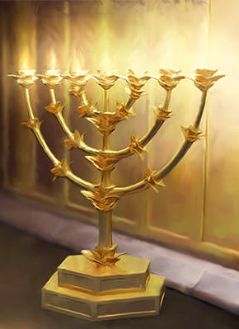
The Lampstand
at Central
Laodicea
Purchased For Me
Revelation 3:15-18a

Slide 2
VIDEO – 024- hot/cold

Slide 3
Lukewarm is not being half-hearted
but being ineffective.
‘Effective’ is not based in visible results
but in Christ-centered faithfulness.
Only way you can be hot or cold is if you are living your life in Christ “who is my life” (Col. 3:4)

Slide 4
Jesus gives advice
Woe to the obstinate children, to those who carry out plans that are not mine…”
Isaiah 30:1
“Rahab-the-Do-nothing”
“I counsel you”
Their problem:
30:8-11.

Slide 5
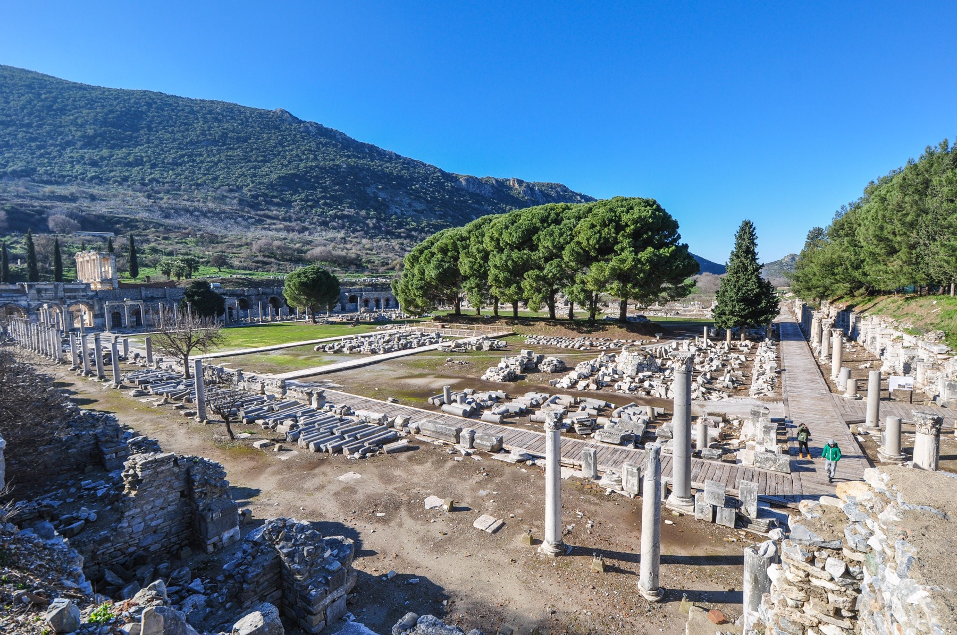
“Buy from me”
Ephesus Agora

Slide 6
VIDEO 001 – Modern Agora

Slide 7
“Buy from me”
“You are worthy to take the scroll and to open its seals, because
you were slain, and with your blood you purchased (agorazo) men for God.” ~ Rev 5:9
Point: the only way we buy
these 3 things is by relying on Christ who has already
made the purchase for us.
Ephesus Agora

Slide 8
“Buy from me”
“glorious riches of this mystery, which is Christ in you, the hope of glory” ~ Col 1:27
Gold refined
in the fire
“Full riches, all the treasures of wisdom and knowledge
Col 2:1-3
Buy from me gold:
re-center your life in
the wealth of Christ
Ephesus Agora

Slide 9
VIDEO 041 riches in christ

Slide 10
“Buy from me”
Ephesians
…riches of God’s grace…(1:7)
…riches of his glorious inheritance (1:18)
…incomparable riches of
his grace…(2:7)
…unsearchable riches of Christ..(3:8)
…out of his glorious riches… (3:16)
Gold refined
in the fire
Ephesus Agora

Slide 11
“Buy from me”
Two ways of being clothed:
initially and continuously.
White clothes
to wear
…for all of you who were baptized into Christ have clothed yourselves with Christ
Gal 3:26, 27
“…clothe yourselves with….”
Col. 3:12-14
Ephesus Agora

Slide 12
“Buy from me”
The only cure to spiritual blindness is grace
…rescued us from the dominion of darkness… ~ Col. 1:13
Salve so that you can see
Ephesians
… eyes of your heart may be enlightened…(1:18)
…now you are light in the Lord. Live as children of light (5:8,9)
Ephesus Agora

Slide 13
Jesus’ Motivation
“Those I love…”
Love:
Esteem, to care for, to want the best for
and supply the best for them.
Love is a relationship and
relationships go in both direction.

Slide 14
Jesus’ Action
“rebukes & disciplines…”
Rebukes:
Harsh correction – Exposes the truth
Discipline:
Training – involves a direction & goal

Slide 15
Jesus’ Counsel
Command those who are rich in this present world not to be arrogant nor to put their hope in wealth, which is so uncertain, but to put their hope in God, who richly provides us with everything for our enjoyment. Command them to do good, and be rich in good deeds and to be generous and willing to share.
1 Tim. 6:17,18
Rahab-the-Do-nothing

