Slide 1
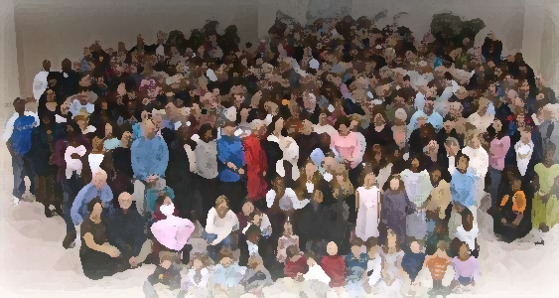
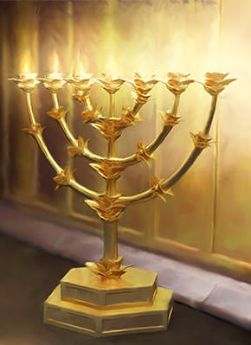
The Lampstand
at Central
Laodicea
Beggars buying Gold
Revelation 3:15-18a

Slide 2
Video – Hierapollis

Slide 3
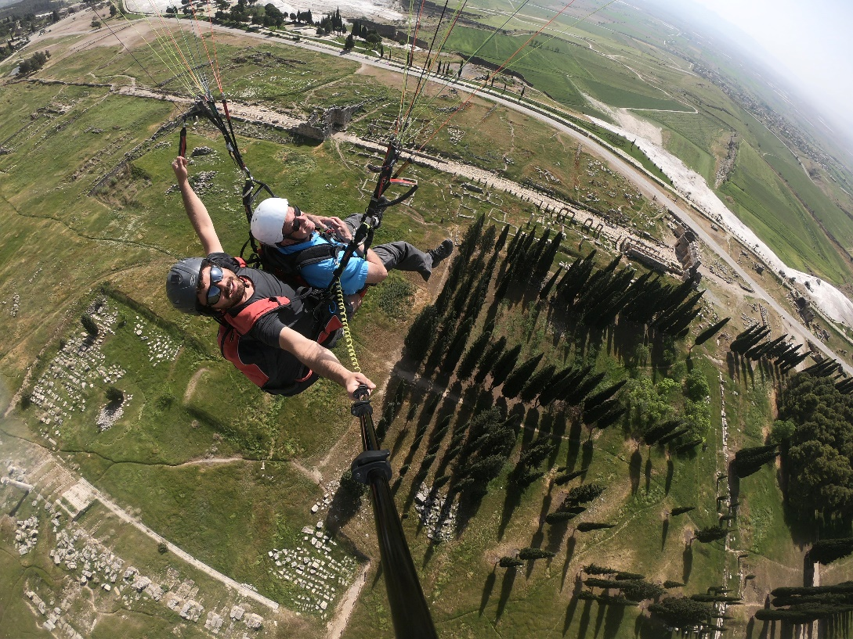
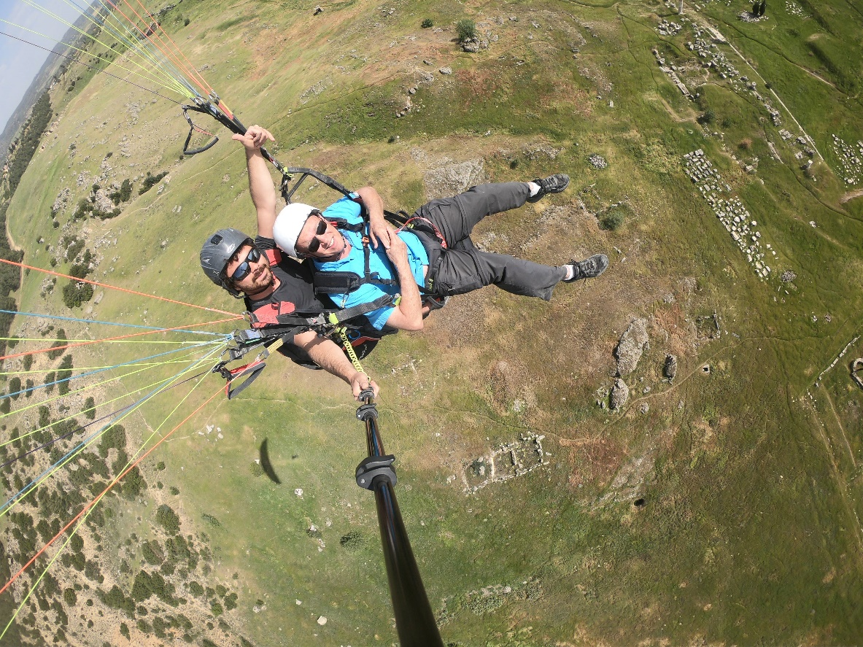
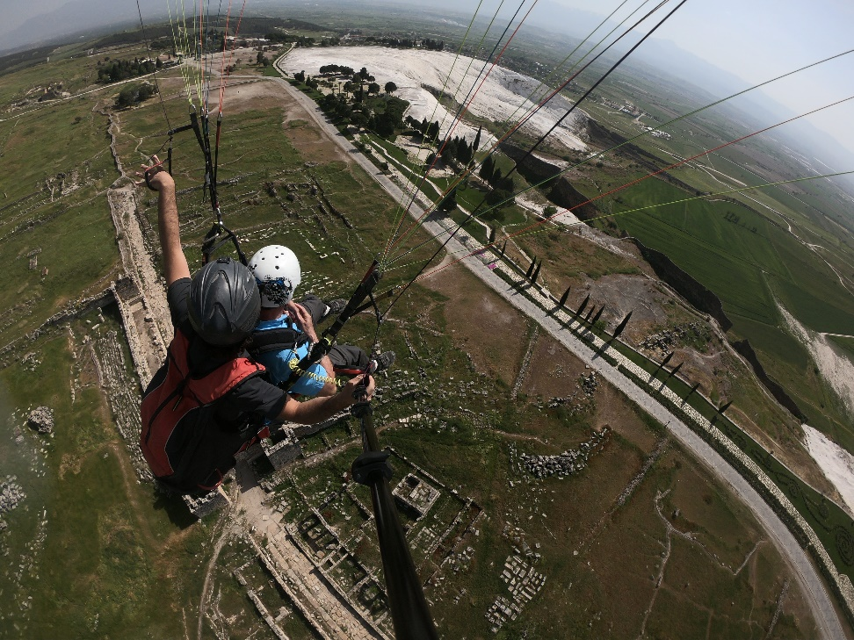
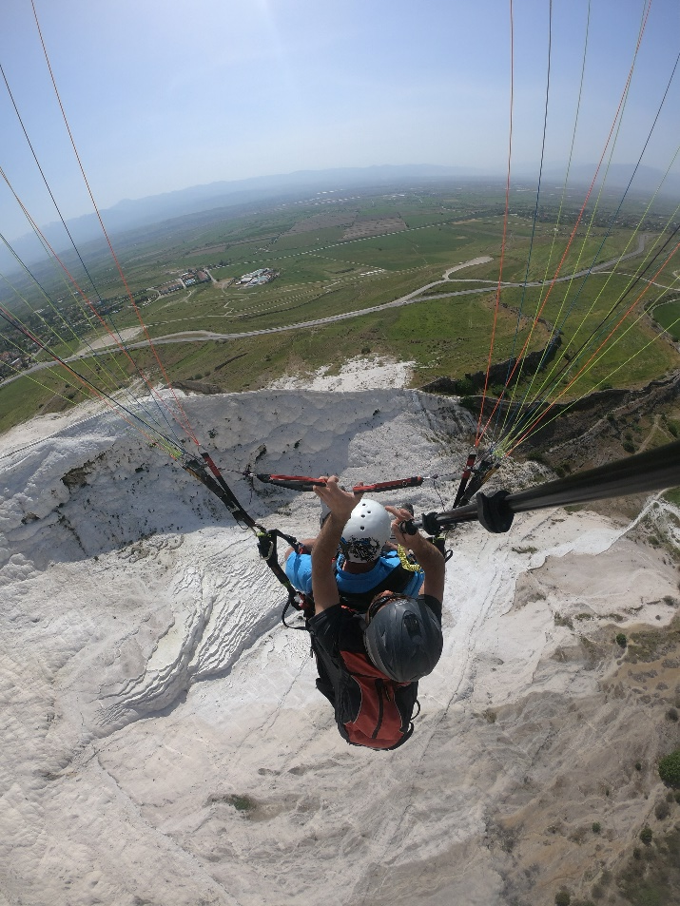
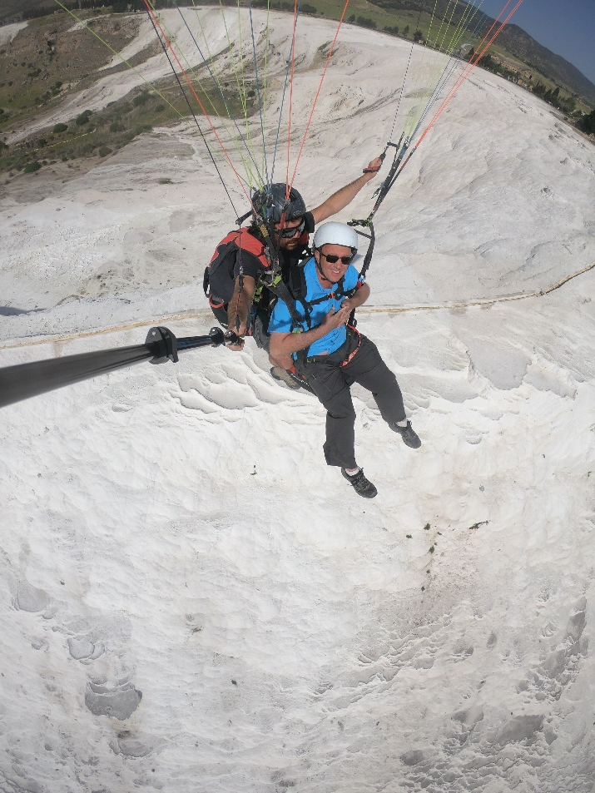
Hierapolis

Slide 4
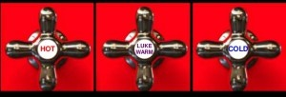
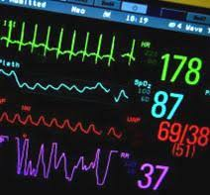
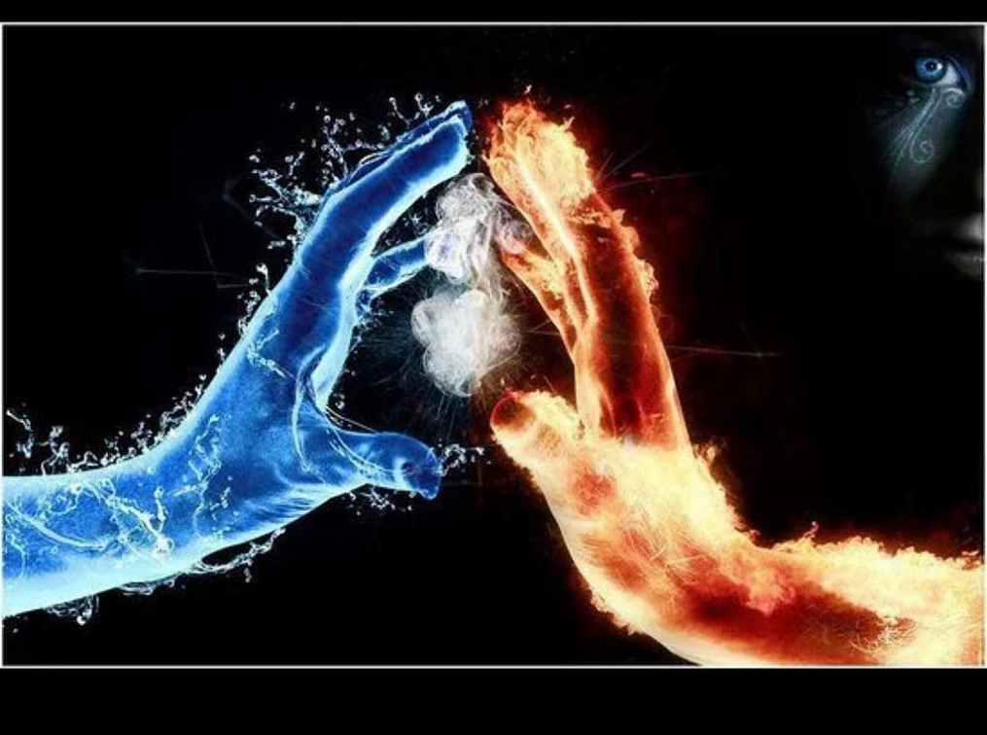
Laodicea’s
condition
“I know
your deeds”
You are lukewarm
Neither cold
nor hot
I’m about to spit you
out of my mouth

Slide 5
Video – You are rich

Slide 6
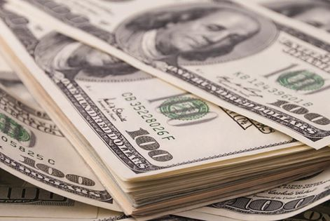
You say, ‘I am rich;
I have acquired wealth and do not need a thing’
But you do not realize that you are…
Poor
deeply destitute
Blind
can’t see.
Wretched… “the wretched one”
Naked - wearing bare minimum
Pitiful – someone in need of mercy

Slide 7
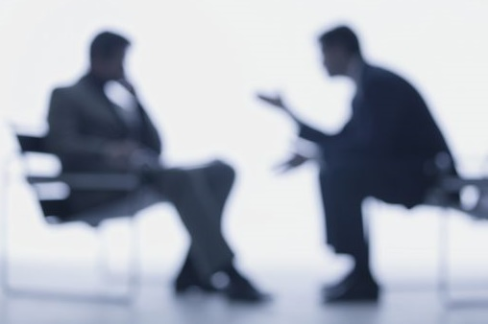
Jesus’ Counsel
I advise you.
Buy from me
Getting advice from the one who has every right to command
He’s telling a beggar – buy gold from me – can’t be done!

Slide 8
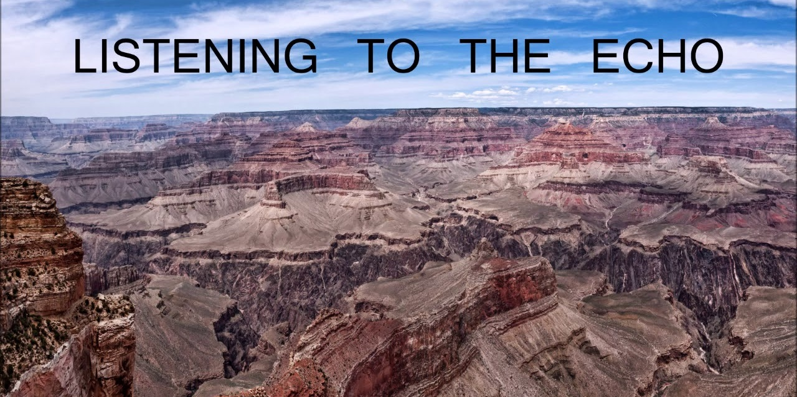
Isaiah 55:1-8

Slide 9
The opposite of lukewarm isn’t hot or cold – it’s listening to the voice of God
and living our lives centered in him.
For you died and your life is now hidden with Christ
in God. When Christ, who is your life appears,
then you also will appear with him in glory.
Col 3:3,4

Slide 10
I know everything you do, I know your works and how you spend your energy. You’re not a boiling pot of water and you’re not a refreshing cup of cold water. Oh that’s what I’d want – cold or hot! In your circumstance you are tepid – not hot tea, not iced tea. I’m about ready to spew you out of my mouth!
But you say, “I’m loaded! I’ve become wealthy! I don’t need anyone or anything!” You don’t have a clue. You (and I mean you!) are the wretched one: You need mercy, you’re beggarly poor, you are blind and can’t see a thing;
you’re walking around in your underwear.
Here’s what you need to do. Purchase from me….

