Slide 1
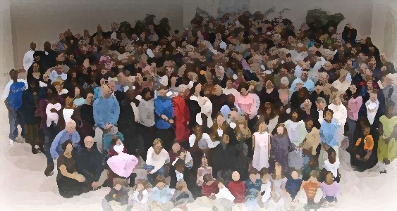
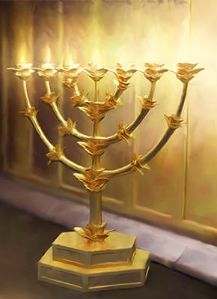
The Lampstand
at Central
Philadephia –
Weak Christians/Strong God
Revelation 3:7-13

Slide 2
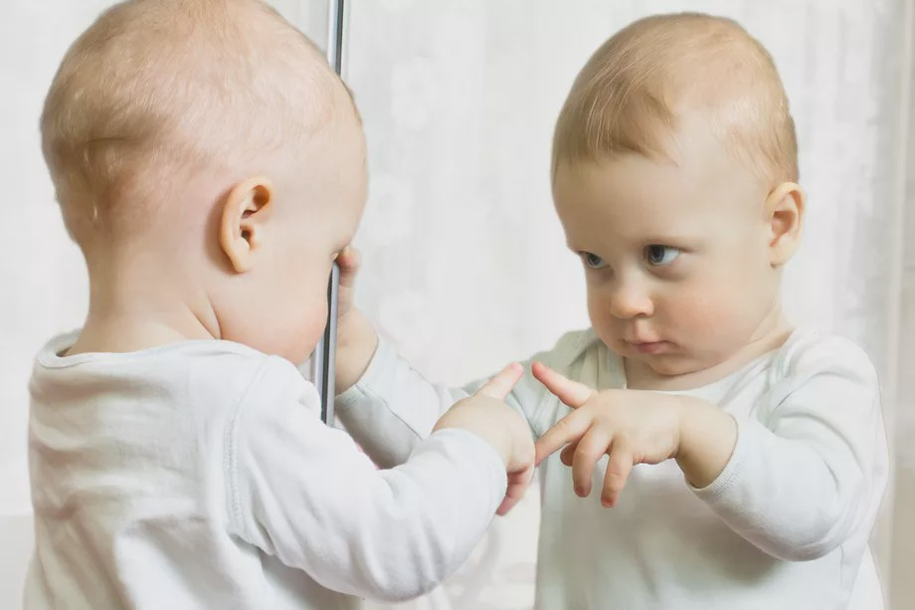
How
do we see ourselves?

Slide 3
REVELATION:
From Jesus, about Jesus, our response
to Jesus

Slide 4
Video: Philadelphia intro

Slide 5
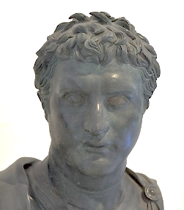
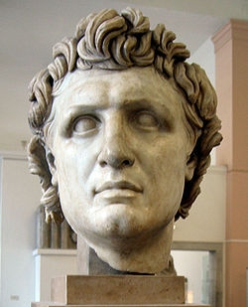
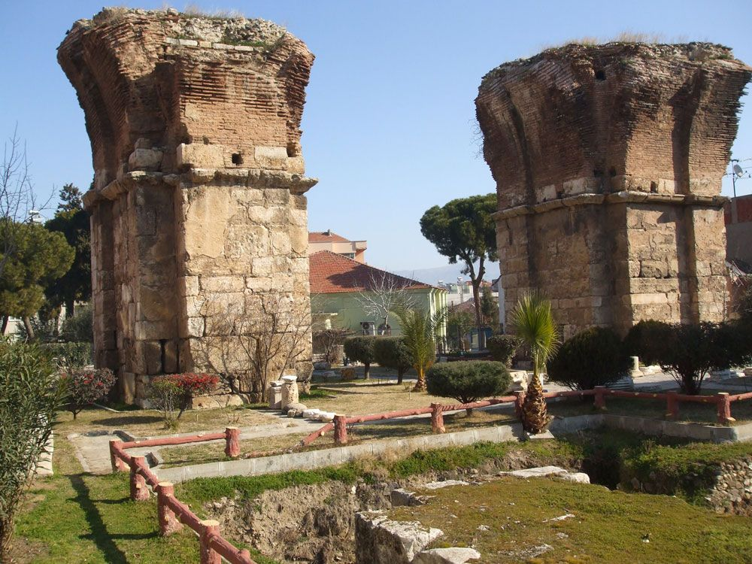
City of brotherly love
Eumenes II Attalus II
Philadelphia
Particular purpose:
a “missionary” city.

Slide 6
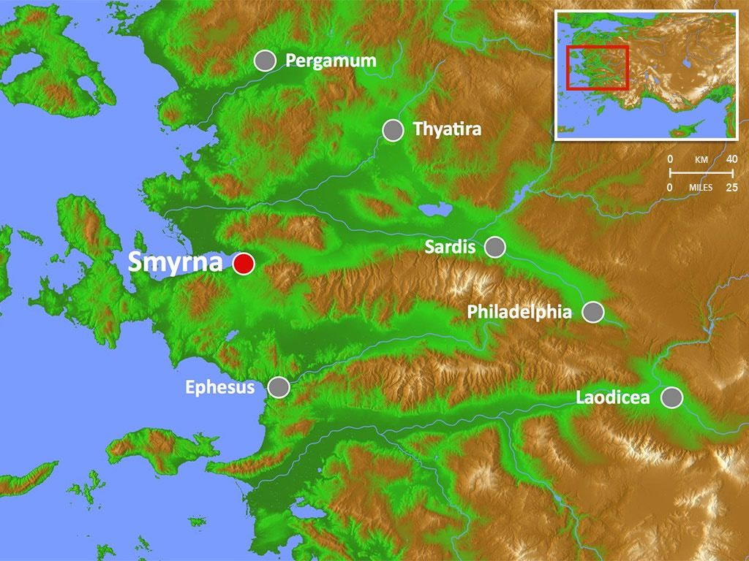
Earthquake of 17 AD
Philadelphia
A very ordinary city

Slide 7
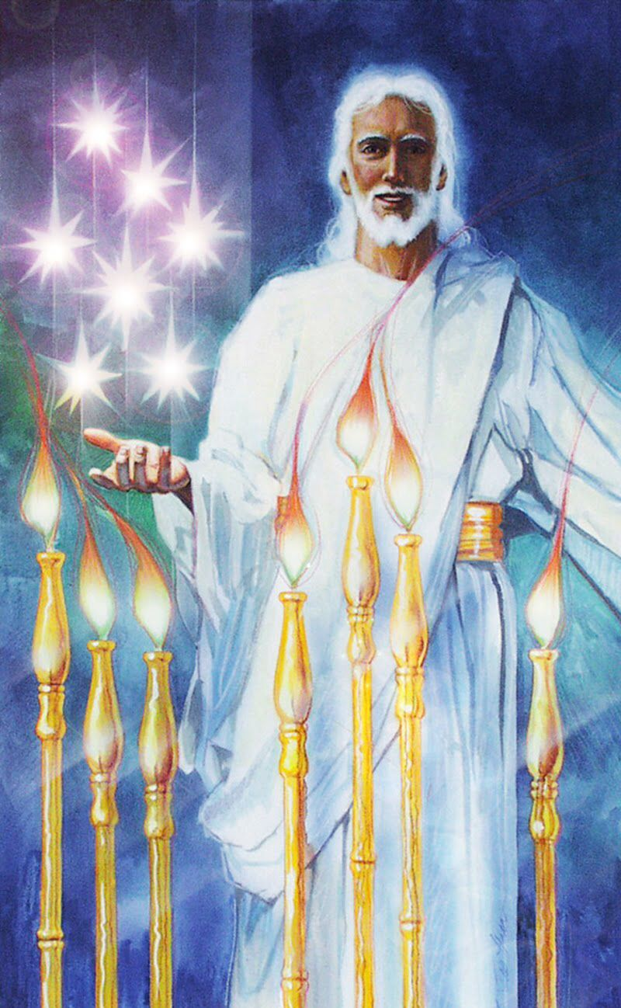
“the holy, the true”
“set apart”
unique. different, unlike
anything else, otherness, special
Holy
For this is what the high and lofty One says – he who lives forever, whose name is holy Is. 57:15a
True
the standard, pinnacle of what is true.

Slide 8
Messiah/the Door
Holds the key of David
I will place on his shoulder the
key to the house of David; what
he opens no one can shut, and
what he shuts no one can open
Isaiah 22:22
I am the gate (door), whoever enters through me will be saved. John 10:9

Slide 9
I Know
Your deeds
Your little strength
But we have this treasure in jars of clay to show
that this all-surpassing power is from God
and not from us.
2 Cor. 4:7

Slide 10
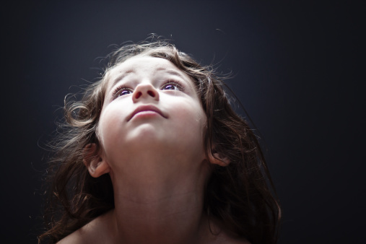
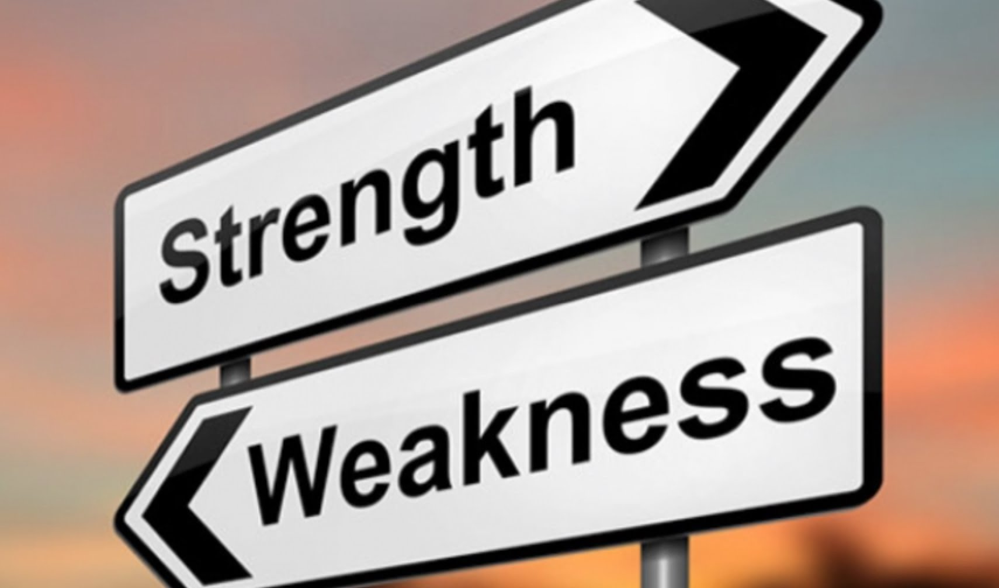
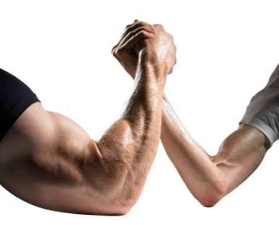
Look!
I Can’t!
I Can!

Slide 11
Look!
V. 8 – “Look! I have placed before you an open door
V. 9– Twice: “Look!”
Don’t miss this!
V. 9– “I will make those…”
“Look! I give…”
Give to whom?
The worse of the worst

Slide 12
Look!
I will give and keep on giving to that group of the Adversary…those who claim to be my people but are really a synagogue of liars…
Look! (See what I am about to do!)
I will cause them to worship in your presence
at your very feet.
Indeed, they shall realize that I have loved you.

Slide 13
Philadelphians in an impossible situation
“…whose name is holy. I live in a high and holy place,
but also with him who is contrite and lowly in spirit,
to revive the spirit of the lowly.
Is 57:15b

Slide 14
But if an unbeliever or someone who does not understand comes in while everybody is prophesying,
he will be convinced by all that he is a sinner and
will be judged by all, and the secrets of his heart
will be laid bare. So he will fall down and worship God, exclaiming, “God is really among you!”
1 Cor 14:24,25
Who are the “impossible ones”
in our lives?

