Slide 1
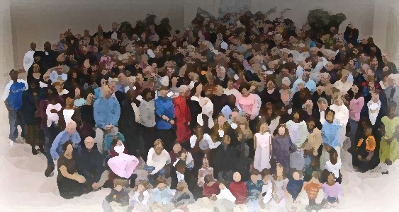
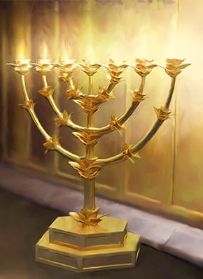
The Lampstand
at Central
Thyatira – Better than Ever
Revelation 2:18-29

Slide 2
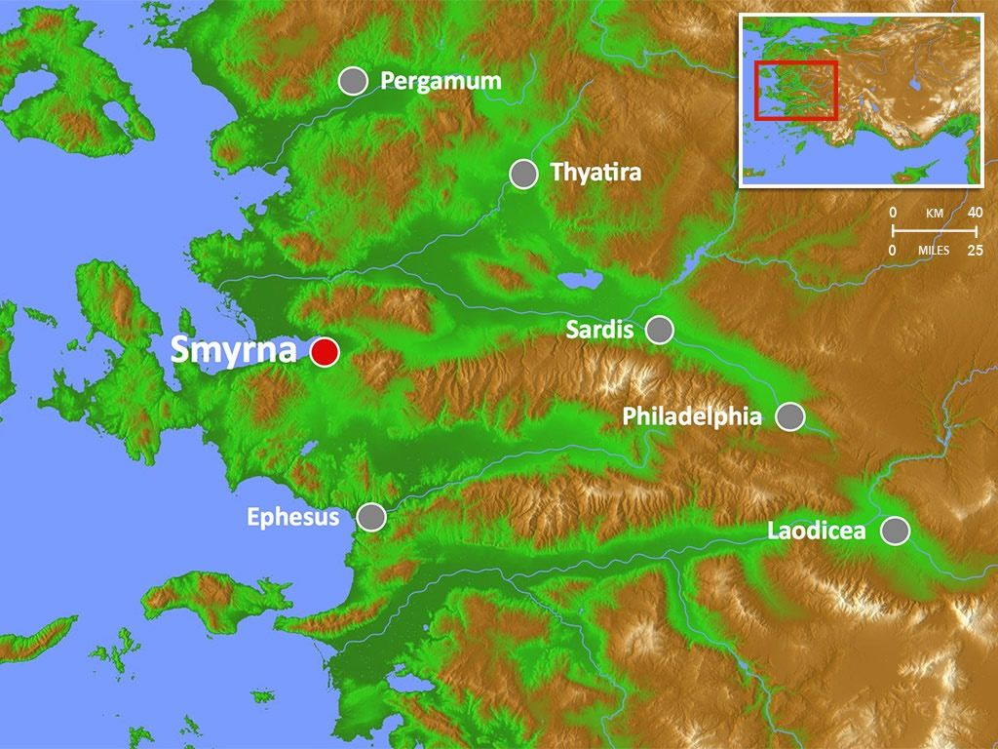
Patmos

Slide 3
Lost Video

Slide 4
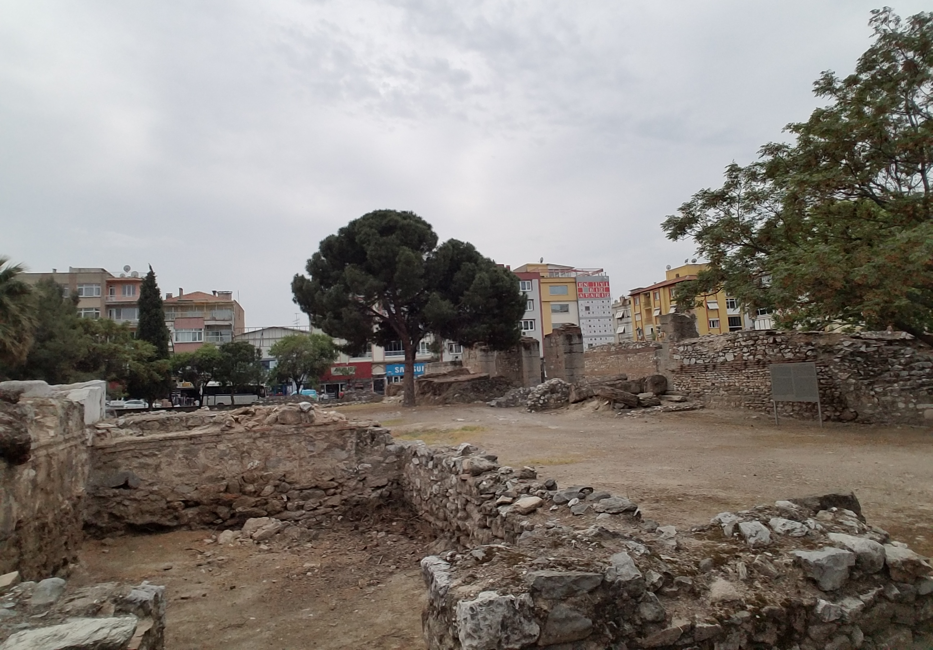
Thyatira
An outpost to protect Pergamum
A manufacturing town

Slide 5
006 - Story of Lydia VIDEO

Slide 6
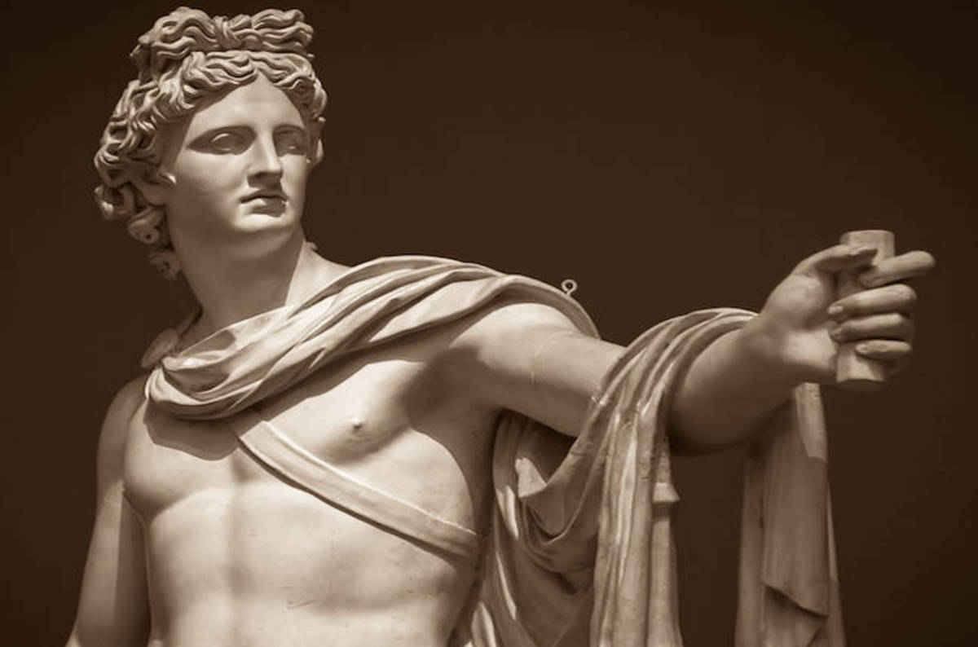
Thyatira
Christian difficulty
Apollo –
Healing, light, truth, music, arts, prophecy, defender of herds and flocks – radiant with grace and beauty.
How to make a living and yet not participate in the trade guilds honoring of gods.

Slide 7
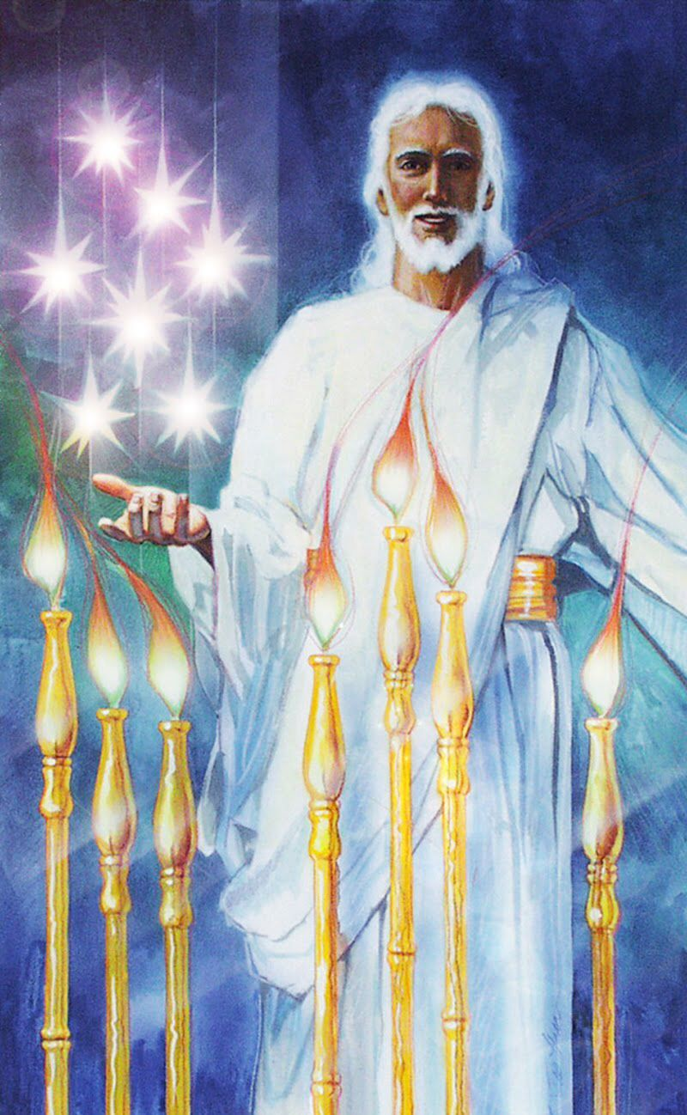
Son of God:
Divinity
Eyes like blazing fire:
Sees perfectly.
Feet like burnished bronze: Holy strength, judgement.

Slide 8
007 - Commendation

Slide 9
“I know”
Your deeds: You are energetic in what you do.
Your love – agape. Value, esteem
Your faith – firm persuasion, belief, conviction
Your service – willing to wait and attend to other
Your perseverance- patience endurance.
That you are doing more now than at first.

Slide 10
008 - Jezebel

Slide 11
“Yet”
The cancer of Jezebel
Prophetess: “God told me”
Tolerance that lead to compromise
Placing anything above God or participating in
anything contrary to God’s standard is spiritual adultery.

Slide 12
“Yet”
The punishment was severe
The consequences of this cancerous sin:
“Suffering”
Solution – Repent!
“Then all the churches will know”
Churches will know I AM

Slide 13
“Now I say”
“I will not impose any other burden on you”
Echo of Acts 15:28
“I’m not going to make this a burden”
Just don’t do what they are doing
Just “hold fast to what you have”

Slide 14
