Slide 1
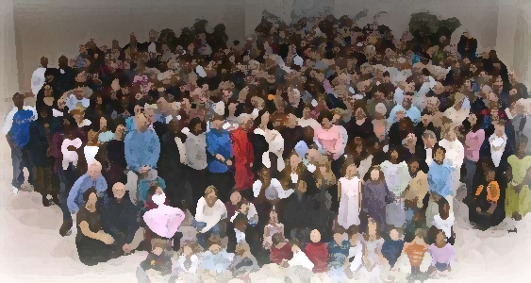
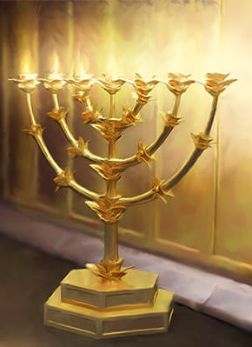
The Lampstand
at Central
The Revelation of Jesus
Revelation 1:1-3

Slide 2
symbolism in Revelation.
1st - Confused by it so that we avoid
reading and studying it.
He was such a wiz at the hoops that when he took the shot he was high fiving even before he swished the net
2nd - Some get so enraptured with an “end-time” message that they read into it bizarre and strange interpretations.

Slide 3
Approach to Revelation.
It was written to real people in real places. It had a particular message to them in their day which has particular application to us in our day.
Two helps in
understanding Revelation
What was happening at that time can be helpful.
2) The other 65 books of the Bible help us understand

Slide 4
Main Message:
God is in control
(even when it doesn’t look that way)
and God (good) will be victorious.

Slide 5
The Revelation of Jesus
ἀποκάλυψις = apokalupsis = apocalypse
“Unveiling, to reveal” (thus revelation)
The revelation of Jesus Christ… about or from Jesus?
About: his Lordship, the central nature of Jesus.
From: about the “things that would soon take place.”

Slide 6
John: The Witness
God only works through humans on this earth
“Show” - to exhibit or visibly show
Testify – John’s work
“Testify”
martureo.
martyr.

Slide 7
Blessed
So happy as to be in an enviable position.
Two groups are blessed
Those who read and those who hear
ana – “up”
Ginosko – “know through experience”

Slide 8
Any message not centered in Christ
is a false message.
We must be witnesses.
Don’t miss the blessing.

Slide 9
What to expect to see in Revelation
The awesome majesty of a sovereign God.
The complete deliverance received through
a sacrificed Lamb.
The utter fairness/justice of God.
That God uses people to achieve his eternal purposes of which we will enjoy.

Slide 10
What to expect to see in Revelation
That the world is not worth living for but Christ is worth dying for.
That there is such a difference between the world’s values and God’s reality that it can only be compared to the difference between life and death.
No one is to be excluded from the glorious plan of God unless they choose so.
Any suffering we have on this earth is nothing compared to the glory that awaits us.

Slide 11
